Slide 1
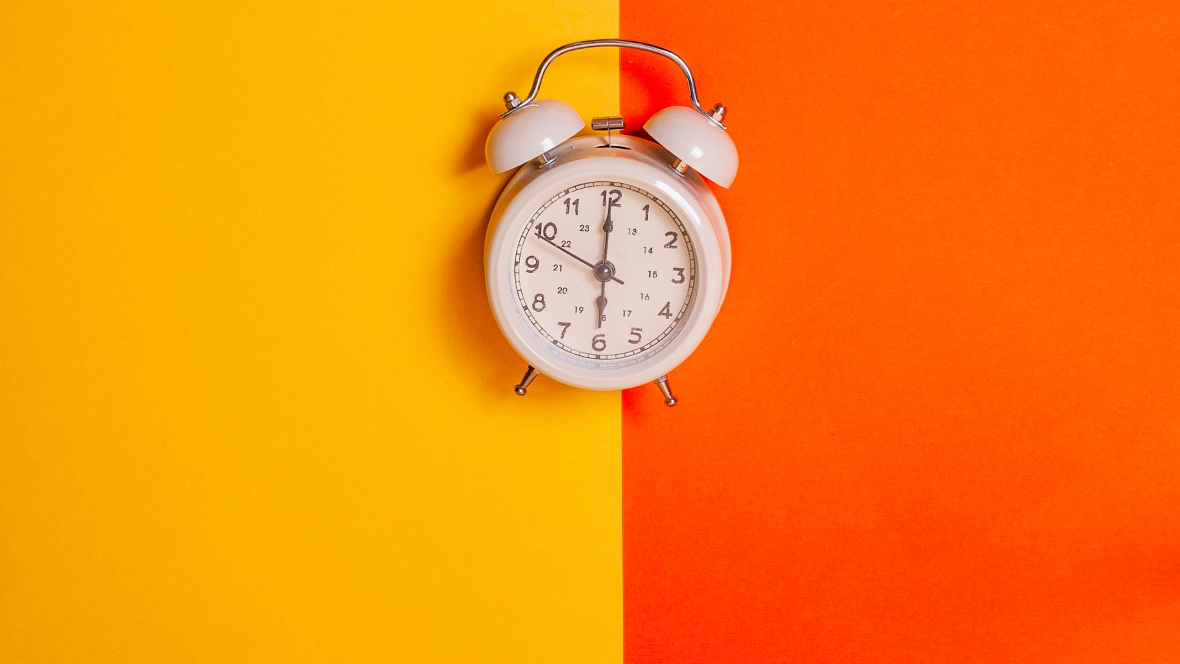
What Time Is It?
Physics, Challenges, and Solutions for Time

Slide 2

Agenda
How does a computer tell time?
How accurate is the time on a computer?
Linear time vs reality
Local time
Leap seconds
Time syncs
Manual Interventions
Delays
What time is it?
Who’s clock is right?
The consensus problem
Overcoming These Issues
Don’t use time
Use Sequence
Partial Mitigations for Time

Slide 3
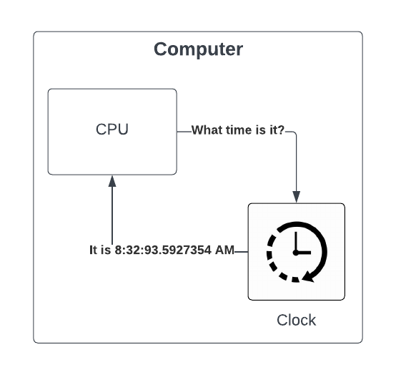
How does a computer tell time?
Computers have a clock
Precision is 100 nanoseconds (10⁻⁷)

Slide 4
How accurate is the time on a computer?
Computers use a quartz clock
Accuracy is generally +/- 15 seconds a day

Slide 5
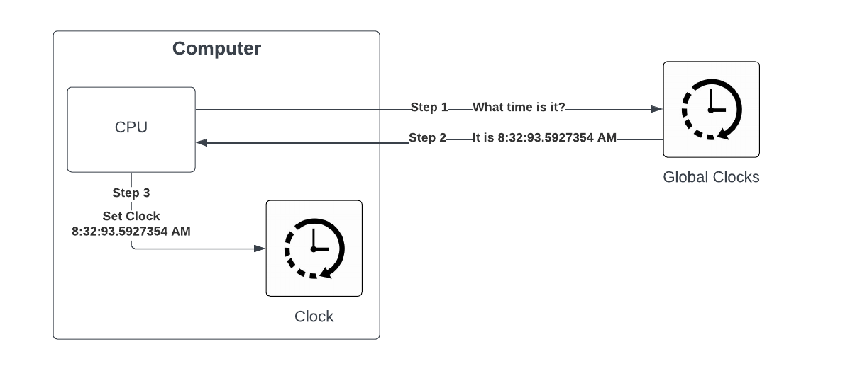
How accurate is the time on a computer?
To improve accuracy of computer time we have a Network Time Protocol (NTP) that syncs time with globally recognized sources of time

Slide 6

Linear time vs reality

Slide 7
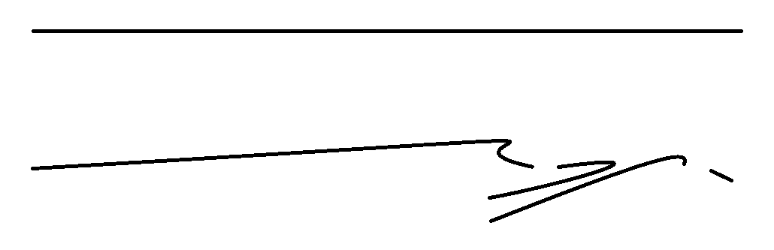
Linear Time vs Reality
We think of time as linear…continuously moving forward
The reality is with clocks time doesn’t always move forward linearly
It skips forward
It resets backward
It moves too fast / slow
It isn’t a strait line
How we think time works on a computer
How we time actually works on a computer

Slide 8
Local Time
Logical mistake #1 - using local time
Local time
Is not linear (skips ahead 1 hour and skips back 1 hour a year in US)
Varies based on laws for given jurisdictions across the globe and there are some points in time which the laws and population were not consistent so we are not even sure what local time was or means (even within the US)
Is non-deterministic. We can not say based on some specific local time when it actually occurred (i.e. repeated 1-2 AM at end of DST for the year)
Simple fix…DO NOT USE LOCAL TIME or at minimum store with the UTC offset so that UTC can be determined

Slide 9
Leap Seconds
The earths rotation & spin is not perfectly consistent
To adjust and keep time in sync leap seconds are occasionally declared
Added June 30th or December 31st
Usually about every 1.5 years one is declared

Slide 10
Time Sync
Computer clocks drift over time
To keep them accurate they periodically sync to keep their clocks accurate
When they do the clock skips forward or backward on the computer
These can be minor changes of <1 second or can be large (minutes or hours) depending on scenarios
Network / Firewall blocks of NTP
Other technical issues
Usually time drifts of several minutes start to cause issues with other security / consensus protocols used in systems but sometimes not
X

Slide 11
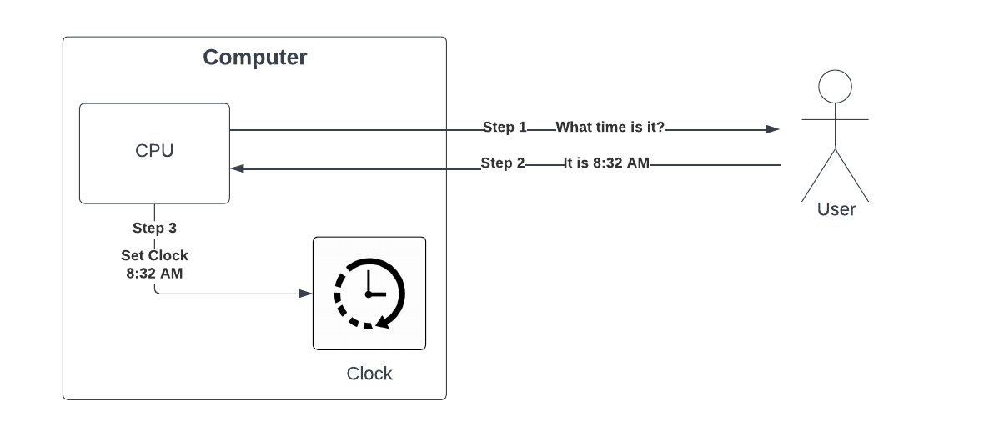
Manual Interventions
While not as common today this still occurs and can lead to significant issues including setting a computer to the wrong time by accident

Slide 12
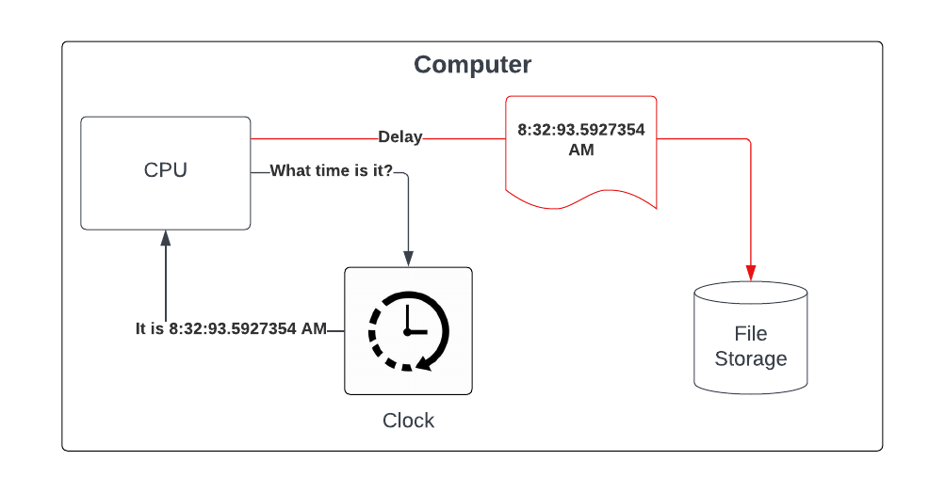
Delays
Heisenberg Uncertainty Principle – it is impossible to know both the position and speed of a particle
We can tell time but recording / displaying it will cause a delay and thus the time is no longer accurate
Depending on use case this can be a significant risk

Slide 13
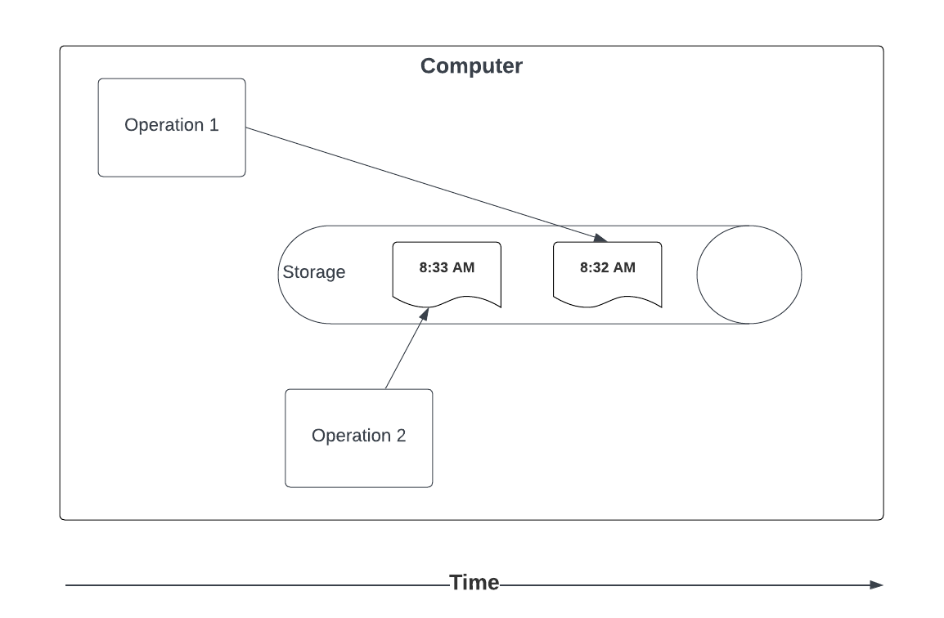
Delays…it gets worse
When using time delays are not consistent within the same computer so things may be stored / displayed out of order based on the delay

Slide 14
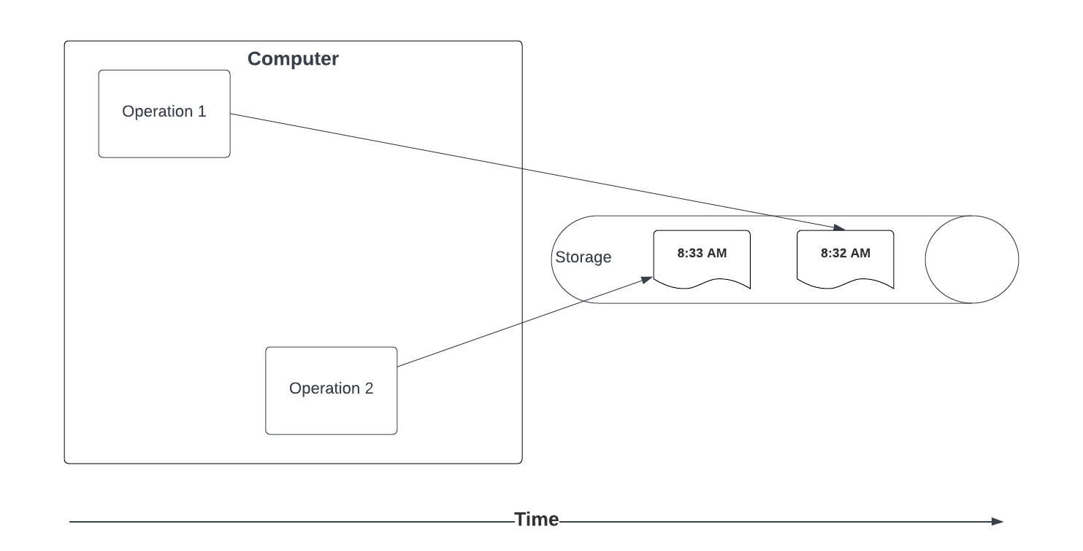
Delays…it gets worse
Most systems in today’s world use time off the device that determines the time.
Increases the delays
Increases the likelihood of time sequencing issues

Slide 15
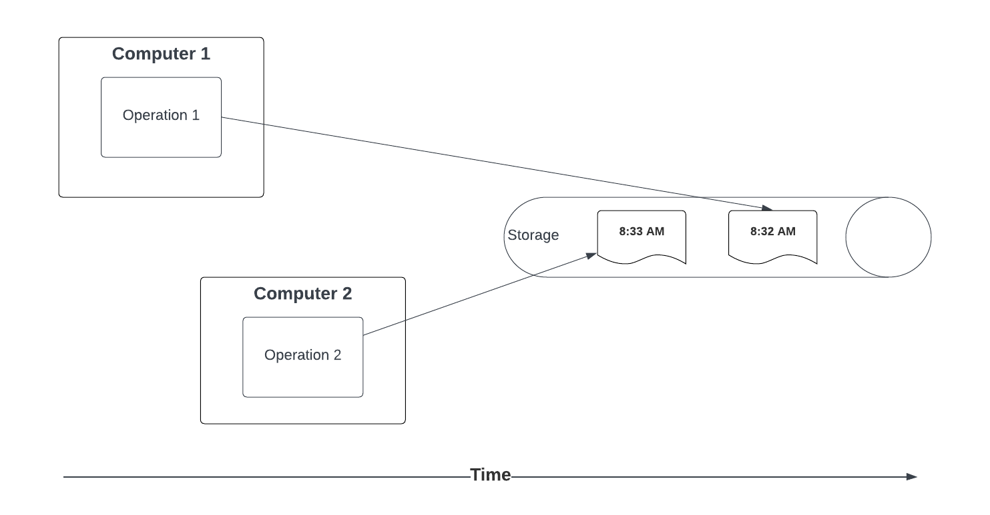
Delays…it gets worse
Many systems in today’s architectures are distributed for scalability reasons so time is captured on many computers and used / stored on others.
Increases the delays
Increases the likelihood of time sequencing issues

Slide 16

What time is it?

Slide 17
What time is it?
If you have a watch, you always know what time it is. If you have more than one, you are never quite sure.

Slide 18
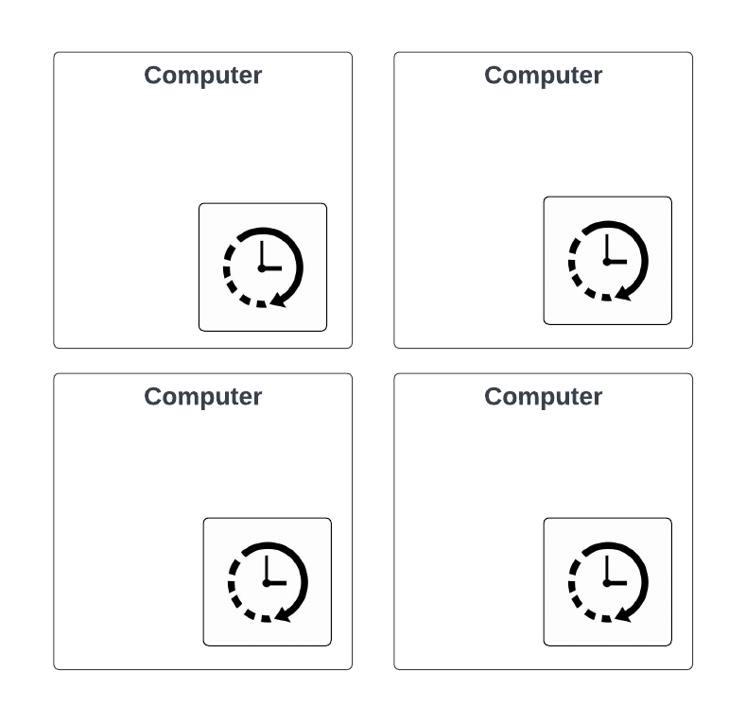
What time is it?
Each computer has it’s own clock.
Each clock will have a different time and will drift

Slide 19
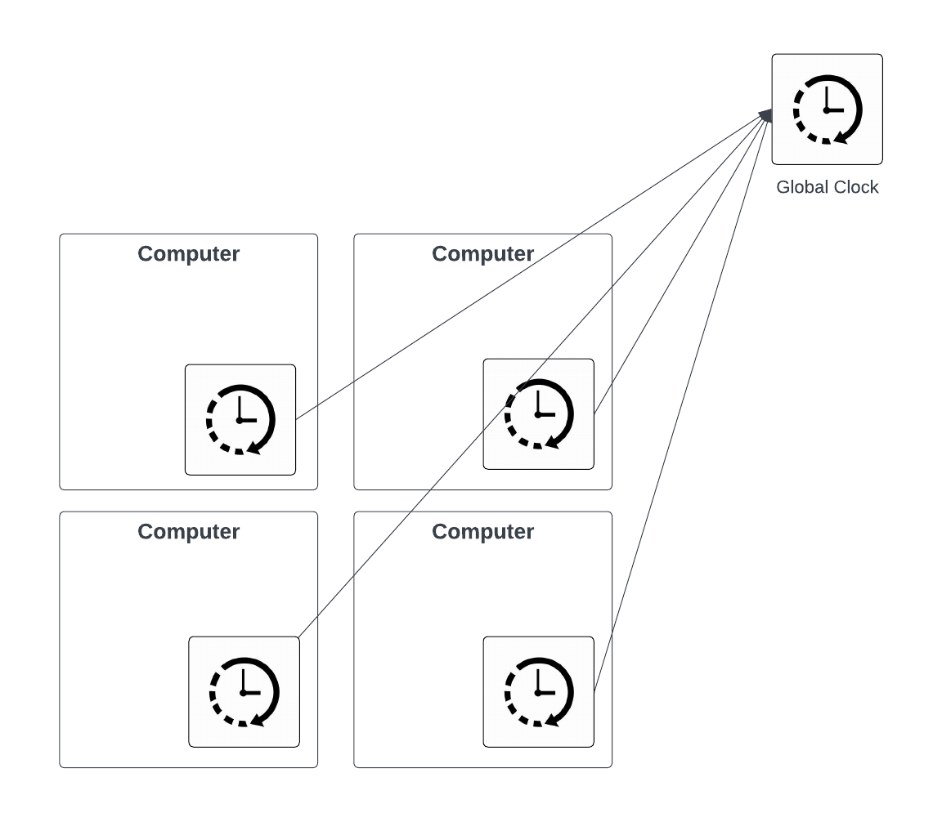
What time is it?
We minimize the difference by sync’ing to the global clock but this has all the limitations / issues as previously discussed
There are solution to guarantee a distributed system agrees on a specific value (a.k.a. consensus problem).
There is NO solution nor will there ever be to ensure a distributed system agrees on time because it is “in motion”

Slide 20

Overcoming These Challenges
How do we win given the issues with time?

Slide 21

Don’t Use Time
Don’t use time with computers in a way that relies on it being linear

Slide 22
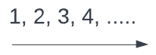
Use Sequence
When you need linear, use a sequence (i.e. atomically increasing number)
Atomically increasing number have proven solutions for consensus in distributed systems.
This is what Kafka does under the hood by default.

Slide 23
Partial Mitigations for Time
Minimize delays in telling time vs. using time
Control the clock
Only one clock if we can (seldom is feasible and impacts scalability)
Build in “fuzzy” time logic to allow for delayed uses and clock variances
Wait for an arbitrary amount of time and assume variances / delays are resolved by that time
Re-order timeline to allow for variances
No ability to completely solve this
X

