Slide 1
Liskov Substitution Principle
Shaping the past, present, and future of software development

Slide 2
Agenda
About Me
LSP Talk Constraints
Inheritance in OOP
History of LSP
LSP Defined
Applying LSP
Implication of LSP
Value
Questions

Slide 3

Michael Kreeger
Currently IT Strategy Director for Modern Application Development and Architecture at eviCore
My passions are building great cultures, cultivating high performing teams, agile software development, DevOps, coaching, technical excellence disciplines, unit testing, architecture, best practices, DDD… I love software development
Lots of different hats over the years….
Architecture Manager
Agile Coach
Development Manager
Platform development
Feature development
DevOps
Special operations / technical swat team
Developer Evangelist

Slide 4
LSP Talk Constraints
Andy – Can’t talk about or define LSP using other SOLID principles
Carl – Fun and engaging for all experience levels
Mike – Have to sell the impact of LSP and value today
Brian – Timebox

Slide 5
Inheritance in OOP
In object orientated programming (OOP) we have 4 fundamentals
Abstraction
Encapsulation
Inheritance
Polymorphism

Slide 6
Inheritance in OOP
So what is inheritance in OOP?
Ability to create a new class by starting with the definition of another class
without having to copy / paste the same code
Without having to maintain the code in both classes if the base class needs to change
Programmers like avoiding duplication of code (DRY)

Slide 7
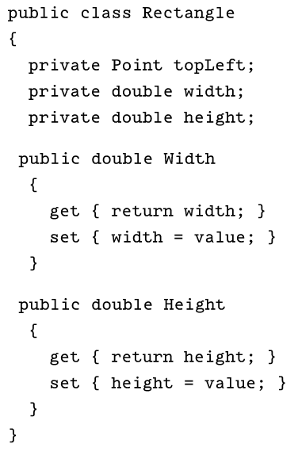
Inheritance in OOP
Rectangle Class
Width & Height
Area
Draw
Etc.

Slide 8
Inheritance in OOP
Square Class
I don’t want to write the code twice
Just inherit from Rectangle
Makes sense since Square “is a” Rectangle

Slide 9
Inheritance in OOP
Square
is a
Rectangle
Derived Class
Base Class

Slide 10
Inheritance in OOP
The “is a” test
Use inheritance to save code / time when a class “is a” another class
Examples
Square is a Rectangle
Man is a Person
Dog is an Animal
Microwave is an Appliance
Book is an Item

Slide 11
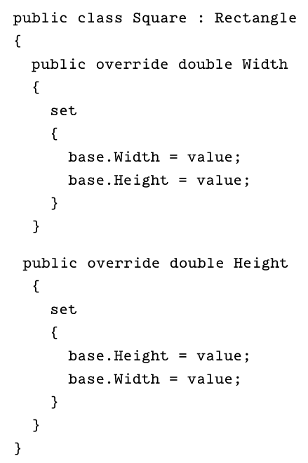
Inheritance in OOP
Square Class
Width & Height
Area
Draw
Etc.

Slide 12
LSP Defined
is a
Derived Class
Base Class

Slide 13
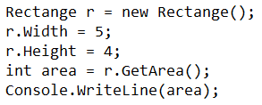
Inheritance in OOP
How is Rectangle used?
Output:
20

Slide 14
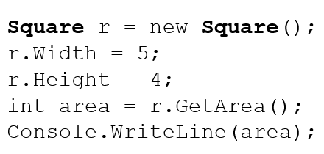
Inheritance in OOP
Replace Rectangle with Square…what!!!
Output:
16

Slide 15
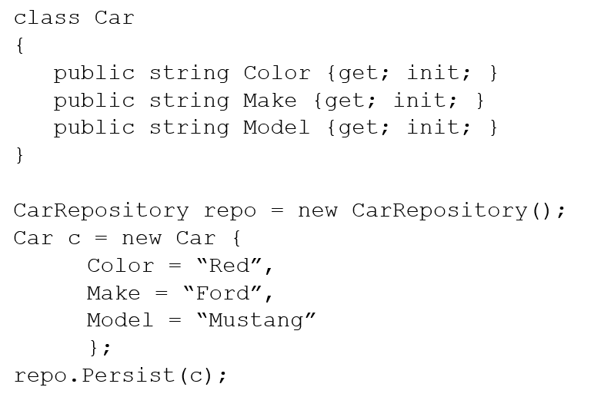
Inheritance in OOP

Slide 16
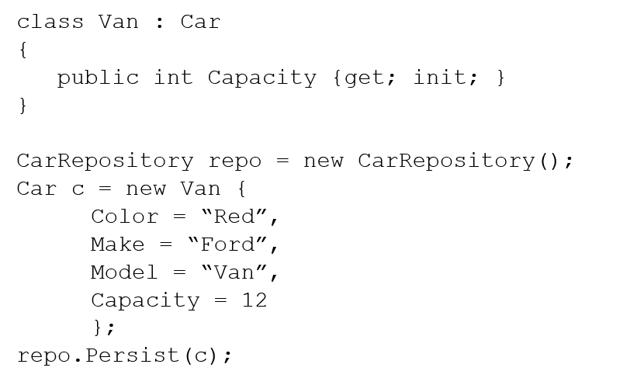
Inheritance in OOP

Slide 17
Inheritance in OOP
What just happened?
We passed the “is a” test
We don’t like using the Square like we do Rectangle
We are not sure it’s save to use a Van for a Car
Want is going on here?
Help!!!!!!

Slide 18
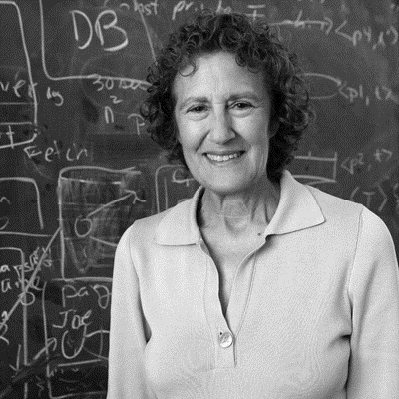
History of LSP
Barbara Liskov
Computer Scientist
Pioneer contributions to programming languages and distributed computing
1988 - Keynote talk “Data abstraction and hierarchy”
1994 – Jeannette Wing paper “A behavioral notion of subtyping”

Slide 19
History of LSP

Slide 20
History of Lsp
2001 – Agile Manifesto as Snowbird
Pace of change dramatically accelerates
Ever increasing release tempo (months between releases to a few weeks, days, or hours in todays world)
Encourage changes to requirements as opposed to limiting / resisting change
Build only what you need now and add to it later
Eliminate building for future need / gold plating
Measure progress through working software
PPT’s and documentation not considered progress

Slide 21
History of LSP
July 20th, 2006 – Agile Principles, Patterns, and Practices in C#
Robert Martin
Popularized SOLID acronym and focus on software development techniques to make agile work.
Designing for future change not future need

Slide 22

LSP Defined

Slide 23
LSP DEFined
A derived class must satisfy all the explicit or implicit behaviors of the base class.

Slide 24
LSP Applied
Explicit Behaviors
Set width & hight independently
Implicit Behaviors
The width and hight could be set to different values
I assume basic geometry / logic applies (i.e. Area = L x W)

Slide 25
LSP Applied
Derived Class
behaves like
Base Class

Slide 26
LSP Applied
Examples
Square does NOT behave like a Rectangle
Van does NOT behave like a Car

Slide 27
Implication of LSP
Inheritance is the strictest form of coupling to a base class
Direct dependency on base class
LSP - Required implicit and explicit behavior adherence
Single root inheritance so only one choice for a base class
Many engineers avoid inheritance in favor of loosely coupled interfaces / injections
LSP violations are
subtle
can be caused by how the class is used not just how it is defined

Slide 28
Implications of LSP
Smells
Type testing
Not implemented members
Runtime checking / exceptions in derived classes for invalid conditions
Classes open for inheritance but no logical derivation

Slide 29
LSP implications
Component Library Impacts
Component libraries / API’s should use inheritance to force strict adherence to expected constructs
You are going to provide X implementation and not be able to do anything else special
C# language regret of not using abstract based classes more
Seal classes for which derivation makes no sense

Slide 30
LSP implications
Architecture Impacts
LSP was the early pre-cursor to DDD and understanding that “behavior” is the main organizing construct of software
Relatedness does not imply tight coupling
Car and Van are related but based on the “behavior” should not be coupled
Square and Rectangle are related but based on the “behavior” should not be coupled.
LSP guides us down a path or organizing ecosystems, domains, micro-services, code around cohesive behaviors

Slide 31
VAlue
Quick wins by being deliberate (seal classes, using abstract classes, etc.)
Focus on the important questions (behaviors)
Breaks the mental model from relatedness / existing world constructs
Constrains the shape of most significant coupling mechanism is software
Great step into DDD thinking / mindset

Slide 32
Review
About Me
LSP Talk Constraints
Inheritance in OOP
History of LSP
LSP Defined
Applying LSP
Implication of LSP
Value

Slide 33
Questions?

