Slide 1
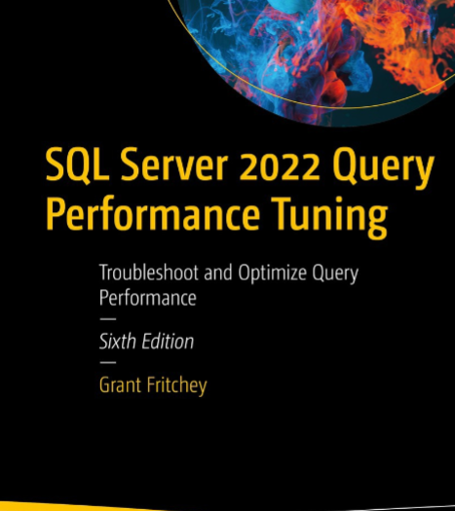
SQL Server Performance Study Group
User Defined Functions (UDF) – Session 7

Slide 2

Agenda
What is a User Defined Function?
What are the three types of UDFs?
How do UDFs compare to Stored Procedures?
What are the “advertised” benefits?
What are the actual benefits?
What are the dangers with UDFs
Recommendations

Slide 3
What is a User Defined Function (UDF)
A user defined function is similar conceptually to functions in other programming languages such as java, c#, etc.
The fundamental difference is that SQL is a declarative language.
SQL server must interpret our SQL statement included calls to UDFs and determine what steps to execute to satisfy the desired intent.
SQL server uses its optimization process to try and find the best steps to achieve the desired results in the fastest time.
In imperative languages the function is executed as a set of instructions.

Slide 4
What are the three types of UDFs?
Scalar functions
Returns a single data value
Table-valued functions
Returns a table (rows and columns) of data
System functions
Built in SQL functions to perform various operations (i.e. Dynamic Management Views).
Can not be changed
These can be scalar or table-valued functions

Slide 5
Example
CREATE FUNCTION dbo.f_celsiustofahrenheit(@celcius real)
RETURNS real
AS
BEGIN
RETURN @celcius*1.8+32
END
GO
select
c.Name,
dbo.f_celsiustofahrenheit(c.AverageTempCelsius) as fahrenheit
from CityTemps

Slide 6
How do UDFs compare to Stored Procedures?
UDFs are the same as stored procedures when it comes to compilation and optimizations
Query plans are cached when executed
Optimization best practices apply to UDFs just like stored procedrues
Most all the best practices with stored procedures apply to UDFs

Slide 7
What are the advertised benefits?
Modular programming
Re-use of common routines
Faster execution
Exact same benefit as stored procedures do query plan caching
Reduce network traffic
Reduce the number of rows / data sent back to the client

Slide 8
What are the actual benefits?
Modular programming
Re-use of common routines
Faster execution
Exact same benefit as stored procedures do query plan caching
Reduce network traffic
Reduce the number of rows / data sent back to the client

Slide 9
What are the actual benefits?
Modular Programming
Re-use of SQL statements is a fools errand. Your goal should be to ensure that each SQL statement / stored procedure is an exact fit for the use case at hand. If the use case is different in any way, the SQL statement should be different.
Do not attempt re-use / abstraction when working with SQL server. Seek fit for purpose SQL statements.
Even if there are potentially re-usable bits of SQL statements mixing SQL statements with UDF calls adds additional complexity for the optimization engine and in many cases will lead to less efficient query plans.

Slide 10
What are the actual benefits?
Faster Execution
This is purely based on plan caching which is exactly the same as stored procedures.

Slide 11
What are the actual benefits?
Reduce Network Traffic
This is based on returning less data over the network to the client.
Only return what you need with SQL (not just UDFs) ensures this.

Slide 12

What are the dangers with UDFs
The risk with UDFs is that they will be intermixed with other SQL statements to build more complex statements.
UDFs promote a pattern of composability which not the goal when working with SQL server.
This hurts query optimization through sub-optimization (UDF optimized at the expense of the whole)
It promotes server side computation instead (especially in the case of UDF scalar functions)
It hurts readability
This is very similar to having stored procedures that call other stored procedures

Slide 13
Recommendations
Don’t use user defined functions
Any benefit of a UDF can be achieved through well written stored procedures and computation logic in the service / domain layer
In 25+ years I haven’t had a SQL problem for which writing custom UDFs was the best solution.

Slide 14
Recommendations
CREATE FUNCTION dbo.f_celsiustofahrenheit(@celcius real)
RETURNS real
AS
BEGIN
RETURN @celcius*1.8+32
END
GO
select
c.Name,
dbo.f_celsiustofahrenheit(c.AverageTempCelsius) as fahrenheit
from CityTemps

Slide 15
Example
select
c.Name,
c.AverageTempCelsius
from CityTemps
Within C# code on the service layer, convert to fahrenheit

