Slide 1
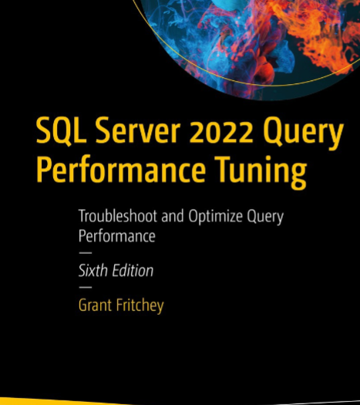
SQL Server Performance Study Group
UUIDs – Session 5

Slide 2

Agenda
What is a UUID?
Math behind UUIDs
Why use UUIDs?
How to use UUIDs in SQL
SQL Performance
System Architecture & Performance

Slide 3
What is a UUID?
UUID – Universally Unique Identifier (a.k.a. Unique Identifier, GUID)
UUID are globally unique identifiers that will not overlap with any other existing UUID.
Traditional identities which are typically integer based overlap
i.e. Patient ID = 1001 and ProviderID = 1001. 1001 is a unique identifier for both a patient and a provider. 1001 is not a UUID because it is not globally unique.
UUID is a random 16 Bytes of data expressed usually like follows as a hexadecimal number separated by hyphens.
Ex. 67492bd7-bc91-492d-971d-82f94f41f175

Slide 4

Math behind UUIDs
Modern systems generate a true random (version 4) UUID when asked to create a new UUID. Historically this wasn’t the case but all modern systems generate random UUIDs.
c# - Guid.NewGuid()
SQL - NEWID()
There are 122 Bits (4 reserved for versioning and type) giving ~5.3×10³⁶ possible UUIDs
Due to the “birthday paradox” the odds of collision are as follows:
1 in ~2.71 x 10¹⁸
You would need to generate 1 billion UUIDs per second for 85 years to have a 50% chance of a single collision.
1 in ~2.9 x 10⁸ chance of winning the lottery. Add 10 more 0’s behind that.

Slide 5
Math behind UUIDs
If this still makes you uneasy about a possible collision, it is likely you still think that software runs with absolute guarantees. Everything within running software is probabilistic.
Chance of a bit flipping over fiberopic connection: 1 in 10¹².
Chance of a bit flipping over ethernet cable connection: 1 in 10¹⁴.
Chance of a bit unrecoverable on disk: 1 in 10¹⁴.
Based on the math, it is prudent to work with UUIDs and assume they are unique and when creating a new UUID assume that it is unique. If you have two UUIDs that are the same they represent the same thing. Any logic trying to prevent collisions is only adding additional risk / complexity and probabilities of false positives.

Slide 6

Why Use UUIDs?
Fewer Bugs with UUIDS
Consider the following SQL statement. Can you see the bug?
SELECT SR.[ServiceRequestID], P.ProgramName
FROM [ServiceRequests] SR
INNER JOIN [Programs] P ON SR.PatientID = P.ProgramID
It is easy to accidentally mis-match ID’s when they are integers and get a system that is “partially working”. This issue is completely eliminated with the use UUIDS.

Slide 7
Why Use UUIDs?
Simpler code with UUIDs
ID’s generated by a database and used a primary keys force a “tight coupling” to the data layer and coordination within inserts.
Stored procedure must look up previously inserted @@IDENTITY / SCOPE_IDENTITY()
Identity framework must get returned identity values from SQL to perform the next insert.
UUIDs are best generated in the service or even at the client layer thus you know the PK before even talking to the database and can avoid the coupling & coordination associated with integer based IDs.

Slide 8
Why Use UUIDs?
Safer code with UUIDs
With auto-generated ID’s you don’t know if the record you are inserting was already inserted. Thus retries of inserts when things fail the first time can cause duplicate records being created.
Remember that with TCP communication it is possible the DB doesn’t respond with an ACK and thus the client isn’t sure if the destination received / processed the message.
With UUIDs the client (in many cases the UI) determines the UUID and thus retries upon failure are safe and will not create duplicates.

Slide 9
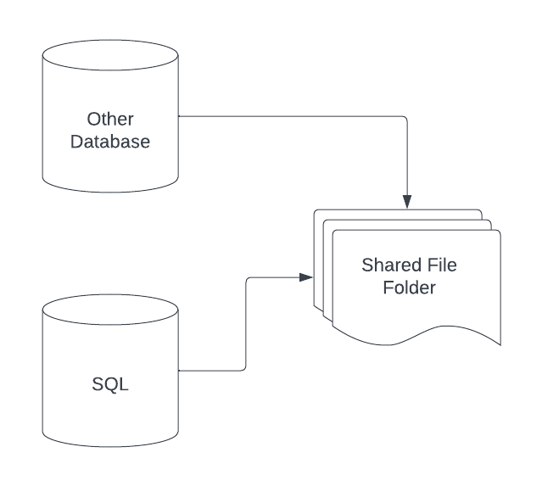
Why Use UUIDs?
Interoperable code with UUIDs
In most systems there is likely data outside of SQL server that have some reference / link to the data within SQL server (files, other databases, etc.). Using UUIDs ensures that the data stored elsewhere also does not conflict with those systems keys.

Slide 10
Why Use UUIDs?
Better practices with IDs
It is a common mistake is to display / provide to users of a system the internal identifiers (i.e. ID’s from a database). There are several problems with this.
Once the users see something, they may want to change it.
ID’s from a database may not be what is most convenient for users to use.
When merging different systems a common need is to determine ways to distinguish or merge the user facing identifiers.
Invoice # story from my early years
ID’s that users use must be designed to be effective for them to use and should not be constrained by how the database internally identifies records.
Never display your internal ID’s to users
UUIDs since they are not user friendly naturally prevent this sort of accidental mistake within an ecosystem.

Slide 11
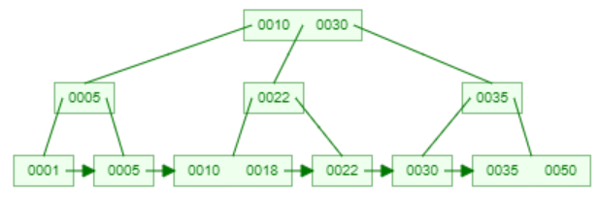
How to use UUIDs in SQL
Datatype UNIQUEIDENTIFIER
If you set the CLUSTERED KEY as a UNIQUEIDENTIFIER the inserts to that table will not always occur on the last page (hot page). Thus, your data will be fragmented across the entire B+Tree.
Additionally, the CLUSTERED KEY is used as the lookup key for all subsequent non-clustered indexes.
Thus, in many situations it makes sense to set the CLUSTERED INDEX to be an IDENTITY column who’s sole purpose is to order the data with the B+Tree ensuring we are inserting new records at the end (hot page) and then only have a 4 byte lookup key for subsequent non-clustered indexes.
There may be situations where this isn’t needed or advisable and you must think through your data use cases to evaluate this.

Slide 12
How to use UUIDs in SQL
What this looks like in SQL syntax.
CREATE TABLE MyTable(
ID INT IDENTITY(1,1) NOT NULL,
EK UNIQUEIDENTIFIER NOT NULL,
ValueB VARCHAR(50),
CONSTRAINT [MyTable_PK_EK] PRIMARY KEY NONCLUSTERED (EK)
);
CREATE CLUSTERED INDEX MyTable_ID ON MyTable (ID);

Slide 13

SQL Performance
Looking at just what we’ve discussed thus far, UUIDs actually add some additional costs we didn’t have before.
16 bytes vs 4 bytes – some additional CPU / storage costs
Additional memory/IO costs with randomness of UUIDs
Depending on scenario this may be easily mitigated through selective index
The entire B-Tree will used instead of a narrow branch in most cases
However, UUIDs allow us to do something architecturally that can dramatically improve performance of SQL.

Slide 14
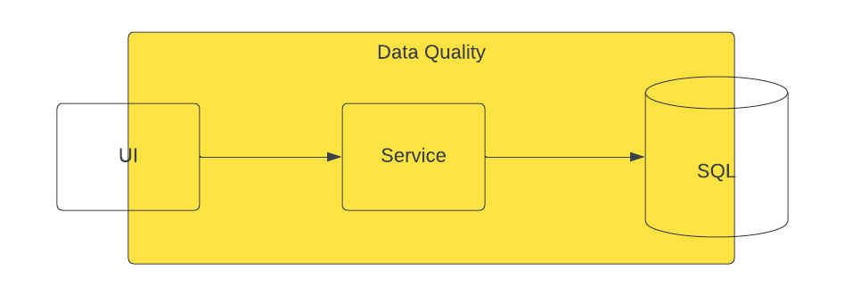
System Architecture & Performance
However, UUIDs allow us to do something architecturally that can dramatically improve performance of SQL.
Most systems / architectures split the responsibility of data quality between the application and the database with each playing some role in ensuring the data is accurate.

Slide 15
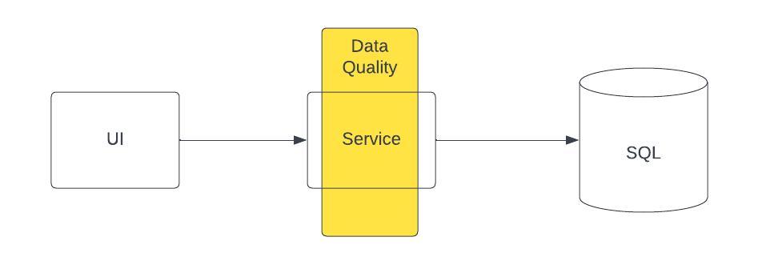
System Architecture & Performance
With UUIDs, CQRS, and Domain Driven Design we move all this logic into the service layer with the database job being solely storage and the UI being purely user experience. Additionally we store the data how it is used and where appropriate part ways with 3rd normal form.

Slide 16

System Architecture & Performance
When the responsibility of data quality is removed from SQL and the data is stored in schemas that match how the data is used the performance gains can be substantial.
Elimination of FK’s and consistent ordering of inserts and selects can all but eliminate all deadlocks
Data is stored how it is used thus all selects are extremely simple
SQL simply becomes a data storage tool and not dynamic query engine
In truth, at this point SQL becomes overkill and simpler, cheaper NoSQL data storage solutions should be explored

Slide 17
Homework
The next PK you create, use a UUID instead.
STOP using INT PK’s
START using UUIDs
Reach out for help / designs assistance on indexes

