Slide 1
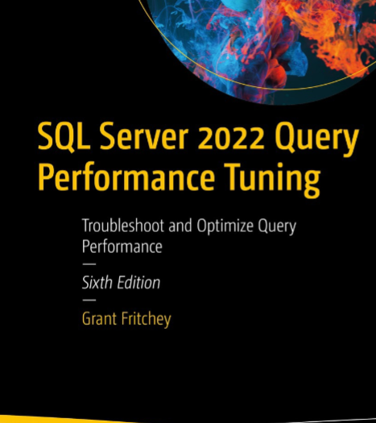
SQL Server Performance Study Group
TSQL Top 7 – Session 6

Slide 2

Agenda
Doing the Right Things in the Right Layers
TSQL Top 7
Selecting More Than You Need
Transforming Results
Invalidating Indexes
Exists vs. Select Count(*)
Conditional Logic
Transaction Isolation Levels
Top & Order By

Slide 3
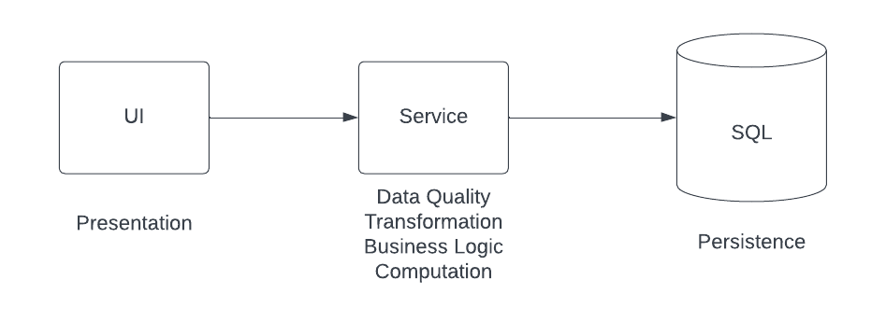
Doing the Right Things in the Right Layers
“Just because you can….doesn’t mean you should”

Slide 4
1. Selecting More Than You Need
Select * …
Should not be used
Technically it is okay in some edge scenarios but best to avoid
Focus on the use case at hand
If the user doesn’t see it, you likely don’t need it
Don’t attempt to “reuse” stored procedures that do not match the use case exactly. Stored procedures are not designed for re-use. They are designed for query plan caching, abstraction, and tighter security.

Slide 5
2. Transforming Results
RDBS should be used for data storage & retrieval…not result transformation
Do not…
LEFT, RIGHT, Concatenate (.i.e. +)
Format XML / JSON
CAST
User Defined Functions
CASE statements
…or any other transformation logic that could be done in the service layer

Slide 6

2. Transforming Results
Example
StandardHCP_PatientsGrid

Slide 7
3. Invalidating Indexes
Watch your conditions
Casts
SELECT account_nbr, account_reference AS account_ref_nbr
FROM Accounts
WHERE account_type LIKE 'Business%'
AND CAST(account_reference AS INT) > 20;
Predicate Order
GetPAPEligibilityQuestions
Like with prefixed ‘%’
Careful with OR / IN conditions
Sometimes replacing with Unions is better
Think like a binary search algorithm…can you seek the record

Slide 8
4. Exists vs. Select Count(*)
Don’t count rows if all you need to know is if a record exists
0<(SELECT COUNT(*) from ProgramFunctions WHERE …)
EXISTS(SELECT * from ProgramFunctions WHERE …)
Example
[GetPatientBAAInfo]

Slide 9
5. Conditional Logic
Do not use IF
Move the logic to the service layer
Why?
IF Conditions make it harder for SQL to optimize queries
Can more easily unit test in service layer
Most of the time IF represents business logic

Slide 10

6. Transaction Isolation Levels
Understand what data guarantees you need
READ UNCOMMITTED will return you
Duplicate Records
Partial Updates
Phantom Reads
Data from Failed Transactions

Slide 11
7. Top & Order By
Top without order by is non-deterministic in behavior and is not recommend.
Order by should not be used (except for filtering records using a top command or by ranking).
Only valid use case for TOP & ORDER BY
SELECT TOP N … FROM … ORDER BY …
SELECT … RANK() OVER (PARTITION BY …. ORDER BY …) as RowNum ... WHERE RowNum = #

Slide 12
Homework
Analyze 5 random stored procedures against this list and capture your observations.
Apply everything you have learned to do things differently for the next stored procedure.
Reach out for help / designs assistance on indexes

