Slide 1
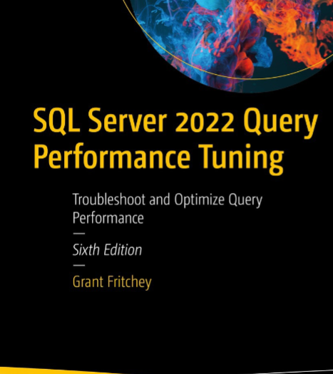
SQL Server Performance Study Group
Fundamentals – Session 2

Slide 2
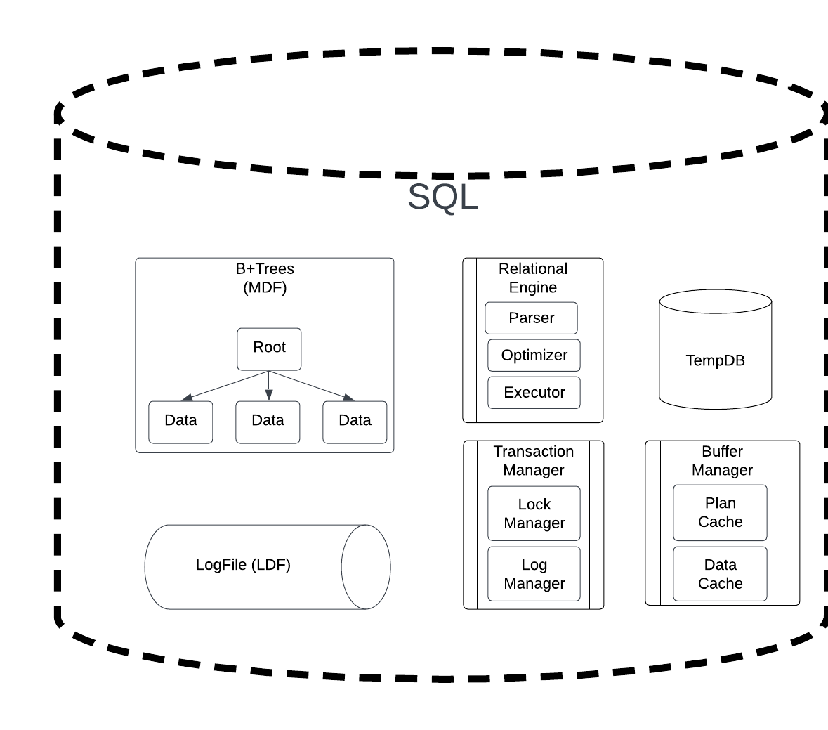
SQL Under the Hood

Slide 3
How To Store Data?
Use Cases
Get Patient
Add Patient
Update Patient
Delete Patient
1
5
10
18
22
30
35
50
File

Slide 4
How To Store Data?
Use Cases
Get Patient
Add Patient
Update Patient
Delete Patient
Find patient #18
binary search in action
O(log(n))
Step 1
Step 2
Step 3
1
5
10
18
22
30
35
50
File

Slide 5
How To Store Data?
Use Cases
Get Patient
Add Patient
Update Patient
Delete Patient
Delete patient #18
Options to handle the deleted records?
Leave the deleted record and waste some disk space -> O(log(n))
Compact the records by moving those >18 to the left incurring additional IO -> O(n)
Step 1
Step 2
Step 3
1
5
10
18
22
30
35
50
File

Slide 6
How To Store Data?
Use Cases
Get Patient
Add Patient
Update Patient
Delete Patient
Add patient #19
Steps to add a record:
Add space to the file
Move records to the right one at a time till we find a record less than the record we want to add.
Add the new value
O(n)
1
5
10
18
19
22
30
35
50
File

Slide 7
How To Store Data?
Use Cases
Get Patient
Add Patient
Update Patient
Delete Patient
Update patient #1 to #29
Steps to update a record:
Binary search to find the original record
Update record to new value
Sequentially move records to resort the list
O(n)
5
10
18
22
29
30
35
50
File

Slide 8
Different Ways To Store Data and Performance
Type | Get | Insert | Update | Delete
Sorted List | O(log(n)) | O(n) | O(n) | O(log(n))
Unsorted List (Heap) | O(n) | O(1) | O(n) | O(n)

Slide 9
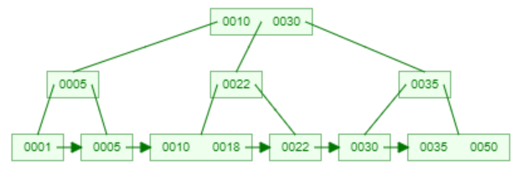
B+Tree
Variation on B-Tree
Data (or data pointers) are always stored at the leaf node
Leaf nodes always contain pointers to the next leaf node.
B-Tree Invented by Rudolf Bayer and Edward M. McCreight in July 1970
Original Paper: “Organization and maintenance of large ordered indices”
Published in “Acta Informatica”

Slide 10
How To Store Data?
Use Cases
Get Patient
Add Patient
Update Patient
Delete Patient
5
[10]
1
[5]
30
[35]
50
[]
22
[30]
10
[18]
35
[50]
18
[22]
R10-22
[N5, N18, N35]
N5
[1,5]
N18
[10, 18]
N35
[30, 35]
File

Slide 11
How To Store Data?
Use Cases
Get Patient
Add Patient
Update Patient
Delete Patient
Get patient #18
Step 1
Step 2
Step 3
5
[10]
1
[5]
30
[35]
50
[]
22
[30]
10
[18]
35
[50]
18
[22]
R10-22
[N5, N18, N35]
N5
[1,5]
N18
[10, 18]
N35
[30, 35]
File

Slide 12
How To Store Data?
Use Cases
Get Patient
Add Patient
Update Patient
Delete Patient
Delete patient #18
Step 1
Step 2
Step 3
Step 4
5
[10]
1
[5]
30
[35]
50
[]
22
[30]
10
[22]
35
[50]
18
[22]
R10-22
[N5, N18, N35]
N5
[1,5]
N18
[10, 18]
N35
[30, 35]
File

Slide 13
How To Store Data?
Use Cases
Get Patient
Add Patient
Update Patient
Delete Patient
Add patient #19
Step 3
Step 1
Step 4
Step 2
5
[10]
1
[5]
30
[35]
50
[]
22
[30]
10
[18]
35
[50]
18
[19]
R10-22
[N5, N18, N35]
N5
[1,5]
N18-22
[10, 18, 22]
N35
[30, 35]
19
[22]
Step 5
File

Slide 14
Different Ways To Store Data and Performance
Type | Get | Insert | Update | Delete
Sorted List | O(log(n)) | O(n) | O(n) | O(log(n))
Unsorted List (Heap) | O(n) | O(1) | O(n) | O(n)
B+Tree | O(log(n)) | O(log(n)) | O(log(n)) | O(log(n))

Slide 15
B+Tree Geekout
Create your own B+Tree
https://www.cs.usfca.edu/~galles/visualization/BPlusTree.html
The topic of data storage and algorithms is a rich area of study which has found renewed interest with the NoSQL movement.

Slide 16
SQL Server Storage
The primary data structure used within MS SQL Server is B+Tree’s.
Notable exceptions
Heaps (unorder lists) which are seldom recommended
Column Store indexes which are suited more for analytical queries vs. transactional queries.

Slide 17
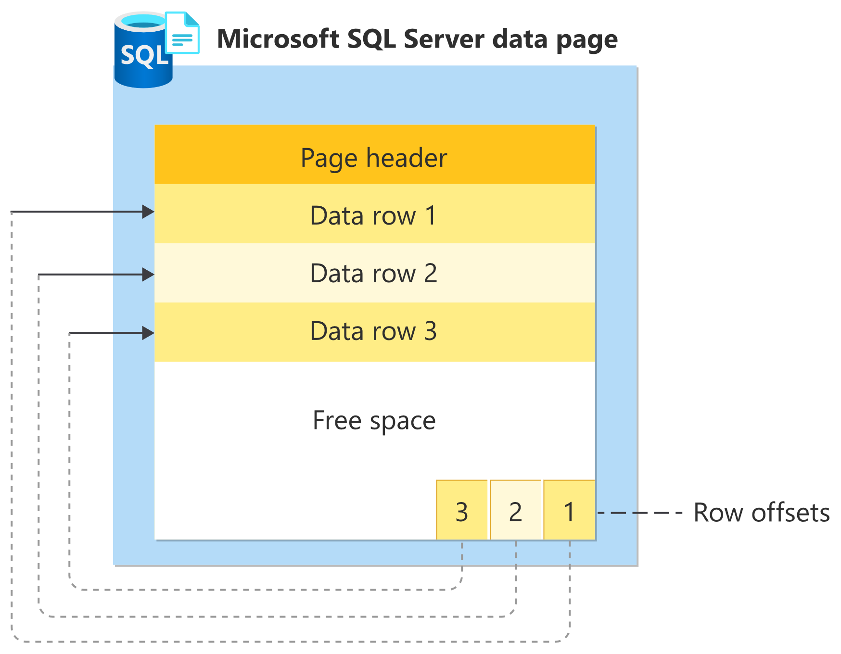
Pages
Pages
SQL server organizes it’s data into “pages”. In simple terms, these pages are the B+Tree nodes.
A SQL server page is always a fixed size – 8K Bytes => 8,192 Bytes
SQL server performs Disk I/O at the page level
Three key components
Page Header – Metadata
Data Row – data
Row Offsets – pointers to Data Rows

Slide 18
Pages
What if the size of the data row exceeds the available space on the page (max available is 8,060 Bytes)?
Extra data is moved to separate pages in the ROW_OVERFLOW_DATA allocation unit.
This incurs extra I/O to pull that data

Slide 19
Pages
What if every data row is 4,031 bytes? (max data row 8,060 / 2 + 1)
Approximately 50% of the page is left empty. The corresponding table will be ~50% larger on disk than the data itself requires.

Slide 20
Pages
SQL Server page size comes up in a lot of areas for optimization.
Dense pages mean fewer I/O operations to read data.
Dense pages may cause more I/O if data manipulation causes a data row to no longer fit within the free space of the page. This will cause a page split.
Depending on the data manipulation patterns, sometimes we can cause performance issues due to page splits or low density of pages both increasing I/O.

Slide 21



Pages
Storage
Memory
Every page is read / written into memory and cached.
SQL server will rely on memory as much as possible to reduce disk I/O.
This again is another area where data row size & page density impact performance.
Design impacts to pages impact both storage and memory
SQL Pages

Slide 22
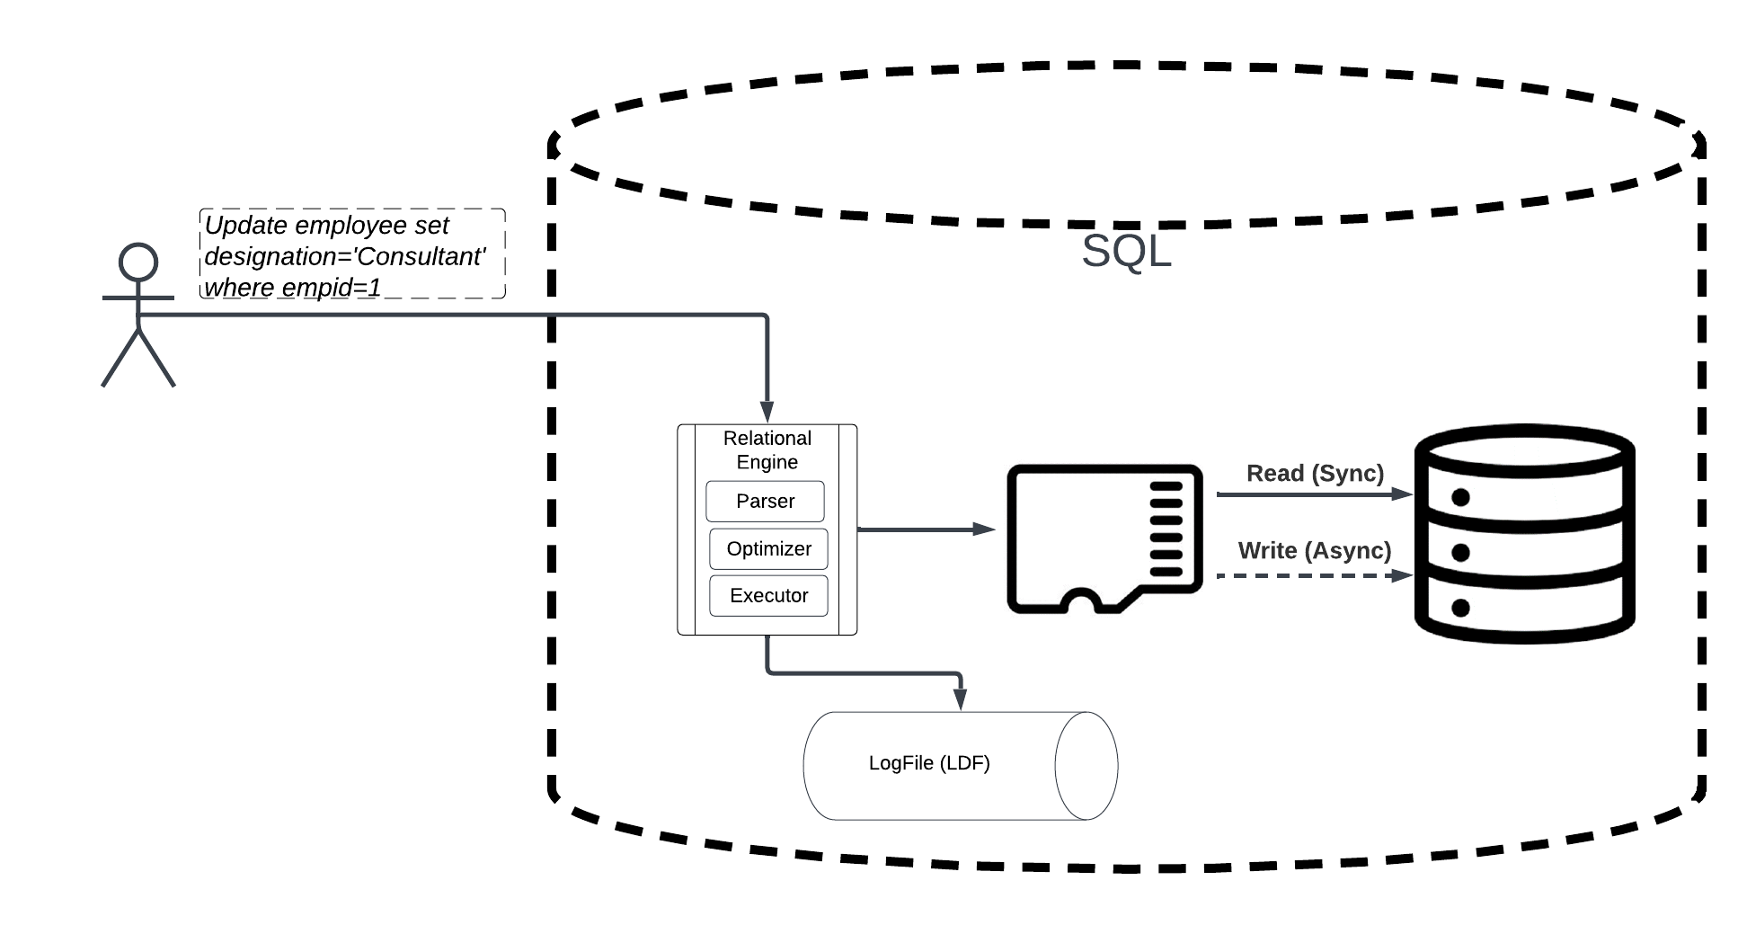
How SQL Works

Slide 23
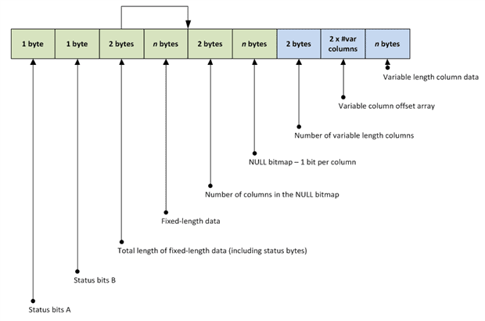
Diving Deeper into the Data Record
Two Fundamental Data Types
Fixed Length Variables
Variable Length Variables

Slide 24
Diving Deeper into the Data Record
Fixed Length Data Types
Always consume the same space whether they no matter their value including null or not.
Requires no math to find location within Data Record.
May reduce page splits due to data changes as the change in data will never change the length of a data record thus once put on a page it will always fit.
Hint – For fixed length columns that have a high percentage of null values, use SPARSE.
This will consume 0 bytes for null values and an additional 2 bytes for non null values.
This is very helpful for fixed length data types that are nullable.
https://learn.microsoft.com/en-us/sql/relational-databases/tables/use-sparse-columns?view=sql-server-ver16

Slide 25
Diving Deeper into the Data Record
Variable Length Data Types
Will only consume space necessary for storing value.
VARCHAR(100) with value “Todd” will only consume 4 bytes
+2 bytes for offsets so actually 6 bytes
+2 bytes if this is the first nullable column so maybe 8 bytes
+1 byte if this is 1, 9, 17, 25, … (# null columns mod 8 = 1) nullable column so maybe 9 bytes
VARCHAR(100) storing “Todd” is far less than CHAR(100) for the same value….;)
Requires math to find location within Data Record
May cause page splits if record first inserted with a smaller value requiring less space but then updated to include a value that consumes more space.

Slide 26
Diving Deeper into the Data Record
Fixed Length Variables
Always consume the same space whether they no matter their value including null or not.
Require no math to find location within Data Record

Slide 27
Homework
Sales.SalesOrderDetail Table
Execute the following to get a baseline and after each step that follows. This will allow us to see the impact of data types and updates to data
SELECT
record_count,
page_count,
min_record_size_in_bytes,
max_record_size_in_bytes,
avg_record_size_in_bytes,
avg_page_space_used_in_percent
FROM sys.dm_db_index_physical_stats(DB_ID(N'AdventureWorks2022'), OBJECT_ID(N'Sales.SalesOrderDetail'), NULL, NULL , 'DETAILED')
WHERE index_level = 0 and index_type_desc = 'CLUSTERED INDEX'
EXEC sp_spaceused 'Sales.SalesOrderDetail'
Use this to rebuild the index and clean up free space / fragmentation as needed when experimenting
ALTER INDEX PK_SalesOrderDetail_SalesOrderID_SalesOrderDetailID ON SALES.SalesOrderDetail REBUILD
GO

Slide 28
Homework
Add a new nullable column
ALTER TABLE SALES.SalesOrderDetail
ADD TestMyNewColumn UNIQUEIDENTIFIER SPARSE NULL
GO
Fill with some data causing page splits
UPDATE SALES.SalesOrderDetail
SET TestMyNewColumn = CONVERT(VARCHAR(50), NEWID())
WHERE
SalesOrderID % 50 = 1
Fill all the data but is slightly more efficient at using the free space
UPDATE SALES.SalesOrderDetail
SET TestMyNewColumn = CONVERT(VARCHAR(50), NEWID())
WHERE
TestMyNewColumn is NULL
Alter column and make NVARCHAR(500)
ALTER TABLE SALES.SalesOrderDetail
ADD TestMyNewColumn NVARCHAR(500) NULL
Drop column
ALTER TABLE SALES.SalesOrderDetail
DROP COLUMN TestMyNewColumn

Slide 29
Homework
Know Your Data Types
https://learn.microsoft.com/en-us/sql/t-sql/data-types/data-types-transact-sql?view=sql-server-ver16
Think Critically When Choosing Your Data Types
Fixed vs. Variable Data Types
SPARSE (when & where it makes sense)
How does data change after it is inserted

