Slide 1
QA Role within High Performing Agile Teams
Quality is a way working

Slide 2
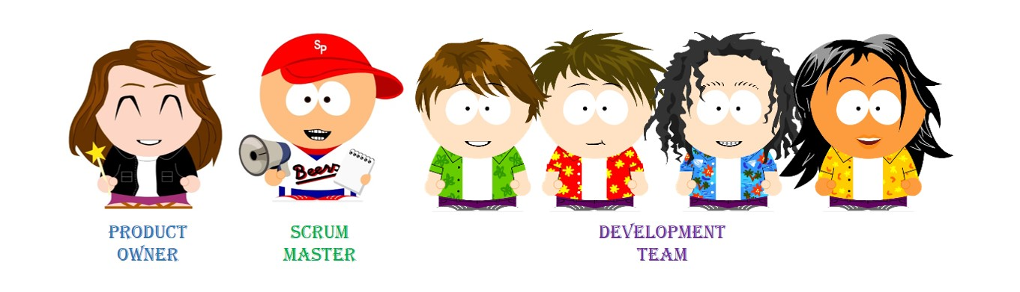
Roles
There are 3 roles
Dev Team
SM
Product Owner

Slide 3
Lots of Skills
UI Development
Analysis
Story Writing
Database Development
CI/CD
Unit Tests
Exploritory Testing
TDD
DDD
UI Automation Tests
Operations
Middle layer development
C#
Angular
Azure Cloud
ADO
Refactoring
Simple Design
Terraform
ARM templates
PaaS
SQL
Couchbase
Elastic Search
Kafka
Story Splitting
SOLID
Design Patterns
Visio Designing
Communication
React
Angular 1.6
Service Fabric
Docker
App Services
AppInsights
Facilitation
…

Slide 4
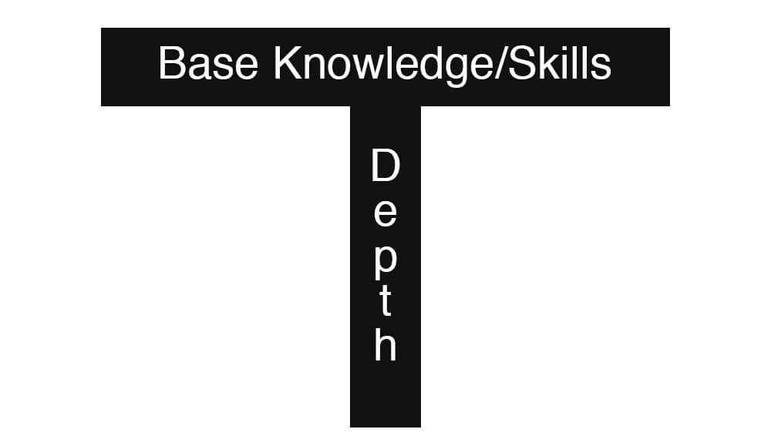
T Shaped Skills
Some people have more knowledge / experience with some skills
We seek to build teams with a mix of experiences and talents
+
+
=
Team Member
Team Member
Team Member
Team

Slide 5
Self Organizing Teams
Silo Working Style
Work
Team Member
Team Member
Team Member

Slide 6
Self Organizing Teams
Cross Functional Working Style
Work
Team Member
Team Member
Team Member

Slide 7
Self Organizing Teams
Pair Programming
Work
Mentorship / Coaching
Team Member
Team Member
Hands On Keyboard
Watch / Mentorship

Slide 8
Cross Functional / High Performing Teams
Higher Quality
Team Resiliency
Self Balancing
Faster Flow
Professional Growth
…
+
+
=
Team Member
Team Member
Team Member

Slide 9
Quality is how we work
TDD
Red
Green
Clean
Write test cases as a team and do them first
Testing should be done by everyone on the team. QA should not be doing most of the testing. Pair testing.
Automate everything

