Slide 1
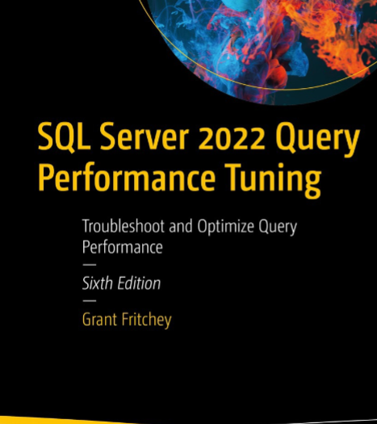
SQL Server Performance Study Group
Fundamentals – Session 3

Slide 2
Query Performance
Single Queries
Currently Running Queries
Previously Run Queries
Query Plans

Slide 3
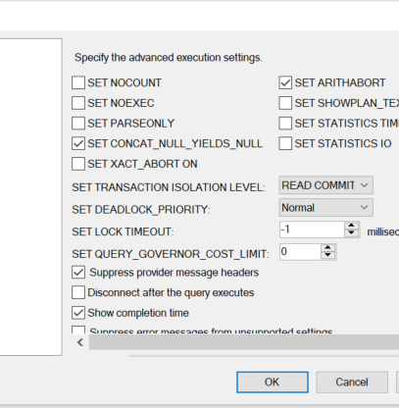
Single Queries
SET STATISTICS TIME ON
SET STATISTICS IO ON

Slide 4
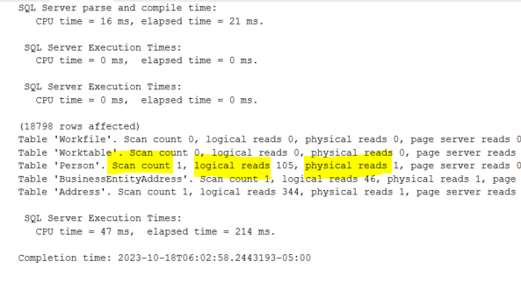
Single Queries
Scan Count - # of different seeks or scans started towards the left or right side at the leaf level after locating a specific key
Logical Reads - # of times a SQL page was requested from the cache
Physical Reads - # of times a SQL page had to be read from disk because it wasn’t in the cache

Slide 5
Single Queries
IO statistics can affect TIME statistics
Hard to parse through in larger queries
Only a single execution so you have to do your own averages

Slide 6
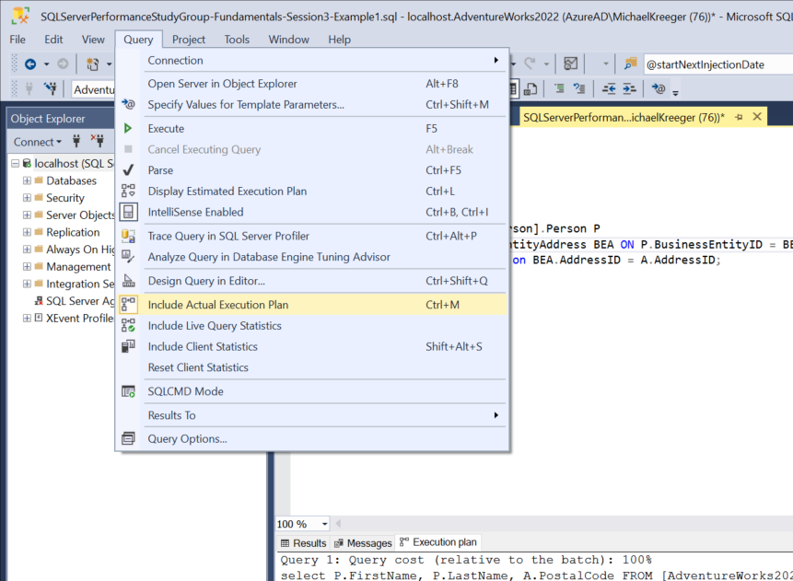
Single Queries
Include Actual Execution Plan
Organizes the IO & Time statistics by operation

Slide 7
Currently Running Queries
SELECT
dest.text,
deqp.query_plan,
der.cpu_time,
der.logical_reads,
der.writes
FROM sys.dm_exec_requests AS der
CROSS APPLY sys.dm_exec_query_plan(der.plan_handle) AS deqp
CROSS APPLY sys.dm_exec_sql_text(der.plan_handle) AS dest;
Dynamic Management Views

Slide 8
Dynamic Management Views
Dynamic management views (DMVs) and dynamic management functions (DMFs) return server state information that can be used to monitor the health of a server instance, diagnose problems, and tune performance.
Permissions Required:
VIEW SERVER STATE
VIEW DATABASE STATE
VIEW SERVER PERFORMANCE STATE (SQL Server 2022+)
VIEW SERVER SECURITY STATE (SQL Server 2022+)
Get the permission you need to your production systems.
Dynamic Management Views

Slide 9
Previously Run Queries
SELECT
dest.text,
deqp.query_plan,
deqs.execution_count,
deqs.min_logical_writes,
deqs.max_logical_reads,
deqs.total_logical_reads,
deqs.total_elapsed_time,
deqs.last_elapsed_time
FROM sys.dm_exec_query_stats AS deqs
CROSS APPLY sys.dm_exec_query_plan(deqs.plan_handle) AS deqp
CROSS APPLY sys.dm_exec_sql_text(deqs.sql_handle) AS dest;
Dynamic Management Views

Slide 10
Previously Run Queries
SELECT
dest.text,
deqp.query_plan,
deqs.execution_count,
deqs.min_logical_writes,
deqs.max_logical_reads,
deqs.total_logical_reads,
deqs.total_elapsed_time,
deqs.last_elapsed_time
FROM sys.dm_exec_query_stats AS deqs
CROSS APPLY sys.dm_exec_query_plan(deqs.plan_handle) AS deqp
CROSS APPLY sys.dm_exec_sql_text(deqs.sql_handle) AS dest;
Dynamic Management Views

Slide 11

Previous Run Queries
Query Store
When enabled automatically captures a history of queries, plans, and runtime statistics, and retains these for your review

Slide 12
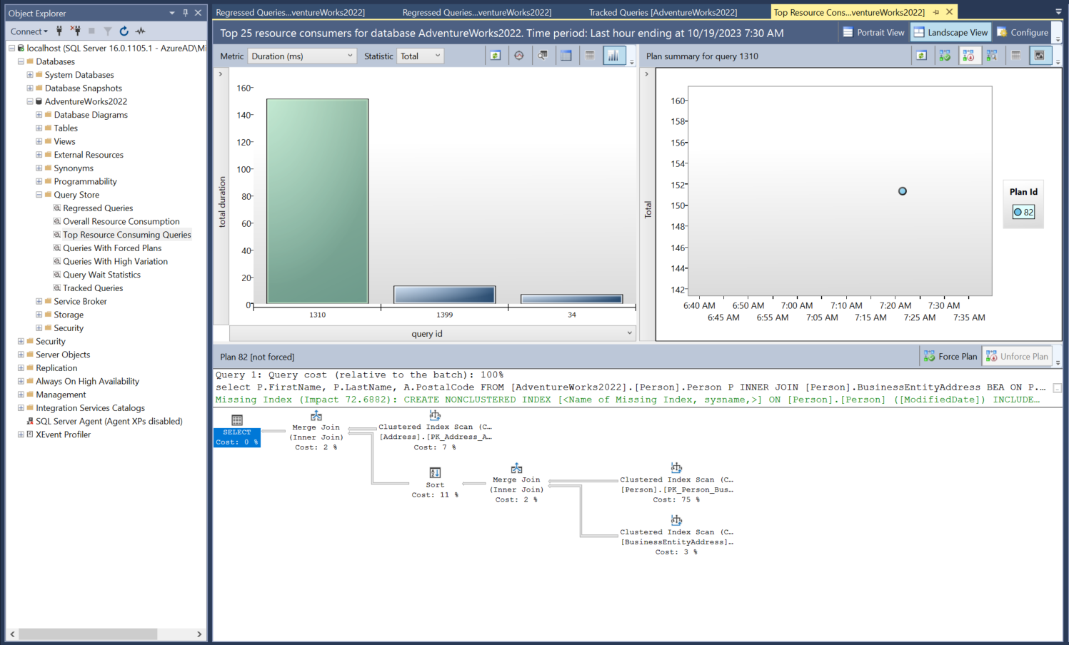
Query Store
Top 25 queries based on selected metric
Query plan history for selected query
Query Store is DB specific
Query plan based on selected query plan in query plan history

Slide 13
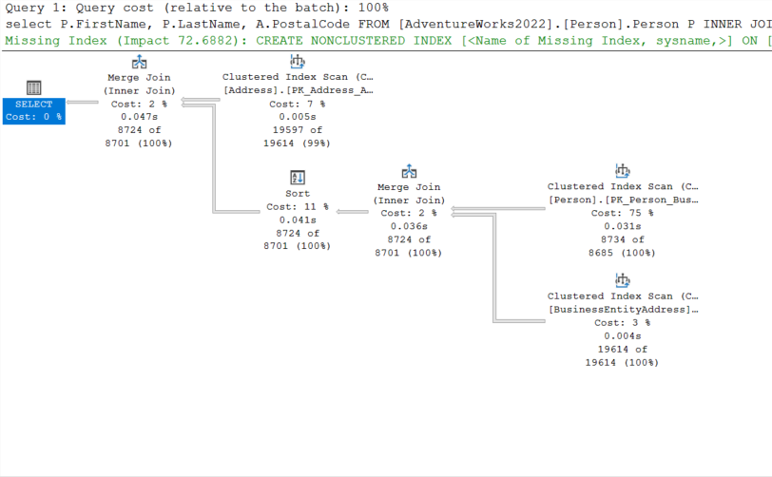
Query Plan
Actual vs. Estimated Query Plan
The plan is the same
Additional statistics of the execution included with actual
Missing Indexes
Not perfect but low hanging fruit
Cost %’s
Operators
Scans
Bookmark Lookups
Properties

Slide 14
Homework
Play around with this query
SET NOCOUNT ON
SET STATISTICS IO OFF
SET STATISTICS TIME OFF
DECLARE @ModifiedDate DATETIME = '2013-10-18'
select
P.FirstName,
P.LastName,
A.PostalCode
FROM [AdventureWorks2022].[Person].Person P
INNER JOIN [Person].BusinessEntityAddress BEA ON P.BusinessEntityID = BEA.BusinessEntityID
INNER JOIN [Person].Address A on BEA.AddressID = A.AddressID
WHERE P.ModifiedDate > @ModifiedDate
OPTION (RECOMPILE)

Slide 15
Homework
Change the @ModifiedDate to 2023-10-18
How did the query plan change?
Change the @ModifiedDate to 2003-10-18
How did the query plan change?
Remove the OPTION (RECOMPILE) and change the dates
Note the query plan doesn’t change
Turn ON STATISTICS IO & TIME and compare with or without the OPTION (RECOMPILE)

Slide 16
Homework
Add the recommended missing index
Add OPTION (RECOMPILE) back
Does the query change based on parameter values
Drop the index and re-add but this time remove the INCLUDE columns
Note the bookmark lookup
How does that impact performance

Slide 17

Pro Tips
Test your query and look at the execution plan. Look for obvious issues such as missing indexes, scans, bookmark lookups, etc.
Test your query for different use cases / different parameter values and test with OPTION(RECOMPILE) to see if the plan changes
Make conscious decisions about things like use of OPTION(RECOMPILE). In the case of option recompile - cost is SQL has to recompile the query every time, benefit is you may have a better execution plan.
Review your queries in production in Query Store to validate you haven’t missed anything

