Slide 1
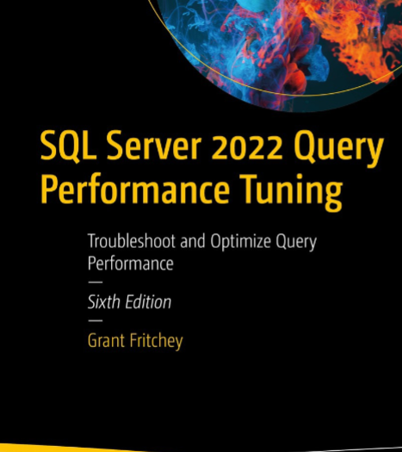
SQL Server Performance Study Group
Fundamentals – Session 1

Slide 2
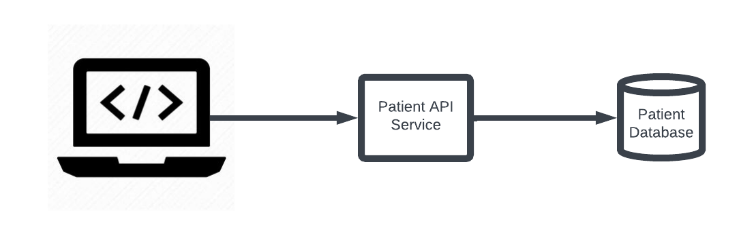
The Data Scaling Problem
Patient service example

Slide 3
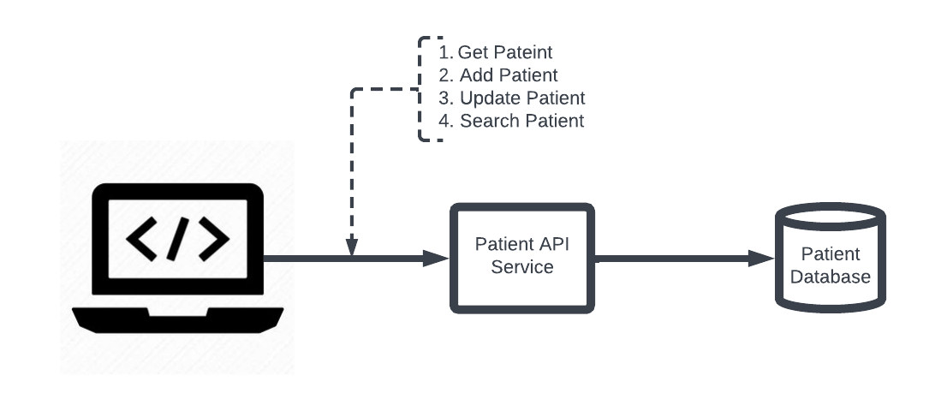
The Data Scaling Problem
Patient Service Example

Slide 4
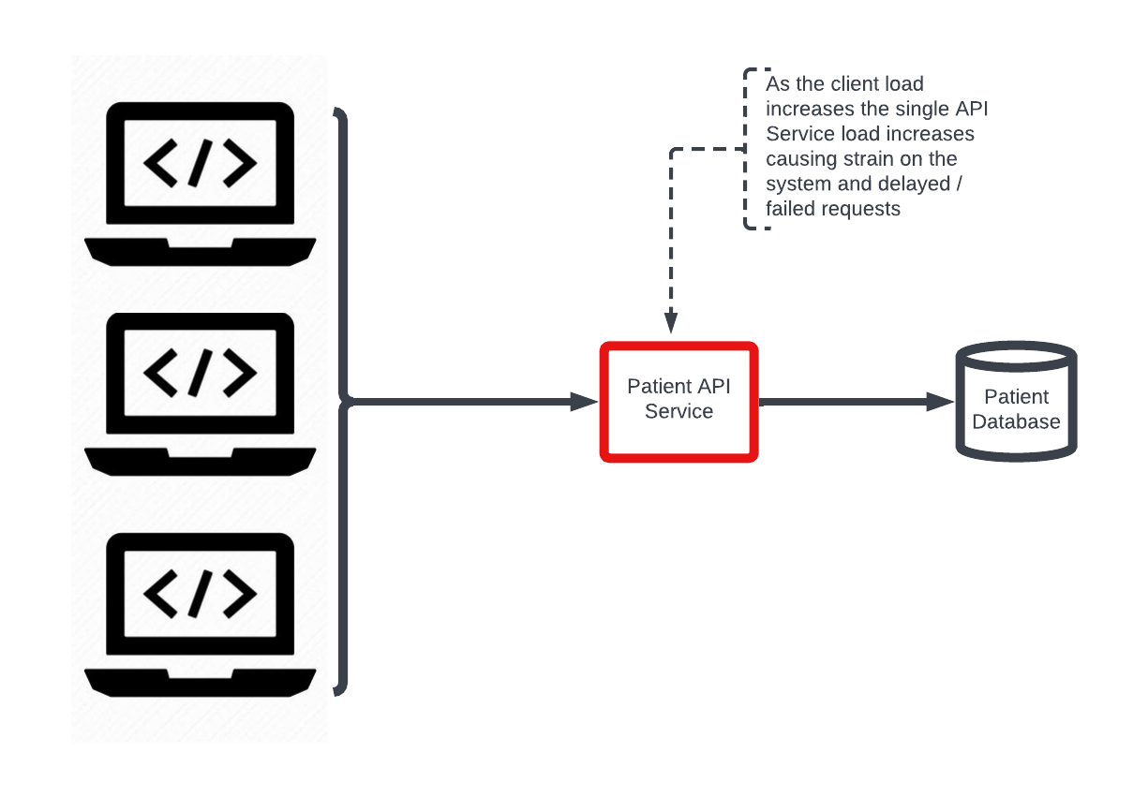
The Data Scaling Problem
Patient Service Example

Slide 5
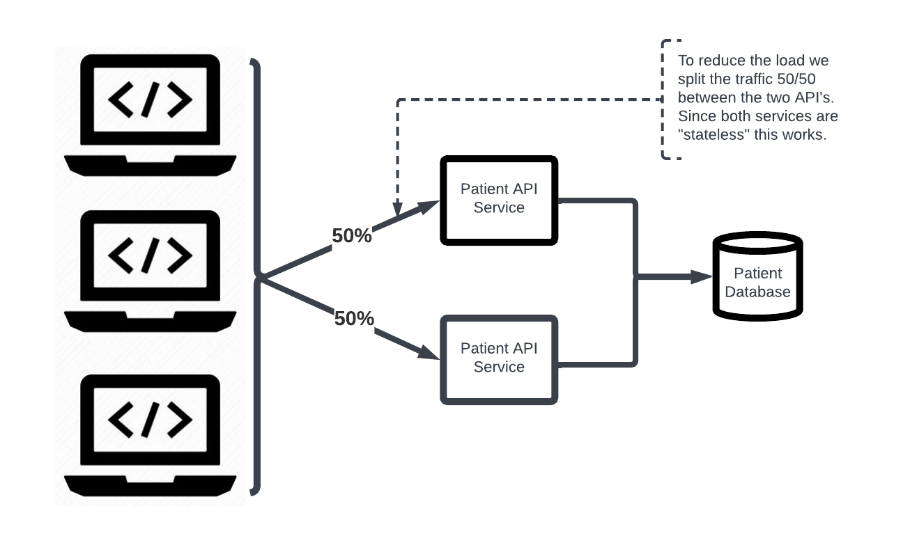
The Data Scaling Problem
Patient Service Example

Slide 6
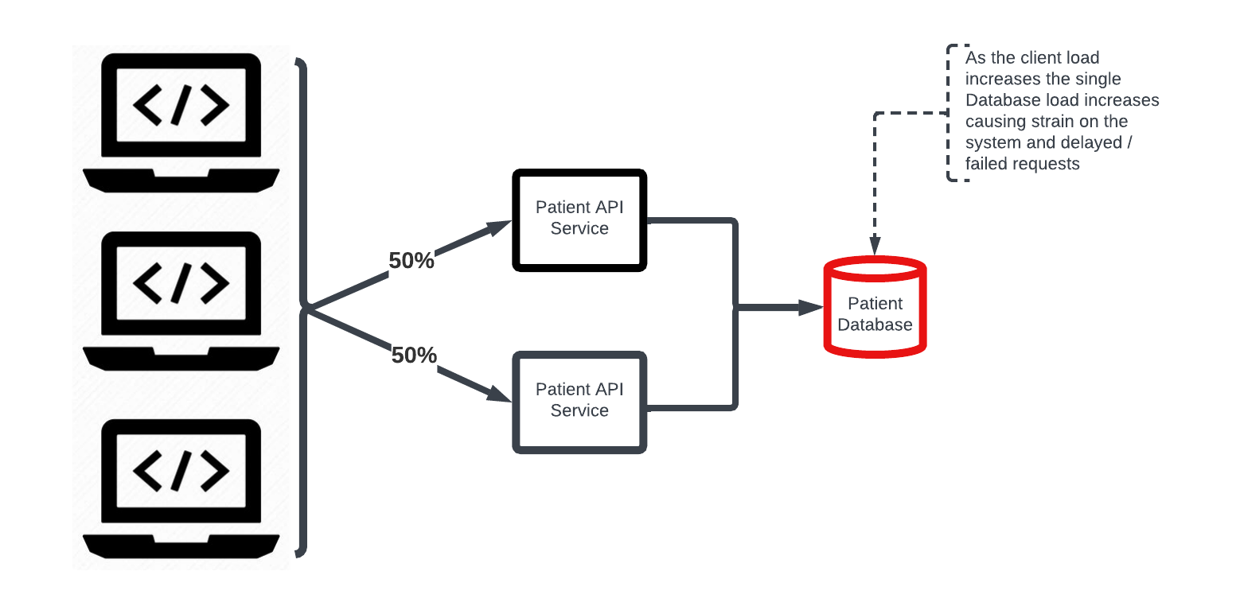
The Data Scaling Problem
Patient Service Example

Slide 7
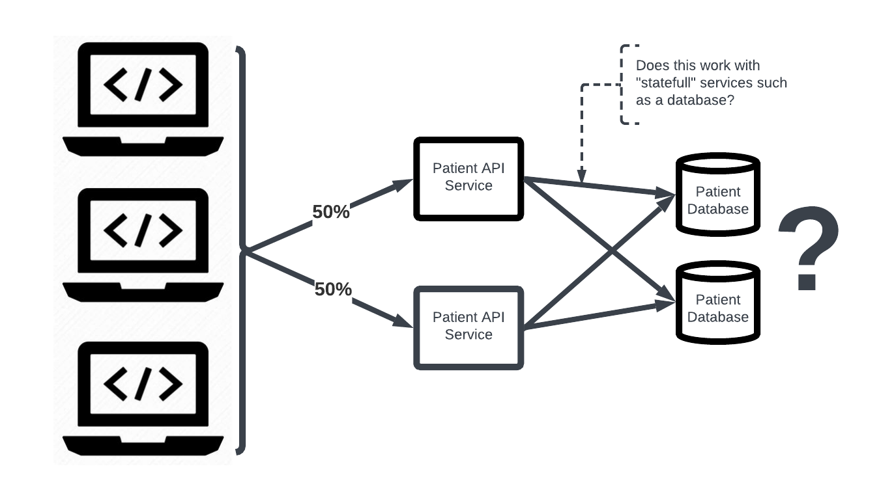
The Data Scaling Problem
Patient Service Example

Slide 8
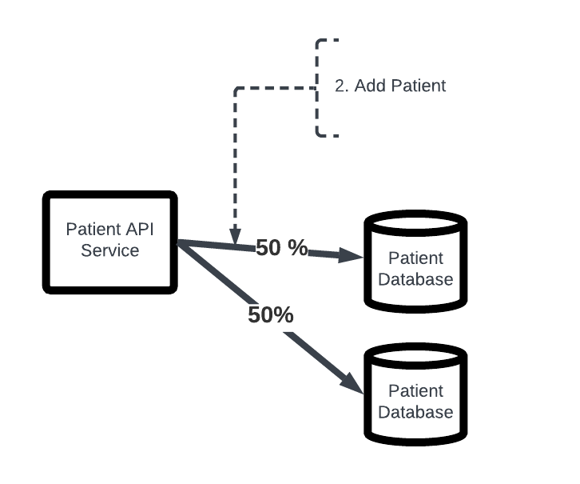
The Data Scaling Problem
Patient Service Example

Slide 9
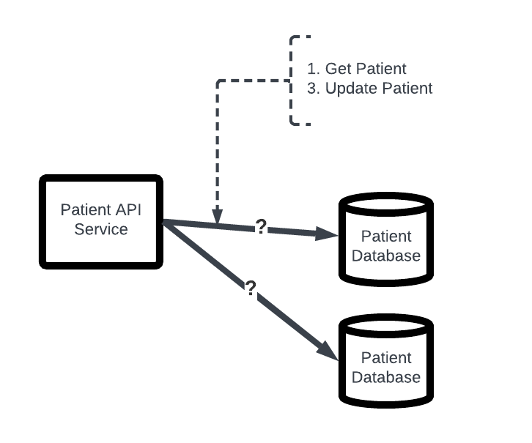
The Data Scaling Problem
Patient Service Example
We could send the request to both databases but that defeats the point of adding another database to reduce the load
We have to send the Get Patient or Update Patient request to where the Patient was originally added. This means we need to decide in advance what patients we send to which database. This is known as “partioning”.

Slide 10
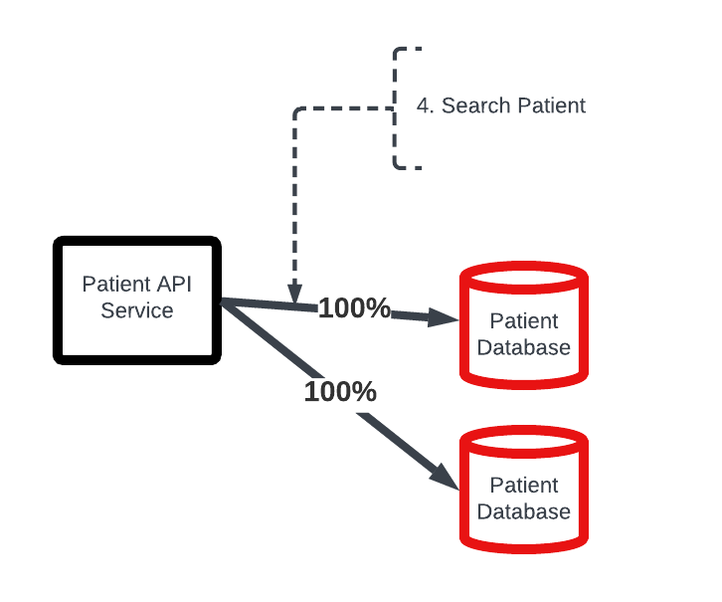
The Data Scaling Problem
Patient Service Example
For search we have to send the request to both databases but that defeats the point of adding another database to reduce the load
Partitioning failed us here

Slide 11
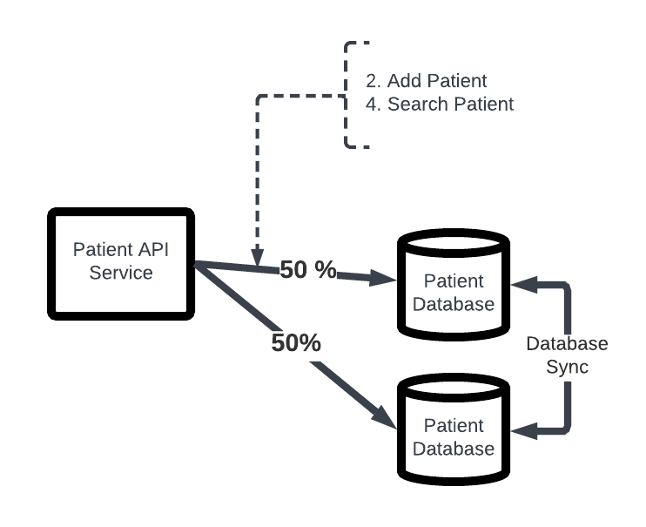
The Data Scaling Problem
Patient Service Example
Let’s just copy the data between the servers in some highly efficient fashion.

Slide 12
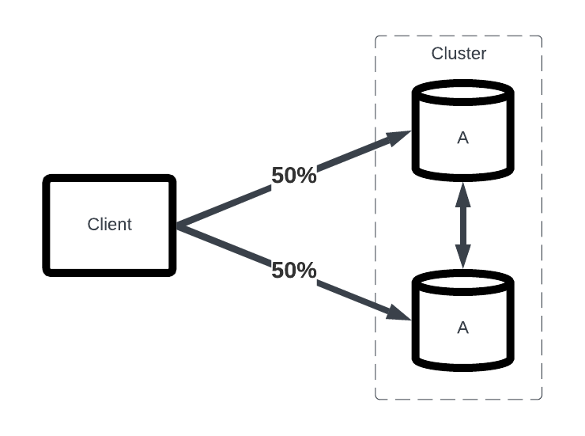
The Data Scaling Problem
Patient Service Example
Suppose we decide to solve the search problem by copying the data.
Assuming we copy all the data between the servers in the cluster, search will return the same “A” data no matter which server we send the request to and thus can split the traffic 50/50.

Slide 13
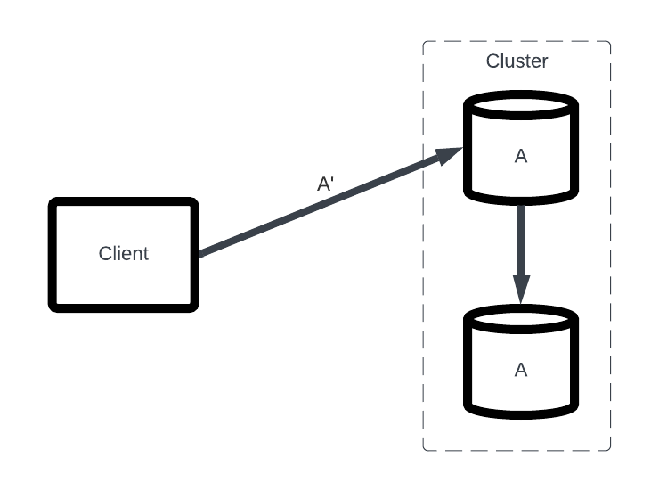
The Data Scaling Problem
Patient Service Example
Let’s say that an update is made and now the correct data is no longer A but A’

Slide 14
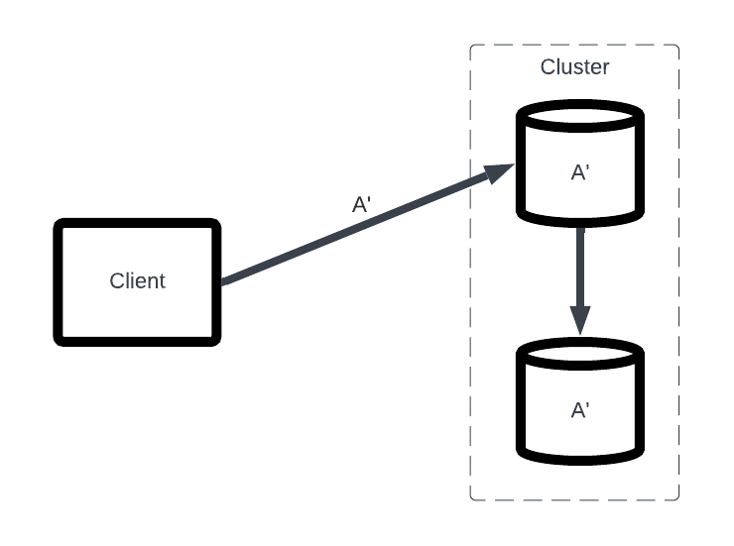
The Data Scaling Problem
Patient Service Example

Slide 15
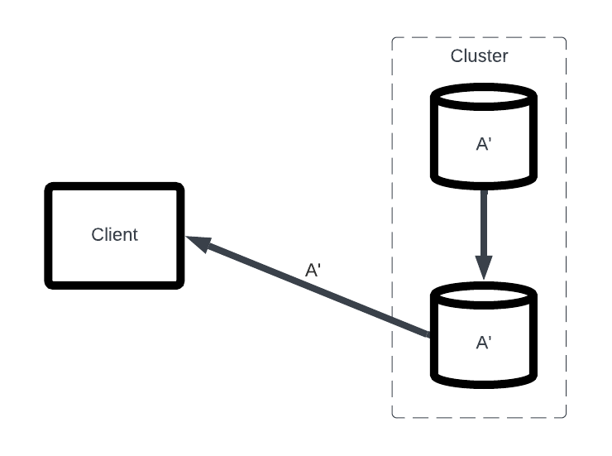
The Data Scaling Problem
Patient Service Example
Request to the other server in the cluster correctly returns A’

Slide 16
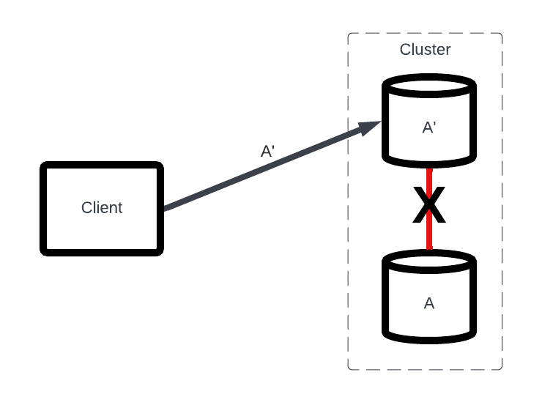
The Data Scaling Problem
Patient Service Example
What happens if the connection between the servers within the cluster is severed or is slow?
This is known as a “partition”

Slide 17
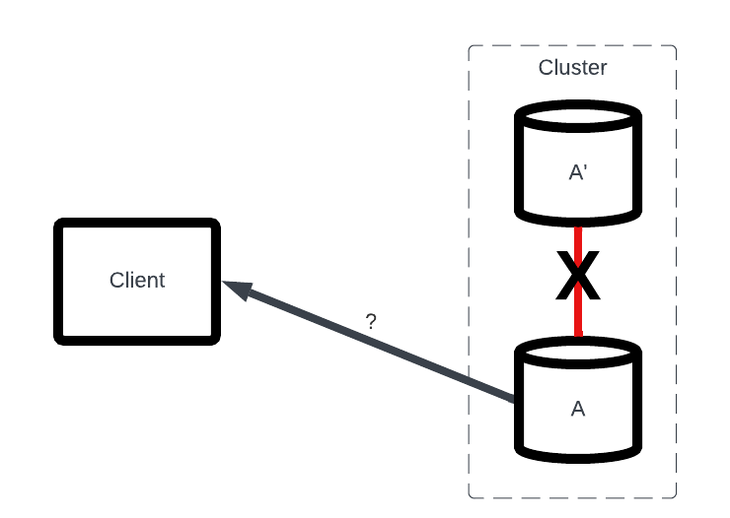
The Data Scaling Problem
Patient Service Example
What will be returned to the client?
We only have two options.
Return the old data A instead of A’. In this case we choose to keep the service “available”.
Fail the request because we don’t have the latest data. In this case we choose to only serve data if the data is “consistent”.

Slide 18
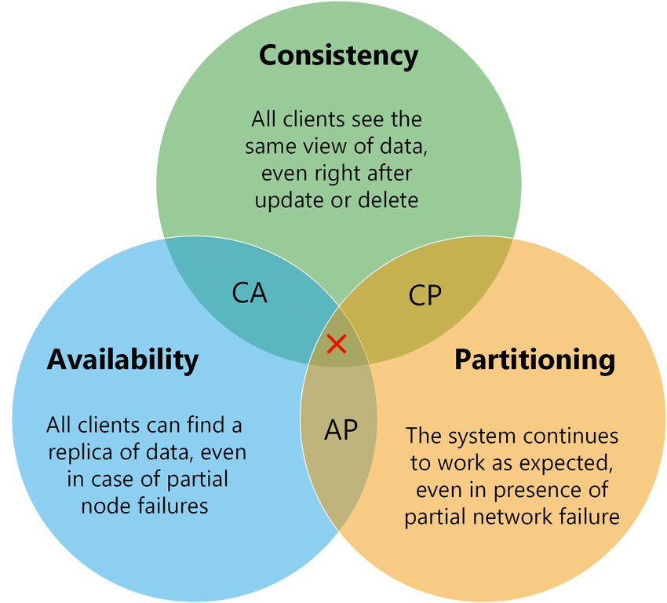
CAP Theorem
“Distributed databases can have at most two of the three properties: consistency, availability, and partition tolerance. As a result, database systems prioritize only two properties at a time.”
Eric Brewer first hypothesized CAP theorem in late 1998
Seth Gilbert and Nancy Lynch completed the mathematical proof in 2002
Partition tolerance is a false choice since networks fail so really the choice is between CP and CA.

Slide 19
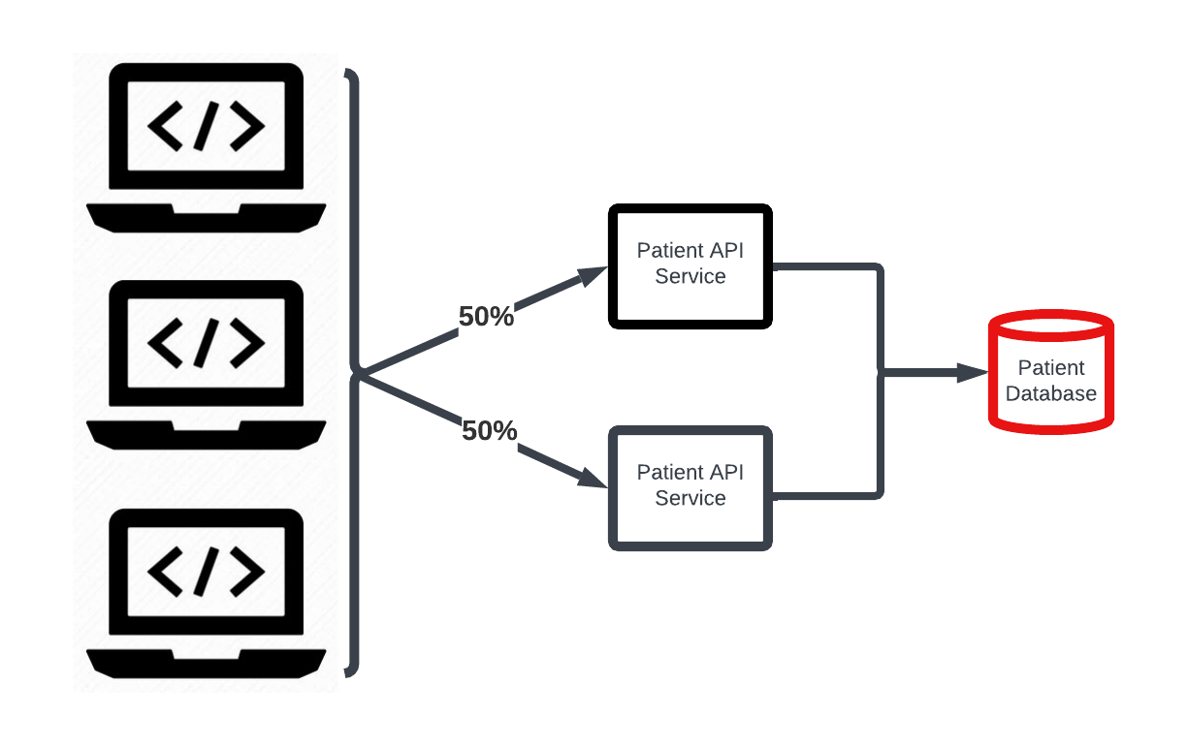
The Data Scaling Problem
So in attempting to solve the problem of our overloaded patient database we have run smack into several challenges.
We can partition data…but that doesn’t solve cross partition needs (i.e. Search Patient).
If we copy data to attempt to scale, we must choose between availability or consistency. We can’t have both.

Slide 20

RDBMS
RDBMS – Relational Database Management Systems
Term first defined in 1970
Mid 1970’s first relational database
1979 Oracle was first released
In the 1980’s relational database became incredibly popular
RDBMS became popular before we fully appreciated or needed to had the challenges of scaling data

Slide 21
RDBMS
Traditional RDBMS are centered around a set of behaviors known as ACID which govern how data is maintained.
Atomic – All or nothing…no partial updates
Consistent – The database must always be consistent (i.e. Primary & Foreign Keys, Schema, etc.)
Isolated – multiple transactions can occur independently without interference (i.e. thread safe)
Durability – Data from a successful transaction are not lost if a system fails

Slide 22
The Data Scaling Problem
So how do RDBMS scale and provide the ACID guarantees that are central to their design?
How do we solve our data scaling problem with an RDBMS?

Slide 23
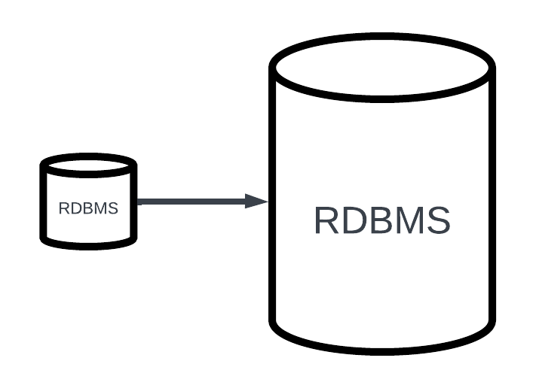
The Data Scaling Problem
We fundamentally can’t scale…we just “scale up” or buy a faster / bigger machine.
Scaling up quickly runs into physical limits and faces the law of diminishing returns
Memory
CPU
I/O
RDBMS were not designed to scale. They were designed to satisfy ACID.

Slide 24
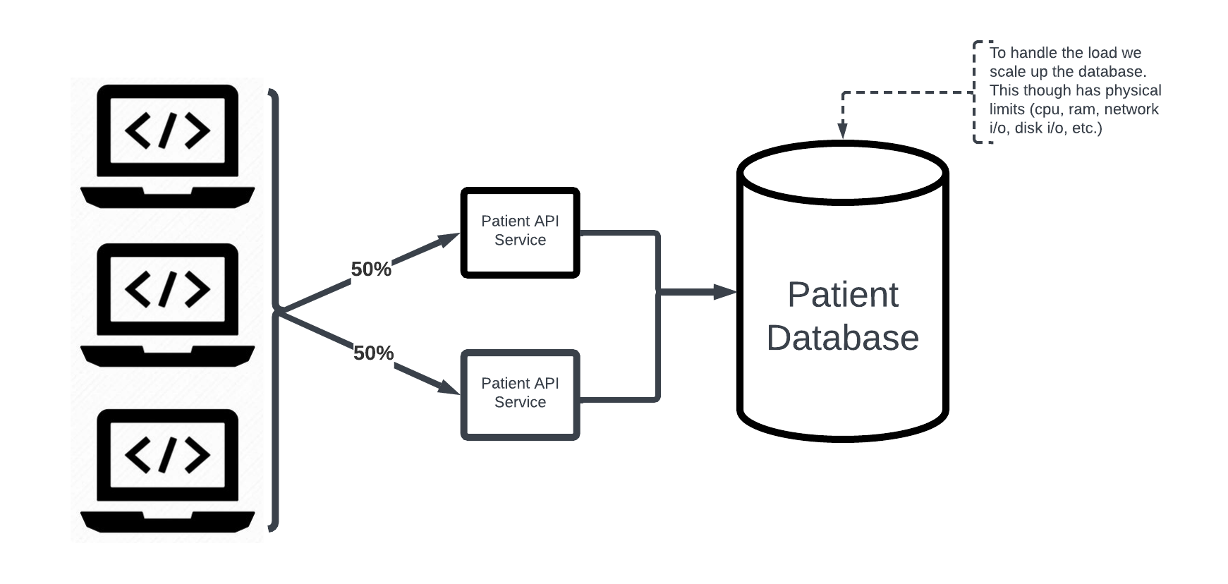
RDBMS Data Scaling Solution

Slide 25
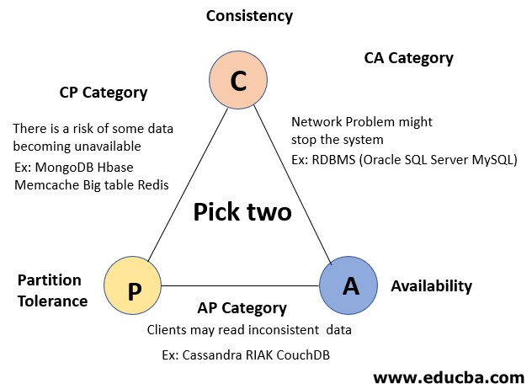
CAP Theorem
RDBMS address CAP theorem by avoiding the distributed systems problem all together. If you have only one logical server, CAP theorem doesn’t apply. CAP theorem only applies to distributed systems (copies of data).
Other data technologies can provide strategies for scaling through distributed systems but they do so by sacrificing consistency and embrace eventual consistency.

Slide 26

RDBMS today
RDBMS in an attempt to stay competitive in the modern data world have been providing ways to relax ACID and embrace eventual consistency (the AP choice from CAP theorem).
i.e. Memory Optimize Tables in SQL Server
Fundamentally though, RDBMS are rooted in designs and approaches that are not designed to scale

Slide 27
So Why Is All This Imporant
We know that fundamentally SQL doesn’t scale.
We also know that we are heavily dependent upon SQL server today.
We must be extremely disciplined in how we use SQL so that we minimize the consumption of this finite resource.
We need to understand SQL at a deep level so that we can use it effectively.

Slide 28
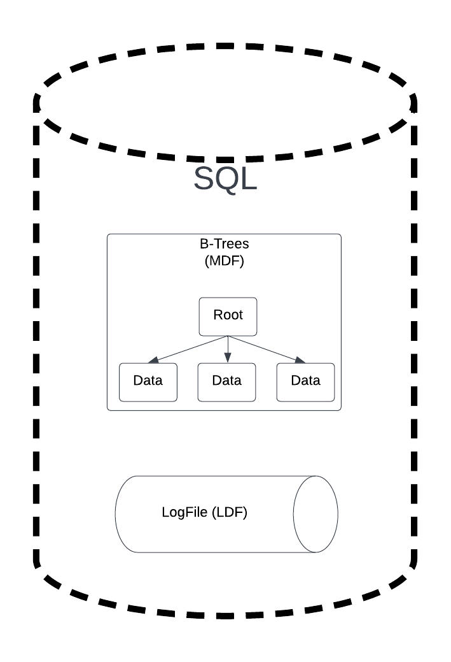
SQL Under the Hood?
From a durability guarantee perspective (ACID) SQL server has two fundamental parts.
LDF – Log data file where each transaction is written to an append only log
MDF – Where the data is persisted to disk use a B-Tree structure

Slide 29
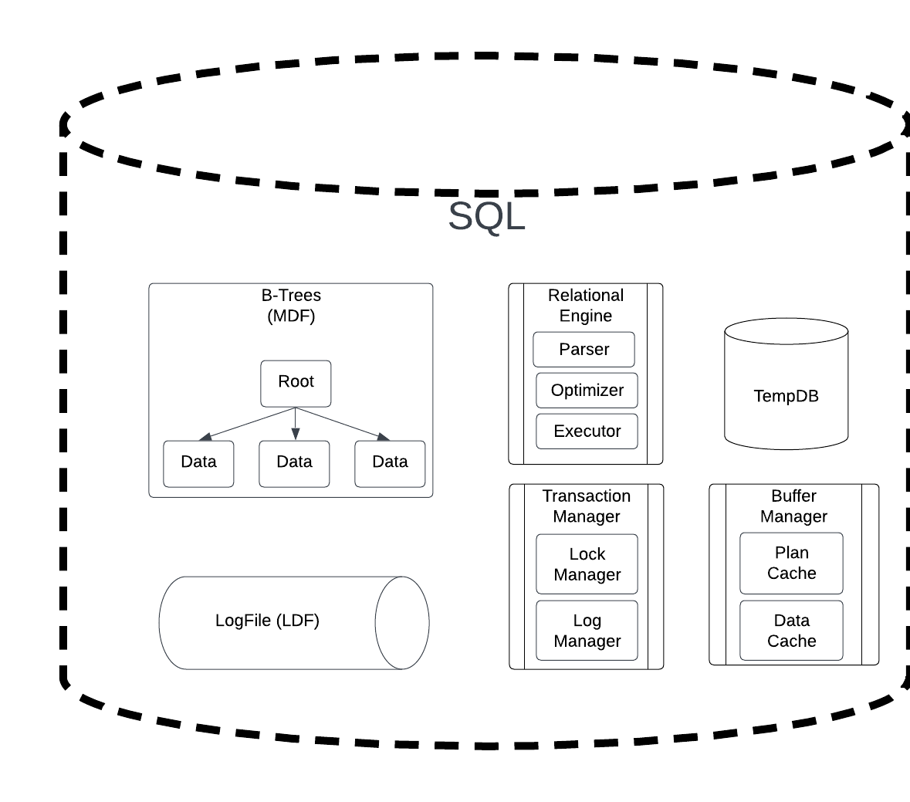
SQL Under the Hood?
SQL Server also has other parts to a running instance
Relational engine - parser, optimizer, and executor. These are the key components that turn SQL syntax into executing queries
Transaction Manager – this is what gives us the full ACID guarantee. Note the use of a lock manager. SQL intentionally locks itself to enforce ACID guarantees on transactions.
TempDB & Buffer Manager are all about saving IO and compute by caching things.

Slide 30

SQL Server - Conservation
SQL Server must be thought of as a finite resource. Here are the key finite resources we want to minimize / optimize:
CPU – anything that requires computation, compilation, transformation, etc. is going to take CPU cycles. We want to minimize CPU cycles.
Memory – SQL server will use all available memory it can get it’s hands on. The trick to minimizing memory consumption is to ensure our data is compact as possible and that we have enough memory.
IO – Any time we need to go to disk to get data or send data over the network we are consuming limited IO resources. We need to ensure we are only moving and consuming the minimal amount of data.
Locks – SQL server locks data during transactions to ensure ACID guarantee. Locks prevent other transactions from modifying data while the transaction is occurring. We need to ensure we minimize the duration and scope of locks.

Slide 31
SQL Server - Conservation
Storage – storage today isn’t really a limiting factor. Storage is cheap and abundant and can be managed off server. This wasn’t true in the past and actually helped accelerate the RDBMS 3NF movement of the 1980’s and early 90’s
Current maximum is 256TB per database

Slide 32
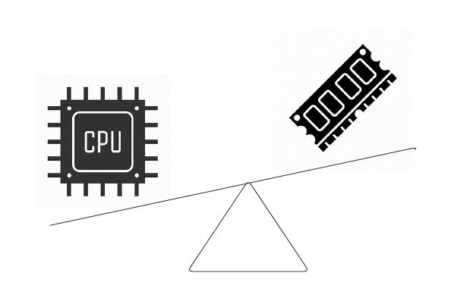
Tradeoffs
Some choices we make come with trade-offs.
Examples:
Using GUIDs can help minimize locking and simplify queries reducing overall CPU / IO while consuming slightly more disk and slightly more memory
Having SQL server summarize data may increase CPU but reduce IO by limiting the data returned
Adding an index to reduce IO and CPU will also increase storage, locking, and memory pressure (although minimally in most cases)
Some choices we make are just pure wins.
Examples:
Using correct data types such as VARCHAR instead of NVARCHAR can reduce storage and memory pressure by 50% for impacted fields.
Moving transformation logic from queries (LTRIM, RTRIM, UPPER, LOWER, SUBSTRING, etc.) to the service layer
Simplifying SQL statements so the optimizer can generate more efficient queries and thus we reduce CPU and IO

Slide 33
Homework
Get access to “Query Store” on your production SQL Server. If it is not enabled, submit a request to get it enabled and get access. This is a key investigative tool we need to understand what is going on with our SQL server.
Recommended metrics to explore
Top 25 queries for Duration
Top 25 queries for CPU
Top 25 queries for Wait
Identify your top query for Duration, CPU, and Wait for a given timeframe
Bonus: Identify a missing index

Slide 34
Homework
See a slow query caused by CPU exhaustion
Enable Query Store
Execute the following against AdventureWorks2022 DB
SELECT STDEV(SOD.LineTotal)
FROM [AdventureWorks2022].[Sales].[SalesOrderDetail] SOD,
[AdventureWorks2022].[Sales].[SalesOrderDetail] SOD2,
[AdventureWorks2022].[Person].[Person] P
Where P.BusinessEntityID between 1 and 1

Slide 35
Homework
See a slow query caused by Locking / Blocking
Execute the following against AdventureWorks2022 DB using two separate query windows. Execute them in the following order.
Query Window 1
BEGIN TRANSACTION
UPDATE [Person].[EmailAddress]
SET [EmailAddress] = 'myemailaddress@emailprovider.com'
WHERE
BusinessEntityID = 1
-- simulating some server side code taking a while before it commits the transaction
WAITFOR DELAY '00:00:30'
COMMIT TRANSACTION
Query Window 2
SELECT EmailAddress
FROM Person.EmailAddress EA
WHERE
EA.BusinessEntityID = 1

