Slide 1
COMP 3006 – Software Engineering
Stock Monitoring System
404 NOT FOUND
12210102 MAK KIT TIN
15208249 LEUNG KAI HIN
13205633 CHAN WING SUN
13207296 YEUNG MAN KIT
Notes:
This template can be used as a starter file for a photo album.

Slide 2
Stock monitoring system
Introduction

Slide 3
What is Stock Monitoring System
Background Removal allows you to quickly and easily remove backgrounds to isolate items in your image.

Slide 4
Why do we need to develop this system
Monitoring multi stocks concurrently

Slide 5
Difficulties of the system
Monitoring multi stocks concurrently

Slide 6
How to overcome the difficulties
Monitoring multi stocks concurrently

Slide 7
Functions of the Program
User Management System
Register
Login*
Logout*
Setting
News Display System
Display news related to HK stock market*
Stock Searching Engine
Search stock real-time information*

Slide 8
Functions of the Program
Stock Monitoring System
Stock price tracking*
Notification System
Notification for custom stock conditions.
Administration System
Modify user information
Member authorization
System statistics

Slide 9
Stock monitoring system
System Overview

Slide 10
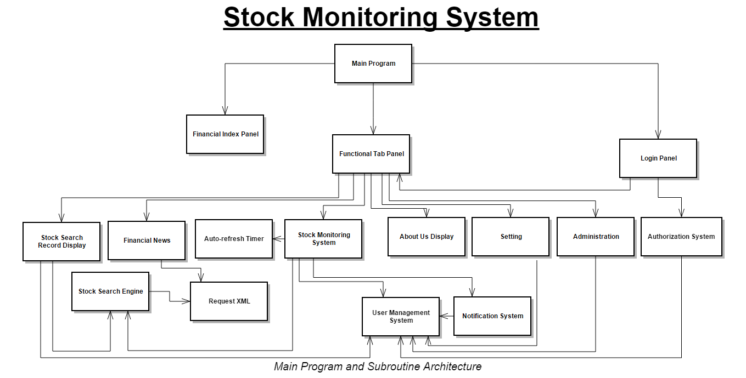
Notes:
System Design

Slide 11
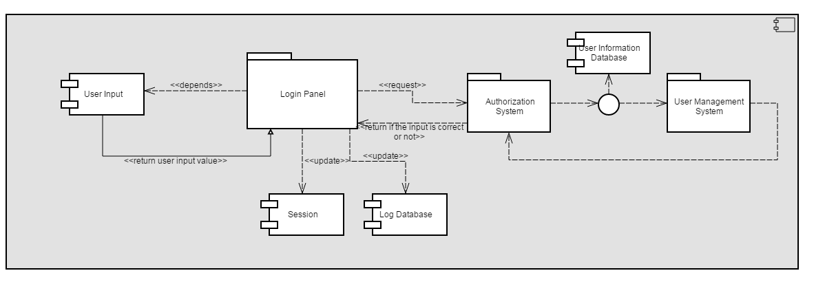
Notes:
Login Process – Component Design

Slide 12
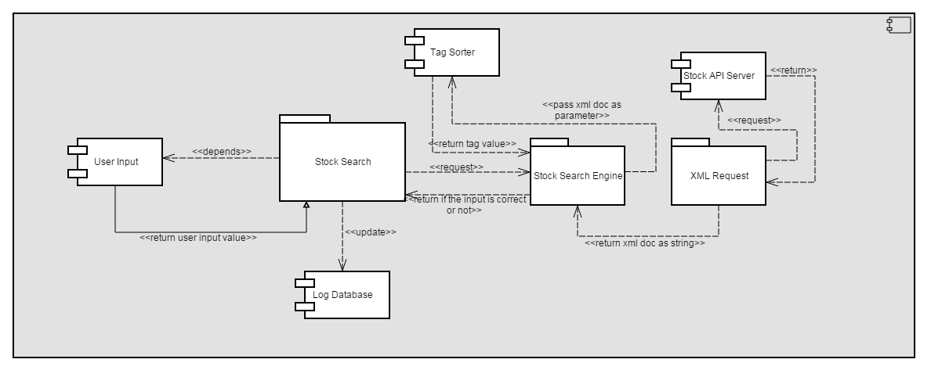
Notes:
Stock Search Engine– Component Design

Slide 13
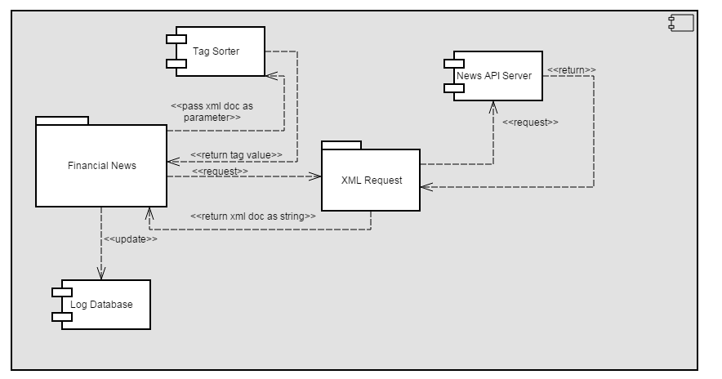
Notes:
Financial News– Component Design

Slide 14
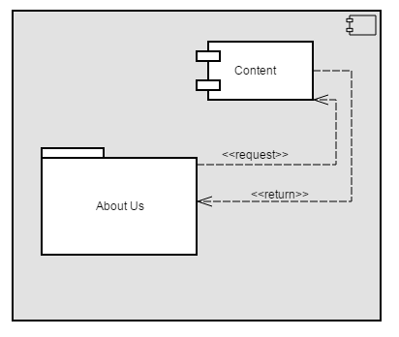
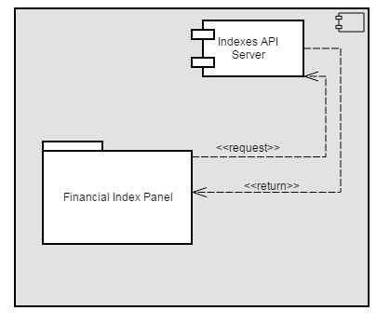
Notes:
About Us & Indexes– Component Design

Slide 15
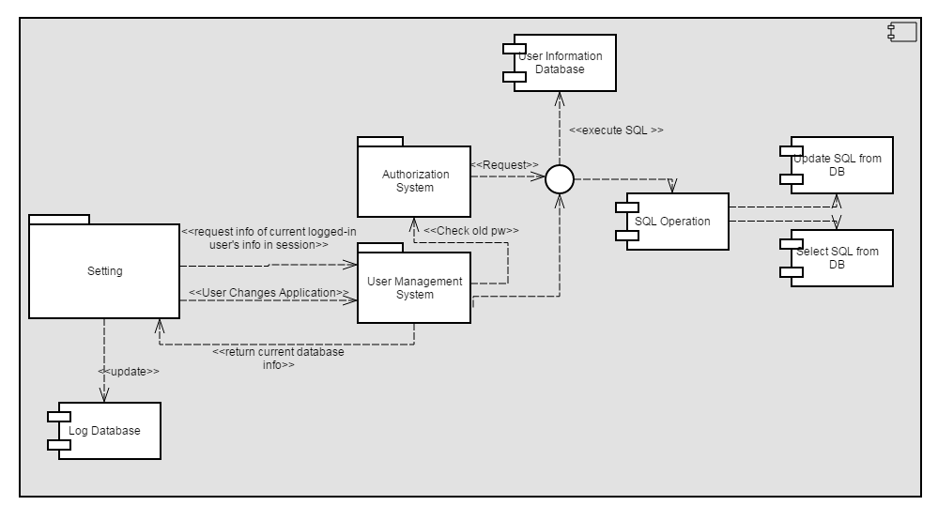
Notes:
Setting– Component Design

Slide 16
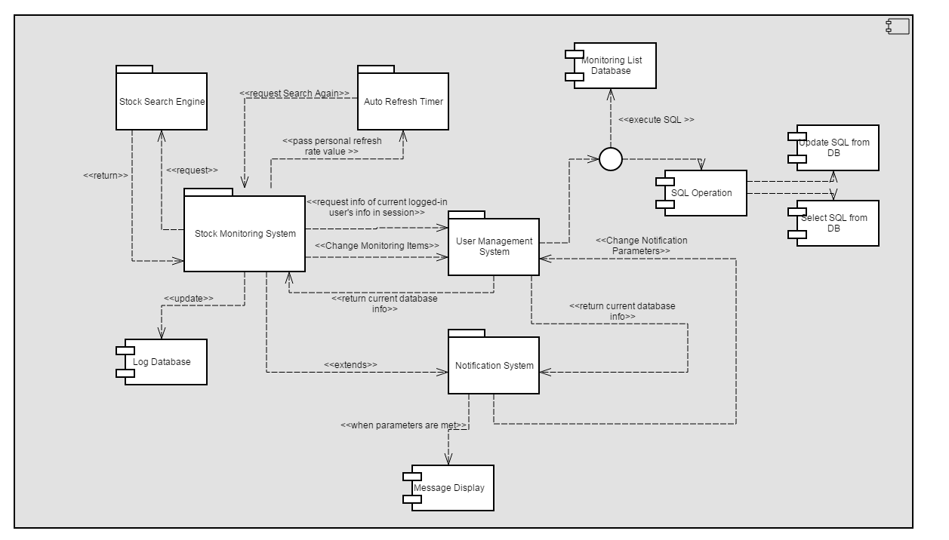
Notes:
Monitoring System + Notification– Component Design

Slide 17
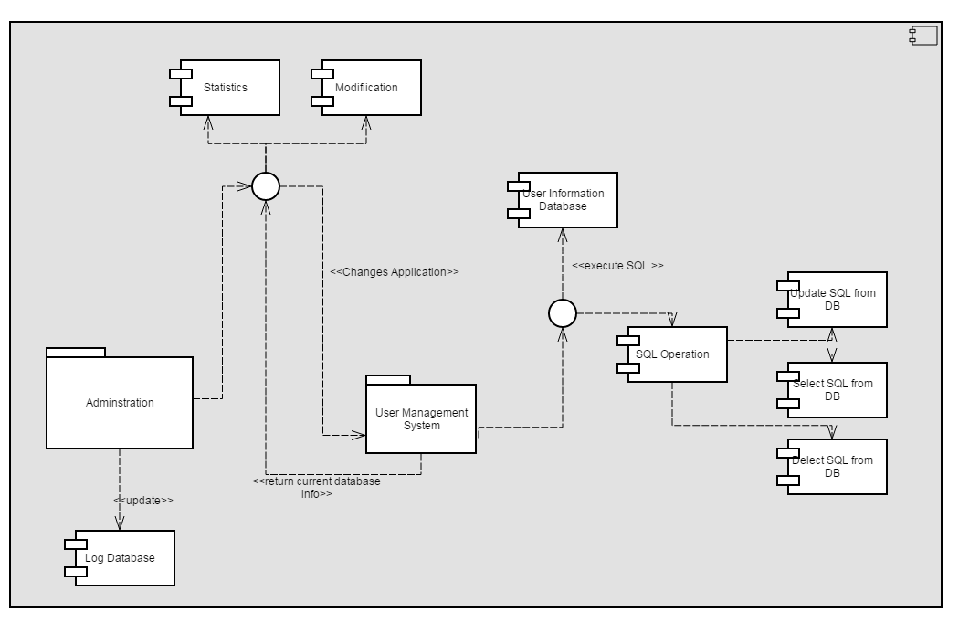
Notes:
Adminstration– Component Design

Slide 18
Notes:
UI – MemberMangagementSystem_Login

Slide 19
Notes:
UI - MemberMangagementSystem_Register

Slide 20
Notes:
UI - MemberMangagementSystem_Logout

Slide 21
Notes:
UI - MemberMangagementSystem_Setting

Slide 22
Notes:
UI - NewsDisplay

Slide 23
Notes:
UI - StockSearchEngine

Slide 24
Notes:
UI - StockMonitoring

Slide 25
Notes:
UI - NotificationSystem

Slide 26
Notes:
UI - ModifiyUserInfo

Slide 27
Notes:
UI - Member authorization

Slide 28
Notes:
UI - System statistics

Slide 29
Stock monitoring system
Demonstration

Slide 30
Stock monitoring system
Future Development

Slide 31
Future development
GUI enhancement
Multi-processing/threading enhancement
Complete Functions Development
Multi-language platforms
System Security
Multi-Platform Compatible
Object Oriented Programming Enhancement

Slide 32

Q&A TIME

Slide 33
Thank You !

