Slide 1
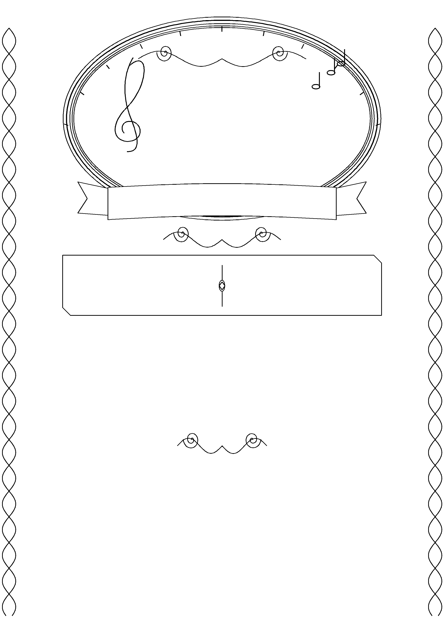
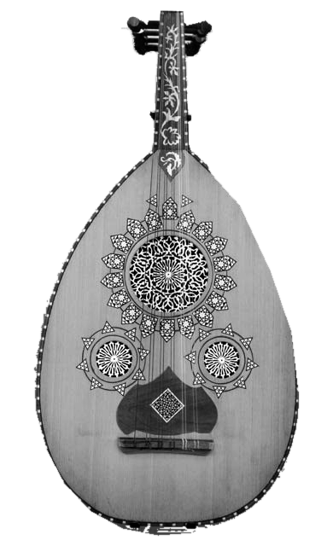

בס״ד
שירת
הבקשות
5
שנה
בשעה
ליל שבת • פרשת
20:30
שם הפרשה
בית הכנסת
אוצרות חיים
רבי יהודה הנשיא 20, פתח תקווה
דברי תורה
שם הרב
עם פייטנים וחזנים
כיבוד קל
וואטסאפ לעדכונים
לעילוי נשמת מנחם יעקב בן מונירה ז״ל • ארי ציון בן שמחה ז״ל
Notes:
Weekly browser template: only שם הפרשה and שם הרב are editable. All other content is a protected background group. For other changes, use the separate Full-Editable presentation or background source code.
Full editing browser copy: replace שם הפרשה and שם הרב. All event text is editable, including the time, venue, address, year, footer, and QR caption. The oud and QR are separate movable, resizable, replaceable pictures. The decorative background remains fixed to prevent accidental moves; update it using the separate background code. Display text uses FrankRuehl and supporting text uses Arial, both Microsoft cloud fonts.
Photograph: Oud - MIM PHX
Photographer: Frank Kovalchek
Source: https://commons.wikimedia.org/wiki/File:Oud_-_MIM_PHX.jpg
Original source: https://www.flickr.com/photos/72213316@N00/14351824475/
License: Creative Commons Attribution 2.0
License URL: https://creativecommons.org/licenses/by/2.0/
Changes: background removed, cropped, resized, and optionally converted to
grayscale. The photograph is used as a separately attributed visual element.
The photograph's license does not imply endorsement by the photographer.
Attribution is included in the editable presentation's notes and HTML editor,
outside the poster artwork. When sharing a standalone image or PDF, include
the following credit in its accompanying message or caption:
"Oud - MIM PHX" photograph by Frank Kovalchek, CC BY 2.0.
https://commons.wikimedia.org/wiki/File:Oud_-_MIM_PHX.jpg
https://creativecommons.org/licenses/by/2.0/
Modified: background removed, resized, and grayscale for print.

