Slide 1
bugfree-adventure
Jonathan Burge
Hannah Gamiel
Tommy Glasser
Michael Lindahl

Slide 2

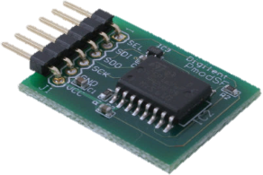
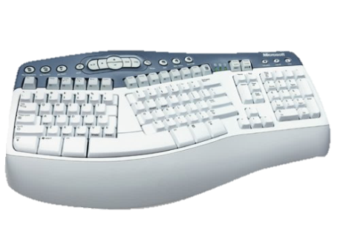
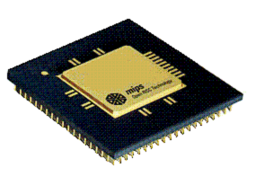
System Overview
Calculate and Display a Fibonacci number based off user input.
Character Gen

Slide 3
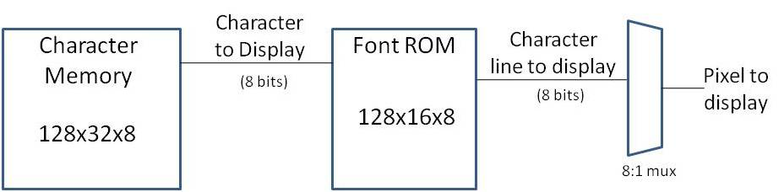
Character Generator
-- column <= x / 8;
column <= "000" & xsignal(11 downto 3);
-- row <= y / 16
row <= "0000" & ysignal(11 downto 4);
-- char_read_addr <= row * 128 + column
char_read_addr <= (row(4 downto 0) & "0000000") + column;

Slide 4
Font ROM
"00000000", -- 0 "00000000", -- 1 "00010000", -- 2 * "00111000", -- 3 *** "01101100", -- 4 ** ** "11000110", -- 5 ** ** "11000110", -- 6 ** ** "11111110", -- 7 ******* "11000110", -- 8 ** ** "11000110", -- 9 ** ** "11000110", -- a ** ** "11000110", -- b ** ** "00000000", -- c "00000000", -- d "00000000", -- e "00000000", -- f

Slide 5
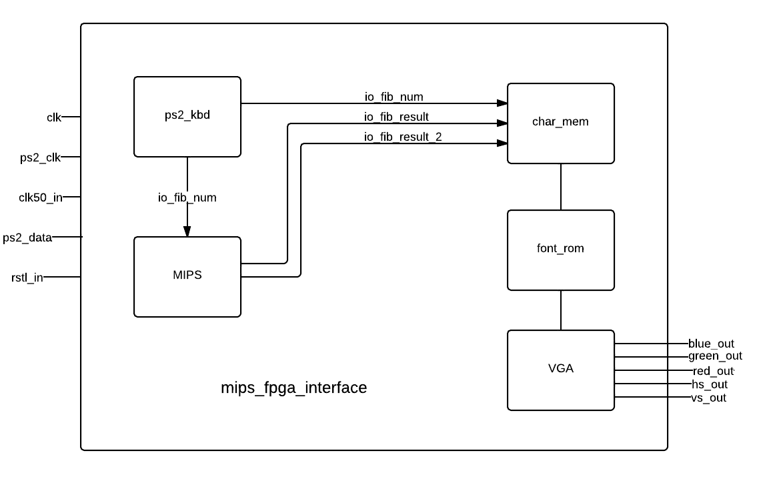
Top Level Diagram

Slide 6
Road-blocks
Two digit I/O
Human beating MIPS
Jenky display
Connecting char_mem (SDRAM)
Connecting MIPS

Slide 7
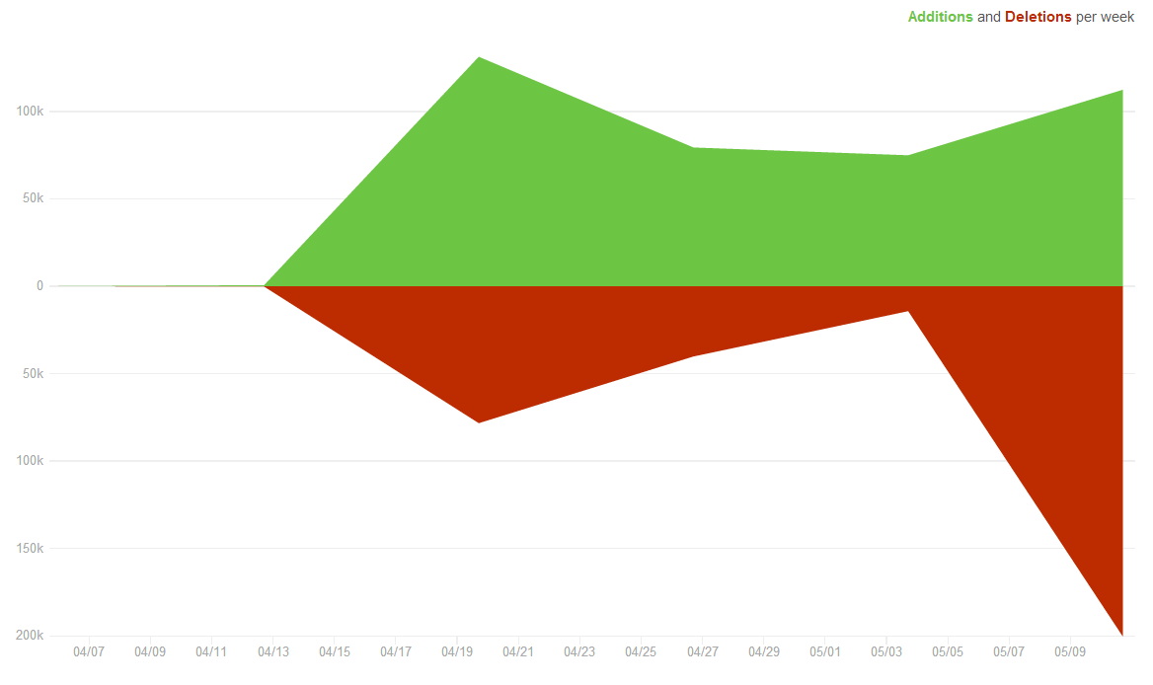
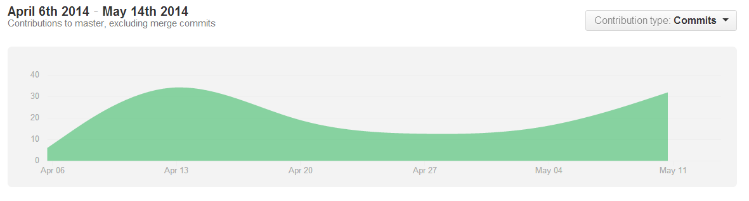
Time Spent
~ 30 hours

Slide 8
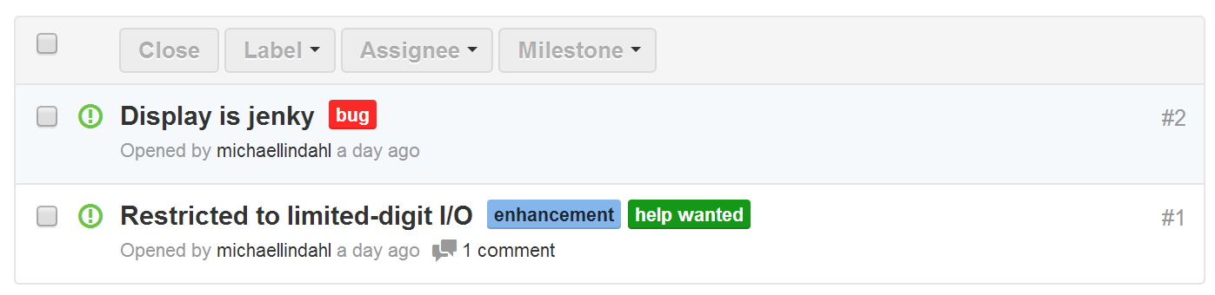
Stretch Goals

