Slide 1
PRACTICUM IN LLM EVALUATION • FINAL PRESENTATION
Medical LLM Robustness
to Noisy User Inputs
Does prompt repair restore accuracy when real users ask messy medical questions?
Group 2
Dataset: MedQuAD • Models: 10 • Pilot: 50 questions
Group 2

Slide 2
01 • PROBLEM & MOTIVATION
Real users do not ask clean questions.
The gap between benchmark inputs and real-world inputs.
RESEARCH QUESTIONS
Medical QA models are evaluated on clean, well-formed questions, but real patients type messy ones — typos, slang, vague symptoms, missing context.
When the input degrades, does the answer degrade too? And can a lightweight prompt-repair step recover what was lost?
RQ1
How do different noise types affect LLM performance on medical QA?
RQ2
Does a prompt-repair step recover that lost performance; and for which kinds of noise?
Why it matters
In healthcare, a wrong or hallucinated answer to a vague question is not a UX bug — it is a safety problem. Robustness under noisy input is a safety requirement, not a nice-to-have.
Pipeline: Clean Q → Add Noise → Repair → Model Answer → Evaluate
MedQuAD Robustness • Group 2 • Practicum LLM Evaluation
2 / 12

Slide 3
02 • APPROACH
Three pipelines, five noise types, one controlled comparison.
Clean Q
›
Add Noise
›
Repair
›
Answer
›
Evaluate
MedQuAD source
5 noise types
GPT-5.4 rewrite
Model under test
BERTScore, G-Eval
DATA & EXPERIMENTAL SETUP
FIVE NOISE TYPES
Dataset: MedQuAD — curated medical Q&A from NIH/NLM sources
Pilot size: 50 questions × 10 models (full target: 1,000)
Models tested: GPT family, LLaMA, Qwen, Gemma, and others (10 total)
Generators: GPT-5.4 (repair) · GPT-5.4-mini (noise + judge)
Modes: end_to_end · fixed_repair · self_repair
Metrics: BLEU, chrF, ROUGE-L, token F1, BERTScore, G-Eval
Typos / grammar
spelling, spacing, casing slips
Layperson
swap technical terms for patient phrasing
Ambiguity
blur a key medical detail
Incomplete
drop condition, body part, or timeframe
Overgeneralization
broaden a specific question
MedQuAD Robustness • Group 2 • Practicum LLM Evaluation
3 / 12

Slide 4
03 • OUTPUTS
What the noise & repair actually look like.
Example 1
CLEAN
NOISY
REPAIRED
Do you have information about A1C?
I need some info 'bout my glucose levels test, is it called AIC?
Is the glucose level test you're referring to known as Hemoglobin A1c (HbA1c)?
Example 2
CLEAN
NOISY
REPAIRED
What is (are) Abdominal Pain?
Whats da abdominel pane? Its somethin that hurts in der belly area, na?
What is abdominal pain? It refers to discomfort located in the stomach/belly region.
MedQuAD Robustness • Group 2 • Practicum LLM Evaluation
4 / 12

Slide 5
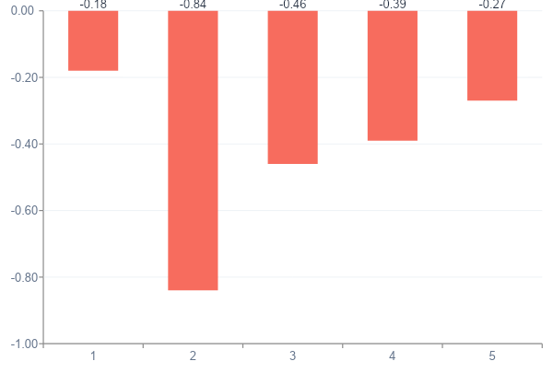
04 • KEY RESULTS
Noise hurts — but not all noise hurts equally.
Degradation by noise type
G-Eval drop from clean → noisy (lower bar = larger drop in answer quality, averaged across the 10 models in the pilot).
−0.84
Average G-Eval drop on layperson noise — the worst offender, even after repair.
+0.10
G-Eval recovery from repair on typo / grammar noise — surface fixes work.
Illustrative pilot averages (n=50, 10 models). Negative = quality dropped under noise.
MedQuAD Robustness • Group 2 • Practicum LLM Evaluation
5 / 12

Slide 6
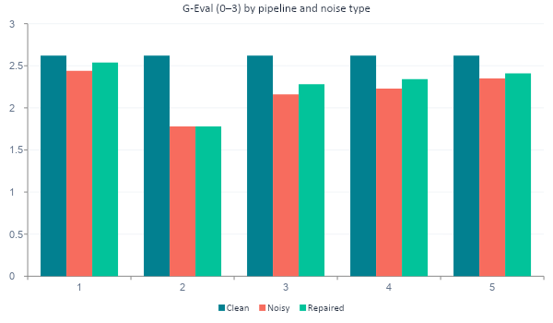
04 • KEY RESULTS
Repair only meaningfully recovers surface-level noise.
WHAT THIS SAYS
Typos & grammar
Repair almost fully recovers performance.
Layperson
Repair gives ~zero recovery — the meaning gap survives the rewrite.
Ambiguity / incomplete
Partial recovery — depends on whether the missing detail can be inferred.
MedQuAD Robustness • Group 2 • Practicum LLM Evaluation
6 / 12

Slide 7
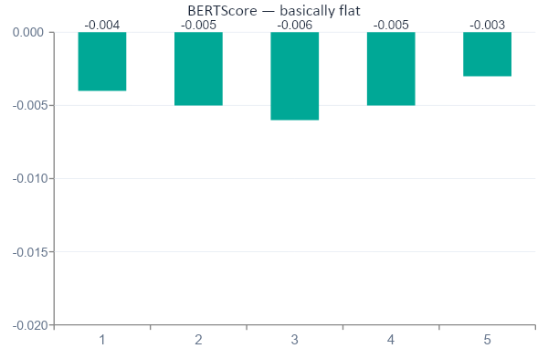
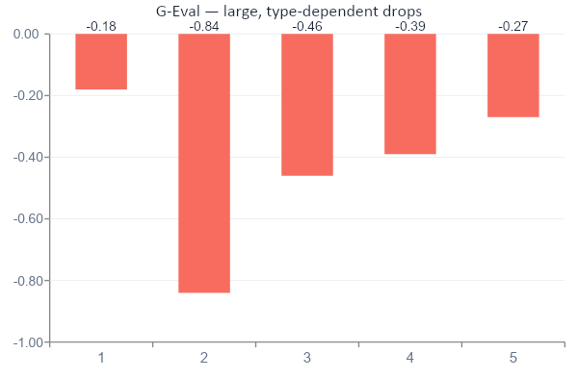
04 • KEY RESULTS
BERTScore is misleading: it barely moves while answer quality collapses.
Takeaway: Surface similarity metrics like BERTScore can declare an answer “fine” while the model has lost the medical meaning. Use semantic / judge-based eval for medical QA.
MedQuAD Robustness • Group 2 • Practicum LLM Evaluation
7 / 12

Slide 8
05 • INSIGHTS
What we learned — and what surprised us.
INSIGHT 1
INSIGHT 2
INSIGHT 3
Repair is a bandage, not a cure.
Layperson framing is the hardest noise.
Your eval metric decides your story.
It fixes typos and clumsy phrasing, but it cannot recover information the user never gave. If the noisy version is missing a key clinical detail, the repaired version usually is too.
Patient-style wording isn't just stylistically different — it shifts what the model thinks is being asked. Repair models tend to preserve the lay framing, so the answer model still drifts.
Run only BERTScore and you would conclude noise barely matters. Run G-Eval and the picture flips. Surprised us most: a metric choice is also a safety choice.
MedQuAD Robustness • Group 2 • Practicum LLM Evaluation
8 / 12

Slide 9
06 • LIMITATIONS
Honest about what this study cannot yet claim.
Pilot scale
Single dataset
Synthetic noise
Numbers are from 50 questions × 10 models. The full 1,000-question run is in progress; effect sizes may shrink or shift.
MedQuAD is curated NIH/NLM content. It is not representative of patient-portal messages, EHR notes, or non-English medical questions.
We use LLM-generated noisy variants. Real user noise is messier, more correlated across categories, and includes images/voice.
Judge bias
No clinical safety scoring
Single repair prompt
G-Eval uses GPT-5.4-mini as judge. The same family generates noise and repairs — risk of stylistic preference toward its own outputs.
We measure answer quality, not clinical harm. A “mostly correct” answer can still be dangerous in a medical setting.
One repair prompt template. Performance ceiling for repair is unknown — better prompts or task-specific repair could move results.
MedQuAD Robustness • Group 2 • Practicum LLM Evaluation
9 / 12

Slide 10
07 • FINAL TAKEAWAYS
What we want you to remember.
Prompt repair is useful — but bounded.
It buys you back surface-level noise. It does not buy you back missing clinical meaning, and it cannot rescue a model from a misleading layperson framing.
01
02
03
Robustness ≠ accuracy
Eval choice is a safety choice
Don't oversell repair
A clean-input score tells you nothing about how a medical LLM behaves with a real, messy patient.
Surface metrics underreport failures. Pair semantic / judge-based eval with human review for medical QA.
Repair helps, but presenting it as a fix-all overstates the case — especially for layperson and incomplete inputs.
MedQuAD Robustness • Group 2 • Practicum LLM Evaluation
10 / 12

Slide 11
08 • NEXT STEPS
What we'd do with more time.
NOW
NEXT
THEN
LATER
Finish 1,000-Q run
Better repair prompts
Realistic noise sources
Clinical safety eval
Scale the pilot from 50 → 1,000 MedQuAD questions across all 10 models, with bootstrapped CIs.
Test medically-grounded repair templates and few-shot variants; measure recovery ceiling per noise type.
Move from synthetic noise to anonymized patient-portal messages; check whether trends survive real users.
Add a harm-tier rubric (e.g., misleading vs dangerous vs life-threatening) reviewed by a clinician.
MedQuAD Robustness • Group 2 • Practicum LLM Evaluation
11 / 12

Slide 12
Thank you.
Questions, pushback, and especially counter-evidence welcome.
Group 2 • Practicum in LLM Evaluation
MedQuAD Robustness — Final Presentation

