Slide 1
Time, Clocks, and the Ordering of Events in a Distributed System
Leslie Lamport, Communications of the ACM, July 1978

Slide 2
Distributed System
A distributed system consists of a collection of distinct processes which are spatially separated, and which communicate with one another by exchanging messages.

Slide 3
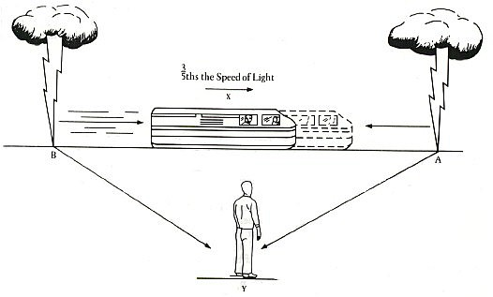
Simultaneous events at a distance

Slide 4
Total Ordering
For every pair of distinct events a and b.
a happened before b, or
b happened before a.
Transitive property:
if a before b and b before c,
then a before c.

Slide 5
Counting
1, 2, 3, 4, 5, …

Slide 6
Partial Ordering
For some pairs of distinct events a and b.
a happened before b, or
b happened before a.
Transitive property:
if a before b and b before c,
then a before c.

Slide 7
Build Dependencies
Common
Library A
Library B
Application

Slide 8
Happened Before
Fixed number of processes, P₀, P₁, P₂, …
a → b if
P_{i} executed a before P_{i} executed b.
a is P_{i} sending a message, and b is P_{j} receiving it.
a → n, and n → b.
in a distributed system

Slide 9

Causality
a cannot cause b unless a happened before b

Slide 10
Process
Totally ordered sequence of events

Slide 11
Concurrency
Events with no ordering between them

Slide 12
Distributed System
Distinct processes exchanging messages

Slide 13
Logical Clock
Assign a clock per process P_{i}
C_{i}(a)
Increasing for each event
C_{i}(a) > C_{i}(b) if a → b
Combine clocks
C(a) = C_{i}(a), where a is an event in P_{i}.
Clock condition
For any pair of discrete events a and b
If a → b, then C(a) < C(b).

Slide 14
Increasing Clock
Each process (P_{i}) increments C_{i} between each event.
When P_{i} sends message m, it includes a timestamp:
T_{m} = C_{i}(send(m))
When P_{j} receives m, it updates C_{j}
C_{j} = max(C_{j}, T_{m}+Δ)

Slide 15
Logical Clock
P₀
2
3
4
5
6
7
8
9
P₁
4
5
6
7
8
9
10
11
P₂
1
2
3
4
5
6
9
10

Slide 16
Satisfying the Clock Condition
If a and b are events in the same process (P_{i}),
then C_{i}(a) < C_{i}(b).
If a is sending a message from P_{i} and b is the receipt of a message from P_{j},
then C_{i}(a) < C_{j}(b)
Either way
C(a) < C(b)

Slide 17
Mutual Exclusion Problem
Find an algorithm satisfying these requirements:
The process that has the resource must release it.
Requests must be granted in the order in which they are made.
If every process which is granted the resource eventually releases it, then every request is eventually granted.
A distributed system with a shared resource

Slide 18
Centralized Scheduler
P₀
1
2
Request for resource
Scheduler
5
6
Request for resource
P₂
3
4
Fails to satisfy the second condition

Slide 19
Request the Resource
P₀
1
4
5
P₁
2
3
P₂
3
4

Slide 20
Release the Resource
P₀
1
P₁
2
P₂
3

Slide 21
Granted a Resource
P_{i} is granted the resource if
It has requested the resource.
The request from P_{i} happened before any request from another process.
Every other process has acknowledged the request.

Slide 22
Late Request
P₀
1
4
5
6
P₁
2
3
0
3
4
P₂
Transmission protocol must ensure order of delivery

Slide 23
Locally Verifiable
P_{i} knows its own request.
P_{i} knows all competing requests; it acknowledged them.
All processes agree on a full ordering: a is before b if
C(a) < C(b), or
C(a) = C(b) and i < j [P_{i} executed a and P_{j} executed b]

Slide 24
Physical Clocks
Each process (P_{i}) maintains clock C_{i}.
When P_{i} sends message m, it includes a timestamp:
T_{m} = C_{i}(send(m))
When P_{j} receives m, it updates C_{j}
C_{j} = max(C_{j}, T_{m}+µ_{m})
The clocks will synchronize within τd.
Resolve anomalous behavior arising from external events
Notes:
mu is the shortest transition time for interprocess messages
tau is the mean time between messages

Slide 25
Failure Conditions
A process fails
Indistinguishable from a slow process
No mechanism for recovery
Network fails
Acknowledgement or release is lost
A process does not play by the rules
Does not advance its own clock
Sends a message with the wrong timestamp
Does not send acknowledgement
Does not release the resource

Slide 26
Successors
Byzantine Generals
Vector Clocks
CAP Theorem
CSP
Fork-Join Causal Consistency
Historical Modeling

