Slide 1
Collaborate
Windows Phone and Windows 8

Slide 2
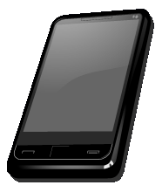










Architecture

Slide 3
What is Correspondence?
SkyDrive for your objects
Local and cloud storage
Sharing across devices and users
Realtime UI

Slide 4
Objects
State
Facts
History

Slide 5
Demo

Slide 6
Thank you
Michael L Perry
CorrespodenceCloud.com

