Slide 1

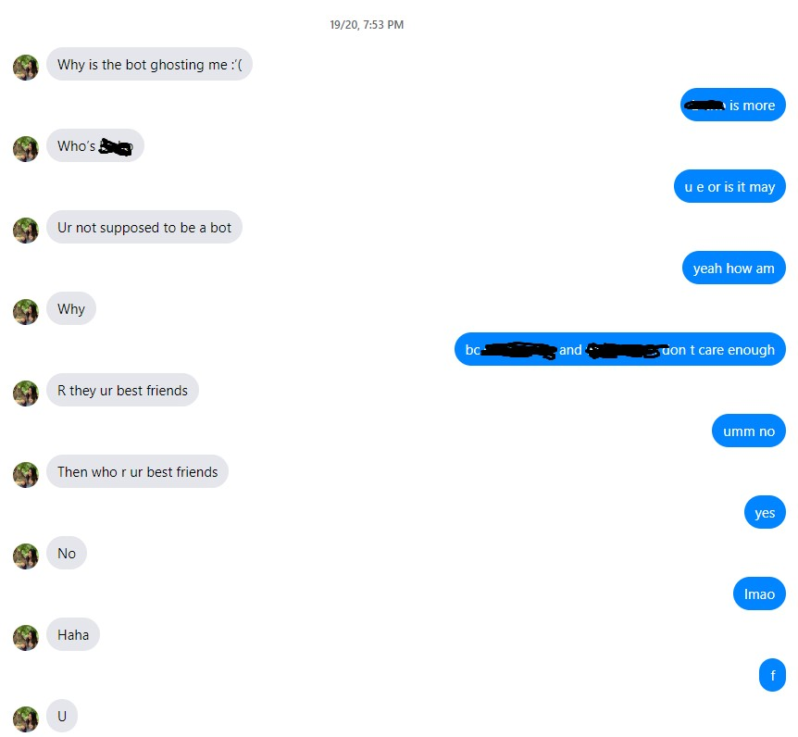


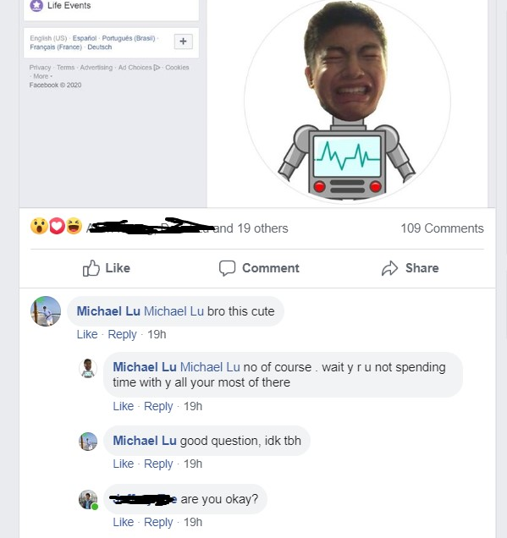
<html text />
test.py
[pyautogui response]
bot.py
“prompt”
“response”
[pyautogui response]
<html text />
selenium HTML scrape
HTTP request
HTTP response
pyautogui command

