Slide 1
U-Panel KIU
Version 1.0.0 · Digital university operations — attendance, notices, course work, reports
Less paper · one digital workspace · QA + students · Flutter + Firebase

Slide 2
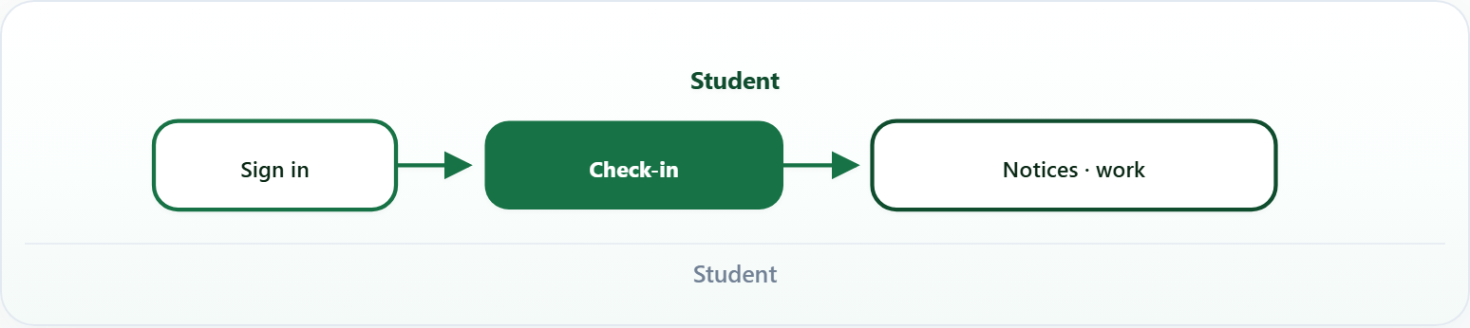
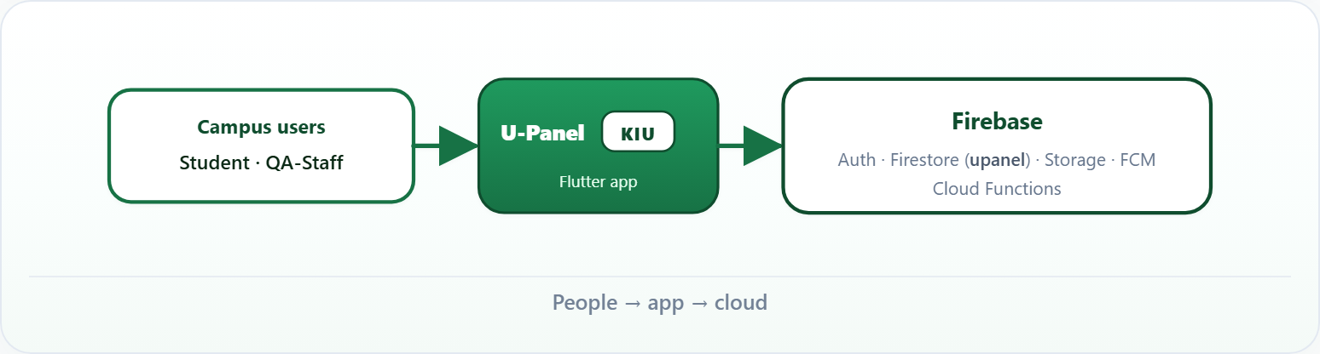
1. Overview
U-Panel at KIU — university ops in one app: attendance, notices, course work, reports. Phone · web · desktop.
Student
People → app → cloud

Slide 3
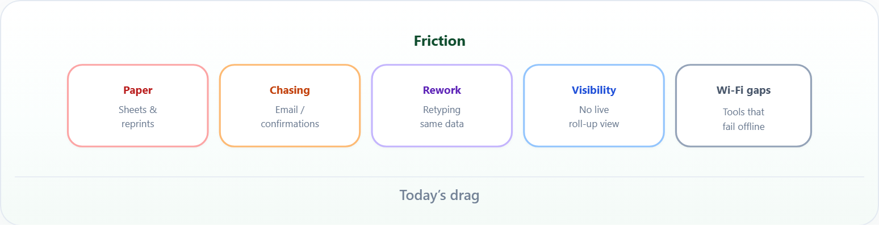
2. Pain
Today’s drag

Slide 4
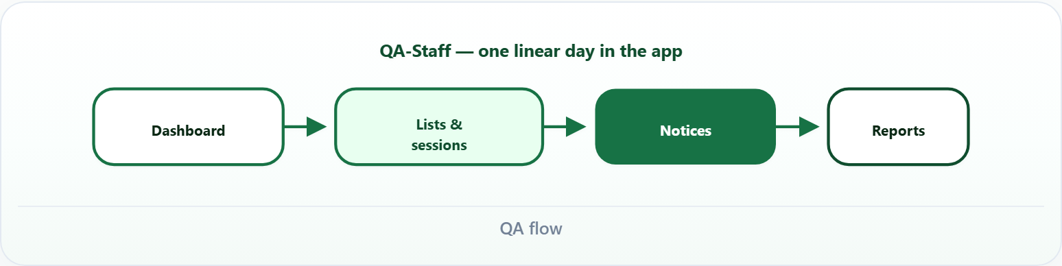
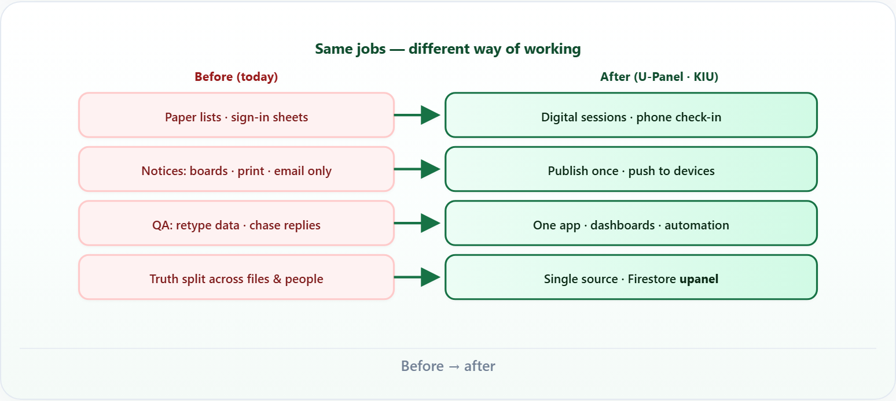
3. Shift
QA flow
Before → after

Slide 5
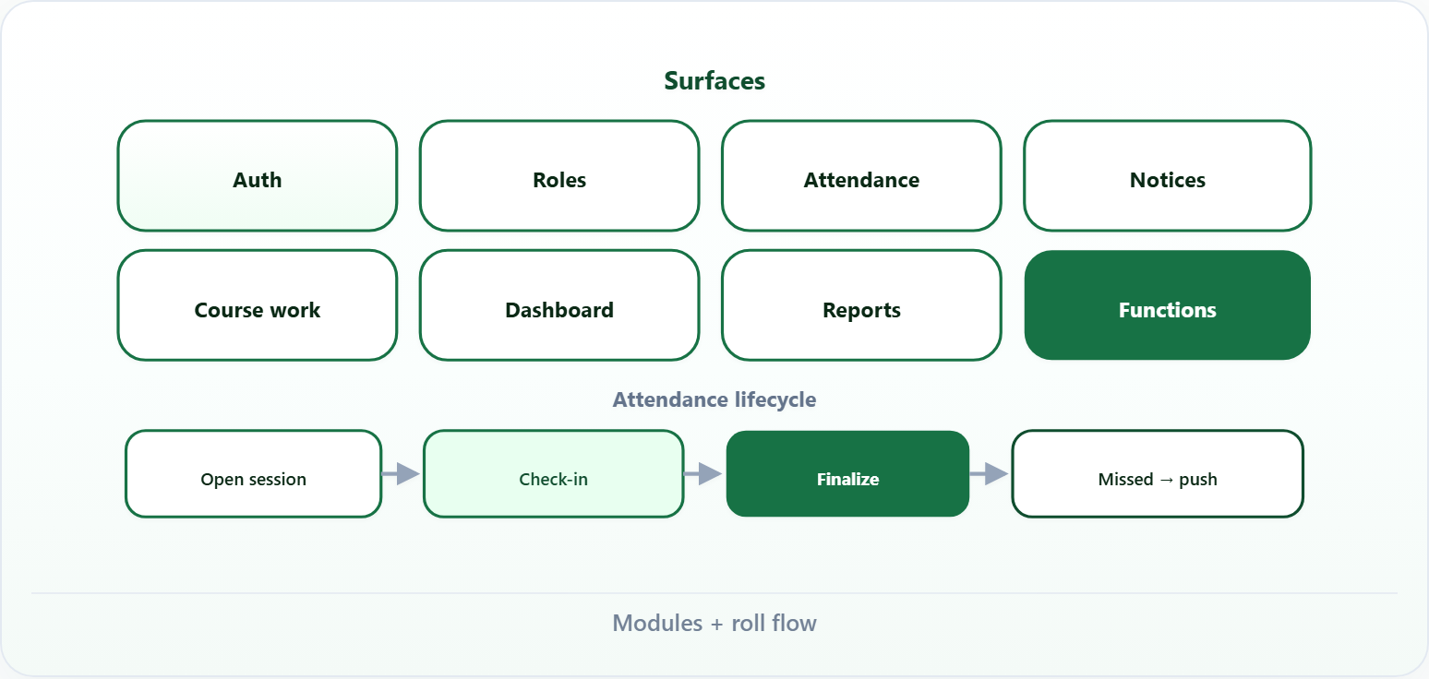
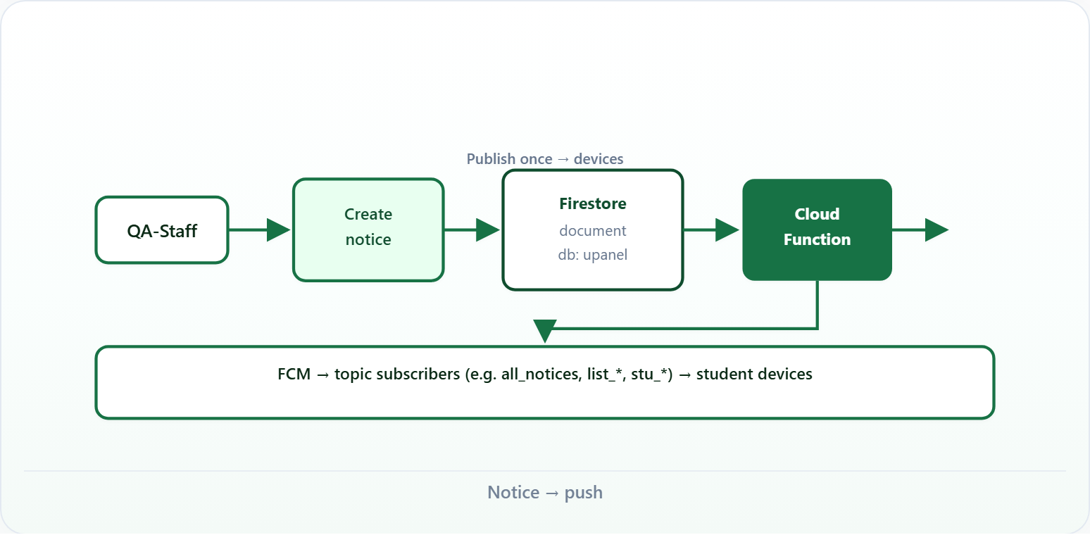
4. Product
Modules + roll flow
Notice → push

Slide 6
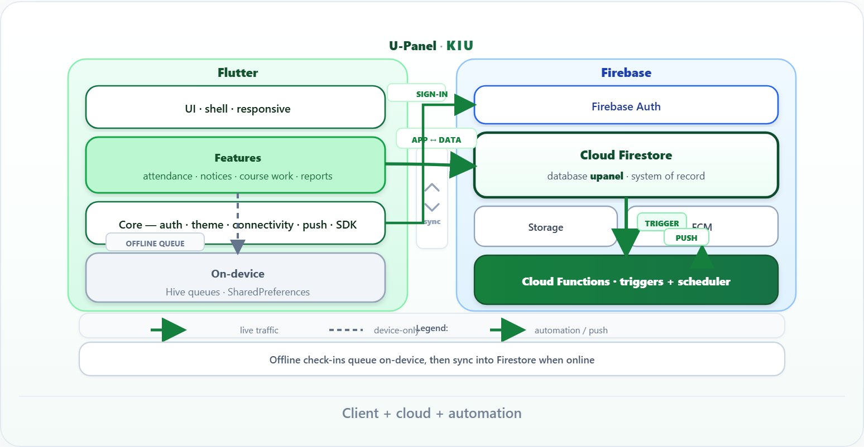
5. Architecture
Client + cloud + automation

Slide 7
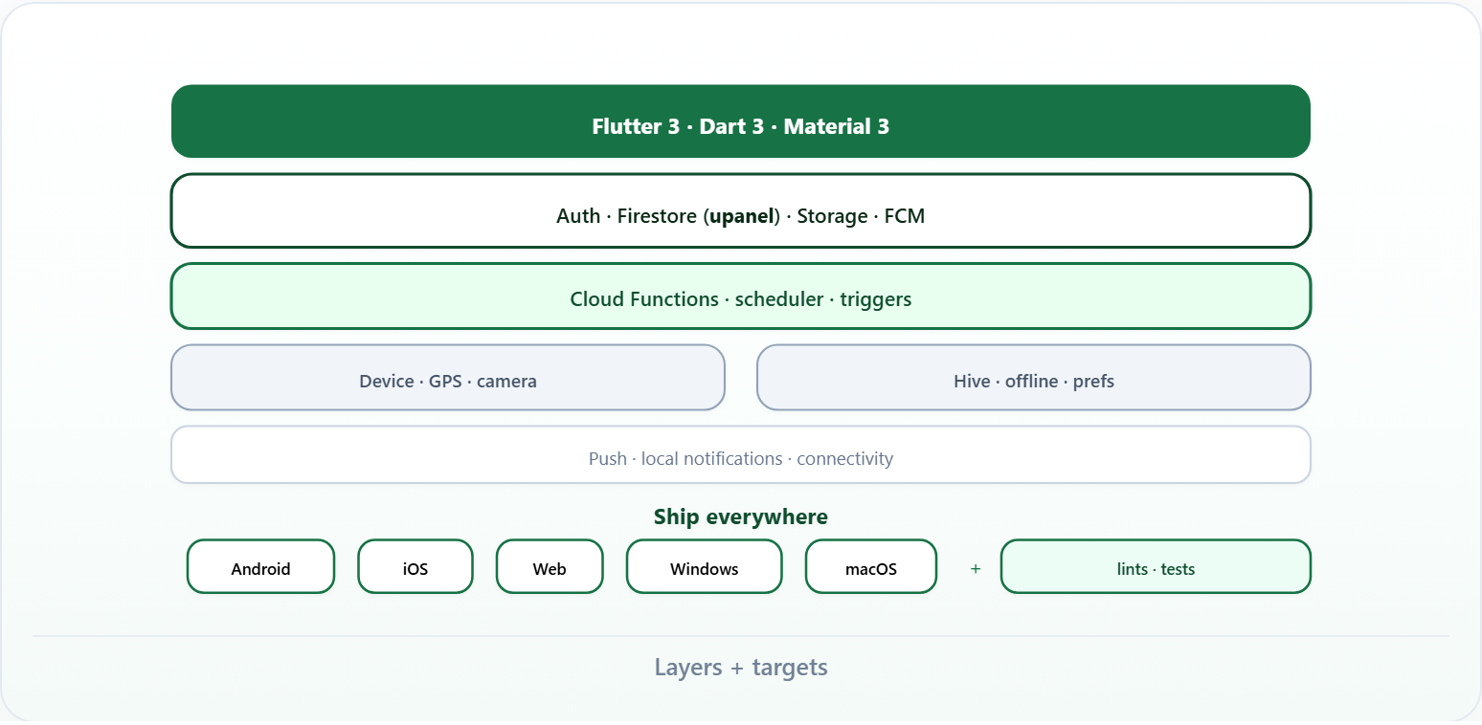
6. Stack
Layers + targets

Slide 8
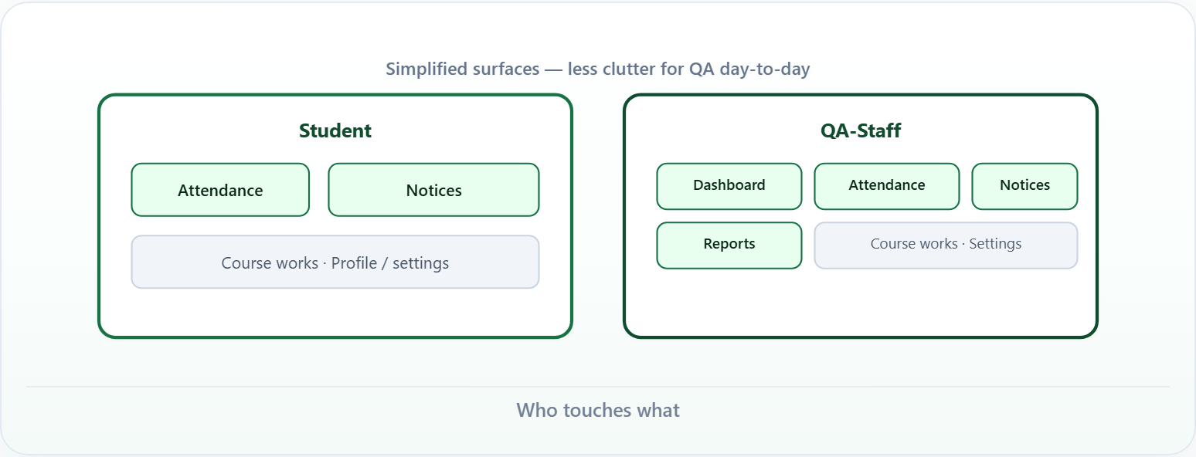
7. Roles
Who touches what

Slide 9
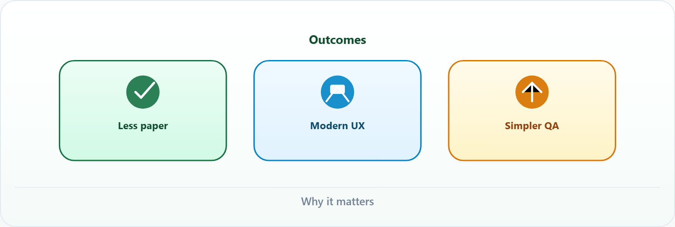
8. Value
Why it matters

Slide 10
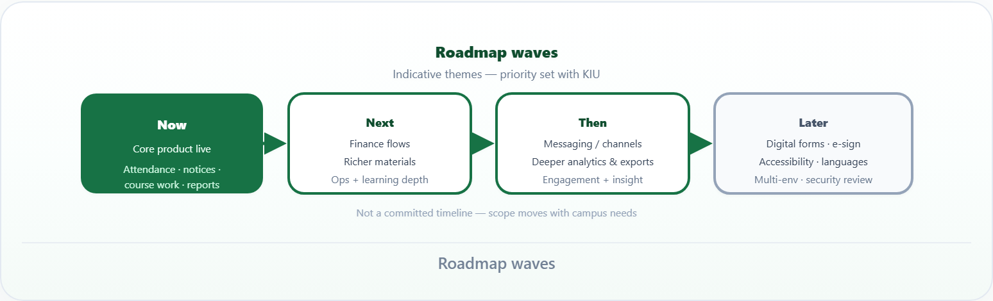
9. Next
Roadmap waves

Slide 11
10. Close
One system of record · less paper · automation where it counts · built to grow.
U-Panel · KIU · Project overview

