Slide 1
Software Architecture and Product Lines for Mobile Applications
Team Member
Zhouhao Lu
Xiaoyang Lu
Qianqi Guan

Slide 2
Influence of Product-line in Mobile Devices Fields
Software Product-Line for Mobile Software
Product-Line Architecture for Mobile Devices
Notes:
we will firstly talk about the influence of product-line in mobile devices fields in two parts: 1. software product-line for mobile software; 2: product-line architecture for mobile devices.

Slide 3
Software Product-Line for Mobile Software
A software product-line is a set of systems that share a common architecture and a set of reusable components. Jointly,they constitute a software platform supporting application development for a particular domain.
Notes:
Read above

Slide 4
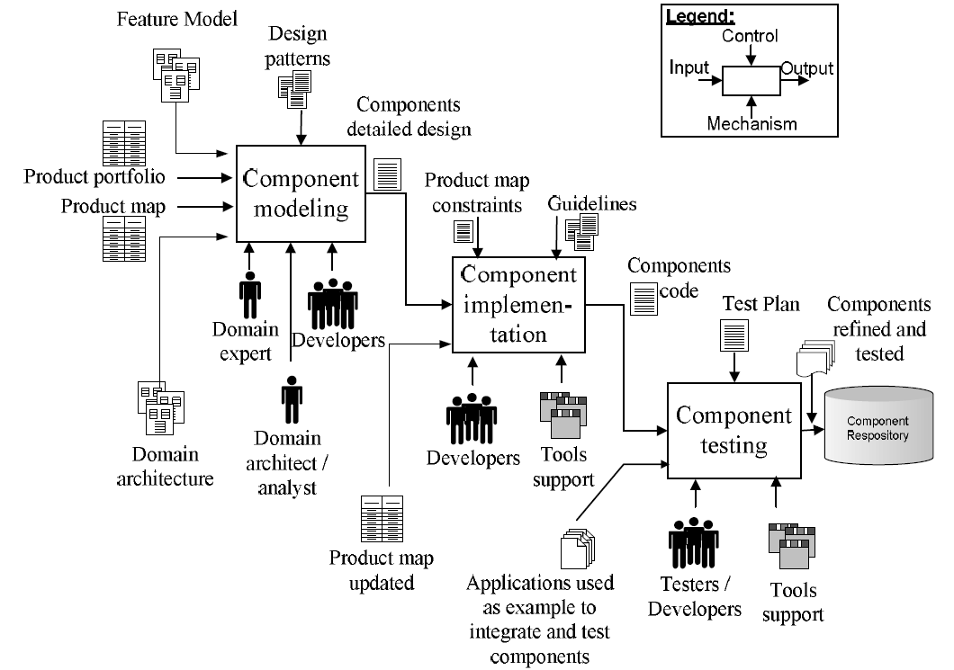
Process overview of SPL domain implementation phase
Component Modeling
Component Implementation
Component Testing

Slide 5
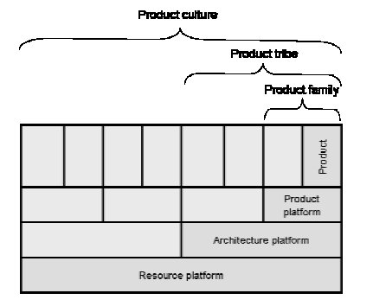
Divide the components of a software system into four categories, each constituting a layer
Resource Platform Layer
Architecture Platform Layer
Product Platform Layer
Product Layer
Notes:
The components of a software system can be divided into four categories, each constituting a layer. If a software component depends only on the way general resources are provided but not on any particular architectural style, it belongs to the resource platform layer.(it is the lowest layer in the figure). If a software component depends on a chosen architectural style, but not on a particular domain or product category, it belongs the architecture platform layer. If a software component depends on an application domain or on the type of a product but not on a particular product, it belongs to the product platform layer. Finally, if a software component depends on a particular product, it belongs to the product layer(uppermost layer). All the software artifacts belonging to any of these layers are collectively called a product-line.

Slide 6
Product-Line Architecture for Mobile Devices
The large number of mobile device types and possible device configurations makes it possible to deliver mobile applications to users devices that are not fully compatible with device characteristics. In these situations, users must perform the tedious and error-prone tasks of altering their device configurations to meet the needs of applications.
Notes:
Second part

Slide 7
Three contributions to model-driven product-line variant selection for mobile devices
Describes an infrastructure-driven product variant configuration tool
Show how this tool automates the capture of device capabilities and maps them to product-line feature models
Show how a constraint solver can be used to derive a valid product variant and incorporate a device’s resource constraints into the derivation process.

Slide 8
Product line architecture
Layers, components and frames have significant role in product line architecture
make reuse of software modules easier, that leads further into more reliable software programs, better time controlled projects, increased productivity of the development, less development risks, easier prototyping
Notes:
The set of software programs, which have similar structure and functionality, is often called product line architecture

Slide 9
Development baselines for mobile app
understanding the design and development process of mobile value added service
emphasizing on the reusability right from the beginning and developing by applying an abstract architecture design for the mobile service.

Slide 10
Mobile solutions & development tools
the whole software architecture can be modeled and programmed with the integrated CASE environment that supports automated code generation for different solutions, debugging and reverse engineering

Slide 11
Different architectural solutions are grouping into product line architectures

Slide 12
Comprehensive programming environments for the major mobile platforms
Apple - iOS Dev Center-Xcode package
android - development tools plug-in for the eclipse
windows phone - specialized version of Microsoft's visual studio environment
blackberry
Symbian
cross-platform development tools - ThoMobile’s Rhodes, MoSync, PhoneGap
Notes:
These powerful development tools and frameworks greatly helps in implementing a mobile application, but only for small scale apps.

Slide 13
other areas for new research and development for mobile application domain
Potential interaction with other applications.
Sensor handling.
Native and hybrid (mobile web) applications
Families of hardware and software platforms
User interfaces
Complexity of testing
Power consumption

Slide 14
Intro to the game domain
extertainment business is one of the most growing part of the mobile business and games have always being the best test bed of new tech.

Slide 15
Game Domain
Require obligatory non-functionalities
Portability
Different platforms in mobile device
Performance
Result of market analysis
UI features
Screen size
Difference between platforms

Slide 16
SPL in Mobile Game Domain
Develop cycle
The size of company
No explicit method for implementing reusable architectures in that domain

Slide 17
Feature-oriented Architecture Pattern
UI-oriented decentralized control pattern
UI reusability and maintainability
MVC, MVP, MVVM
Example: setting menus page
Example: leader board and achievement pages

Slide 18
Feature-oriented Architecture Pattern
Centralized control pattern
Bind similar UI with similar data
Contents-adaptable pattern
Maintainability
Content manage component
Manage adding, modifying, removing contents

Slide 19
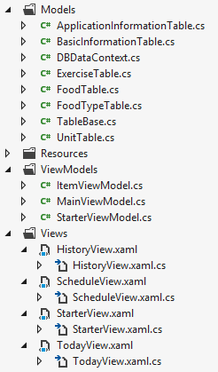
Example based on my mobile application
MVVM
UI reusability

