Slide 1
Lab Basic Blocks
J. Nelson Amaral

Slide 2
A Basic Block

Slide 3
Only the first instruction of a
basic block can be the target
of a branch.
If any instruction of the
basic block is executed,
then all of them must be
executed.
Execution can
only start here
TARGET: andi $t2, $t0, 0x1
add $t2, $t2, $t4
or $t2, $t3, $t0
bnez $t2, ODD
Only the last instruction of the
basic block can be a branch
or a jump.
Execution can
only stop here

Slide 4
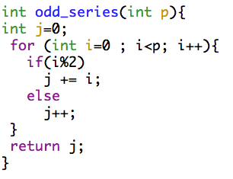
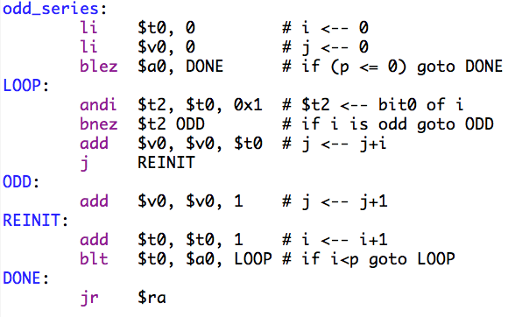
A Program Example

Slide 5
Finding Leaders

Slide 6
Rule 1: The first statement of a procedure is a leader.

Slide 7
Rule 2: Any target of a branch or jump is a leader.

Slide 8
Rule 3: Any instruction that follows a branch or jump is a leader.

Slide 9
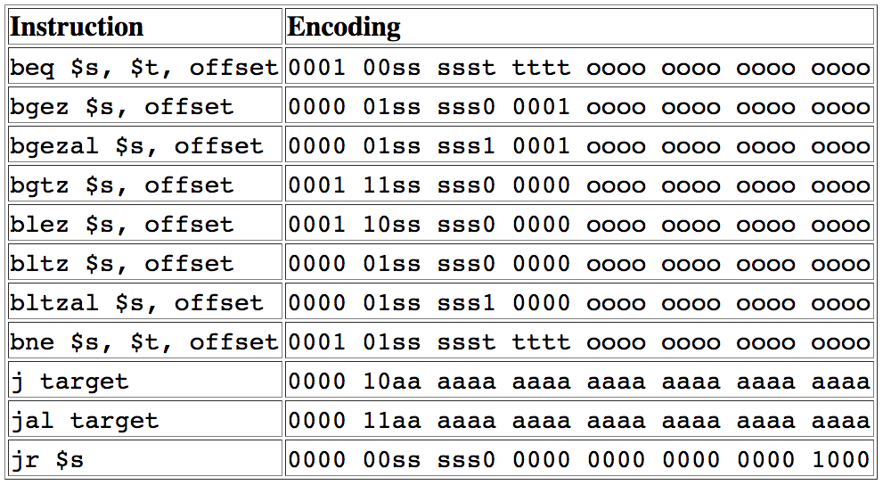

Slide 10
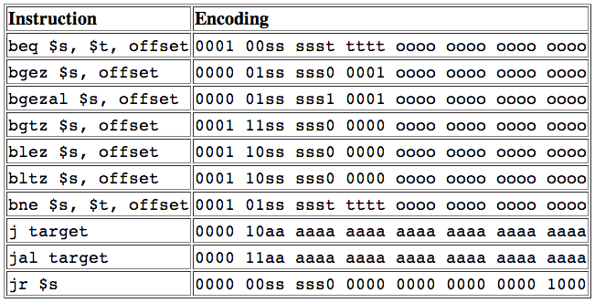
Finding the Leaders – Lab #2

Slide 11
Given the Leaders, How do we get the Basic Blocks?

Slide 12
A basic block is the leader followed by all subsequent instructions
up to, but not including, the next leader.

Slide 13
A basic block is the leader followed by all subsequent instructions
up to, but not including, the next leader.

Slide 14
The Actual Code
[10010000] 34080000 ori $8, $0, 0 ; 52: li $t0, 0 # i
[10010004] 34020000 ori $2, $0, 0 ; 53: li $v0, 0 # j
[10010008] 18800009 blez $4 36 [DONE-0x10010008]; 54: blez $a0, DONE # if (p
[1001000c] 310a0001 andi $10, $8, 1 ; 56: andi $t2, $t0, 0x1 # $t2
[10010010] 15400003 bne $10, $0, 12 [ODD-0x10010010]
[10010014] 00481020 add $2, $2, $8 ; 58: add $v0, $v0, $t0 # j
[10010018] 08100029 j 0x10010020 [REINIT] ; 59: j REINIT
[1001001c] 20420001 addi $2, $2, 1 ; 61: add $v0, $v0, 1 # j
[10010020] 21080001 addi $8, $8, 1 ; 63: add $t0, $t0, 1 # i
[10010024] 0104082a slt $1, $8, $4 ; 64: blt $t0, $a0, LOOP # if i
[10010028] 1420fff9 bne $1, $0, -28 [LOOP-0x100100ac]
[1001002c] 03e00008 jr $31 ; 66: jr $ra
0
1
6 block(s) found.
Block Leader: 0x10010000, Size: 3
Block Leader: 0x1001000C, Size: 2
Block Leader: 0x10010014, Size: 2
Block Leader: 0x1001001C, Size: 1
Block Leader: 0x10010020, Size: 3
Block Leader: 0x1001002C, Size: 1
2
3
4
5

Slide 15
Control Flow Graphs

Slide 16
0
odd_series:
li $t0, 0
li $v0, 0
blez $a0, DONE
This is the edge
(0x10010000, 0x1001000c)
This is the
basic block at
address
0x10010000
1
LOOP:
andi $t2, $t0, 0x1
bnez $t2 ODD
This is the
basic block at
address
0x1001000c
add $v0, $v0, $t0
j REINIT
ODD:
add $v0, $v0, 1
2
3
REINIT:
add $t0, $t0, 1
blt $t0, $a0, LOOP
4
5
DONE:
jr $ra

Slide 17
The Actual Code
[10010000] 34080000 ori $8, $0, 0 ; 52: li $t0, 0 # i
[10010004] 34020000 ori $2, $0, 0 ; 53: li $v0, 0 # j
[10010008] 18800009 blez $4 36 [DONE-0x10010008]; 54: blez $a0, DONE # if (p
[1001000c] 310a0001 andi $10, $8, 1 ; 56: andi $t2, $t0, 0x1 # $t2
[10010010] 15400003 bne $10, $0, 12 [ODD-0x10010010]
[10010014] 00481020 add $2, $2, $8 ; 58: add $v0, $v0, $t0 # j
[10010018] 08100029 j 0x10010020 [REINIT] ; 59: j REINIT
[1001001c] 20420001 addi $2, $2, 1 ; 61: add $v0, $v0, 1 # j
[10010020] 21080001 addi $8, $8, 1 ; 63: add $t0, $t0, 1 # i
[10010024] 0104082a slt $1, $8, $4 ; 64: blt $t0, $a0, LOOP # if i
[10010028] 1420fff9 bne $1, $0, -28 [LOOP-0x100100ac]
[1001002c] 03e00008 jr $31 ; 66: jr $ra
0
1
Edges:
0x10010000 --> 0x1001000C
0x10010000 --> 0x1001002C
0x1001000C --> 0x10010014
0x1001000C --> 0x1001001C
0x10010014 --> 0x10010020
0x1001001C --> 0x10010020
0x10010020 --> 0x1001000C
0x10010020 --> 0x1001002C
2
3
4
5

Slide 18
0
odd_series:
li $t0, 0
li $v0, 0
blez $a0, DONE
0
1
1
LOOP:
andi $t2, $t0, 0x1
bnez $t2 ODD
2
3
add $v0, $v0, $t0
j REINIT
ODD:
add $v0, $v0, 1
2
3
4
REINIT:
add $t0, $t0, 1
blt $t0, $a0, LOOP
4
5
5
DONE:
jr $ra

Slide 19
Dominators

Slide 20
0
1
2
3
4
5

Slide 21
0
1 dominates 4 because you cannot
execute 4 unless you have already
executed 1
1
2
3
4
5

Slide 22
0
1 dominates 4 because you cannot
execute 4 unless you have already
executed 1
1
2
3
3 does not dominate 4 because
there is a path (0→1→2→4) that
reaches 4 without executing 3.
4
5

Slide 23
0 dominates all the basic blocks.
0
1 dominates 4 because you cannot
execute 4 unless you have already
executed 1
1
2
3
3 does not dominate 4 because
there is a path (0→1→2→4) that
reaches 4 without executing 3.
4
A basic block dominates itself.
5

Slide 24
0
1
Intuitive Understanding of
Dominance
2
3
4
5

Slide 25
0
1
Intuitive Understanding of
Dominance
2
3
4
5

Slide 26
0
1
Intuitive Understanding of
Dominance
2
3
4
5

Slide 27
0
1
Intuitive Understanding of
Dominance
2
3
1 dominates nodes 1, 2, 3 and 4.
4
5

Slide 28
0
Which nodes dominate
node 4?
1
2
3
4
5

Slide 29
0
Which nodes dominate
node 4?
1
2
3
4
5

Slide 30
0
Which nodes dominate
node 4?
1
Dom(4) = {0, 1, 4}
2
3
This is called the
Dominator Set of 4
4
5

Slide 31
0
We can use a bit in a binary vector to
represent each node in the CFG
1
Bit position
in binary vector
5
4
3
2
1
0
0
1
0
0
1
1
2
3
5
4
3
2
1
0
4
We can now represent the
dominator set of 4 as a binary vector
5
Dom(4) = {0, 1, 4}

Slide 32
0
Dominator Bit Vectors:
0000 0000 0000 0000 0000 0000 0000 0001
0000 0000 0000 0000 0000 0000 0000 0011
0000 0000 0000 0000 0000 0000 0000 0111
0000 0000 0000 0000 0000 0000 0000 1011
0000 0000 0000 0000 0000 0000 0001 0011
0000 0000 0000 0000 0000 0000 0010 0001
1
2
3
4
5

Slide 33
How to Compute Dominator Sets?

Slide 34
Initialization:
0
0 is the only dominator of 0
All other nodes are dominated
by every node.
1
Node | Dominators
 | 5 | 4 | 3 | 2 | 1 | 0
0 | 0 | 0 | 0 | 0 | 0 | 1
1 | 1 | 1 | 1 | 1 | 1 | 1
2 | 1 | 1 | 1 | 1 | 1 | 1
3 | 1 | 1 | 1 | 1 | 1 | 1
4 | 1 | 1 | 1 | 1 | 1 | 1
5 | 1 | 1 | 1 | 1 | 1 | 1
2
3
4
5

Slide 35
For each edge (n_{j}, n_{i}) in CFG:
0
Dom(n_{i}) = {n_{i}}∪(Dom(n_{i})∩ Dom(n_{j}))
1
Node | Dominators
 | 5 | 4 | 3 | 2 | 1 | 0
0 | 0 | 0 | 0 | 0 | 0 | 1
1 | 1 | 1 | 1 | 1 | 1 | 1
2 | 1 | 1 | 1 | 1 | 1 | 1
3 | 1 | 1 | 1 | 1 | 1 | 1
4 | 1 | 1 | 1 | 1 | 1 | 1
5 | 1 | 1 | 1 | 1 | 1 | 1
2
3
4
5

Slide 36
n_{j}
n_{i}
For each edge (n_{j}, n_{i}) in CFG:
0
Dom(n_{i}) = {n_{i}}∪(Dom(n_{i})∩ Dom(n_{j}))
Dom(1) = {1}∪({0,1,2,3,4,5}∩ {0})
1
Dom(1) = {1}∪{0} = {0,1}
Node | Dominators
 | 5 | 4 | 3 | 2 | 1 | 0
0 | 0 | 0 | 0 | 0 | 0 | 1
1 | 1 | 1 | 1 | 1 | 1 | 1
2 | 1 | 1 | 1 | 1 | 1 | 1
3 | 1 | 1 | 1 | 1 | 1 | 1
4 | 1 | 1 | 1 | 1 | 1 | 1
5 | 1 | 1 | 1 | 1 | 1 | 1
2
3
4
5

Slide 37
n_{j}
n_{i}
For each edge (n_{j}, n_{i}) in CFG:
0
Dom(n_{i}) = {n_{i}}∪(Dom(n_{i})∩ Dom(n_{j}))
Dom(1) = {1}∪({0,1,2,3,4,5}∩ {0})
1
Dom(1) = {1}∪{0} = {0,1}
Node | Dominators
 | 5 | 4 | 3 | 2 | 1 | 0
0 | 0 | 0 | 0 | 0 | 0 | 1
1 | 0 | 0 | 0 | 0 | 1 | 1
2 | 1 | 1 | 1 | 1 | 1 | 1
3 | 1 | 1 | 1 | 1 | 1 | 1
4 | 1 | 1 | 1 | 1 | 1 | 1
5 | 1 | 1 | 1 | 1 | 1 | 1
2
3
4
5

Slide 38
For each edge (n_{j}, n_{i}) in CFG:
0
Dom(n_{i}) = {n_{i}}∪(Dom(n_{i})∩ Dom(n_{j}))
1
Node | Dominators
 | 5 | 4 | 3 | 2 | 1 | 0
0 | 0 | 0 | 0 | 0 | 0 | 1
1 | 0 | 0 | 0 | 0 | 1 | 1
2 | 1 | 1 | 1 | 1 | 1 | 1
3 | 1 | 1 | 1 | 1 | 1 | 1
4 | 1 | 1 | 1 | 1 | 1 | 1
5 | 1 | 1 | 1 | 1 | 1 | 1
2
3
4
5

Slide 39
For each edge (n_{j}, n_{i}) in CFG:
0
Dom(n_{i}) = {n_{i}}∪(Dom(n_{i})∩ Dom(n_{j}))
1
Node | Dominators
 | 5 | 4 | 3 | 2 | 1 | 0
0 | 0 | 0 | 0 | 0 | 0 | 1
1 | 0 | 0 | 0 | 0 | 1 | 1
2 | 1 | 1 | 1 | 1 | 1 | 1
3 | 1 | 1 | 1 | 1 | 1 | 1
4 | 1 | 1 | 1 | 1 | 1 | 1
5 | 1 | 0 | 0 | 0 | 0 | 1
2
3
4
5

Slide 40
For each edge (n_{j}, n_{i}) in CFG:
0
Dom(n_{i}) = {n_{i}}∪(Dom(n_{i})∩ Dom(n_{j}))
1
Node | Dominators
 | 5 | 4 | 3 | 2 | 1 | 0
0 | 0 | 0 | 0 | 0 | 0 | 1
1 | 0 | 0 | 0 | 0 | 1 | 1
2 | 1 | 1 | 1 | 1 | 1 | 1
3 | 1 | 1 | 1 | 1 | 1 | 1
4 | 1 | 1 | 1 | 1 | 1 | 1
5 | 1 | 0 | 0 | 0 | 0 | 1
2
3
4
5

Slide 41
For each edge (n_{j}, n_{i}) in CFG:
0
Dom(n_{i}) = {n_{i}}∪(Dom(n_{i})∩ Dom(n_{j}))
1
Node | Dominators
 | 5 | 4 | 3 | 2 | 1 | 0
0 | 0 | 0 | 0 | 0 | 0 | 1
1 | 0 | 0 | 0 | 0 | 1 | 1
2 | 0 | 0 | 0 | 1 | 1 | 1
3 | 1 | 1 | 1 | 1 | 1 | 1
4 | 1 | 1 | 1 | 1 | 1 | 1
5 | 1 | 0 | 0 | 0 | 0 | 1
2
3
4
5

Slide 42
For each edge (n_{j}, n_{i}) in CFG:
0
Dom(n_{i}) = {n_{i}}∪(Dom(n_{i})∩ Dom(n_{j}))
1
Node | Dominators
 | 5 | 4 | 3 | 2 | 1 | 0
0 | 0 | 0 | 0 | 0 | 0 | 1
1 | 0 | 0 | 0 | 0 | 1 | 1
2 | 0 | 0 | 0 | 1 | 1 | 1
3 | 1 | 1 | 1 | 1 | 1 | 1
4 | 1 | 1 | 1 | 1 | 1 | 1
5 | 1 | 0 | 0 | 0 | 0 | 1
2
3
4
5

Slide 43
For each edge (n_{j}, n_{i}) in CFG:
0
Dom(n_{i}) = {n_{i}}∪(Dom(n_{i})∩ Dom(n_{j}))
1
Node | Dominators
 | 5 | 4 | 3 | 2 | 1 | 0
0 | 0 | 0 | 0 | 0 | 0 | 1
1 | 0 | 0 | 0 | 0 | 1 | 1
2 | 0 | 0 | 0 | 1 | 1 | 1
3 | 0 | 0 | 1 | 0 | 1 | 1
4 | 1 | 1 | 1 | 1 | 1 | 1
5 | 1 | 0 | 0 | 0 | 0 | 1
2
3
4
5

Slide 44
For each edge (n_{j}, n_{i}) in CFG:
0
Dom(n_{i}) = {n_{i}}∪(Dom(n_{i})∩ Dom(n_{j}))
1
Node | Dominators
 | 5 | 4 | 3 | 2 | 1 | 0
0 | 0 | 0 | 0 | 0 | 0 | 1
1 | 0 | 0 | 0 | 0 | 1 | 1
2 | 0 | 0 | 0 | 1 | 1 | 1
3 | 0 | 0 | 1 | 0 | 1 | 1
4 | 1 | 1 | 1 | 1 | 1 | 1
5 | 1 | 0 | 0 | 0 | 0 | 1
2
3
4
5

Slide 45
For each edge (n_{j}, n_{i}) in CFG:
0
Dom(n_{i}) = {n_{i}}∪(Dom(n_{i})∩ Dom(n_{j}))
1
Node | Dominators
 | 5 | 4 | 3 | 2 | 1 | 0
0 | 0 | 0 | 0 | 0 | 0 | 1
1 | 0 | 0 | 0 | 0 | 1 | 1
2 | 0 | 0 | 0 | 1 | 1 | 1
3 | 0 | 0 | 1 | 0 | 1 | 1
4 | 0 | 1 | 0 | 1 | 1 | 1
5 | 1 | 0 | 0 | 0 | 0 | 1
2
3
4
5

Slide 46
For each edge (n_{j}, n_{i}) in CFG:
0
Dom(n_{i}) = {n_{i}}∪(Dom(n_{i})∩ Dom(n_{j}))
1
Node | Dominators
 | 5 | 4 | 3 | 2 | 1 | 0
0 | 0 | 0 | 0 | 0 | 0 | 1
1 | 0 | 0 | 0 | 0 | 1 | 1
2 | 0 | 0 | 0 | 1 | 1 | 1
3 | 0 | 0 | 1 | 0 | 1 | 1
4 | 0 | 1 | 0 | 1 | 1 | 1
5 | 1 | 0 | 0 | 0 | 0 | 1
2
3
4
5

Slide 47
For each edge (n_{j}, n_{i}) in CFG:
0
Dom(n_{i}) = {n_{i}}∪(Dom(n_{i})∩ Dom(n_{j}))
1
Node | Dominators
 | 5 | 4 | 3 | 2 | 1 | 0
0 | 0 | 0 | 0 | 0 | 0 | 1
1 | 0 | 0 | 0 | 0 | 1 | 1
2 | 0 | 0 | 0 | 1 | 1 | 1
3 | 0 | 0 | 1 | 0 | 1 | 1
4 | 0 | 1 | 0 | 0 | 1 | 1
5 | 1 | 0 | 0 | 0 | 0 | 1
2
3
4
5

Slide 48
For each edge (n_{j}, n_{i}) in CFG:
0
Dom(n_{i}) = {n_{i}}∪(Dom(n_{i})∩ Dom(n_{j}))
1
Node | Dominators
 | 5 | 4 | 3 | 2 | 1 | 0
0 | 0 | 0 | 0 | 0 | 0 | 1
1 | 0 | 0 | 0 | 0 | 1 | 1
2 | 0 | 0 | 0 | 1 | 1 | 1
3 | 0 | 0 | 1 | 0 | 1 | 1
4 | 0 | 1 | 0 | 0 | 1 | 1
5 | 1 | 0 | 0 | 0 | 0 | 1
2
3
4
5

Slide 49
For each edge (n_{j}, n_{i}) in CFG:
0
Dom(n_{i}) = {n_{i}}∪(Dom(n_{i})∩ Dom(n_{j}))
1
Node | Dominators
 | 5 | 4 | 3 | 2 | 1 | 0
0 | 0 | 0 | 0 | 0 | 0 | 1
1 | 0 | 0 | 0 | 0 | 1 | 1
2 | 0 | 0 | 0 | 1 | 1 | 1
3 | 0 | 0 | 1 | 0 | 1 | 1
4 | 0 | 1 | 0 | 0 | 1 | 1
5 | 1 | 0 | 0 | 0 | 0 | 1
2
3
4
5

Slide 50
For each edge (n_{j}, n_{i}) in CFG:
0
Dom(n_{i}) = {n_{i}}∪(Dom(n_{i})∩ Dom(n_{j}))
1
Node | Dominators
 | 5 | 4 | 3 | 2 | 1 | 0
0 | 0 | 0 | 0 | 0 | 0 | 1
1 | 0 | 0 | 0 | 0 | 1 | 1
2 | 0 | 0 | 0 | 1 | 1 | 1
3 | 0 | 0 | 1 | 0 | 1 | 1
4 | 0 | 1 | 0 | 0 | 1 | 1
5 | 1 | 0 | 0 | 0 | 0 | 1
2
3
4
5

Slide 51
Bit Vectors

Slide 52
Use as many words as necessary to store the
bit vector in memory.
Examples:
A 17-bit vector occupies one word.
A 42-bit vector occupies two words.
A 65-bit vector occupies three words.

Slide 53
Bit Ordering
Consider a 47-bit vector stored at address 0x00008000.
Most-significant
bit in vector
Bit positions in vector
46
31
7
0
Byte at address
0x00008007
Byte at address
0x00008002
Byte at address
0x00008001
Byte at address
0x00008000

Slide 54
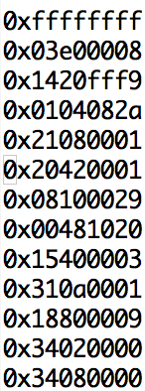
The Assignment (input)
The MIPS code
is guaranteed
to contain a
single procedure.
Memory
This is the sentinel
indicating the end
of the procedure.
$a0
This is the binary
code for the
odd_series
example in
this presentation.
$a0 contains a memory
address
At that address is the binary
representation of the first
instruction

Slide 55
The Assignment (output)
$v0: number of basic blocks in the procedure.
$v1: number of edges in the CFG of the procedure.
Three additional memory addresses returned into the stack.

Slide 56
Returning Addresses in Stack
Memory
Memory
$fp
$fp
Caller
Stack
Frame
Caller
Stack
Frame
Address of list
of dominator
sets
$sp
Address of list
of CFG edges
$sp
Address of list
of basic blocks
Before getControlFlow
After getControlFlow

Slide 57
List of Basic Blocks
Basic blocks in ascending order of
the address of their leaders.
Basic Block List
[10010000] 34080000 ori $8, $0, 0 ; 52: li $t0, 0 # i
[10010004] 34020000 ori $2, $0, 0 ; 53: li $v0, 0 # j
[10010008] 18800009 blez $4 36 [DONE-0x10010008]; 54: blez $a0, DONE # if (p
[1001000c] 310a0001 andi $10, $8, 1 ; 56: andi $t2, $t0, 0x1 # $t2
[10010010] 15400003 bne $10, $0, 12 [ODD-0x10010010]
[10010014] 00481020 add $2, $2, $8 ; 58: add $v0, $v0, $t0 # j
[10010018] 08100029 j 0x10010020 [REINIT] ; 59: j REINIT
[1001001c] 20420001 addi $2, $2, 1 ; 61: add $v0, $v0, 1 # j
[10010020] 21080001 addi $8, $8, 1 ; 63: add $t0, $t0, 1 # i
[10010024] 0104082a slt $1, $8, $4 ; 64: blt $t0, $a0, LOOP # if i
[10010028] 1420fff9 bne $1, $0, -28 [LOOP-0x100100ac]
[1001002c] 03e00008 jr $31 ; 66: jr $ra
0x0000 0001
0x1001 002c
0x0000 0003
0x1001 0020
0x0000 0001
0x1001 001c
0x0000 0002
0x1001 0014
0x0000 0002
0x1001 000c
0x0000 0003
0x1001 0000
higher address ↑
6 block(s) found.
Block Leader: 0x10010000, Size: 3
Block Leader: 0x1001000C, Size: 2
Block Leader: 0x10010014, Size: 2
Block Leader: 0x1001001C, Size: 1
Block Leader: 0x10010020, Size: 3
Block Leader: 0x1001002C, Size: 1
lower address ↓
After getControlFlow
address in $sp+0 is the
address of this word.

Slide 58
List of CFG Edges
CFG Edge List
Edges in ascending order of
the address of the source leader.
higher address ↑
0x1001 002c
0x1001 0020
0x1001 000c
0x1001 0020
0x1001 0020
0x1001 001c
0x1001 0020
0x1001 0014
0x1001 001c
0x1001 000c
0x1001 0014
0x1001 000c
0x1001 002c
0x1001 0000
0x1001 000c
0x1001 0000
Edges with the same source
in ascending order of
the address of the target leader.
[10010000] 34080000 ori $8, $0, 0 ; 52: li $t0, 0 # i
[10010004] 34020000 ori $2, $0, 0 ; 53: li $v0, 0 # j
[10010008] 18800009 blez $4 36 [DONE-0x10010008]; 54: blez $a0, DONE # if (p
[1001000c] 310a0001 andi $10, $8, 1 ; 56: andi $t2, $t0, 0x1 # $t2
[10010010] 15400003 bne $10, $0, 12 [ODD-0x10010010]
[10010014] 00481020 add $2, $2, $8 ; 58: add $v0, $v0, $t0 # j
[10010018] 08100029 j 0x10010020 [REINIT] ; 59: j REINIT
[1001001c] 20420001 addi $2, $2, 1 ; 61: add $v0, $v0, 1 # j
[10010020] 21080001 addi $8, $8, 1 ; 63: add $t0, $t0, 1 # i
[10010024] 0104082a slt $1, $8, $4 ; 64: blt $t0, $a0, LOOP # if i
[10010028] 1420fff9 bne $1, $0, -28 [LOOP-0x100100ac]
[1001002c] 03e00008 jr $31 ; 66: jr $ra
Edges:
0x10010000 --> 0x1001000C
0x10010000 --> 0x1001002C
0x1001000C --> 0x10010014
0x1001000C --> 0x1001001C
0x10010014 --> 0x10010020
0x1001001C --> 0x10010020
0x10010020 --> 0x1001000C
0x10010020 --> 0x1001002C
lower address ↓
After getControlFlow
address in $sp+4 is the
address of this word.

Slide 59
List of Dominator Sets
Basic Block List
0
Dominator Bit Vectors:
0000 0000 0000 0000 0000 0000 0000 0001
0000 0000 0000 0000 0000 0000 0000 0011
0000 0000 0000 0000 0000 0000 0000 0111
0000 0000 0000 0000 0000 0000 0000 1011
0000 0000 0000 0000 0000 0000 0001 0011
0000 0000 0000 0000 0000 0000 0010 0001
higher address ↑
0x0000 0021
0x0000 0013
0x0000 000b
0x0000 0007
0x0000 0003
0x0000 0001
1
lower address ↓
2
3
After getControlFlow
address in $sp+8 is the
address of this word.
If the CFG has more than 32 basic blocks,
then each binary vector will occupy more
than one word.
4
5
Dominator sets in ascending order
of the address of the corresponding
basic-block’s leader.

Slide 60
Testing
Test Cases
A few test cases are provided under Resources
Student-Generated Test Cases
Students will submit test cases
Printing the Output of your solution
MIPS code provided for printing

Slide 61
University of Alberta Code of Student Behavior
http://www.governance.ualberta.ca/en/CodesofConductandResidenceCommunityStandards/CodeofStudentBehaviour.aspx
30.3.2(2) Cheating
30.3.2(2) a No Student shall in the course of an examination or other similar activity,
obtain or attempt to obtain information from another Student or other
unauthorized source, give or attempt to give information to another Student,
or use, attempt to use or possess for the purposes of use any unauthorized
material.

