Slide 1
Montgomery County Traffic Incidents
Michael Metzler

Slide 2
Automated Crash Reporting System
3 Datasets (Incidents, Drivers, Non-Motorists)
56546 incidents since January 1st 2015
100834 drivers
3193 non-motorists
The data is mostly categorical or descriptions
Variety of NA encodings in the data (N/A, NA, empty strings)

Slide 3
Data Cleaning and Wrangling
Identifyied data points with geolocation not in the county
Use One-Hot encoding to create dummy variables for certain categorical variables
Combine the incidents, drivers, and non-motorists tables into a single combined table with count data per incident

Slide 4
Types of Incidents
Report Type | Incidents
Fatal Crash | 142
Injury Crash | 20237
Property Damage Crash | 36167

Slide 5
Weather
weather | n
CLEAR | 37223
RAINING | 6893
CLOUDY | 5902
N/A | 4764
SNOW | 675
UNKNOWN | 349
FOGGY | 228
WINTRY MIX | 172
OTHER | 138
SLEET | 77
SEVERE WINDS | 64
BLOWING SNOW | 54
BLOWING SAND SOIL DIRT | 7

Slide 6
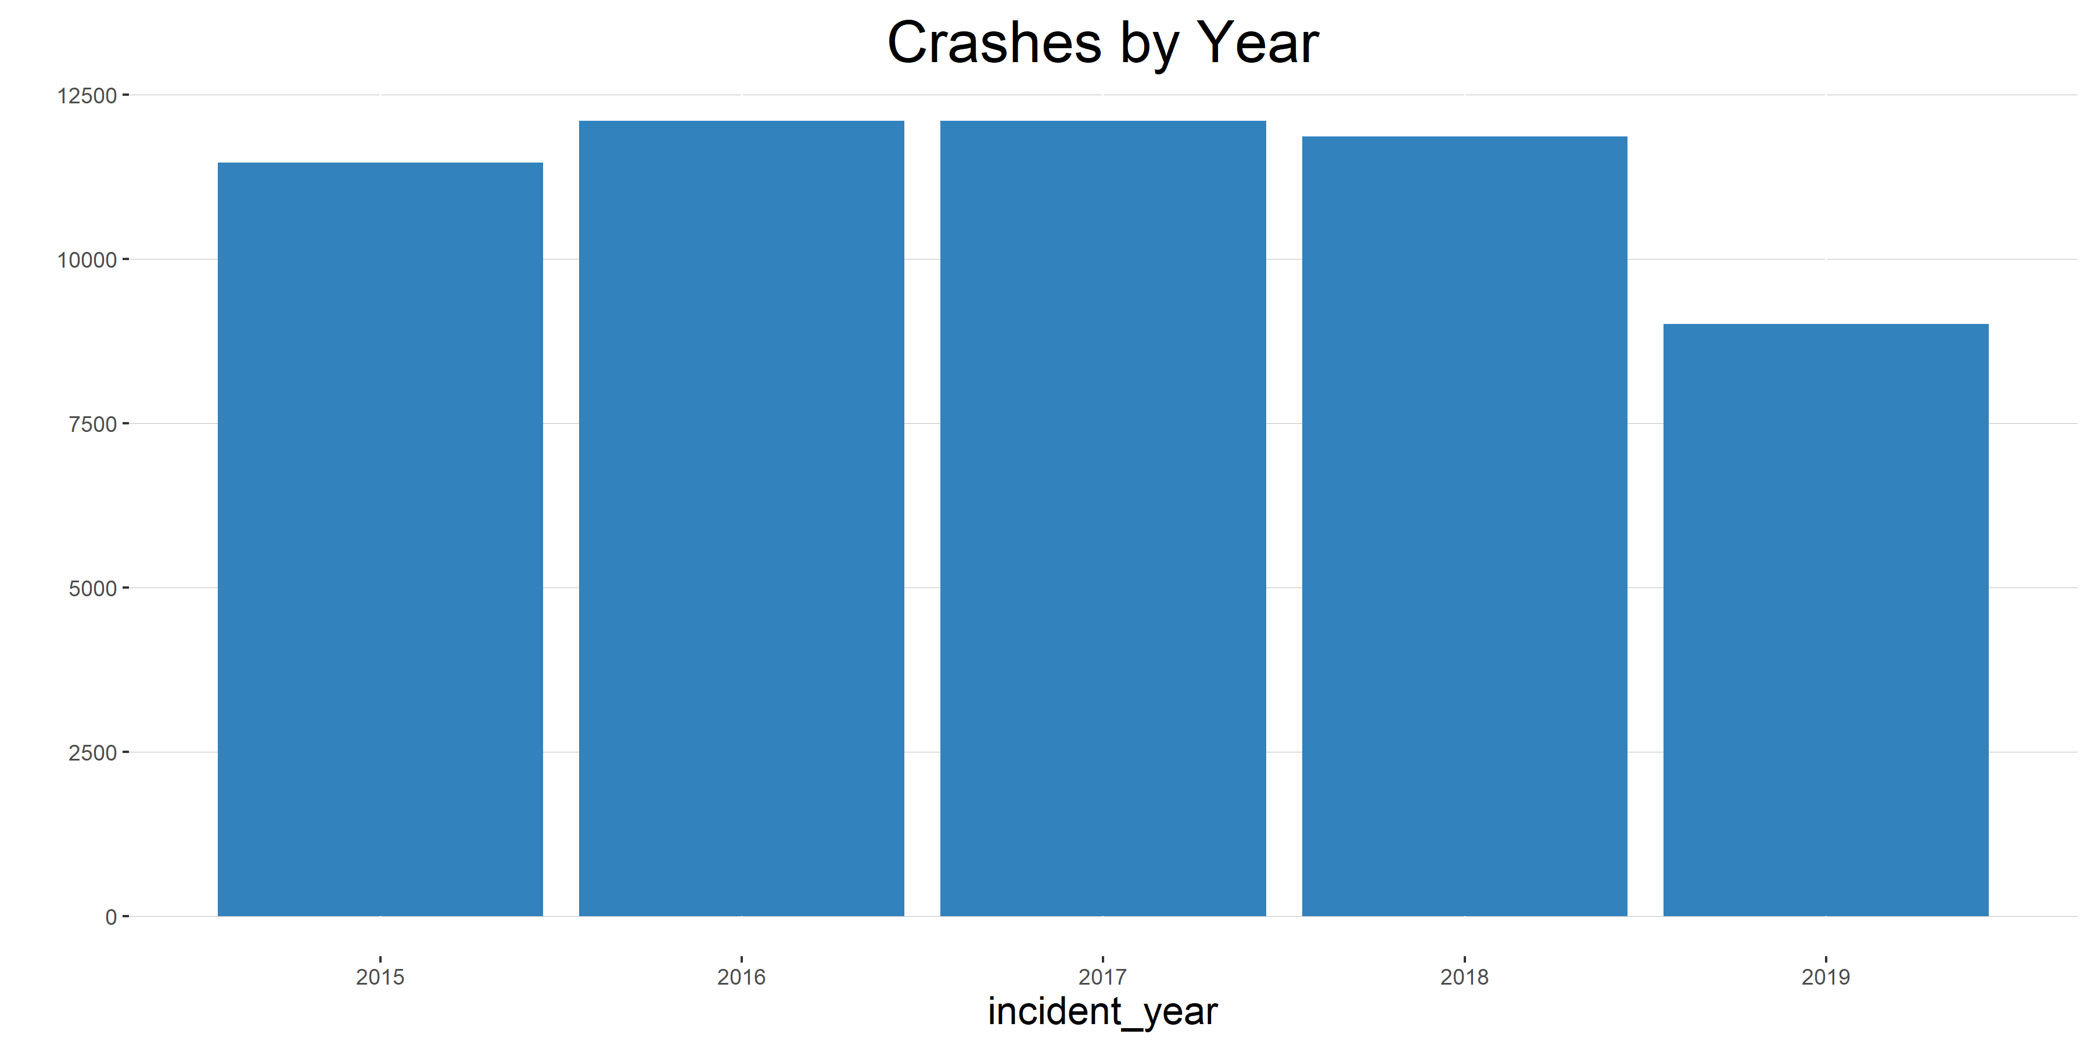

Slide 7
Number of Crashes by Date
Date | Number of Crashes | Rank
12/21 | 206 | 1
11/30 | 188 | 2
11/9 | 186 | 3
11/10 | 182 | 4
12/14 | 181 | 5
12/31 | 100 | 338
1/1 | 96 | 352
7/4 | 92 | 356
12/26 | 88 | 359
12/25 | 85 | 364

Slide 8
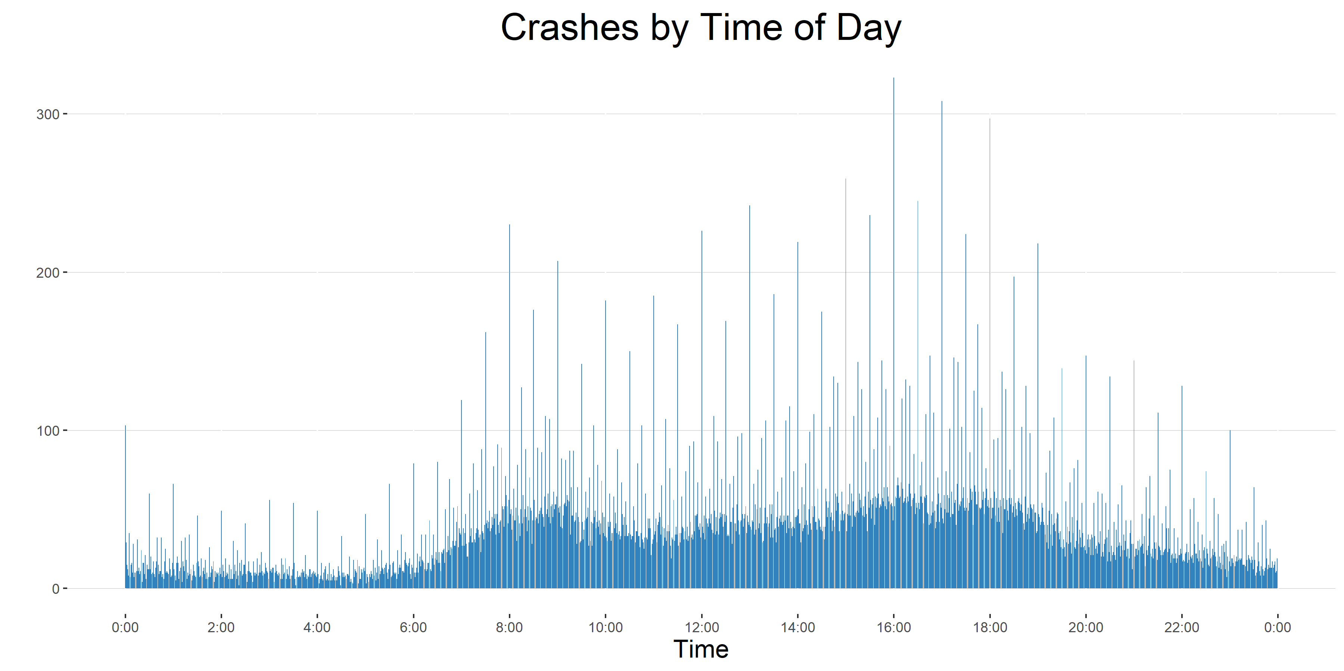

Slide 9
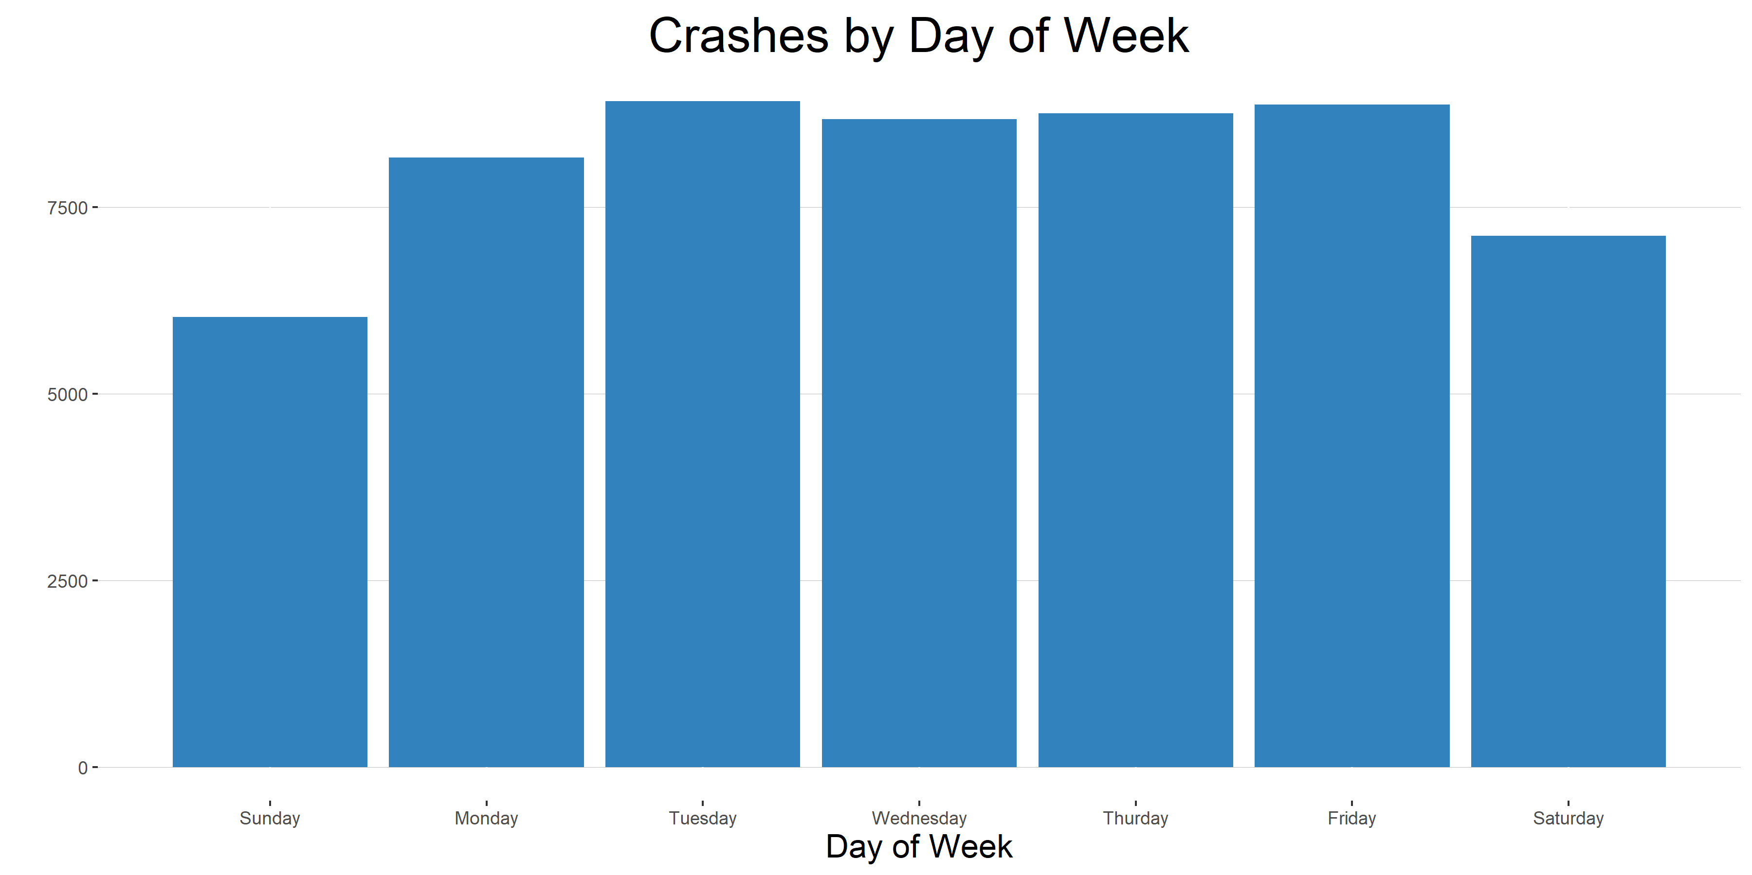

Slide 10
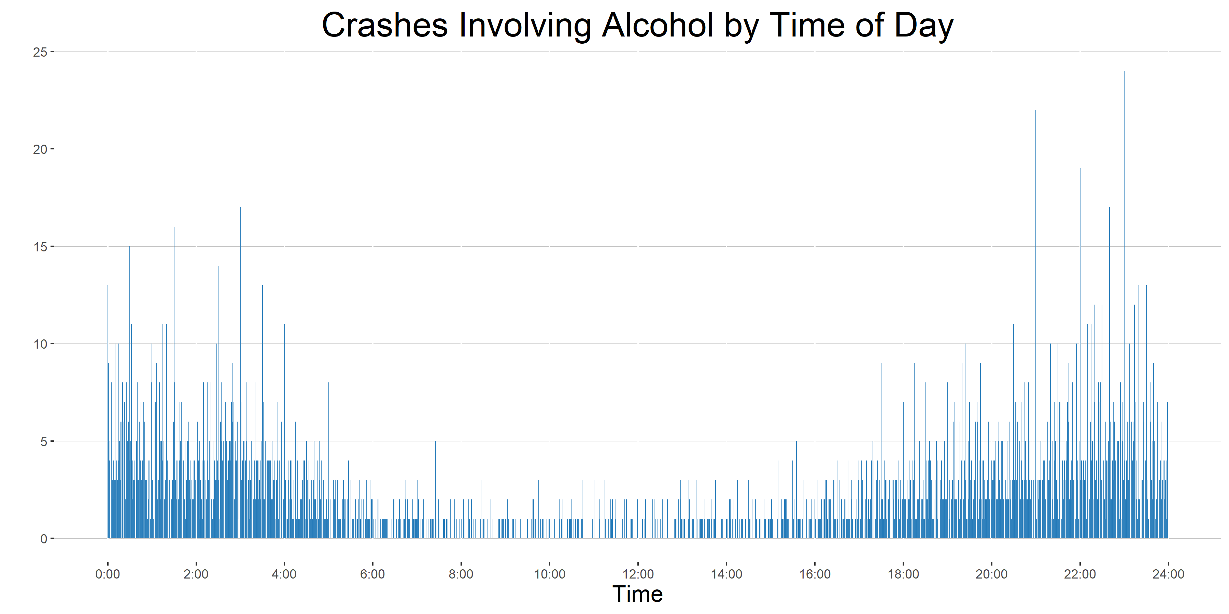

Slide 11
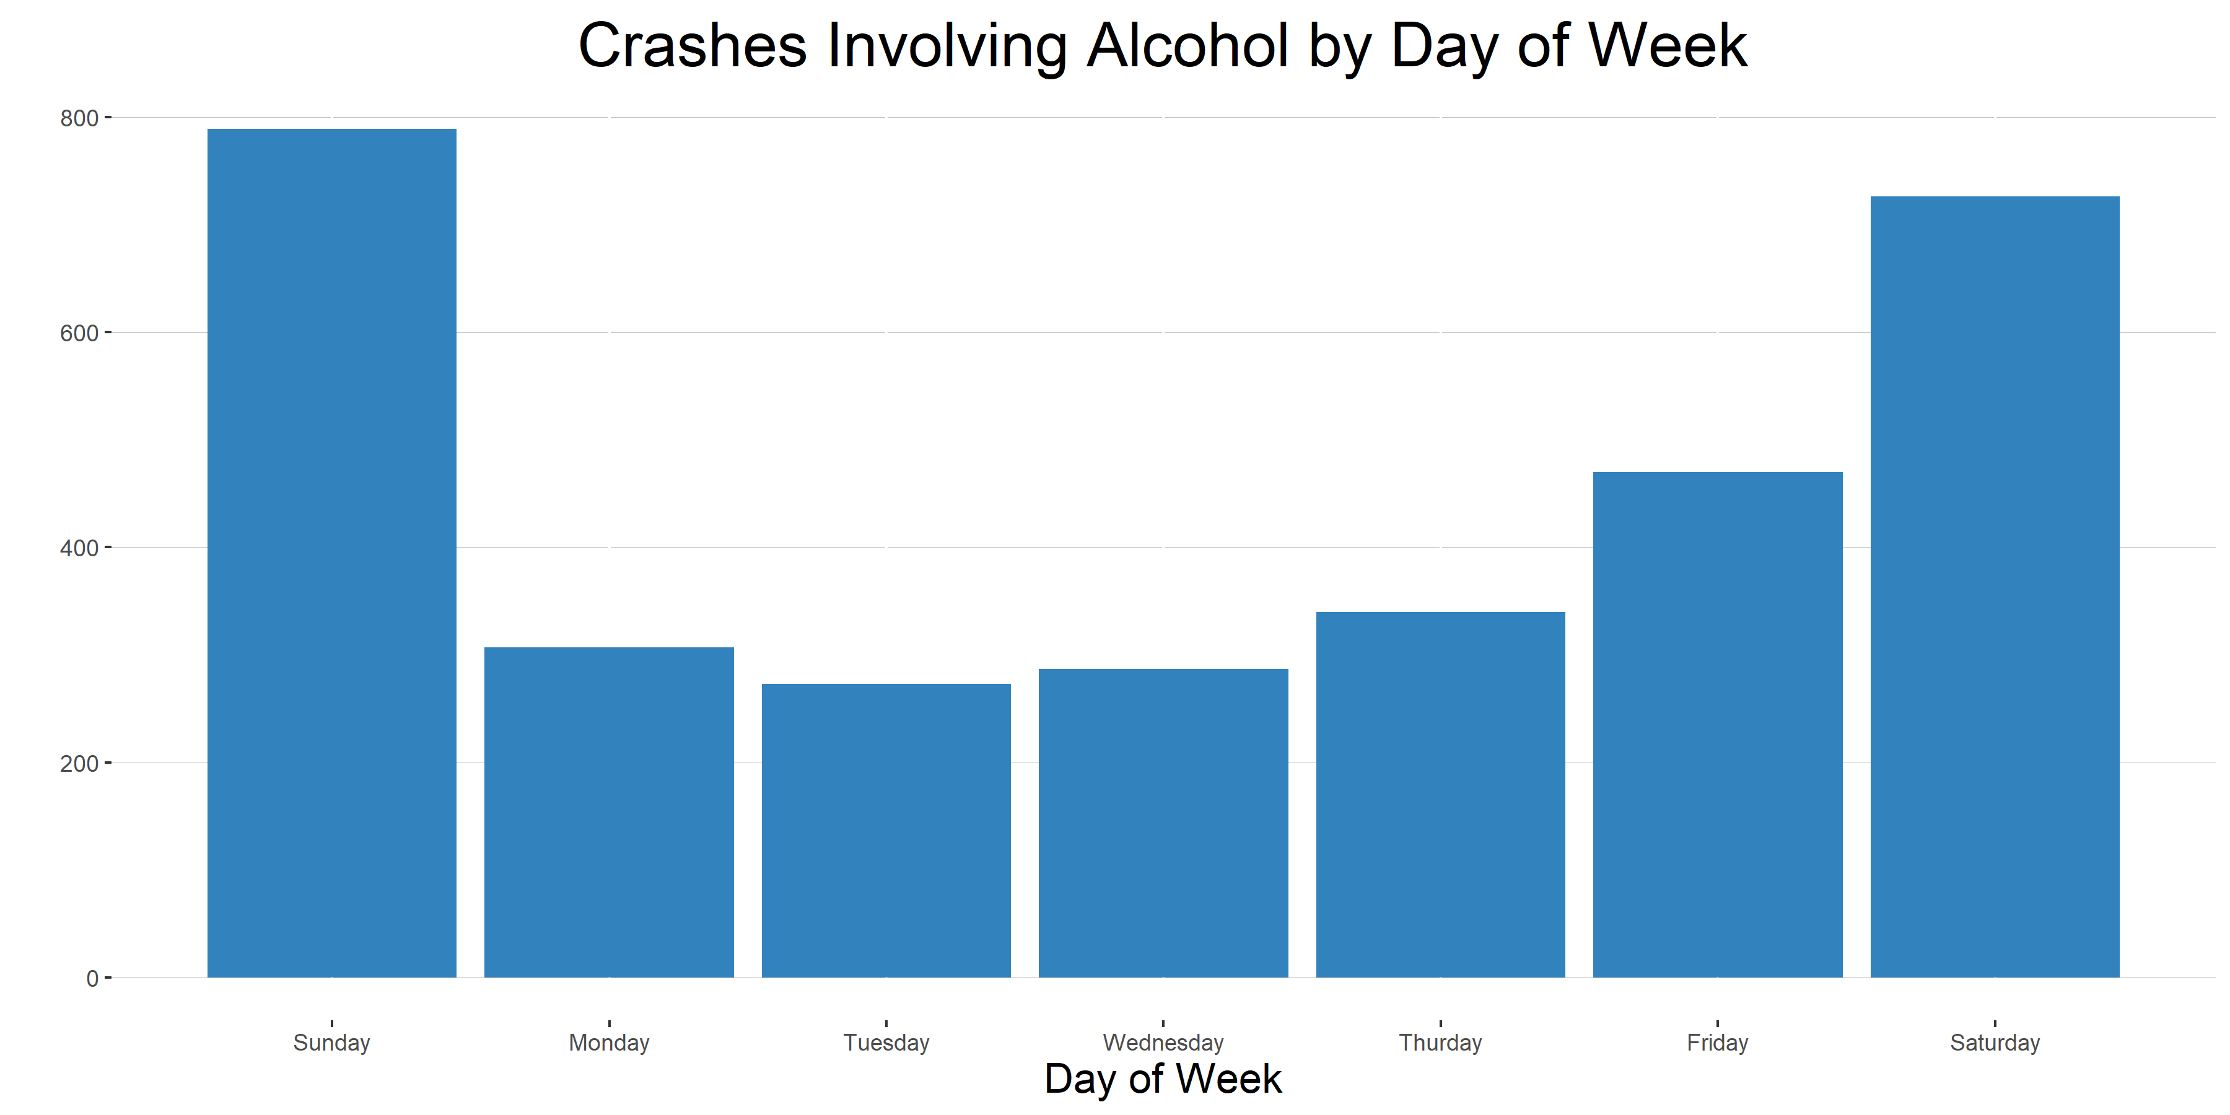

Slide 12
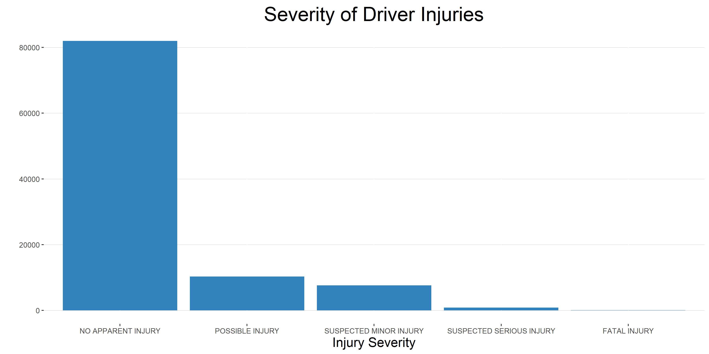

Slide 13
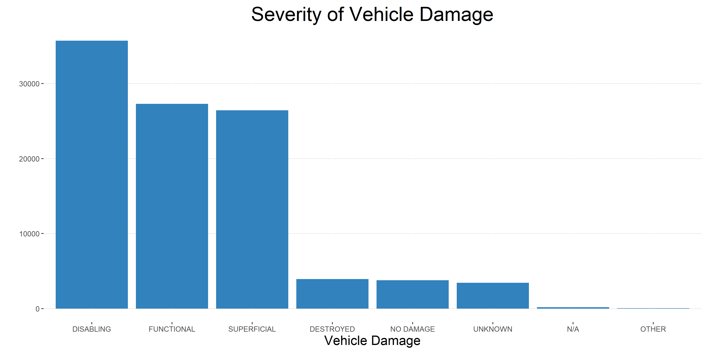

Slide 14
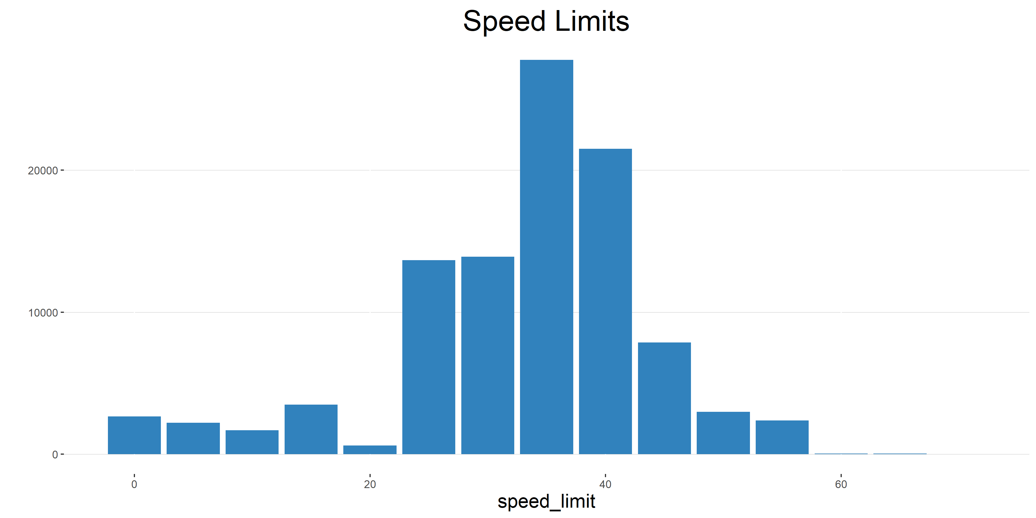

Slide 15
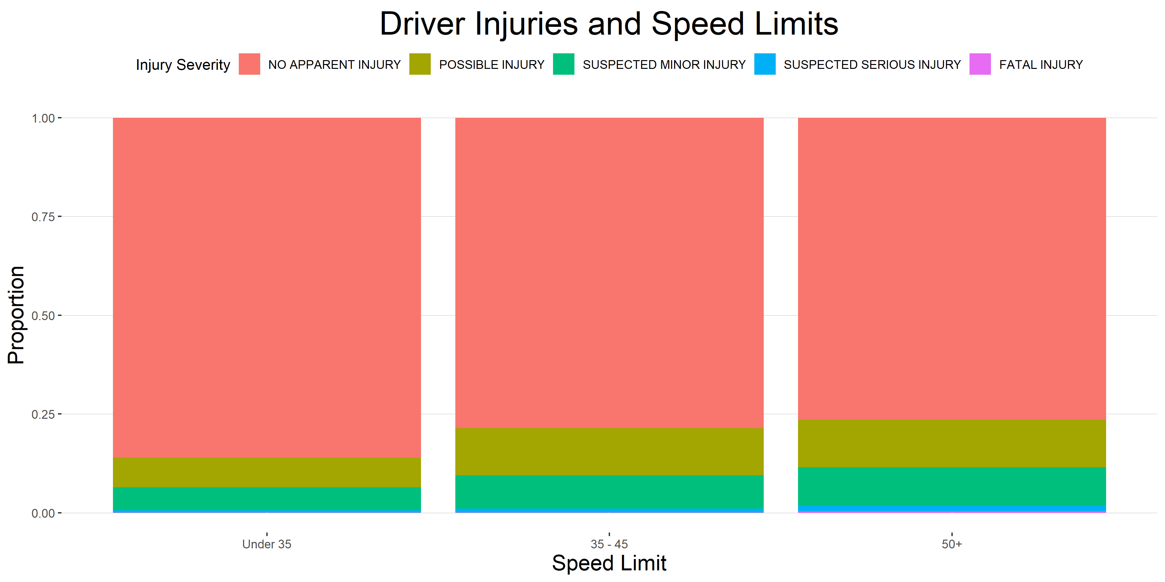

Slide 16
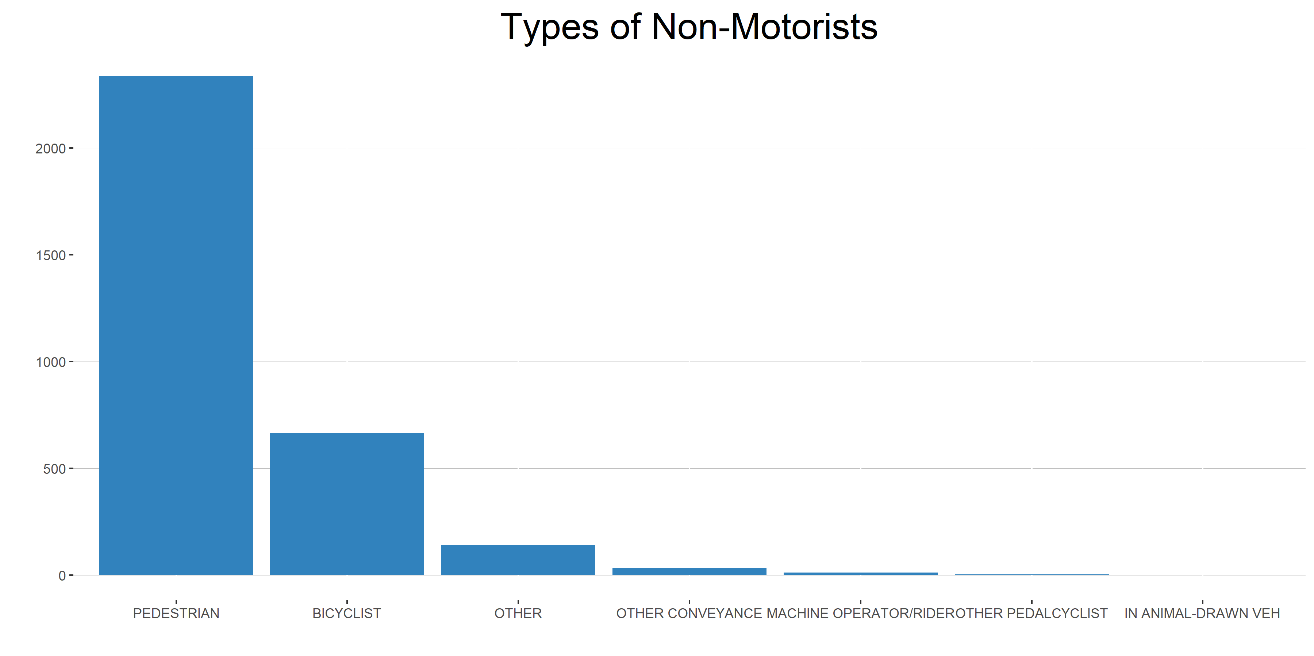

Slide 17
