Slide 1




N
EXECUTIVE BOARDROOM PITCH • HOUSE OF EXPERTISE #35
01 / 12
Misr Consult (House of Expertise #35) • Dar El-Khaleej (DEC) • NEXUS 360° AEC OS
NEXUS 360° AEC COMMAND OS
The Multi-Tenant AI-Powered Engineering ERP, Field Supervision & FIDIC Claims Platform Built for Multidisciplinary Mega-Consultancies
MISR CONSULT (MC #35) + DEC READY
ISO 9001 • 14001 • 45001
3 PILLARS OF EXECUTIVE VALUE
Unifying 527+ Engineers, 6 Core Disciplines & 316 Field Supervisors in One Real-Time Command Center
1. Multi-Discipline RIBA & BOQ Control
Live tracking across Water/SWRO, Civil/Structural, MEP/SCADA, Architecture/BIM, Bridges, and Geotech.
Purpose-built for House of Expertise #35 (Prof. Dr. Sameh Abdel-Gawad) & Dar El-Khaleej: connecting Cairo HQ design studios with remote WWTP, SWRO desalination, and infrastructure sites across Egypt, KSA, and the UAE.
2. GPS-Geofenced Field Companion OS
Mobile NCR/Snag photo pins, Daily Site Diaries, and IR approvals synced directly from remote sites.
3. FIDIC Claims & 360° EPI Scoring
Automated Sub-Clause 8.4 / 20.1 EOT dossiers and objective 4-factor Engineer Performance Index.
TOTAL WORKFORCE
MEGA-PORTFOLIO
AI ARCHITECTURE
527 Staff
$1.4B+
100% Sovereign
316 Site • 128 Design • 83 Support
WWTP • SWRO • Bridges • Silos
Local Ollama LLM + Cloud Sync
LIVE PRODUCTION DEPLOYMENT
LIVE NOW
https://milestonetracker.web.app
CONFIDENTIAL EXECUTIVE BRIEFING • MISR CONSULT (#35) & DAR EL-KHALEEJ (DEC)
LIVE PLATFORM: https://milestonetracker.web.app
Notes:
Good afternoon everyone, and thank you for having me. Today I am excited to show you NEXUS 360° AEC Command OS—and specifically how we have already configured a dedicated tenant environment tailored for Misr Consult (#35 House of Expertise) and Dar El-Khaleej (DEC). When you manage a 527-person multidisciplinary engineering consultancy with 316 site supervision staff across Toshka, New Delta, Hayah Karima, and UAE mega-projects, standard project trackers fail. NEXUS unifies your Cairo design studios, remote supervision sites, and FIDIC contract protection into one real-time AI command platform.

Slide 2




N
THE PROBLEM • WHY LEGACY AEC WORKFLOWS BLEED MARGIN
02 / 12
Misr Consult (House of Expertise #35) • Dar El-Khaleej (DEC) • NEXUS 360° AEC OS
Fragmented Silos Across HQ Studios & Remote Sites
Why WhatsApp photos, disconnected Excel BOQs, and manual FIDIC claim drafting cost mega-consultancies millions in unrecovered variations
01
02
03
04
The Field-to-HQ Blindspot
6-Discipline Coordination Chaos
Slow, Manual FIDIC EOT Claims
Subjective Engineer Evaluation
316+ site engineers supervise remote WWTPs, pump stations, and highways. Site photos, NCRs, and daily diaries sit trapped in WhatsApp threads and Excel sheets instead of feeding live RIBA & BOQ progress.
When utility clashes, client variations, or sovereign delays hit, assembling a defensible FIDIC Red/Yellow/Silver Book notice takes weeks of forensic document hunting—risking the 28-day time bar.
Evaluating 500+ staff relies on subjective manager memory rather than objective CAD workstation telemetry, GPS site attendance, submittal pass rates, and milestone velocity.
Process/Hydraulic, Civil/Structural, Electromechanical/SCADA, BIM/Arch, Bridges, and Geotech teams work in disconnected trackers—causing interdisciplinary clashes and late submittals.
Result: 5–10 Day Reporting Lag
Result: Submittal Bottlenecks
Result: Unrecovered EOT & Fees
Result: Hidden Underperformance
14+ Hrs
100% Solvable
68%
of EOT & variation claims are weakened by incomplete contemporaneous site records
wasted weekly per project director reconciling Excel S-curves with site WhatsApp reports
when CAD telemetry, GPS site logs, BOQs, and FIDIC AI live in one unified database
CONFIDENTIAL EXECUTIVE BRIEFING • MISR CONSULT (#35) & DAR EL-KHALEEJ (DEC)
LIVE PLATFORM: https://milestonetracker.web.app
Notes:
Let's look at what is broken in traditional engineering consultancies today. First: 60% of your workforce is in the field across remote sites like Toshka or Sinai, sending inspection updates via WhatsApp and paper logs that never link back to RIBA stages or Revit models. Second: when variations or delays occur, contract administrators spend weeks digging through emails to assemble a FIDIC Sub-Clause 8.4 Extension of Time claim. Third: management has no objective way to measure engineer productivity across both CAD studios and site supervision.

Slide 3


N
THE SOLUTION • INSTANT AI-POWERED TURNKEY CONTROL
03 / 12
Misr Consult (House of Expertise #35) • Dar El-Khaleej (DEC) • NEXUS 360° AEC OS
How NEXUS Fixes Every Bottleneck Immediately
Replacing fragmented spreadsheets and chat threads with a unified, multi-tenant AEC Command Center
BEFORE NEXUS (LEGACY WORKFLOW)
WITH NEXUS 360° AEC OS (LIVE TODAY)
❌ Disconnected Excel Trackers: Weekly manual S-curve updates that are already outdated by Monday morning.
✅ Live RIBA 0–7 & Earned Value BI: Real-time CPI/SPI, BOQ burn vs. physical progress, and 6-discipline radar charts.
❌ Unverified Site Attendance: Paper sign-in sheets and unindexed WhatsApp site photos across 20+ sites.
✅ GPS-Geofenced Field Companion: 1-tap NCR photo pins, weather/manpower logs, and instant HQ escalation.
❌ Manual FIDIC Claim Drafting: 3 weeks of legal/contract compilation per delay event; high risk of missed 28-day notices.
✅ 1-Click FIDIC EOT Claim Dossiers: Automated Sub-Clause 8.4, 13.1 & 20.1 legal narratives with quantum breakdown.
❌ Public Cloud AI Leaks: Engineers pasting confidential tender specs into consumer ChatGPT accounts.
✅ Air-Gapped Local AI (Ollama): Run DeepSeek-R1 & Qwen2.5-Coder on-premise with zero external data leakage.
10x Faster
100% Verified
Zero Leaks
< 60 Sec
FIDIC EOT & Variation Dossier Generation
Geofenced Site Supervision & CAD Telemetry
On-Premise Ollama LLM + Tenant Isolation
White-Label Firm Provisioning & Demo Seeding
CONFIDENTIAL EXECUTIVE BRIEFING • MISR CONSULT (#35) & DAR EL-KHALEEJ (DEC)
LIVE PLATFORM: https://milestonetracker.web.app
Notes:
Here is how NEXUS solves all four problems immediately. Every discipline and RIBA stage (0 to 7) is connected to live Earned Value S-Curves. Field engineers log inspections and NCRs from their phones with automatic GPS geofencing. Contract managers generate complete FIDIC EOT dossiers in one click, and our AI Engineering Copilot answers complex portfolio questions using 100% private local Ollama models.

Slide 4


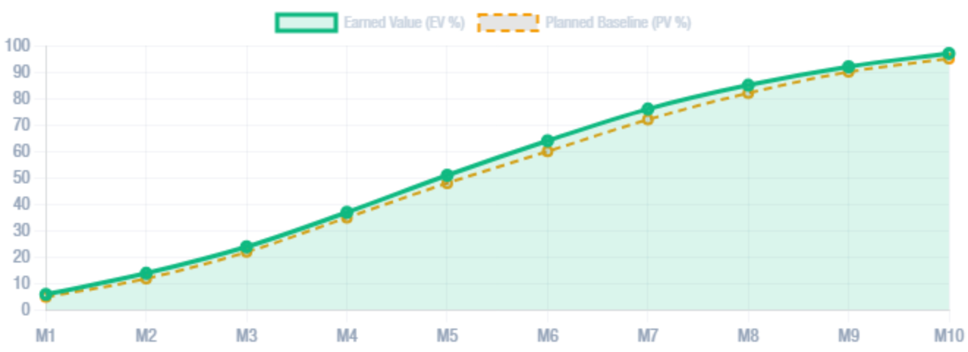

N
PRODUCT OVERVIEW • THE 'AHA!' MOMENT
04 / 12
Misr Consult (House of Expertise #35) • Dar El-Khaleej (DEC) • NEXUS 360° AEC OS
One Dual-Mode Platform: Portal + NEXUS ERP
Switch seamlessly between Executive Consultancy Portal and full Turnkey Engineering ERP across Desktop, Tablet, and Mobile
LIVE PORTFOLIO S-CURVE (EARNED VALUE VS. PLANNED VS. ACTUAL)
SPI 1.04 • CPI 1.02
8 INTEGRATED MODULES IN ONE APP
Aggregated across WWTP, SWRO Desalination, Bridges & Grain Silos
1. Executive BI & S-Curve
2. 6-Discipline Hub
3. 360° EPI Scoreboard
4. Live CAD & Site Telemetry
5. Field Companion Mobile
6. FIDIC EOT Claim Engine
7. Commercial Risk & HSE
8. Boardroom TV Mode
MOBILE + BOARDROOM RESPONSIVE
Works identically on a 65-inch Cairo Boardroom screen (with auto-cycling TV mode) and on a 375px iPhone screen in the middle of a Toshka or Sinai construction site.
CONFIDENTIAL EXECUTIVE BRIEFING • MISR CONSULT (#35) & DAR EL-KHALEEJ (DEC)
LIVE PLATFORM: https://milestonetracker.web.app
Notes:
The 'Aha!' moment happens the second you sign in. On the login screen, you can launch an isolated tenant for Misr Consult or DEC in one click, or switch between the Consultancy Portal and NEXUS ERP. Let's look at the live Earned Value S-Curve and 8 integrated modules that power the entire firm.

Slide 5


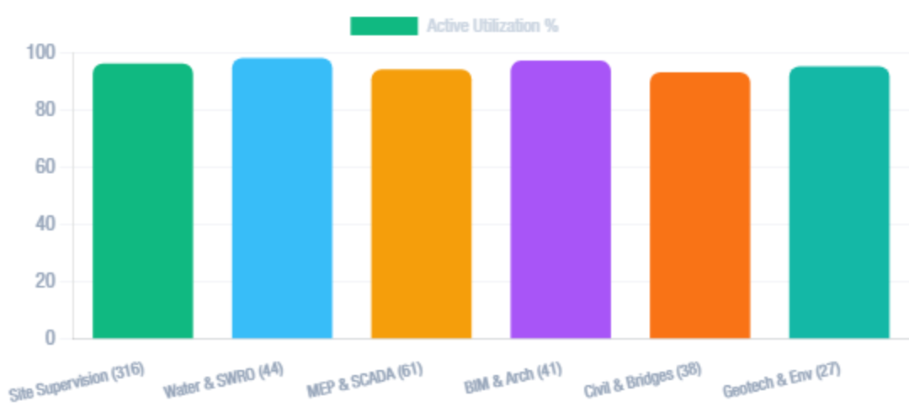
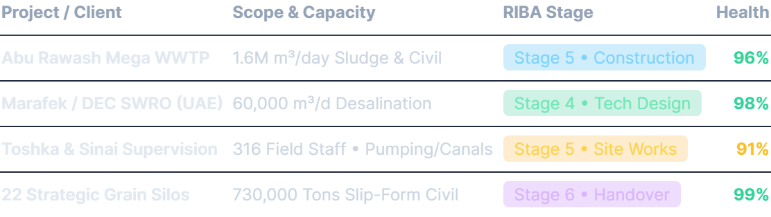
N
CORE FEATURE DEEP-DIVE #1 • MULTI-DISCIPLINE & RIBA HUB
05 / 12
Misr Consult (House of Expertise #35) • Dar El-Khaleej (DEC) • NEXUS 360° AEC OS
6-Discipline Engineering, RIBA 0–7 & BOQ Control
Purpose-built for Misr Consult's exact organizational structure (527 Staff across Water/SWRO, Civil, MEP, BIM, Bridges & Supervision)
MISR CONSULT 527-STAFF HEADCOUNT & UTILIZATION BY DIVISION
LIVE MEGA-PROJECT PORTFOLIO PRE-LOADED FOR MC (#35)
SUBMITTAL FIRST-TIME PASS
ACTIVE REVIT / CIVIL3D SYNC
ISO STAGE-GATE AUDIT
94.8%
BIM LOD 400
100% Compliant
CONFIDENTIAL EXECUTIVE BRIEFING • MISR CONSULT (#35) & DAR EL-KHALEEJ (DEC)
LIVE PLATFORM: https://milestonetracker.web.app
Notes:
Let's dive into Core Feature #1: the Multi-Discipline Engineering, RIBA Stage-Gate, and BOQ Control Hub. We mapped this directly to Misr Consult's 527-staff structure: 316 in Construction Supervision, 128 in Design Studios across Water/SWRO, Electromechanical/SCADA, BIM/Architecture, Civil/Bridges, and 83 in Support/Management. Every project tracks RIBA stages 0 through 7, live submittal pass rates, and BOQ earned value.

Slide 6


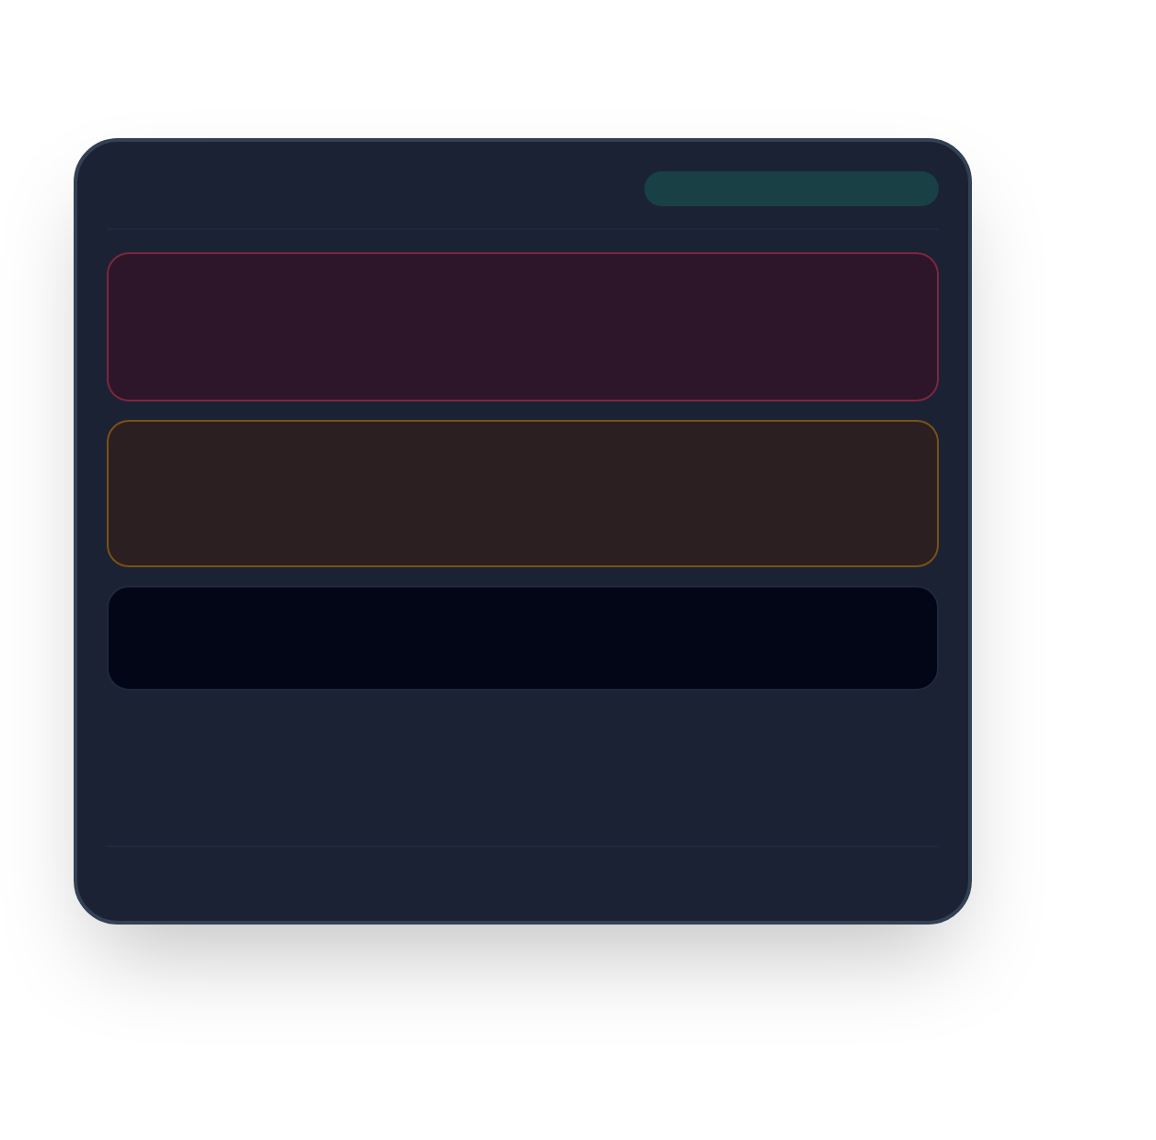
N
CORE FEATURE DEEP-DIVE #2 • FIELD COMPANION MOBILE OS
06 / 12
Misr Consult (House of Expertise #35) • Dar El-Khaleej (DEC) • NEXUS 360° AEC OS
Mobile Site Supervision, Geofenced GPS & NCR Pinning
Empowering 316+ Resident Engineers & Site Inspectors across remote sites with instant mobile-to-HQ synchronization
📱 FIELD COMPANION MOBILE VIEW
GPS VERIFIED • TOSHKA SITE
How Field Companion Transforms Site Supervision
NCR #108 • HIGH SEVERITY
10:14 AM • Zone B2
1. Geofenced GPS Check-In
2. Instant NCR & Snag Photo Pinning
Reinforcement cover < 50mm on Clarifier Tank Wall
Verifies resident engineers are physically inside the project boundary (Toshka, New Delta, Abu Rawash, UAE) with live lat/long telemetry.
Capture defect photos, tag discipline (Civil, MEP, SWRO, Safety), assign severity, and lock contractorpour approvals until resolved.
Assigned: Civil Contractor • Photo + GPS Coordinates Attached
IR #442 • MEP HYDRO-TEST
11:30 AM • Pump Stn 3
HDPE 1200mm Pressure Line Test @ 16 Bar
3. Contemporaneous FIDIC Evidence
4. Deep Workstation + Field Sync
Status: Approved by Resident Engineer (Digital Sign-off)
Every daily site diary, weather delay, and obstructed access log is timestamped and feeds directly into the FIDIC EOT Claim Generator.
Combines Cairo studio CAD/BIM active hours with remote site GPS logs in the Live Operations Monitor.
Weather
Site Manpower
Heavy Plant
34°C Sunny
412 Workers
28 Active
IMPACT FOR MISR CONSULT'S 316 SUPERVISION STAFF
0 Lag
Offline-First IndexedDB Cache • Syncs Automatically on Reconnect
Eliminates 100% of manual daily report typing and creates an unshakeable audit trail for ISO 9001 & 45001.
CONFIDENTIAL EXECUTIVE BRIEFING • MISR CONSULT (#35) & DAR EL-KHALEEJ (DEC)
LIVE PLATFORM: https://milestonetracker.web.app
Notes:
Core Feature #2 is built specifically for your 316 site supervision engineers—the largest division in Misr Consult. Instead of sending loose photos over WhatsApp, resident engineers open the Field Companion App on their phone. It verifies their GPS geofence on site, lets them snap photos and pin Non-Conformance Reports (NCRs) or Snags by severity, log daily weather, manpower, and equipment counts, and approve Inspection Requests (IRs) that update the Cairo HQ dashboard in real time.

Slide 7


N
CORE FEATURE DEEP-DIVE #3 • FIDIC CLAIMS, RISK & 360° EPI
07 / 12
Misr Consult (House of Expertise #35) • Dar El-Khaleej (DEC) • NEXUS 360° AEC OS
Automated FIDIC EOT Dossiers & 360° Engineer Scoring
Protecting consultancy fee margins under FIDIC Red/Yellow/Silver Books while ranking top engineering talent objectively
⚖️ FIDIC EOT & VARIATION CLAIM GENERATOR
1999 / 2017 Editions
🏆 360° ENGINEER PERFORMANCE INDEX (EPI)
4-Pillar Weighted Formula
1-Click Legal Dossier & Quantum Calculation
35%
25%
25%
15%
Select any delay event (e.g., Unforeseen Subsurface Utilities at Toshka Canal or SWRO High-Pressure Pump Customs Delay) and automatically generate a ready-to-sign claim notice:
CAD/BIM Telemetry
Geofenced Site GPS
Submittal QA Pass
Milestone Velocity
• Contractual Basis: Auto-cites FIDIC Sub-Clause 20.1 (28-Day Notice), 8.4 (EOT), 4.12 (Unforeseeable Physical Conditions) & 13.1 (Variations).
#1 Eng. Ahmed Seera (Mega WWTP Division)
100 / 100
CAD: 100% • GPS: 100% • QA: 98% • Logs: 100%
• Critical Path & Quantum: Calculates net critical delay days, site supervision prolongation cost, and remobilization fees.
#2 Eng. Ahmed Abdel-Gawad (SWRO & Marafek UAE)
99 / 100
CAD: 100% • GPS: 99% • QA: 97% • Logs: 99%
• Contemporaneous Exhibits: Links directly to timestamped Field Companion diaries, NCRs, and RFIs.
#3 Eng. Mohamed Saber (Site Supervision – 316 Staff)
97 / 100
CAD: 100% • GPS: 96% • QA: 93% • Logs: 95%
Plus: ISO 45001 HSE TRIR & Monte Carlo Risk Matrix
Export PDF / Print Ready
Responsive 2-tier cards ensure zero text truncation on both desktop and mobile viewports.
CONFIDENTIAL EXECUTIVE BRIEFING • MISR CONSULT (#35) & DAR EL-KHALEEJ (DEC)
LIVE PLATFORM: https://milestonetracker.web.app
Notes:
Core Feature #3 protects your bottom line and your people. First, our FIDIC EOT & Variation Claim Generator turns logged delay events into formal, clause-cited FIDIC 1999/2017 notices (Sub-Clauses 8.4, 8.5, 13.1, 17.4, and 20.1) complete with critical-path impact and prolongation cost quantum. Second, our proprietary 360° Engineer Performance Index (EPI) objectively scores every engineer out of 100 across four weighted pillars.

Slide 8

N
UNDER THE HOOD • HOW THE HYBRID AI & TELEMETRY ARCHITECTURE WORKS
08 / 12
Misr Consult (House of Expertise #35) • Dar El-Khaleej (DEC) • NEXUS 360° AEC OS
100% Sovereign Local AI (Ollama) + Real-Time Firestore
Zero data leakage for sovereign water, military, and infrastructure tenders—powered by on-premise LLMs
STAGE 1 • MULTI-SOURCE INGESTION
STAGE 2 • SOVEREIGN AI PROCESSING
STAGE 3 • EXECUTIVE ACTION OUTPUTS
Unified Telemetry & Project Context
Local Ollama LLM + RAG Pipeline
Instant Decisions & Legal Dossiers
Workstation Daemons: Active Revit, AutoCAD, Civil 3D, WaterGEMS, and Primavera P6 window telemetry.
100% On-Premise Ollama: Connects to localhost:11434 running Qwen2.5-Coder 32B, DeepSeek-R1 32B, or Llama 3.
AI Engineering Copilot: Answers "Summarize delayed projects" or "Draft FIDIC EOT notice" in seconds.
Field Companion GPS: Mobile check-ins, NCR defect pins, and daily manpower/weather logs.
Automated EPI Calculation: Recomputes 360° engineer rankings dynamically as logs arrive.
Live Context Injection: Injects active project KPIs, overdue milestones, SPI/CPI variances, and FIDIC clauses into every prompt.
Multi-Tenant Firestore: Strict tenant-isolated real-time collections (firms / projects / logs).
Boardroom TV Broadcast: Auto-cycles 5 executive views every 12 seconds for client visits.
Zero-Latency Fallback: Built-in deterministic AEC domain engine if offline on remote sites.
Real-Time Snapshot Sync (<150ms)
Air-Gapped Sovereign Security
Exportable to PDF, CSV & Print
CONFIDENTIAL EXECUTIVE BRIEFING • MISR CONSULT (#35) & DAR EL-KHALEEJ (DEC)
LIVE PLATFORM: https://milestonetracker.web.app
Notes:
A critical question for any House of Expertise handling national water security, grain silos, and sovereign infrastructure is: 'Where does our data go when we use AI?' Under the hood, NEXUS uses a Hybrid Sovereign AI pipeline. It connects directly to your local Ollama server running models like DeepSeek-R1 and Qwen2.5-Coder on your own hardware—meaning zero confidential tender data ever leaves your network.

Slide 9


N
STEP-BY-STEP USER GUIDE • FROM SIGN-UP TO FIRST RESULT IN 3 STEPS
09 / 12
Misr Consult (House of Expertise #35) • Dar El-Khaleej (DEC) • NEXUS 360° AEC OS
Launch Your Firm Workspace in Under 60 Seconds
Zero 6-month ERP implementation pain—how a new consultancy goes from login to live FIDIC & BI output in 3 steps
STEP 1 • 15 SECONDS
Provisioning
STEP 2 • 20 SECONDS
Live Operations
STEP 3 • 25 SECONDS
AI & Claims
Launch Tenant or One-Click Demo
Track RIBA, EPI & Field Logs
Generate FIDIC Claim or Board Mode
Visit milestonetracker.web.app/login. Click "Launch Misr Consult (#35) Demo" or "+ New Firm" to provision an isolated multi-tenant workspace pre-seeded with your divisions, projects, and staff.
Land on the Executive Command Center. Filter the 360° EPI Scoreboard by discipline (Water & SWRO, Site Supervision, MEP, BIM, Civil), or log a mobile site inspection in Field Companion.
Open the FIDIC Claim Engine to export a formal Sub-Clause 8.4/20.1 EOT dossier, ask the AI Copilot for a portfolio risk summary, or launch Boardroom TV Mode for client presentations.
Included Out of the Box:
Instant Visibility:
Immediate ROI Outputs:
• Custom Firm Name & Theme
• Role-Based Access (Admin/Lead/Engineer)
• Pre-Seeded Mega-Project Portfolio
• Earned Value S-Curve (CPI / SPI)
• 6-Discipline Submittal QA Pass Rates
• Live CAD & Geofenced GPS Telemetry
• Signed FIDIC EOT Notice Dossier
• ISO 45001 HSE & Risk Register
• Full-Screen Auto-Cycling TV Mode
Zero Disruption Adoption: Can run alongside existing Primavera P6 / Revit workflows on Day 1 via CSV/Excel import & workstation telemetry.
Time to Value: < 1 Hour
CONFIDENTIAL EXECUTIVE BRIEFING • MISR CONSULT (#35) & DAR EL-KHALEEJ (DEC)
LIVE PLATFORM: https://milestonetracker.web.app
Notes:
Getting started with NEXUS takes less than 60 seconds—not six months of painful ERP consulting. In Step 1, you click 'New Firm' or 'Launch Misr Consult (#35) Demo' on the login screen. In Step 2, you explore the live Command Dashboard, 6-Discipline Hub, and 360° EPI Scoreboard. In Step 3, you open the AI Copilot or FIDIC Claim Generator to export your first board-ready report.

Slide 10


N
REAL-WORLD USE CASES • WHO BENEFITS ACROSS THE CONSULTANCY
10 / 12
Misr Consult (House of Expertise #35) • Dar El-Khaleej (DEC) • NEXUS 360° AEC OS
3 High-Impact Scenarios Built for Misr Consult & DEC
How Principals, Resident Engineers, and Contract Directors use NEXUS every single day
SCENARIO 1 • EXECUTIVE BOARDROOM
SCENARIO 2 • REMOTE MEGA-SITES
SCENARIO 3 • COMMERCIAL PROTECTION
Chairman & Managing Principals (Prof. Dr. Sameh Abdel-Gawad)
Head of Construction Supervision (316 Field Staff)
Contracts, Claims & Cost Control Directors
When electro-mechanical equipment customs delays or underground utility clashes impact critical path, the director opens FIDIC Claim Generator and exports a Sub-Clause 8.4 & 20.1 EOT dossier in 2 minutes.
During a ministerial review or Marafek UAE partner visit, leadership switches on Boardroom Presentation TV Mode. The 65" screen auto-cycles live KPIs, S-Curves, 6-discipline radars, and top EPI engineers every 12 seconds.
Across Toshka, New Delta, and Hayah Karima WWTP sites, resident engineers check in via Field Companion GPS, pin concrete cover NCRs with photos, and log daily manpower. Cairo HQ sees every active site in real time.
Measurable Outcome:
Measurable Outcome:
Measurable Outcome:
Unmatched institutional prestige; proves real-time ISO 9001/14001/45001 governance to sovereign clients.
Saves 15+ hours/week per site lead and eliminates unverified attendance or lost WhatsApp defect reports.
Zero missed 28-day FIDIC time bars and full recovery of prolonged site supervision fees.
CONFIDENTIAL EXECUTIVE BRIEFING • MISR CONSULT (#35) & DAR EL-KHALEEJ (DEC)
LIVE PLATFORM: https://milestonetracker.web.app
Notes:
Let's look at three concrete real-world scenarios tailored to Misr Consult and Dar El-Khaleej. Scenario 1 is for the Managing Principal and Board during high-stakes Ministerial or UAE client meetings. Scenario 2 is for the Head of Construction Supervision managing 316 field engineers across Toshka and New Delta. Scenario 3 is for the Contracts & Claims Director recovering EOT and variation fees on a 60,000 m3/day SWRO desalination plant.

Slide 11


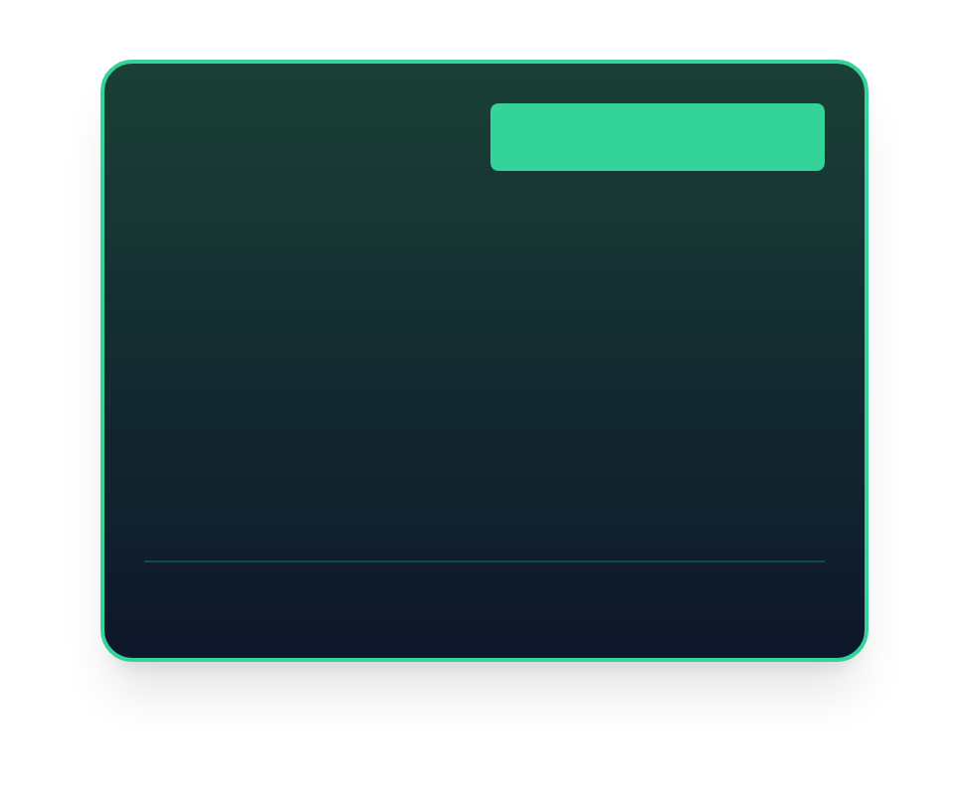
N
PRICING & DEPLOYMENT MODEL • FLEXIBLE ENTERPRISE ROLLOUT
11 / 12
Misr Consult (House of Expertise #35) • Dar El-Khaleej (DEC) • NEXUS 360° AEC OS
Multi-Tenant Cloud, Dedicated White-Label, or Sovereign On-Prem
Tailored commercial tiers designed for growing engineering firms and 500+ staff Houses of Expertise
TIER 1 • DIVISION PILOT
TIER 2 • HOUSE OF EXPERTISE
RECOMMENDED FOR MC & DEC
TIER 3 • NATIONAL SECURITY GRADE
Department Cloud
Sovereign On-Prem + AI
Up to 50 Engineers • Instant Setup
Enterprise White-Label
Air-Gapped Local Ollama LLM Cluster
✅ Multi-Tenant Isolated Firestore Workspace
✅ Executive BI S-Curves & RIBA 0–7 Tracker
✅ 360° Engineer Performance Index (EPI)
✅ Field Companion Mobile Web App
✅ Standard FIDIC EOT Claim Templates
500+ Staff Across Egypt, KSA & UAE
✅ Everything in Enterprise White-Label
✅ On-Premise Ollama AI (Qwen2.5 / DeepSeek-R1)
✅ Zero External Cloud Data Transmission
✅ Custom Revit / Primavera P6 / ERP Connectors
✅ Dedicated SLA & Custom Feature Engineering
✅ Full Custom Branding (MC #35 & DEC Portals)
✅ Unlimited Mega-Projects & 6-Discipline Hubs
✅ 316+ Field Supervision Mobile Companion Seats
✅ Full FIDIC Red/Yellow/Silver Claim & Quantum Engine
✅ Boardroom TV Mode + Dedicated Onboarding
Ideal for single-project or single-division pilot
Ready for immediate 30-Day Pilot Rollout
Built for sovereign water, silo & defense tenders
CONFIDENTIAL EXECUTIVE BRIEFING • MISR CONSULT (#35) & DAR EL-KHALEEJ (DEC)
LIVE PLATFORM: https://milestonetracker.web.app
Notes:
We offer three flexible deployment models depending on your governance needs. Tier 1 is our Multi-Tenant Cloud Workspace for fast department pilots. Tier 2 is our Enterprise House of Expertise White-Label—recommended for Misr Consult and DEC—supporting all 527+ staff across Egypt, KSA, and the UAE with custom branding. Tier 3 is our Sovereign On-Premise + Local Ollama AI deployment for classified national infrastructure.

Slide 12



N
CALL TO ACTION • YOUR MISR CONSULT (#35) TENANT IS LIVE RIGHT NOW
12 / 12
Misr Consult (House of Expertise #35) • Dar El-Khaleej (DEC) • NEXUS 360° AEC OS
Let's Step Inside Your Live Misr Consult Command Center
Pre-seeded with MC's 527-staff structure, Abu Rawash WWTP, Marafek UAE SWRO, Toshka Supervision, and 22 Strategic Grain Silos
LIVE INTERACTIVE DEMO READY NOW
PROPOSED 30-DAY PILOT ROADMAP
Experience Misr Consult (#35) & DEC Live in 1 Click
Week 1 • Brand & Portfolio Alignment
Configure MC (#35) & DEC custom domains, import active WWTP/SWRO BOQs, and onboard division heads.
Open https://milestonetracker.web.app/login on any laptop, tablet, or phone in this room and click "Launch Misr Consult (#35) Demo".
Week 2 • Field Companion Pilot
Equip resident engineers on 2 flagship sites with mobile GPS check-in, NCR photo pinning, and daily logs.
Live URL (Desktop & Mobile)
Pre-Configured Tenant
https://milestonetracker.web.app
Misr Consult (MC #35) & DEC
Week 3–4 • FIDIC Claims & Board Review
Deploy local Ollama AI Copilot on-premise and review first 30-day 360° EPI & Earned Value report.
Let's Switch to the Live Platform Walkthrough →
Prepared by: Eng. Michael Magdy
Engineered for: Prof. Dr. Sameh Abdel-Gawad & MC / DEC Leadership
CONFIDENTIAL EXECUTIVE BRIEFING • MISR CONSULT (#35) & DAR EL-KHALEEJ (DEC)
LIVE PLATFORM: https://milestonetracker.web.app
Notes:
Thank you. Best of all—we didn't just bring slides today. We have already provisioned and deployed a live Misr Consult (#35 House of Expertise) and Dar El-Khaleej workspace at milestonetracker.web.app. Let's switch over to the live browser right now, click 'Launch Misr Consult (#35) Demo', and walk through your projects together.

