Slide 1
Research Methods in Information Systems Research :
“Matching method to researcher”
Alistair Cockburn
(Prescribed Topic)
http://Alistair.Cockburn.us
http://Alistair.Cockburn.us/crystal/talks/rmiisr2003.03-045min.ppt

Slide 2
Purpose of this lecture
Demonstrate that the candidate can
  look things up in books,
  stand up and talk about them.
Get candidate to learn something new about the topic.
Illuminate something relevant to the dissertation topic
(Be entertaining)

Slide 3
There is no “ideal” method:
Each has both strengths & shortcomings.
(COST: acceptable cost (-> get someone to pay for it!))
RL: Real-Life (-> apply to real-world situations)
HR: Hi-resolution, detail (-> discover unknown effects)
OE: No “Observer Effect” (-> apply to real-world situations)
SS: Statistically sound (-> allow generalization)
CV: Control variables (-> eliminate irrelevant effects)
Oppositions
HR <----/----> OE
RL <----/----> SS & CV
Sample scorecard:
RL
X
√
SS,CV
HR
√
X
OE

Slide 4
People have different ambitions for their research.
Make-sense-of what is happening
  [ Cooperative game of invention & communication ]
Explain what is happening (or validate an explanation)
  [ Information radiators ]
Predict what will happen
  [ Proximity between developers ]
  `
Cause something particular to happen
  [ Remove interruptions; Seat team in same room ]
Sample scorecard:
mso - expl - pred - cause

Slide 5
This talk contrasts research methods in 3 frames
Method strengths vs. Method character
Researcher priorities oppositions
  RL: Real-Life
  HR: Hi-resolution (detail) OE <----/----> HR
  OE: No “Observer Effect” RL <----/----> SS&CV
  SS: Statistically sound
  CV: Control variables
Researcher Ambitions
  mso: Make sense of what is happening
  expl: Explain what is happening (validate an explanation)
  pred: Predict what will happen
  cause: Cause something particular to happen
Alistair’s desired scorecard:
RL
√ ⁺
X
SS,CV
HR
+
√
OE
mso - expl - pred - cause

Slide 6
Composite view of methods and their oppositions.
CV,
SS
Survey
Hi-Res
Lab experiment
Videotaping
Field experiment
Action research
Grounded theory
Case study
Action research
Employee
(hi-res memory)
Case study
absence of
observer-effect
Real-
Life
Employee
Videotaping
Lab experiment
Action research
Longitudinal
Survey
Case study
(time)
snapshot
episode
project
years/decades

Slide 7
Primary Sources:
Galliers, R., "Choosing Information System Research Approaches," in Galliers, R. (ed.), Information System Research: Issues, Methods and Practical Guidelines, Blackwell Scientific, Oxford, 1992, pp. 144-162.
Glaser, B, Strauss, A., The Discovery of Grounded Theory: Strategies for Qualitative Research, Aldine de Gruyter, NY, 1967.
Pettigrew, A.M., “Longitudinal field research on change,” in Huber, G.P., van de Ven, A.H. (eds.), Longitudinal Field Research Methods, Sage Publications, 1995, pp. 91-125
Mathiassen L., "Collaborative Practice Research,” in Information, Technology & People, Vol. 15, No. 4, 2002, pp 321-345. (Older version at http://www.cs.auc.dk/~pan/pdf/mathiassen-aalborg2000.pdf)

Slide 8
Galliers splits the methods into
“Scientific” and “Interpretive”
Lab Experiments
Field experiments
Surveys
Case studies
Forecasting
Simulation
(Grounded research)
Action research
Subjective / argumentative
Descriptive / interpretive
Futures research
Reviews
(“the challenge . . . is to find practical ways to combine qualitatively different research approaches” --Mathiassen 2002)
Combinational approaches:
Longitudinal studies
(Collaborative practice research)
(Dialectical)

Slide 9
#1. Laboratory Experiments:
Control, study small number of variables intensively.
Identifying precise relationships between chosen variables via a designed lab situation, using quantitative analytical techniques, with a view to making generalizable statements
(+) The solution and control of a small number of variables which may then be studied intensively.
(-) Limited extent to which identified relationships exist in the real world due to oversimplification of the experimental situation and the isolation of such situations from most of the variables that are found in the real world.
Uses: Laurie Williams’ Pair Programming PhD dissertation: 36 students, varying only solo/pair , controlling for sex, experience, methodology.
RL
X
√
SS,CV
HR
√
X
OE
mso - expl - pred - cause

Slide 10
#2. Field Experiments:
Realism at the expense of control.
Extension of the laboratory experiments into the real-life situations of organizations and/or society.
(+) Greater realism
(-) Achieving sufficient control to enable replication, with only the study variables being altered.
Finding organizations prepared to be experimented on.
Uses: Cockburn experiments in courses and projects:
  - OO design course: techniques and language used
  - Project strategies (eg, Increment lengths, collocation)
RL
√
X
SS,CV
HR
√
+
OE
mso - expl - pred - cause

Slide 11
#3. Surveys: Time-stamped samples from which inferences are made.
Snapshots at a particular point in time from which relationship inferences are made using quantitative analytical techniques.
(+) Greater number of variables studied; Description of real-world situations; More appropriate generalizations.
(-) Can’t ask about variables not yet recognized.
Little insight obtained re. causes/ processes behind the phen.
Possible bias in respondents, researcher.
Must be rechecked against behavior on live projects.
Variations: Literature surveys, Structured interviews.
Uses: Keil, Carmel, "Customer-Developer Links” (CACM, May’95, pp. 33-44), paired surveys on research topic to project success.
RL
X
√
SS,CV
HR
X
+
OE
mso - expl - pred - cause

Slide 12
#4. Case Studies:
Descriptive reports of projects / episodes.
Describe relationships which exist in reality, usually within a single organization. They are helpful to detect, develop, refine frames of reference.
(+) Captures the local situation in greater detail and with respect to more variables than is possible with surveys.
(-) Difficulty in generalizing.
Lack of control of variables.
Different interpretations by different people.
Unintentional biases and omissions in the description.
Uses: Project “Winifred” in Surviving OO Projects (Cockburn 98)`
RL
√
X
SS,CV
HR
+
+
OE
mso - expl - pred - cause

Slide 13
#5. Grounded Theory:
Look for patterns in collected situational data.
“Instead of starting with a theory, begins with an area of study and what is relevant to that area is allowed to emerge” (G&S 67).
(+) Discovery of unexpected patterns. Utilization of large bodies of situational data not having individual significance.
(-) Works best from hi-resolution data.
Sensitive to thoroughness and skills of individual researcher.
Variations: How rigorously researcher follows original procedure.
Uses: Thoresen, Computer Use, Doctoral thesis, Univ. of Oslo, 1999.
Kim, Hahn, “An empirical study of the cognitive differences between the creators and users of object-oriented methodologies,”
//hci.yonsei.ac.kr/non/e01/96-IJMS-An_Empirical_Study_on_the_Cognitive_Difference_be.pdf
RL
√
X
SS,CV
HR
√
+
OE
mso - expl - pred - cause

Slide 14
#6. Action Research:
The researcher participates directly in a project.
Results of practical value to study group; Adds to theoretical knowledge and enhances competencies of local actors.
May have moral / ethical base (“emancipatory” outcomes).
(+) Captures the local situation in greater detail and with respect to more variables. Improves practioners’ practice.
(-) Restriction to a single project and organization, lack of control over variables, openness of interpretation, biases / omissions in the description, competition of objectives
(Intrusion of “research” creates observer effect).
Uses: Baskerville, Stage, “Controlling prototype development through risk analysis,” MIS Quarterly, 20(4), 1996, pp. 481-502
RL
√
X
SS,CV
HR
+
+
OE
mso - expl - pred - cause

Slide 15
#7. Subjective / Argumentative Research:
Idea generation
Creative research based primarily on opinion and speculation, useful in building a theory that can subsequently be tested. Places greater emphasis on the role/perspective of the researcher.
(+) Creation of new ideas & insights, building theory to be subsequently tested.
(-) Unstructured, subjective nature.
Likelihood of biased interpretations.
Uses:
- Construction of the “Cooperative Game” lexicon.
- That amicability matters to a project’s outcome.
RL
X
X
SS,CV
HR
OE
mso - expl - pred - cause

Slide 16
#8. Combinations: Longitudinal Research
Reexamine situational data over long time periods.
Pettigrew on longitudinal research in organizational settings:
“To conduct the kind of [contextualist] research outlined in the previous section, we have undertaken longitudinal research by means of the comparative case study method. Our case studies involve comparisons between firms in the same industrial sector and between firms in the different sectors . . . Time is captured in our work through a combination of retrospective and real-time analysis. Thus far, the retrospective element can provide us with up to a 20-year time series, whereas for reasons of funding we have been restricted to a real-time analysis of up to 3 years.”
(p.96) (my italics)

Slide 17
#8. Combinations: Longitudinal Research
Reexamine situational data over long time periods.
Calls for systematic data collection over a long period of time, to reveal ongoing patterns (or discover new patterns).
Can use multiple data collection methods.
(+) Ability to reexamine data.
Richness and amount of data collected (particularly w.r.t. time).
(-) Close ties needed to obtain and retain the data;
Long time duration involved
Uses: Larsen, Bjorn-Andersen, “From reengineering to process management - a longitundinal study of BPR in a Danish manufacturing company” computer.org/Proceedings/hicss/0981/volume%208/09818041.pdf
Mathiassen, Pries-Heje, Ngwenyama, Improving Software Organizations, Addison-Wesley, 2001.
RL
√
X
SS,CV
HR
+
√
OE
mso - expl - pred - cause

Slide 18
#9. Combinations: Collaborative Practice Research
Combining approaches over time.
Incorporate & balance multiple approaches dialectically:
action research + experiments + practice studies.
Recipients of research: people on projects + research community.
Researchers: do the practice + build research.
(+) Combines research approaches so they compensate each others’ weaknesses. Improves practice.
(-) “Tight connection to practice with first-hand information / in-depth insight” competes with “rigorous and publishable results” [Mathiassen]. May need long time periods.
Uses: Improving Software Organizations, Addison-Wesley, 2001.
Pourkomeylian, Software Practice Improvement, PhD dissertation, Gothenburg Univ., 2002.
RL
√
X
SS,CV
HR
+
√
OE
(mso - expl - pred - cause)

Slide 19
#10. Dialectic Investigation:
Examine from opposing perspectives.
The opposing sides are reframed into a third view that could contain them both.
(+) Inclusion of opposing ideas.
(-) Sensitive to the skill, ideology of the researcher.
Uses: Jørgensen, Gundersen, Thrysøe, Learning to Improve
(Master’s course project report, Aalborg University,
combining CMM and workshop diagnostics to SPI.)
Mathiassen, Collaborative practice research. (In RSD and CPR, the research output is given to the practitioner, and the researcher learns the practice.)
Cockburn, dissertation.

Slide 20
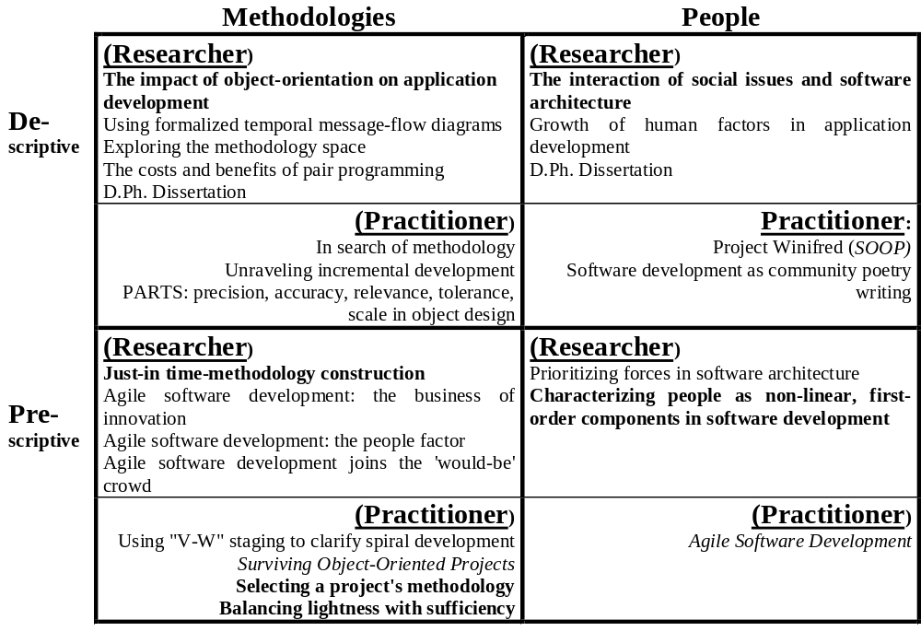
#11. Dialectic Investigation in Cockburn’s research:

Slide 21
Putting methods together with researchers:
(Warning - added sound effects as late-lecture attempt to be entertaining)
Researcher’s priorities Researcher’s ambition
vs. Method’s strengths
RL hr OE ss/cv M. m.s.o expl. predict cause
-- V -- V Lab X
-- + + V Survey X
V + + -- Case X
V V + -- Grnd. X
Forec. X
V V + -- Field X
-- -- Subj. X X
Descr X
vV + + -- Action X X
vV V V -- Empl X

Slide 22
Goal of the Talk : Describe and contrast multiple research methods in 45 minutes
Demonstrate that the candidate can
  look things up in books,
  stand up and talk about them.
Get candidate to learn about something specific.
  Methods to < make-sense-of / explain / predict / cause >
Illuminate something relevant to the dissertation topic:
  Select method with flaws appropriate to research objective;
  Combine methods to compensate;
  Cockburn selected for the following characteristics:
(Be entertaining/interesting)
√ √
RL
~
HR
√
OE
X
SS
X
CV

Slide 23
Additional references
Homans, G.C., “The strategy of industrial sociology,” American Journal of Sociology, 54, pp.330-339 cited in Pettigrew, A.M., “Longitudinal field research on change,” pp. 91-125,
in Huber, G.P., van de Ven, A.H. (eds.), Longitudinal Field Research Methods, Sage Publications, 1995.
Venkatesh, Vitalari, "Longitudinal Surveys in Information Systems Research," Kramer (ed.), The Information Systems Challenge: Survey Research Methods, Harvard University Press, 1991, 115-144.

