Slide 1
MediQueue
Smart Doctor Appointments & Scheduling | Django Final Project
Find a doctor.
Book a time.
Manage your visit.
● ● ●
MediQueue / Find a Doctor
Specialty
Orthopedics ▾
Available today
View doctors
One simple platform for patients, doctors and clinics.
MEDIQUEUE • AXSOS ACADEMY
01

Slide 2
The problem → Our solution
A practical clinic scheduling problem, without accessing hospital medical records
The problem
MediQueue solves it
• Patients call to ask which doctors are available
• Staff coordinate appointments manually
• Rescheduling requires another phone call
• Browse doctors by specialty
• Book available time slots online
• Doctors reschedule follow-up visits from their dashboard
MediQueue manages appointments — not diagnoses, patient medical records, or hospital databases.
MEDIQUEUE • AXSOS ACADEMY
02

Slide 3
How the system works
A simple booking journey from patient to doctor
01
02
03
04
Register
Find a doctor
Book a slot
Manage visit
→
→
→
Patient creates an account and selects insurance.
Choose a specialty and view available doctors.
Reserve an open time on the doctor’s calendar.
Patient views booking; doctor can reschedule or complete.
MEDIQUEUE • AXSOS ACADEMY
03

Slide 4
Patient experience
Key screens: Find a Doctor, Available Slots, Patient Dashboard
● ● ●
Find a Doctor
● ● ●
Available Slots
● ● ●
My Appointments
Choose specialty
Dr. Sarah | Today
Upcoming visits
Orthopedics ▾
09:00
10:30
13:00
Orthopedics
Today · 10:30
Status: Booked
Dr. Sarah • Available
See availability
Book appointment
View details
MEDIQUEUE • AXSOS ACADEMY
04

Slide 5
Doctor & insurance features
Simple role-based access: patients see their bookings; doctors manage their own schedules
● ● ●
Doctor Dashboard
Insurance on profile
Today’s appointments
Patient selects an accepted insurance plan and reads general coverage notes.
Patient A
09:00
Reschedule
Patient B
10:30
Reschedule
Important limitation
Patient C
13:00
Reschedule
Coverage notes are informational; real-time eligibility and claims require insurer integration.
MEDIQUEUE • AXSOS ACADEMY
05

Slide 6
AI Assistant + AJAX
Helps users find the right specialty — not medical diagnosis
● ● ●
AI Specialty Assistant
Behind the scenes
What kind of doctor do you need?
1. JavaScript fetch sends text with AJAX
2. Django receives the request
3. scikit-learn uses TF-IDF + cosine similarity
4. Suggested specialty appears without page reload
“I have knee pain”
Ask assistant
Suggested specialty: Orthopedics
MEDIQUEUE • AXSOS ACADEMY
06

Slide 7
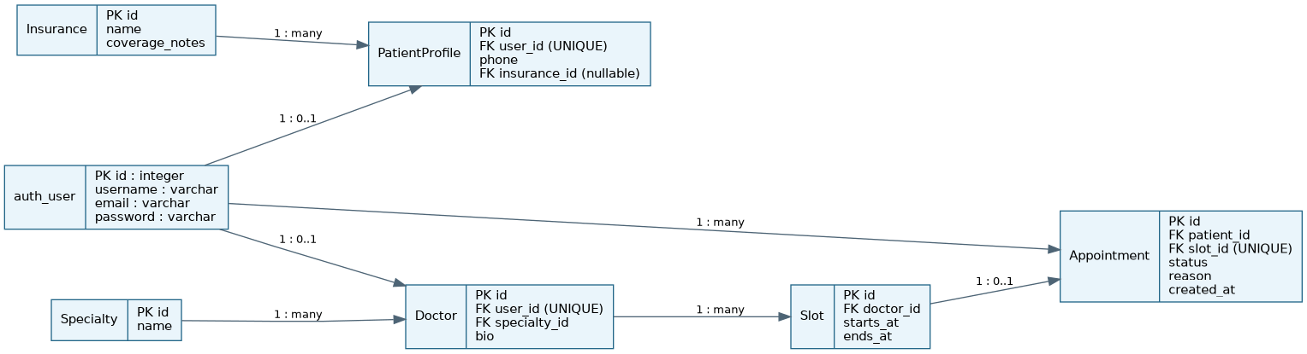
Database ERD
Core tables and relationships from the project diagram
MEDIQUEUE • AXSOS ACADEMY
07

Slide 8
Technology, scope & next steps
Technology stack
Implemented vs future
Python · Django · SQLite
HTML · CSS · Bootstrap 5
JavaScript · AJAX · scikit-learn
GitHub for version control
Current: appointment booking, doctor rescheduling, insurance notes, specialty assistant
Future: real insurance APIs, email alerts, live check-in queue, wait-time estimates
MEDIQUEUE • AXSOS ACADEMY
08

Slide 9

Thank you • Questions?
Special Thanks
Mr. Nasri Ladaa
Miss. Maryan Qassis
Presented by Michael Marajda
MEDIQUEUE • AXSOS ACADEMY
08

