Slide 1
Heart Disease Prediction
Using Machine Learning
CP322 - Machine Learning | Final Project
Michael Marsillo & Gurshan Sidhar Wilfrid Laurier University | April 1st, 2026

Slide 2
Agenda
1. Problem & Motivation
2. Dataset Overview
3. Data Preprocessing & EDA
4. Methodology - Models & Training
5. Hyperparameter Tuning
6. Results & Model Comparison
7. Key Findings & Feature Importance
8. Sensitivity Analysis
9. Conclusion & Future Work
10. Work Distribution

Slide 3
Problem & Motivation
The Problem
Cardiovascular disease: ~17.9M deaths/year (WHO, 2021)
32% of all global deaths
Early detection significantly improves patient outcomes
Diagnosis requires juggling many clinical variables at once
Our Approach
Can ML find patterns that assist clinicians?
Goal: predict heart disease from standard test results
Target: 80%+ accuracy on a binary classification task

Slide 4
Dataset Overview
Source
UCI Heart Disease Dataset (Janosi et al., 1988)
Combined 4 regional sources:
Cleveland Clinic Foundation
Hungarian Institute of Cardiology
University Hospital, Switzerland
Long Beach VA Medical Center
916 total patient records
13 clinical features + 1 target variable
Target Variable
Target: 0 = No Disease, 1 = Disease
Original scale 0–4, binarized for classification
Class split: 55.2% disease / 44.8% no disease
Balanced enough - no class weighting needed

Slide 5
Data Preprocessing
Missing values encoded as '?' - replaced with NaN
Numerical columns (age, trestbps, chol, thalach, oldpeak) -> imputed with median
Categorical columns (cp, thal, ca, slope...) -> imputed with mode
Outliers removed using IQR method (3×IQR threshold - conservative)
StandardScaler applied to 5 numerical features (zero mean, unit variance)
Scaler fit on training data only -> prevents data leakage
Categorical features left as integer-encoded

Slide 6
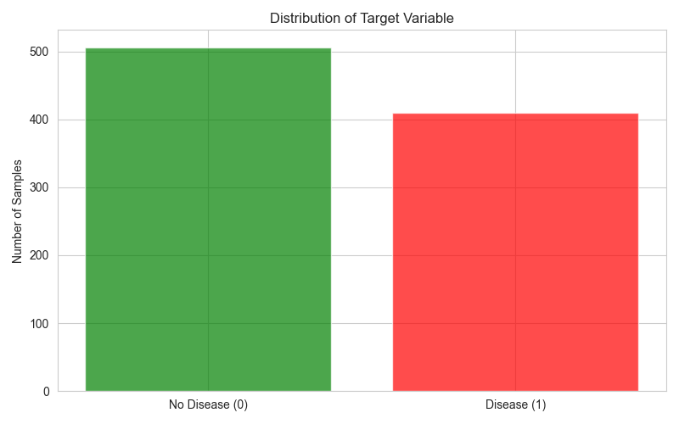
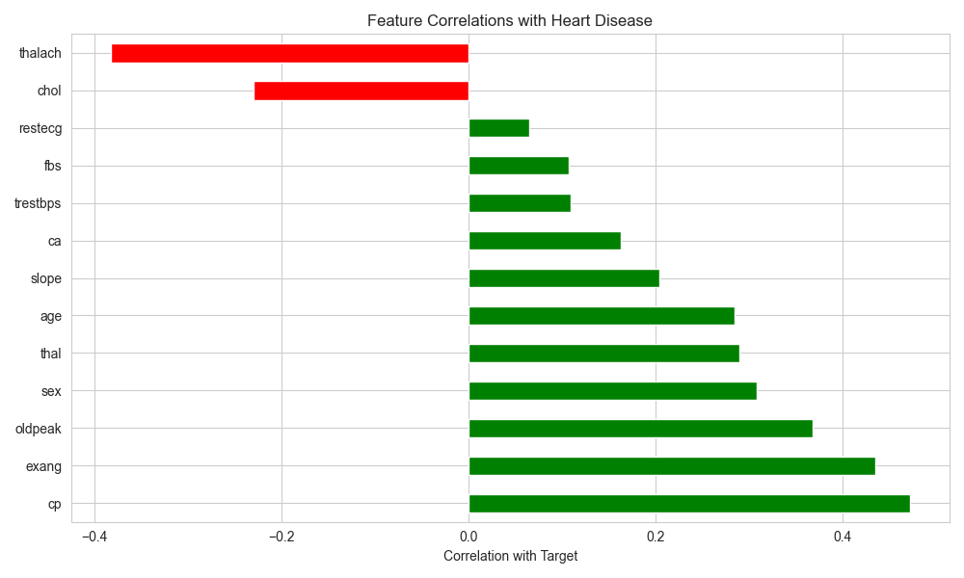
Exploratory Data Analysis
Figure 1: Class distribution (balanced - no weighting needed)
Figure 2: Feature correlations - cp, thalach, exang, ca most predictive

Slide 7
Methodology - Three Models
Logistic Regression
Linear classifier, estimates class probabilities
Interpretable and fast
Requires feature scaling to converge
max_iter=1000, random_state=42
Decision Tree
Binary splits on feature values
Highly interpretable
Prone to overfitting without depth limits
random_state=42, default depth
Random Forest
Ensemble of many decision trees
Reduces variance by averaging predictions
Provides feature importance scores
100 estimators, random_state=42
Data split: 80% train (732 samples) / 20% test (184 samples) - stratified
Metrics: Accuracy | Precision | Recall | F1-Score | ROC-AUC

Slide 8
Hyperparameter Tuning
GridSearchCV with 5-Fold Cross-Validation
Logistic Regression
C ∈ {0.001, 0.01, 0.1, 1, 10}
solver ∈ {lbfgs, liblinear}
Best: C=10, solver=liblinear
Decision Tree
max_depth ∈ {3, 5, 10, 15, None}
min_samples_split ∈ {2, 5, 10}
min_samples_leaf ∈ {1, 2, 4}
Best: depth=3, leaf=4
Random Forest
n_estimators ∈ {100, 200}
max_depth ∈ {5, 10, 15, None}
min_samples_split ∈ {2, 5, 10}
Best: 200 trees, depth=15
Best model saved as best_model.joblib for prediction and evaluation

Slide 9
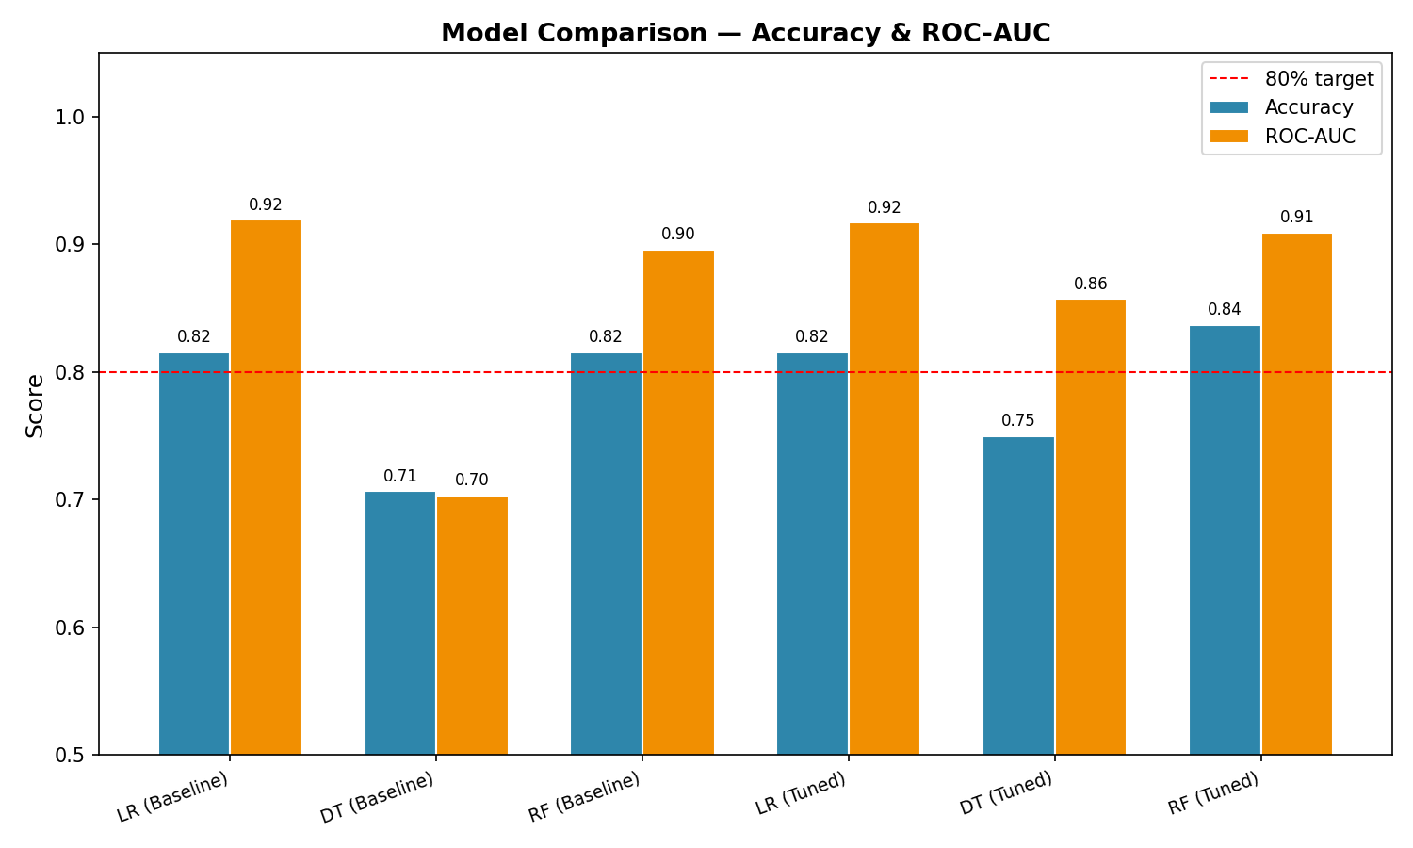
Results - All Six Models
Figure 3: Accuracy & ROC-AUC for all 6 models. Red line = 80% target.

Slide 10
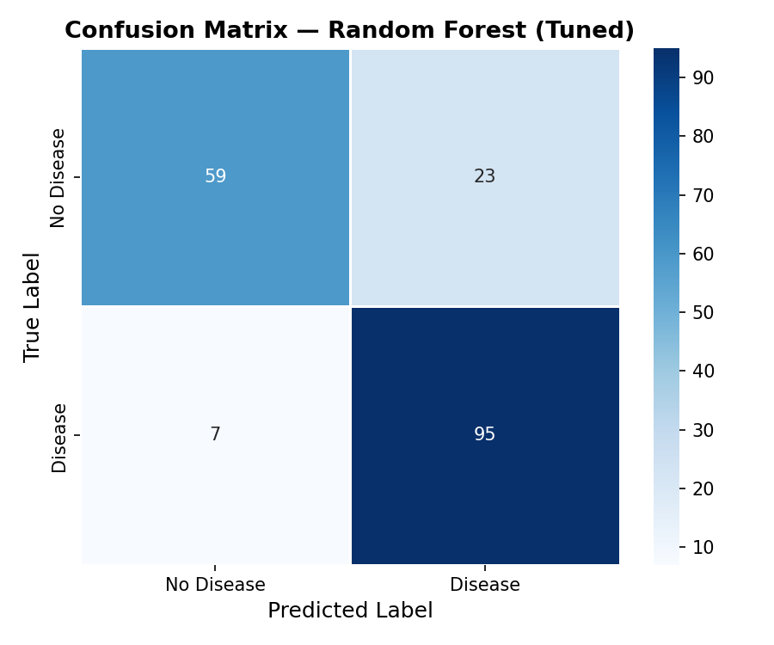
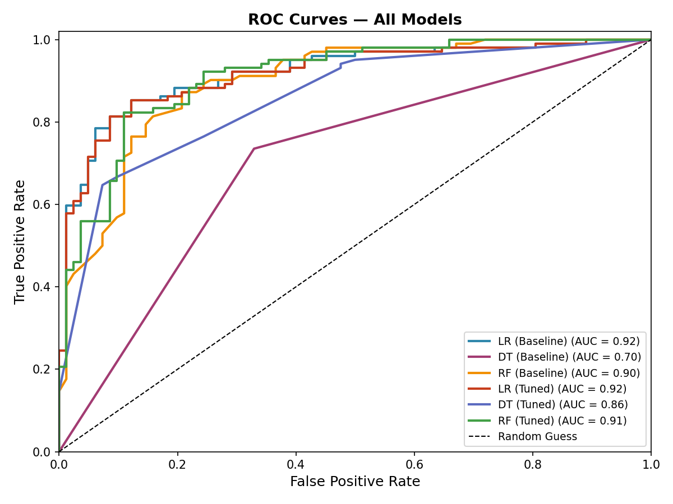
Best Model - Random Forest (Tuned)
83.70% accuracy | ROC-AUC: 0.909 | F1: 0.834
95/102 disease patients correctly identified (93.1% recall on positive class)

Slide 11
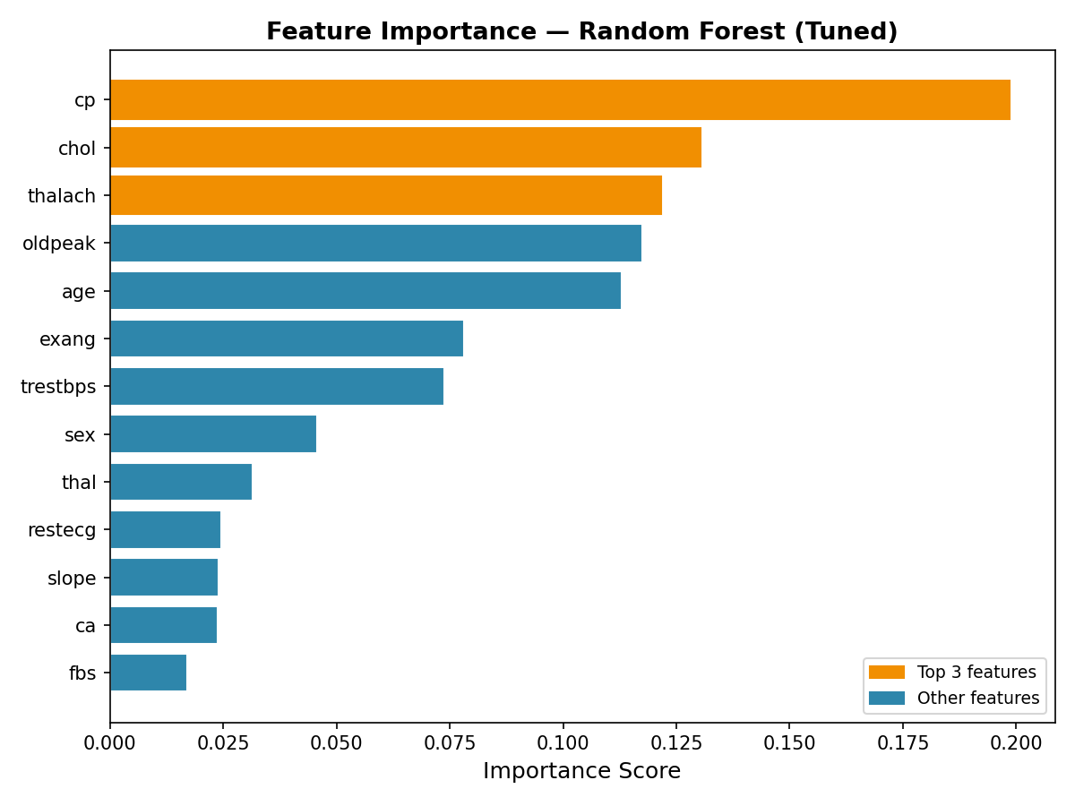
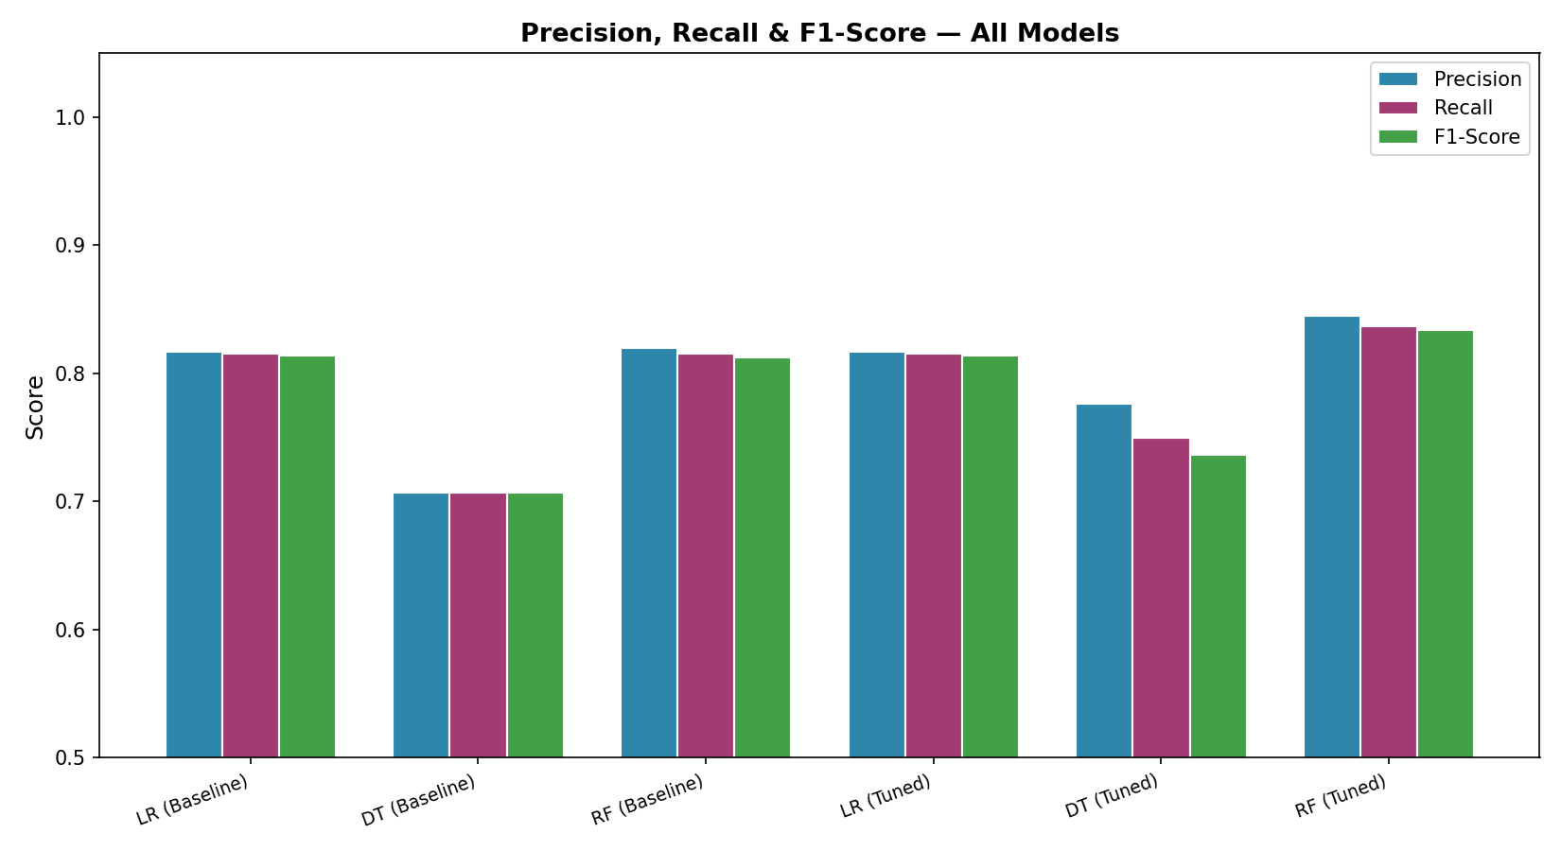
Feature Importance & Precision/Recall
Top predictors: chest pain type (cp), max heart rate (thalach), major vessels (ca)
These align with features cardiologists already use, model is learning real clinical signal

Slide 12
Sensitivity Analysis
CV Stability
5-fold CV on full dataset (tuned RF)
Fold range: 62.8% – 83.6%
Mean accuracy: 76.1% | Std: 7.7%
Wider variance expected with only 916 samples
83.70% test accuracy sits on the higher end
Larger dataset would give more stable estimates
Feature Ablation
Drop cp → accuracy drops 2.7%
Drop ca → accuracy drops 1.1%
Drop thalach → almost no effect alone
Drop chol / fbs / restecg → no meaningful change
A small set of clinical variables drives most predictions

Slide 13
Conclusion & Future Work
Key Findings
Tuned Random Forest: best model at 83.70% accuracy
Exceeded the 80% project target
Top features align with clinical practice (cp, thalach, ca)
Logistic Regression competitive at 81.52%, highest ROC-AUC
Decision Tree improved most from tuning (70% → 75%)
Combining all 4 regional datasets improved diversity
Limitations & Future Work
Dataset is small (916 samples) limits deep learning
High missing values in Switzerland & VA subsets
Single train/test split results may vary
Try Gradient Boosting / XGBoost next
More patient data & features would help generalization
Could package best model as a clinical decision tool

Slide 14
Work Distribution
Michael Marsillo
Gurshan Sidhar
Phase 1: Data loading & raw data setup
Phase 3: Feature engineering & train/test split
Phase 5: Hyperparameter tuning (GridSearchCV)
Phase 7: Visualization scripts (all 5 plots)
Project abstract
Final report writing & editing
Presentation preparation
Presentation recording
Phase 2: Exploratory data analysis (EDA notebook)
Phase 4: Model training (LR, DT, RF baseline)
Phase 6: predict_model.py & evaluate_models.py
Phase 8: main.py pipeline orchestration
Project abstract
Final report writing & editing
Dataset research
Presentation recording

Slide 15
Thank You
Michael Marsillo & Gurshan Sidhar | CP322 | Wilfrid Laurier University

