Slide 1
“It Just Feels Right”
Unpacking Animation Magic for Devs

Slide 2
Describing an animation
Good animation is hard. Explaining why it feels right is even harder.
When done poorly, animation can make your app feel slow, buggy, unresponsive—or worse, distract users from their task.

Slide 3

Demo

Slide 4
What is an animation?

Slide 5
Animations broken down
When broken down, an animation consists of three parts:
Values to animate - usually a start and end point.
An interpolation function - defines how to transition between those values.
Duration - specifies how long the animation should take.
The most common ways to interpolate are with an easing function or a spring animation.

Slide 6
Easing functions
In CSS, easing functions use cubic Bézier curves, defined by two control points that shape how the motion feels. Let’s try it out in an interactive playground to see how those points affect the animation.

Slide 7
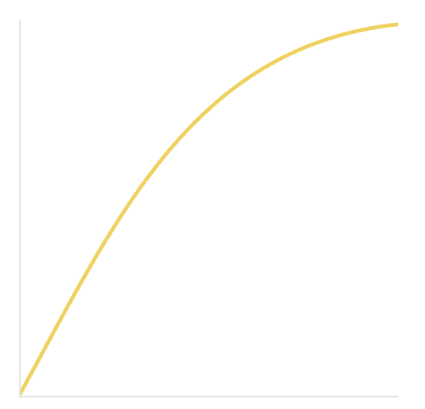
Ease-out
Ease-out animations start fast and slow down toward the end, giving a stronger sense of responsiveness.
It’s my default go-to easing curve.

Slide 8
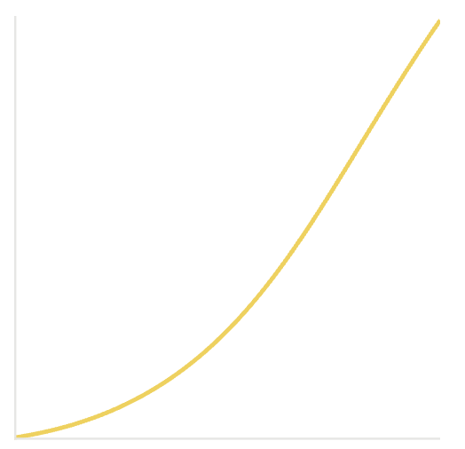
Ease-in
Ease-in is the opposite of ease-out—it starts slow and ends fast.
Avoid using it in most UI interactions , as it can make animations feel sluggish or unresponsive.

Slide 9
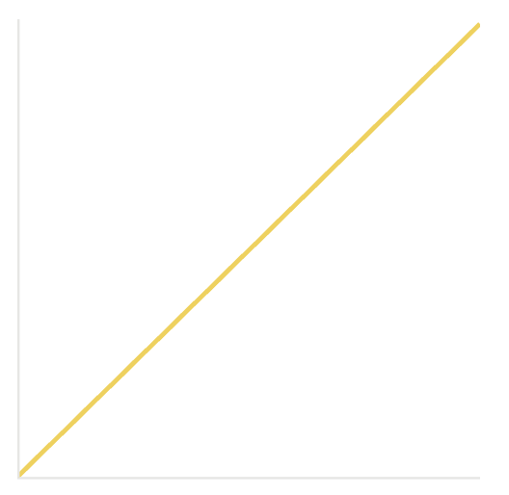
Linear
Linear uses simple, constant-speed interpolation—it feels robotic and lacks natural motion.
Use it sparingly, mostly for spinners or marquees on marketing pages.

Slide 10
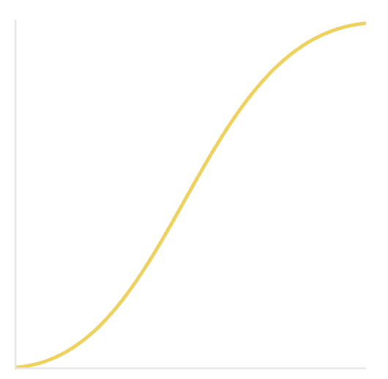
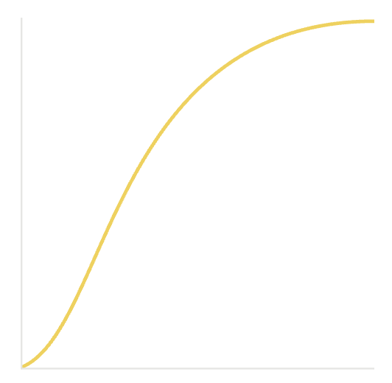
Ease & Ease-in-out
Ease-in-out animations accelerate at the start and decelerate at the end.
It’s a good choice for elements that are already on screen and morph or change position, as it mimics how real objects speed up and slow down.
Ease is similar to ease-in-out, but with a slightly more aggressive start.
It’s the default easing in CSS.

Slide 11
Custom Easing functions
Personally, I find the default easing functions a bit too soft.
One of Stripe’s early designers shared a blog post with a set of custom easing curves that feel much more snappy and intentional—and I’ve been reusing them in most of my projects ever since.

Slide 12
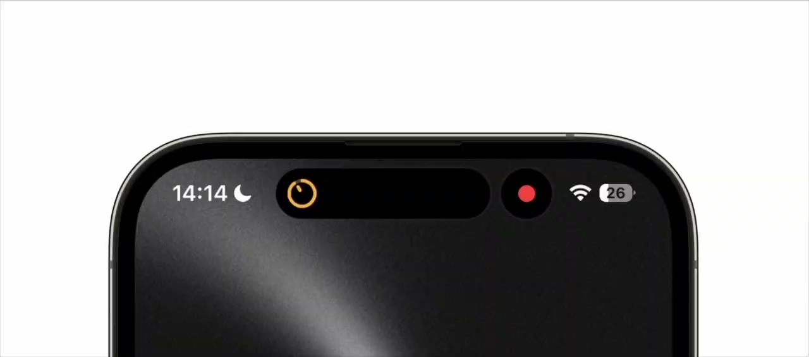
Spring animations

Slide 13
Spring animations
Spring animations are based on how real objects behave when attached to a spring, making them feel natural and fluid.
They’re heavily used in iOS. You configure them using stiffness, damping, and mass, and the curve is calculated using real spring physics.
Apple also introduced a simplified way to configure springs using just duration and bounce—with the twist that the duration is based on perceived duration, not the total animation time.
Let’s take a look at this in the Framer Motion Playground

Slide 14
The Perceived Duration
Notes:
Pourquoi est-ce si important ? - Parce que slon moi, le DX est un des facteurs que tu contrôle en tant que développer les plus important afin de maximiser la vélocité d’une équipe. - Quand “workflow” est simple et agréable, c’est plus facile de rester concentré, de changer de contexte rapidement et même de s’attaquer à ces tâches "ennuyeuses" sans procrastiner.

Slide 15
The perceived duration
While duration affects how an animation feels, the interpolation plays an even bigger role. It shapes the perceived duration, and that’s what truly matters when it comes to how an animation feels.
Using a 95% threshold is an effective and widely adopted way to determine perceived animation completion

Slide 16
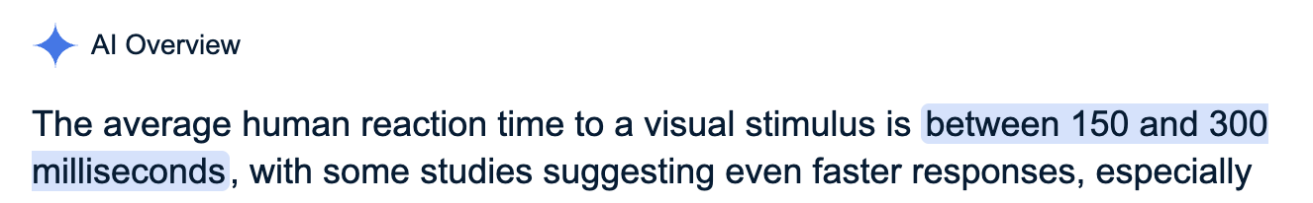
What is a good perceived duration?
If we trust Gemini, the average human reaction time to visual stimuli is between 150–300ms.
To keep your app feeling responsive, aim for animations with a perceived duration in that range.

Slide 17
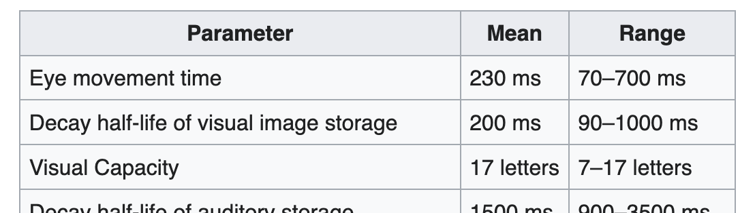
Distance matters
According to the Human Processor Model, eye movement takes between 70–700ms.
That means animation duration should adapt based on where the user is looking—typically near the mouse cursor.
Closer = shorter, farther = longer helps animations feel more natural and easier to follow.

Slide 18
Duration ≈ Distance + Reaction Time
Most animations fall in the 150–250ms range, since they often occur where the user is already focused—typically near the mouse.
But when animating elements that are farther from the user’s focus, durations tend to increase to around 400–600ms.
To keep things feeling snappy while still using longer durations, you can apply a more aggressive interpolation to reduce the perceived duration without sacrificing the richness of motion.

Slide 19
User Interactions

Slide 20
Animation Interruptions
Another key to making animations feel good is handling interruption gracefully.
If the user can interrupt an animation, it should transition smoothly to the new state—not jump or snap.
In CSS, transitions can interpolate from the current state to the new one, while keyframe animations typically skip to the end when interrupted.
A library that does this well is sonner

Slide 21

Demo

Slide 22
Keyframes are bad?
Transitions are usually my first choice for animations—they’re simple, smooth, and handle interruptions well.
But I use keyframes when I need to:
Pause the animation
Create an infinite loop
Define multiple steps in a sequence
Use special timing, like scroll-driven animations
Handle simple entry/exit animations where interruption doesn’t matter

Slide 23
Other considerations
Spring animation libraries typically handle interruptions well, smoothly adapting when states change mid-motion. This come at at cost in bundle size.
Keyboard-triggered animations are a tougher case—inputs often come in rapid succession, making it difficult to achieve clean transitions.
That’s why I usually avoid animations on keyboard input altogether.

Slide 24
Performance Matters

Slide 25
Avoid dropping frames
Dropped frames can make even the best animation feel buggy and unpolished.
If your animation doesn’t run at 60 FPS, it quickly loses its smoothness—and the experience starts to feel broken.

Slide 26

Demo

Slide 27
Understanding Render Costs
Rendering happens in steps, in this order:
Layout → Paint → Composite.
If a step is recalculated, all the steps after it are also reprocessed.
This makes animating properties like height, margin, or padding expensive—they trigger layout, paint, and composite.
By contrast, animating opacity or transform only affects the composite step, making them far more performance-friendly.
When possible, prioritize transform and opacity for smooth, efficient animations.

Slide 28
CSS vs JS
CSS is usually the better choice—when used correctly.
Most JavaScript animation libraries use requestAnimationFrame, which runs on the main thread. If the browser is busy, you risk dropped frames.
In contrast, CSS and WAAPI animations (like transform and opacity) can be hardware-accelerated, running on the GPU.
This means they stay buttery smooth, even if the main thread is under load.

Slide 29

Demo

Slide 30
Clip path <3
Clip-path is a hidden gem for complex animations. It’s hardware-accelerated, so even intricate effects can run smoothly without dropping frames.
Here is an example of Stripe’s blog using clip-path to animate tabs. We can re-implement it to see what’s going on

Slide 31
Key Takeaways

Slide 32
“It Just Feels Right”
If you want your animation to feel right, keep these principles in mind:
Avoid slowing down the user: If your animation needs to be long, use an aggressive easing to keep the perceived duration short.
Handle interruptions: If the user can interrupt the animation, make sure it transitions gracefully, not abruptly.
Prioritize performance: Dropped frames instantly make animations feel buggy and unrefined. Aim for 60 FPS and use GPU-accelerated properties like transform and opacity.

Slide 33
Questions?

