Slide 1
Minnesota Nice
Prepared by:
Michael McAnally
14 July 2019

Slide 2
Introduction to the Business Problem

Slide 3
‘Minnesota Nice’ is a characteristic transcribed to people from the state of Minnesota in the Midwest of the United States. While it is hard to quantify, it is similar to pornography, where ‘I know it when I see it’.
The State Board of Tourism has collaborated with the cities of Minneapolis and St. Paul to promote tourism and relocation. They believe that publishing ‘top ten’ lists of most ‘Minnesota Nice’ neighborhoods in the Minneapolis and St. Paul (referred to as the Twin Cities) region will be highly successful.
The McAnally Consulting Group (MCG) has been contracted by the Minnesota State Board of Tourism to perform a statistical study that creates top ten lists of ‘Minnesota Nice’ neighborhoods for the entire Twin Cities as well as neighborhood types.

Slide 4
Data Analysis and Cleaning

Slide 5
Data was collected across multiple sources. Data for this study was collected from:
The Twin Cities have been releasing limited publicly available data derived from the 2010 Census and 2013 American Community Survey on mncompass.org.
Geolocation data from the Google API
In-depth venue data for parks, churches, schools, and broad general data across all venue types
Walking scores for locations in the Twin Cities from the Walkscore API
Data was accessed from the Google Geocoding, Walkscore, and Foursquare APIs
When data was not available for particular factors of interest (see: Median Household Income, Median Home Value) a median value of the factor for all the neighborhoods was imputed for the ‘NaN’.

Slide 6
Exploratory Data Analysis

Slide 7
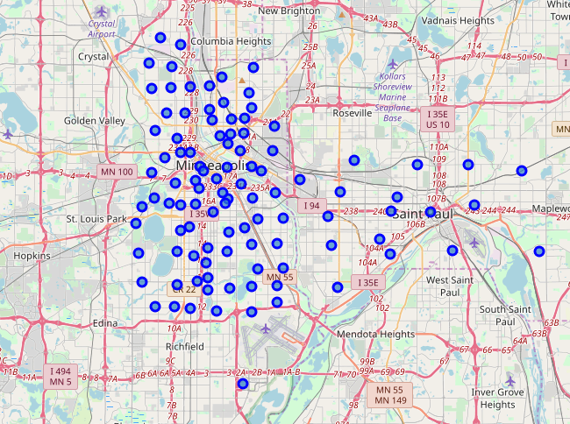
Summary statistics were calculated and checked for reasonability across the factors of interest in determining ‘Minnesota Nice’.
Simple maps were created to visualize location of the 102 neighborhoods in the Twin Cities.
Figure 1: All 102 Neighborhoods in the Twin Cities

Slide 8
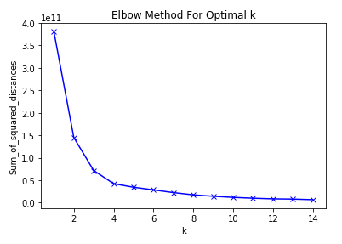
A stability analysis for K-means clustering was performed to examine the best number of clusters for neighborhood analysis.
Figure 2: Analysis of potential cluster sizes in K-means clustering analysis

Slide 9
Predictive Modeling

Slide 10
A mean of ranks in the factors of interest normalized for the number of neighborhoods to give a ‘Minnesota Nice’ factor in the interval of [0,1] with ‘1’ being the most ‘Minnesota Nice’ neighborhood.
Top ten neighborhoods (with Minnesota Nice score):
Nicollet Island-East Bank, Minneapolis 0.921569
St. Anthony West, Minneapolis 0.859477
Downtown East, Minneapolis 0.848856
Sheridan, Minneapolis 0.826797
Bottineau, Minneapolis 0.808824
Field, Minneapolis 0.792484
Page, Minneapolis 0.776144
North Loop, Minneapolis 0.772059
East Isles, Minneapolis 0.770425
West Calhoun, Minneapolis 0.746732

Slide 11
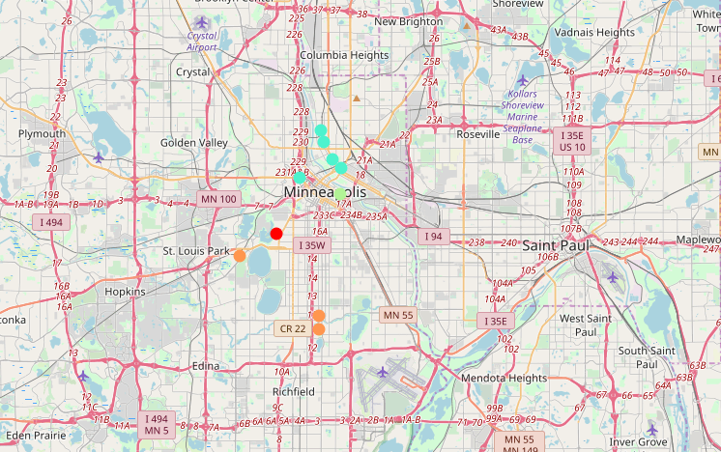
Figure 3: Locations of top ten 'Minnesota Nice' neighborhoods

Slide 12
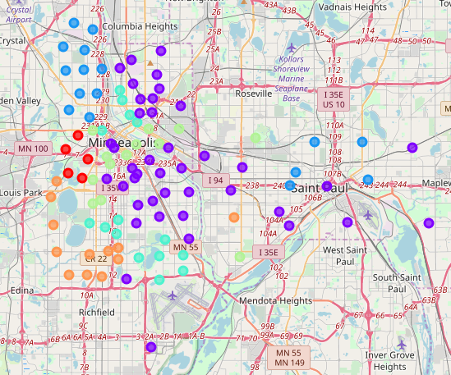
A K-means cluster analysis of the neighborhoods with no geographic data attached. Using the top ten venue types per neighborhood, parks per capita, churches per capita, schools per capita, median household income, median home value, walk score, percentage of population under 18, total population, and average household size were used to cluster the neighborhoods in six clusters.
Figure 4: Location of neighborhoods colored by cluster assignment

Slide 13
Results and Conclusions

Slide 14
High ‘Minnesota Nice’ neighborhoods were correlated with high income and home value.
Even without geographic information in the clustering analysis, the clusters are localized geographically. This suggests that the character of the neighborhood is highly dependent on the neighborhoods surrounding it.
Each of the six clusters have a top ten list and map associated with them

Slide 15
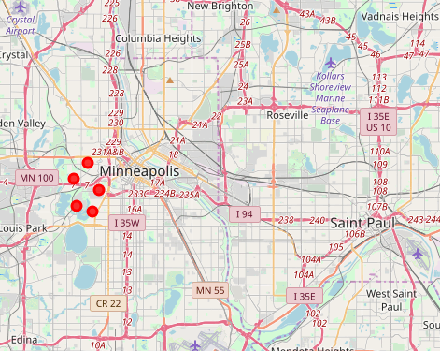
Top ten for Cluster 1 (note: only 5 assigned in the K-means algorithm):
East Isles, Minneapolis 0.770425
Harrison, Minneapolis 0.723856
Lowry Hill, Minneapolis 0.723856
Kenwood, Minneapolis 0.678105
Bryn-Mawr, Minneapolis 0.645425
Figure 5: Location of top ten neighborhoods in Cluster 1

Slide 16
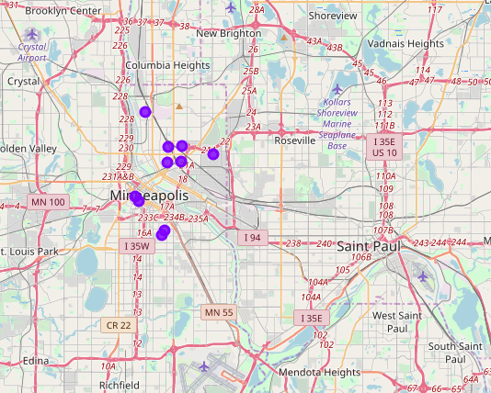
Top ten for Cluster 2:
St. Anthony East, Minneapolis 0.737745
Northeast Park, Minneapolis 0.695261
Logan Park, Minneapolis 0.680556
Beltrami, Minneapolis 0.675654
Mid-City Industrial, Minneapolis 0.656863
Downtown West, Minneapolis 0.615196
East Phillips, Minneapolis 0.600490
Central, Minneapolis 0.596405
Midtown Phillips, Minneapolis 0.580882
Marshall Terrace, Minneapolis 0.578431
Figure 6: Location of top ten neighborhoods in Cluster 2

Slide 17
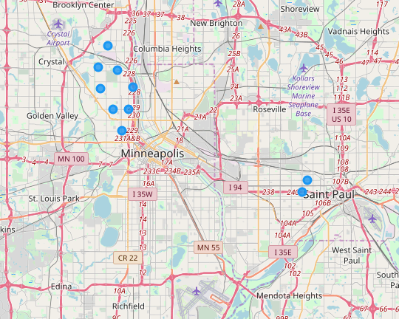
Top ten for Cluster 3:
Hawthorne, Minneapolis 0.387255
Cleveland, Minneapolis 0.370915
Near North, Minneapolis 0.358660
Shingle Creek, Minneapolis 0.339869
McKinley, Minneapolis 0.305556
Victory, Minneapolis 0.258987
Summit-University, St. Paul 0.226307
Frogtown/Thomas-Dale, St. Paul 0.219771
Webber-Camden, Minneapolis 0.218954
Jordan, Minneapolis 0.217320
Figure 7: Location of top ten neighborhoods in Cluster 3

Slide 18
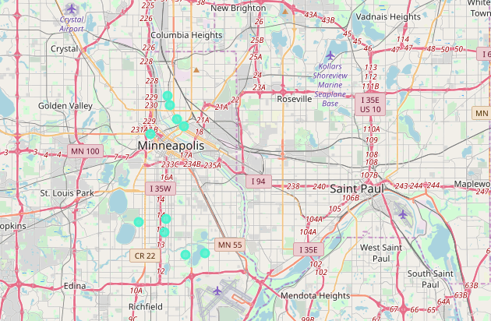
Top ten for Cluster 4:
Nicollet Island-East Bank, Minneapolis 0.921569
St. Anthony West, Minneapolis 0.859477
Sheridan, Minneapolis 0.826797
Bottineau, Minneapolis 0.808824
North Loop, Minneapolis 0.772059
Bryant, Minneapolis 0.702614
Regina, Minneapolis 0.687908
East Harriet, Minneapolis 0.583333
Hale, Minneapolis 0.571895
Keewaydin, Minneapolis 0.567810
Figure 8: Location of top ten neighborhoods in Cluster 4

Slide 19
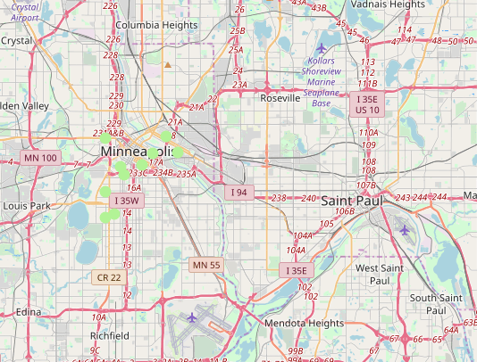
Top ten for Cluster 5:
Downtown East, Minneapolis 0.848856
Elliot Park, Minneapolis 0.732843
Steven's Square-Loring Heights, Minneapolis 0.732026
Sumner-Glenwood, Minneapolis 0.728758
Lowry Hill East, Minneapolis 0.619281
Loring Park, Minneapolis 0.598039
Northrop, Minneapolis 0.598039
South Uptown, Minneapolis 0.541667
Lyndale, Minneapolis 0.516340
Marcy Holmes, Minneapolis 0.411765
Figure 9: Location of top ten neighborhoods in Cluster 5

Slide 20
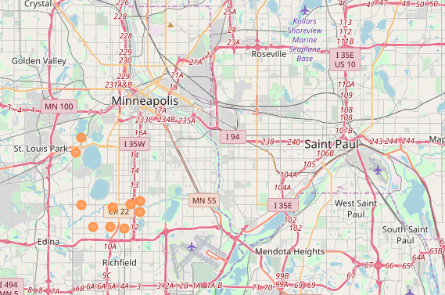
Top ten for Cluster 6:
Field, Minneapolis 0.792484
Page, Minneapolis 0.776144
West Calhoun, Minneapolis 0.746732
Tangletown, Minneapolis 0.719771
Lynnhurst, Minneapolis 0.611111
Cedar-Isles-Dean, Minneapolis 0.598039
Kenny, Minneapolis 0.589052
Fulton, Minneapolis 0.580882
Windom, Minneapolis 0.553922
Armatage, Minneapolis 0.523693
Figure 10: Location of top ten neighborhoods in Cluster 6

