Slide 1
Internet Protocal & OSC
Connecting computers for Musical Collaboration

Slide 2
Connect to a shared WIFI router
SSID (the router name)
lcc-osc
Password
theairband

Slide 3
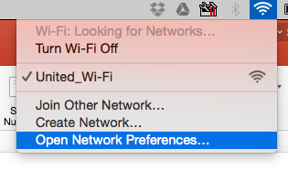
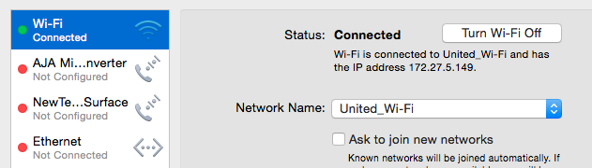
Mac IP address location
Open network preferences
Select wifi, write down the IP address

Slide 4
Windows IP address location
Once connected to the shared wifi (ssid: lcc-osc, pw: theairband)
Go to start menu
Type CMD and hit enter (it may automatically open)
If needed, click on the CMD app
In the CMD (compand propmt app/dialog)
Type ipconfig/all
Scroll down to WLAN and look for the IPv4 address

Slide 5
Windows Extra Apps for SEMI
For OSC:
Max7
LoopMidi (interapplication midi bus)
For Link
AnyASIO (audio driver needed for Link to work).

