Slide 1

MeritLens
Fair, explainable promotion decisions, with a voice for every employee
Final-year project · Design and development of an explainable machine-learning decision support system for employee promotion, with an employee feedback channel
Notes:
Good morning. My project is called MeritLens.
In one line: it helps a company decide who is ready for promotion, explains every decision in plain words, and lets every employee answer back.
You don't need any background in computers or statistics to follow this talk. Whenever I use a technical idea, I'll explain it with an everyday comparison.
(Say your name and your supervisor's name here.)

Slide 2



Promotions often feel like a black box
“Why not me?”
Old habits repeat
No way to answer back
People are often told yes or no, but rarely why, or what to work on next.
Past decisions carry old patterns. In our data, Engineering staff were promoted 16 times as often as Support staff.
If your record is wrong, or the reasoning seems unfair, there is usually nowhere to say so.
2% of Support staff promoted, against 33% in Engineering, in the past records the system learned from.
Notes:
Let's start with the problem. Think about how promotions usually work.
First, people hear "yes" or "no" but rarely "why", so they don't know what to improve.
Second, decisions copy the past. In the records this project learned from, 33 out of every 100 engineers were promoted, but only 2 out of every 100 support staff. If we simply copied those old decisions, a support worker would be held back just because of their department, not their work.
Third, if your record has a mistake, or you think the reasoning is unfair, there's usually no proper channel to say so.
MeritLens is designed to fix all three.

Slide 3



MeritLens in one sentence
The computer advises, people decide, and every employee can answer back.
1 Predict
2 Explain
3 Respond
Estimates how ready each person is for promotion, from their work record only.
Shows why in plain words, and the smallest realistic steps that would get them there.
Lets the employee rate the explanation, or ask HR to fix a wrong record.
Notes:
If you remember one thing from today, make it this sentence: the computer advises, people decide, and every employee can answer back.
The system works in three steps.
Predict: it gives each employee a readiness score, a bit like a weather forecast. A forecast says "70% chance of rain"; this says how likely someone's record looks like the records of people who were promoted.
Explain: every score comes with reasons in everyday language, and a list of realistic things that would raise it.
Respond: the employee can say whether the explanation made sense, or point out a mistake in their record.
The next slides go through each step.

Slide 4






Six people, six jobs
Employee
Manager
Sees their score, the reasons and their path to promotion; answers back.
Sees their team and recommends people, with written reasons.
HR
Finance
Makes the decision, fixes records with evidence, watches fairness.
Signs off the pay rise. Never sees scores or ratings.
Admin
Auditor
Runs accounts and keeps the system healthy.
Checks every decision, read-only. Sees totals, never private feedback.
Notes:
Six kinds of people use MeritLens, and each one can only do their own job. The system checks this on every single request, not just by hiding buttons.
The employee sees their own score and reasons, and can answer back.
The manager recommends people from their team.
HR makes the final decision.
Finance confirms the pay rise. They never see the scores, only what they need to approve the cost.
The admin runs the accounts.
And an auditor can check every decision afterwards, but can't change anything.
Splitting the work like this means no single person can push a promotion through alone.

Slide 5
Step 1 · Predict
How ready is someone for promotion?
Notes:
Step one: predict. How does a computer estimate whether someone is ready for promotion?

Slide 6

It learned from 100,000 past cases
100,000
20
1 in 10
past employee records studied
facts about each person's work
of them had been promoted
Like an experienced reviewer
Someone who has looked at 100,000 cases starts to notice which work records tend to lead to promotion. The model does the same, but it writes down exactly how much each fact counts, so it can always explain itself.
No real person's data
Every record is simulated (a free public dataset from Kaggle), so nobody's privacy was at risk while building and testing it.
Notes:
How does it learn? Imagine an experienced HR reviewer who has looked at a hundred thousand past cases. Over time they notice patterns: people with strong, improving performance and good project records tend to get promoted.
The model does the same thing, but with two big differences. It's consistent: the same record always gets the same score. And it writes down exactly how much each fact counts, so it can always explain why.
It looks at 20 facts about each person's work. In the past data, about 1 in 10 people had been promoted.
Important: all of this data is simulated. It comes from a free public dataset, so no real person's information was used.
(If asked: the "model" is an Explainable Boosting Machine, a type chosen because it can always show its reasoning.)

Slide 7


It looks at work, never at who you are
What it uses
What it never sees
Performance: scores, ratings, targets met, projects and tasks
Growth: training, certificates, mentoring, cross-team work
Reliability: attendance and lateness
Career stage: time since last promotion, time in role
Gender, age, education, marital status
Department: so where you work can't decide for you
Pay: so old pay gaps aren't carried forward
Working hours: results count, not long hours
Notes:
This is one of the most important design choices.
On the left: what the model is allowed to use. Only facts about someone's work: their performance, how they're developing, how reliable they are, and where they are in their career.
On the right: what it never sees. Gender, age, education and marital status, obviously. But also department, because otherwise the support worker from earlier would be marked down just for their team. Pay, because that could copy old pay gaps. And working hours, because we want to reward results, not just staying late.
Each of these exclusions has a written reason in the code.

Slide 8
It never punishes improvement
The common-sense test
We trained four kinds of model, then nudged 2,000 people's records in a better direction: more training, better feedback, more projects.
Three models sometimes gave a lower score for a better record. Only one never did, so that is the one MeritLens uses.
Notes:
How did I choose which model to use? I trained four different kinds and gave them a common-sense test.
I took 2,000 people and improved their record a little: a bit more training, slightly better peer feedback, one more project. A sensible system should never give a lower score to someone who just got better.
The chart shows what happened. The popular models on top sometimes did exactly that: up to 30% of the time, an improvement made the score worse. That would be impossible to explain to an employee: "You did more training, so your chance went down."
Only the model at the bottom, the Explainable Boosting Machine, never did it, because it's built with that rule. Its accuracy was as good as the others, so it was the clear choice.

Slide 9

How good are its forecasts?
88 in 100
6 in 10
30% = 30%
Shown one person who was promoted and one who wasn't, it ranks them the right way round 88 times out of 100.
Of the people who really were promoted, it spots about 6 in 10. The rest are why a person always decides.
Its numbers are honest: of people scored around 30%, about 30 in 100 were promoted.
A forecast, not a verdict. Measured once on 20,000 records it had never seen. Like a weather forecast, it is useful but sometimes wrong, so it only ever advises.
Notes:
How good is it? I tested it once, on 20,000 records it had never seen before, so it couldn't have memorised the answers.
Here are three plain ways to put the results.
One: show it two people, one who was promoted and one who wasn't. 88 times out of 100, it gives the promoted person the higher score.
Two: of everyone who really was promoted, it finds about 6 in 10. It misses some, which is exactly why a human always makes the final decision.
Three: its percentages are honest. When it says 30%, about 30 in 100 of those people were in fact promoted. That's called being well calibrated.
So think of it like a good weather forecast: useful, but not perfect, and never the final word.
(Technical terms if asked: ROC-AUC 0.883, recall 59.5%, precision 41%, calibration error 0.006.)

Slide 10
Fair across groups
The four-fifths rule
A standard test used in hiring: every group should be recommended at least 80% as often as the most-recommended group. Every result here is above 0.8.
Automatic safety gate
A model that fails this test is blocked and can never be switched on. HR also watches the same test on real decisions as they happen.
Notes:
But being accurate isn't enough; it also has to be fair.
I used a standard test from employment law called the four-fifths rule. It says: whichever group is recommended most, every other group should be recommended at least four-fifths, that's 80%, as often.
A score of 1.0 would mean perfectly equal. Gender scores 0.98, age 0.96, education 0.89. All comfortably above the 0.8 line.
Two more safeguards. First, any model that fails this test is blocked automatically and can never be switched on. Second, HR can see the same test on live decisions, at three stages: what the model recommends, who managers nominate, and who HR approves. So if unfairness creeps in through people, not just the computer, it shows up.

Slide 11
Step 2 · Explain
Every score comes with its reasons
Notes:
Step two: explain. A score on its own isn't much use. People need to know why, and what to do next.

Slide 12
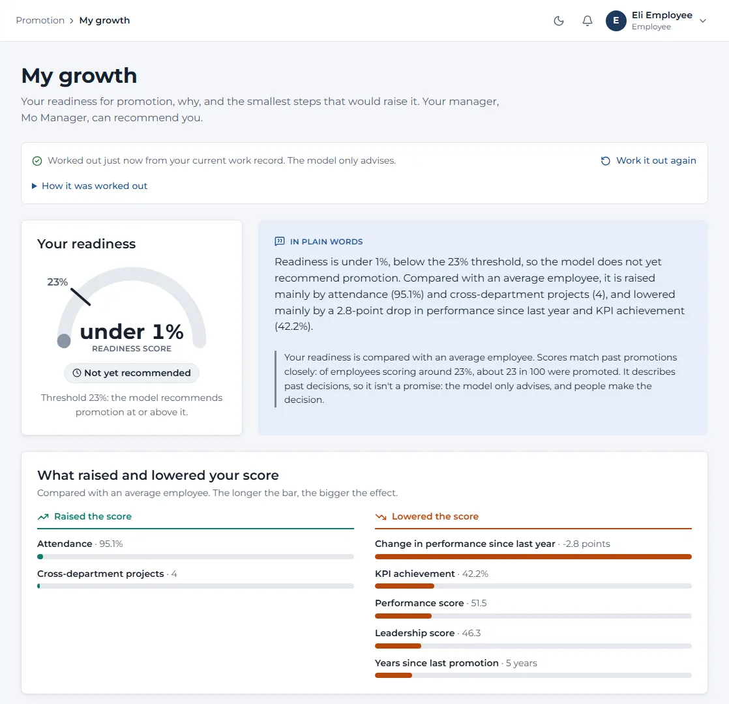
Every score comes with reasons
The readiness score
Shown against the line where the model would recommend promotion (23%).
In plain words
A short summary anyone can read, with real units: hours, points, percentages.
What raised and lowered it
Teal bars helped, orange bars held it back. The longer the bar, the bigger the effect.
Notes:
This is the employee's own page, called "My growth". This is a demo employee called Eli.
At the top is the readiness score, shown against the line where the model would recommend promotion: 23%.
Next to it, in plain words: what this means, written like a person would say it.
Below that, what raised and lowered the score. Teal bars helped, orange bars held it back, and the longer the bar, the bigger the effect. For Eli, attendance helped, but a drop in performance since last year held them back the most.
These numbers aren't guesses about what the model was "thinking". Because of the type of model chosen, the contributions add up exactly to the score. And there's a "technical details" section with the exact numbers and a second, independent method (called LIME) for anyone who wants to double-check.

Slide 13
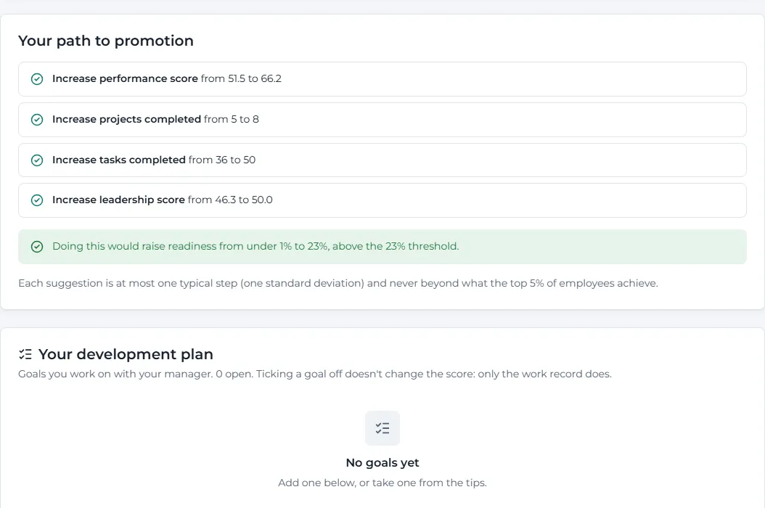
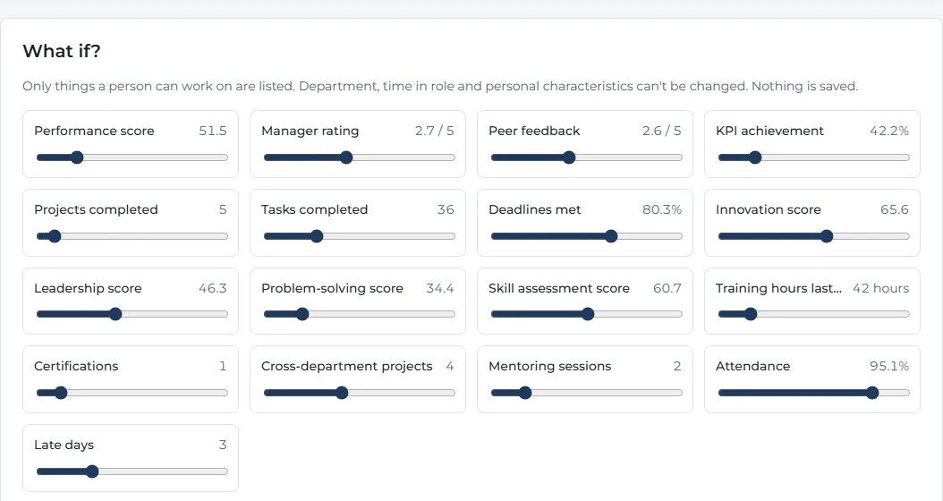
A path forward, and room to explore
What if? Move a slider to see how the score would change. Only things a person can work on are offered, and nothing is saved.
Path to promotion. The smallest realistic steps that would reach the line, each one checked on the model. They work for 98 of 108 demo staff not yet recommended.
Notes:
Telling someone their score is low isn't enough. They need to know what to do about it.
On the left, "Your path to promotion": the smallest realistic improvements that would get them over the line. Realistic means no bigger than a typical step, and never beyond what the top 5% of employees achieve. Each suggestion has been tried on the model to make sure it really works. For 98 of the 108 demo employees not yet recommended, the system found a path. The employee can turn these tips into goals with their manager in a development plan.
On the right, "What if?": the employee can move sliders and watch the score change, like a savings calculator. Only things a person can actually work on are offered (you can't change your department or how long you've been in your role), and nothing is saved.

Slide 14
Step 3 · Respond
A voice for every employee
Notes:
Step three, and this is what makes the project different from most: respond. The employee gets a voice.

Slide 15
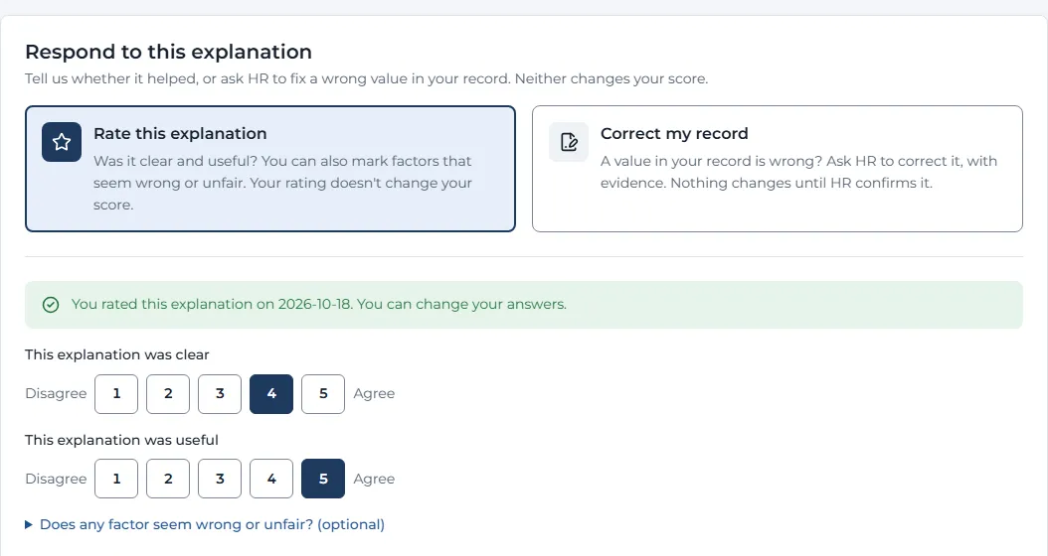


Employees can answer back
Rate this explanation
Was it clear? Was it useful? Mark any factor that seems wrong or unfair. HR sees only totals; managers never see them.
Right under their explanation, every employee finds two buttons.
Correct my record
Point out a wrong value, with evidence. HR checks it. If it's confirmed, the record is fixed and the score is worked out again.
Notes:
Right under their explanation, every employee has two options.
The first is "Rate this explanation": was it clear, was it useful, and does any factor seem wrong or unfair? This tells HR how well the explanations are working. To protect privacy, HR only sees totals, and only once at least 5 people have answered. Managers never see them at all.
The second is "Correct my record". Say Eli's record shows 5 projects but they actually completed 8. They can ask HR to fix it and attach evidence, like a PDF or a photo. HR checks it. If HR confirms it, the record is corrected, Eli is re-scored, and every detail is logged: who changed what, the old and new value, and the score before and after. If HR rejects it, Eli gets the reason.

Slide 16

Feedback never moves a score
A complaint or a rating
A fact HR has checked
Never reaches the model. Shouting louder can't raise a score, and an angry rating can't lower one.
The only thing that changes a record. The person is re-scored and the change is logged for good.
Proven, not just promised
An automatic test records every score, adds ratings, complaints and corrections, then checks every score is identical, down to the last digit.
Two more checks make sure the scoring code can't even read the feedback.
While a correction is pending, HR's review says so, and the decision can be put on hold until it's settled.
Notes:
An obvious worry: if people can complain, will complaining raise their score? The answer is no, and this is built into the design.
On the left: a rating or a complaint never reaches the model. It's used to improve the explanations and to show HR where people disagree, but it can't move anyone's score, up or down.
On the right: the only thing that changes a record is a fact that HR has checked against evidence.
And it's not just a promise. There's an automatic test that records every score, then adds ratings, complaints and corrections, and checks that every score is still identical. Two more checks make sure the scoring part of the code can't even read the feedback.
One more detail: if someone is up for promotion while their correction is still pending, HR's screen warns them, and the decision can be held until the correction is settled. So nobody gets judged on a record that might be wrong.

Slide 17


People make every decision
Model advises
Manager recommends
HR decides
Finance signs off
Employee told
A score and its reasons
Rates 4 areas with real examples; explains in writing if they disagree with the model
Approves or rejects; the model's view is saved next to the decision
Confirms the pay rise, or sends it back with a reason
Only once everything is final
Pay rises stay within limits. HR sets a range (5 to 15% by default); going outside it needs a written reason. Salaries are never stored, only percentages, and Finance never sees scores or ratings.
Notes:
Now let's follow one promotion from start to finish, to show that people make every decision.
First the model advises: a score and the reasons.
Then the manager recommends. They fill in a structured form, rating four areas from 1 to 5, each with a real example. If they disagree with the model, they must write down why.
Then HR decides. The system saves the model's view right next to HR's decision, so later anyone can see where people and the computer disagreed.
Then Finance signs off the pay rise, or sends it back with a reason.
And only when all of that is final is the employee told. Nobody hears about a promotion that might still change.
Pay rises have limits set by HR, salaries are never stored, and Finance only sees what they need.

Slide 18





Built to be trusted
A record that can't be secretly changed
A named person switches each model on
Fairness watched as it happens
Every decision goes into a log where each entry is sealed to the one before. One click proves nothing was edited or deleted.
HR reads the model's report card first. A model that failed the fairness test can't be switched on at all.
The same fairness test runs on real decisions: the model, the managers, and HR.
Your data, your rights
Safe sign-in
A second pair of eyes
Anyone can download what's held about them; leavers' personal data is erased; old data is removed on schedule.
Two-step sign-in, lock-out after 5 wrong passwords, automatic sign-out when idle.
Optionally, big changes need a second HR person to approve.
Notes:
For a system like this to be used in a real company, people have to trust it. Six features are there for that.
One: every decision goes into a log where each entry is sealed to the one before it, like links in a chain. If anyone edits or deletes an old entry, the chain breaks, and one click shows it.
Two: a new version of the model only goes live when a named HR person has read its report card and switched it on. A model that failed the fairness test can never be switched on.
Three: fairness is checked on real decisions as they happen, not just once in the lab.
Four: privacy. Anyone can download everything held about them, people who leave can have their personal data erased, and old data is deleted automatically.
Five: secure sign-in, with two-step codes and lock-out after wrong passwords.
And six: optionally, big changes need a second HR person to approve them.

Slide 19
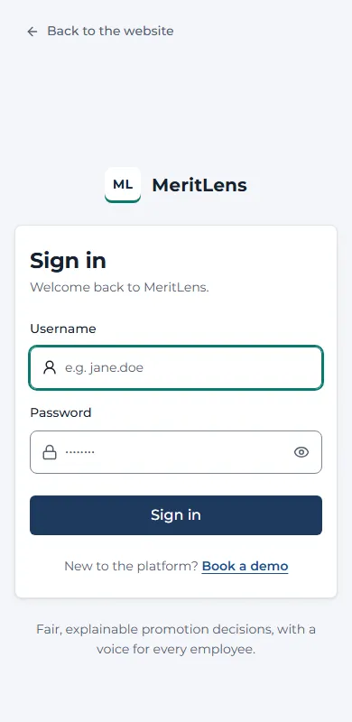
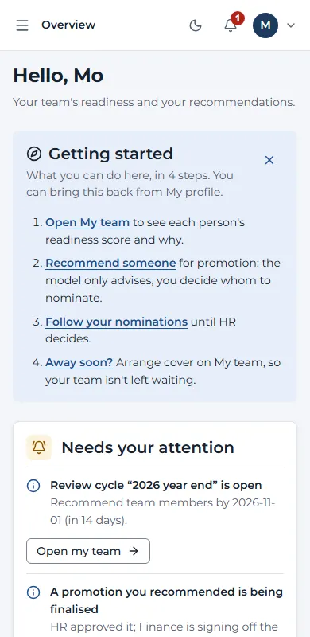
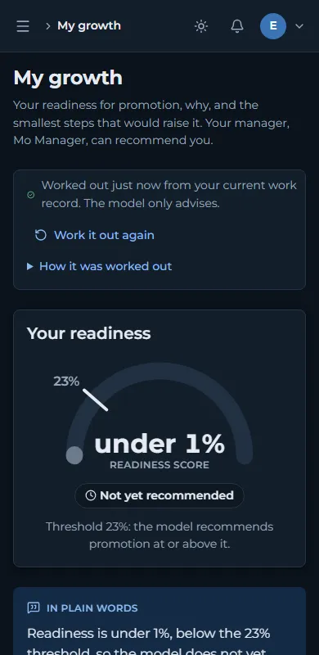
Works on any screen
45
pages checked, for all six roles
0
accessibility problems found (WCAG 2.1 AA)
320 to 430
phone widths tested, small Androids to large iPhones
Light and dark themes, on computers, tablets and phones.
Notes:
Employees won't always be at a desk, so MeritLens works on phones, tablets and computers, in light and dark themes. Here are three screens on a phone: signing in, a manager's overview, and the employee's growth page in dark mode.
All 45 pages were checked automatically for all six roles. There were zero accessibility problems against the international standard, WCAG, which covers things like screen readers, colour contrast and keyboard use. And every page was tested at phone widths from the smallest Androids up to the largest iPhones, so nothing overlaps or runs off the screen.

Slide 20

How we know it works
400
20,000
0
0.27 s
automated tests, all passing, run on two kinds of database
unseen records used to measure the model, once
scores changed by feedback, in the isolation test
slowest page load with 5,000 employees
Next: a study with real people. The kit is ready inside the app: 11 tasks, a standard usability questionnaire, and questions on whether the process feels fair.
Notes:
How do I know it works? Four pieces of evidence.
400 automated tests check everything from who can see what, to the pay rules, to the privacy features. They all pass, on two different kinds of database.
The model was measured once, on 20,000 records it had never seen.
The isolation test showed that feedback changed exactly zero scores.
And with 5,000 employees loaded, even the slowest page loaded in about a quarter of a second.
The next step is a study with real people. Everything for it is ready inside the app: 11 tasks, a standard usability questionnaire, and questions about whether the process feels fair.

Slide 21



What it can't do yet
Simulated data
Not yet tried with real staff
A real company would retrain it on its own history, with consent.
The study is ready but still to be run.
Fairness has a price
Ready to go live, not live yet
Leaving department out made it less accurate at copying past decisions. That is deliberate: it stops scoring people by where they work.
The secure server set-up is written and the tests pass; it hasn't been run for real.
Next steps
Run the study with real people
A confidential way to report unfair treatment
Keep department from sneaking back in through other measures
Notes:
It's important to be honest about the limits.
The data is simulated. A real company would need to retrain the model on its own promotion history, with consent.
It hasn't been tried with real staff yet; that's the study I just mentioned.
Fairness has a price. An earlier version that used department was more accurate at predicting past decisions, but only because it copied the old habit of promoting some departments more. I chose fairness over that kind of accuracy on purpose.
And it's ready to go live on a secure server, but it hasn't been run for real yet.
Future work: run the study, add a confidential way to report unfair treatment, and make sure department can't sneak back in through other measures.

Slide 22
Thank you
The computer advises. People decide. Everyone can answer back.
Questions welcome
Notes:
To sum up: MeritLens predicts how ready someone is for promotion using only their work, explains every score in plain words with a realistic path forward, and gives every employee a way to answer back, while people make every decision and every step is recorded.
The computer advises. People decide. Everyone can answer back.
Thank you. I'm happy to take questions, or to show the live system.

