Slide 1
On the State of the DHARMA Project
Michaël Meyer (CESAH, CNRS)

Slide 2
Website: dharmalekha.info
~50 contributors
~3300 texts in 13+ languages
Inscriptions (but ~50 editions of manuscripts)

Slide 3
Data sources
Original editions
Digital editions borrowed from other projects
Digitization of printed editions

Slide 4
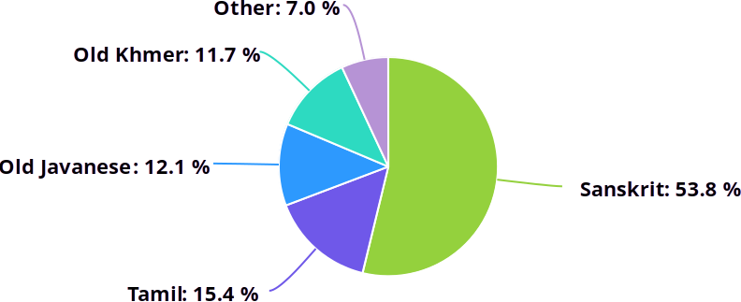
Languages distribution

Slide 5
Where are we at?
Infrastructure ✓ 🐛
Display ✓ 🐞
Search TODO

Slide 6


Infrastructure: which database?
Application platform
(163 MiB code)
Framework
(external)
“Just” a database
(1 MiB code)
Library
(embedded)

Slide 7
Infrastructure: concurrency
No simultaneous write transactions!
Lazy solution:
Single writer process
Complete isolation between database clients

Slide 8


Infrastructure: update system
HTTP server
Writer process
Websocket client

Slide 9
Display: demonstration
Text example: INSPallava00256

Slide 10
Search: TODO
Write something for faceted search
Use some external language processing tools
Deal with source languages

Slide 11
Search: TRE (from Ville Laurikari)
Approximate pattern matching (Levenshtein distance)
Search time linear to the input size
Constant space (fairly small)

Slide 12
Thank you!

