Slide 1
PPT Co-Pilot

Slide 2
Past Papers
Enhancing Presentation Slide Generation by LLMs with a Multi-Staged End-to-End Approach
Generating presentation from document containing multi-modal information (DocPres)
Problem: context too long(hallucinations, failure at picking up context at middle) → divide doc into sections and subsections
Uses LLM to create outline of presentation, generate bird’s eye view + K important topics w titles through chain-of-thought prompt
Maps slides to outline(titles) ask LLM to associate section of document with title (uses edit distance, selects match if over 90% provides robustness against hallucinations)
Concatenate content(text) from sections and feed to LLM in form of bullet points
Uses heuristics + ranking algorithm to determine image and text similarity, VLM for image extraction
Suitability score computed using cosine distance of CLIP embedding
Better than gpt-3.5, limited by CLIP’s capabilities and multiple documents
Human evaluation score based on desired qualities

Slide 3
Past Papers
PPTAgent: Generating & Evaluating Presentations Beyond Text-to-Slides
https://github.com/icip-cas/PPTAgent
“The key challenge lies in enhancing LLMs’ understanding of reference presentations’ structure and content patterns. Second, most presentations are saved in PowerPoint’s XML format, as demonstrated in Figure 11, which is inherently verbose and redundant (Gryk, 2022), making it challenging for LLMs to robustly perform editing operations.” Change XML format to HTML
PPT has two stages, comprehensive analysis and edit APIs with HTML-rendered representation that simplifies slide modifications through code interaction
PPTEval (MLLM-as-a-judge) evaluates presentations though content, design, and coherence
Zenodo10k (presentation dataset)
Stage 1: (slide clustering(2 types ~ content/structure), content extraction, slide element description)
Stage 2: (Outline generation – (contains reference slide and relevant document content), iterative slide generation through edit-based API’s)
Increase robustness, implement a self-correction mechanism using a REPL environment
Framework asses content, design, and coherence using numeric scores 1-5.
PPT Agent implementation consists of GPT-4o, Qwen2.5-72B Instruct + Qwen2
Evaluation metrics: Success Rate, Perplexity, F1 score(Rouge-L), FID (similarity), PPTEval employs GPT-4o as judge
Limitation → Incorporating visual information into generation process

Slide 4
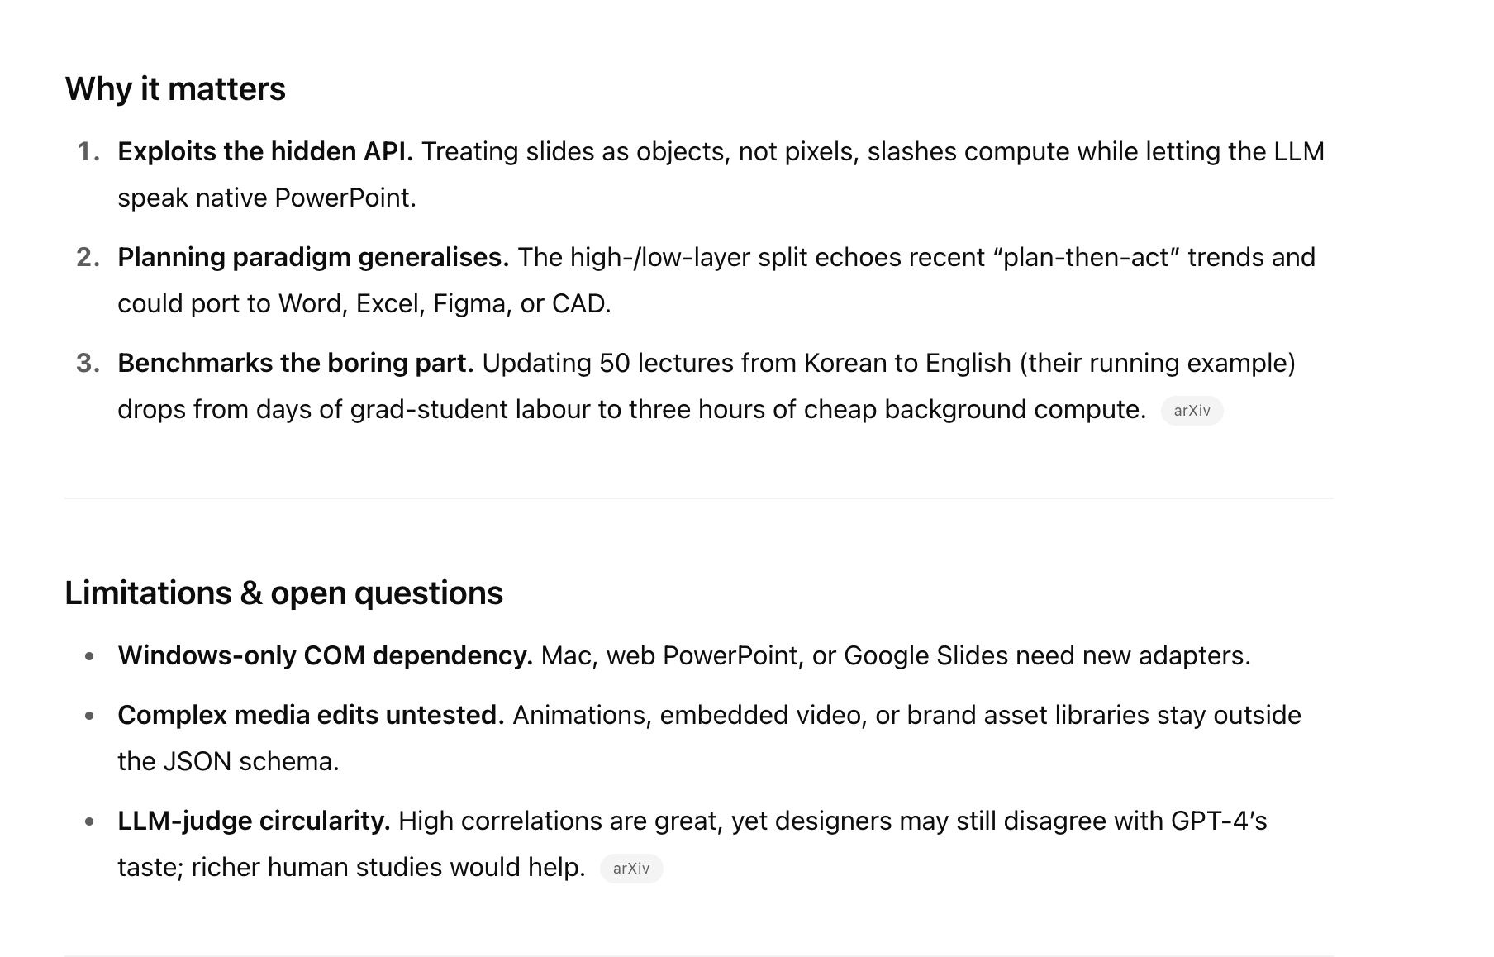
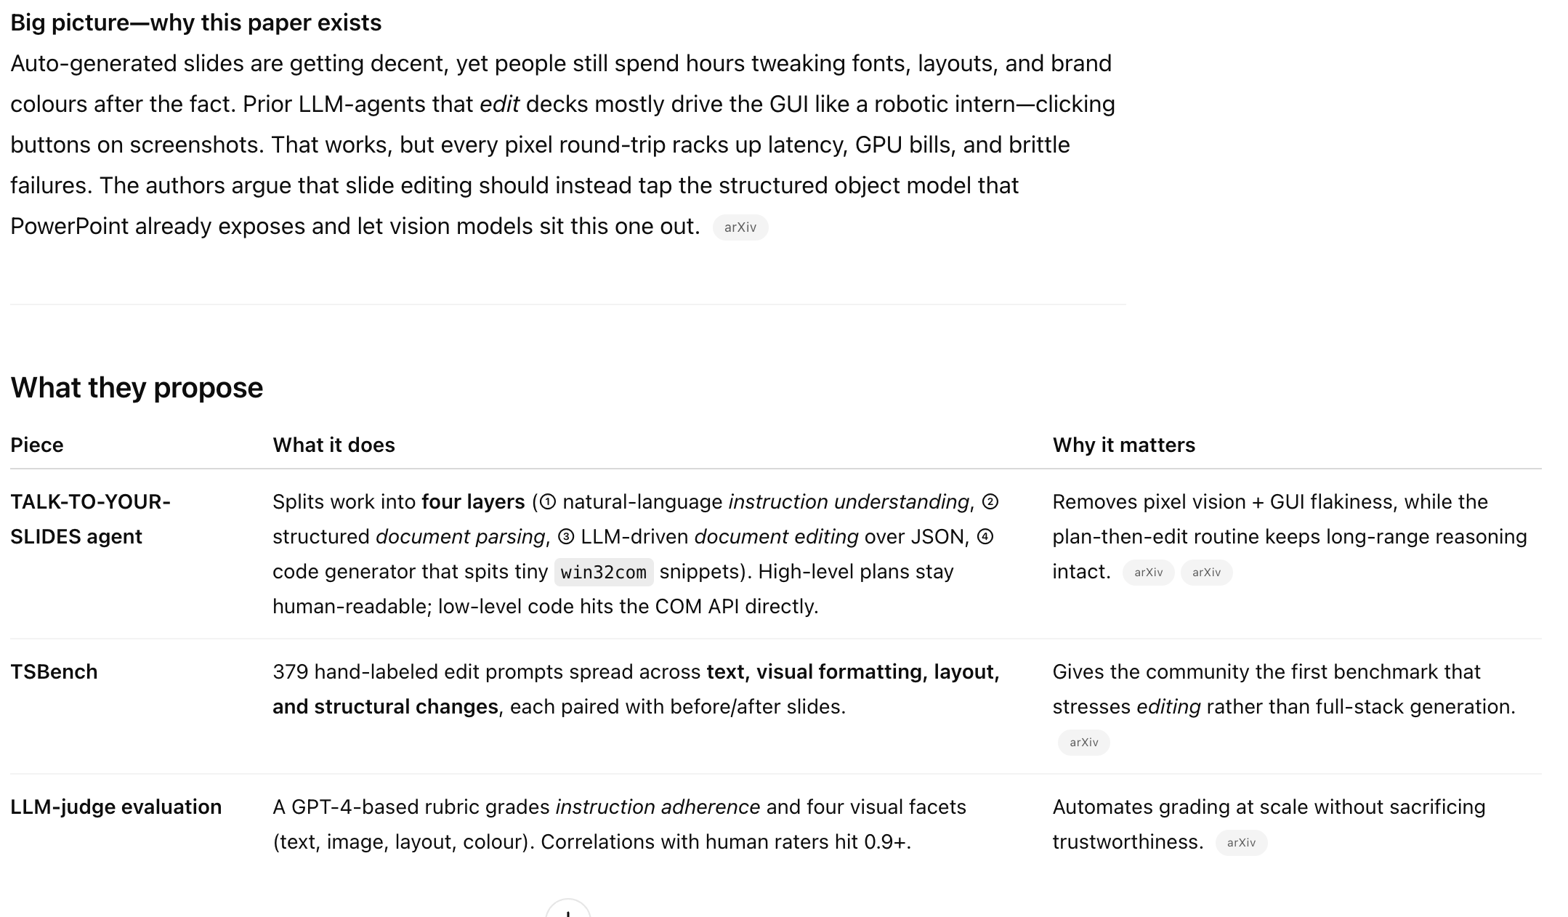
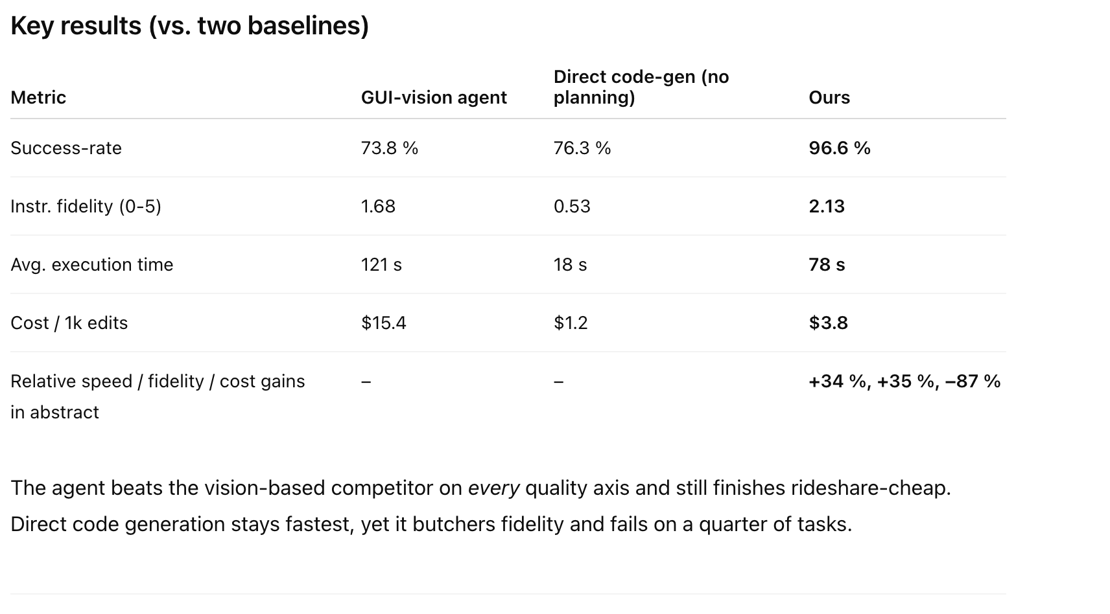
Past Papers
May 25th 2025: Talk to Your Slides: Language-Driven Agents for Efficient Slide Editing
https://anonymous.4open.science/r/Talk-to-Your-Slides-0F4C/README.md

Slide 5
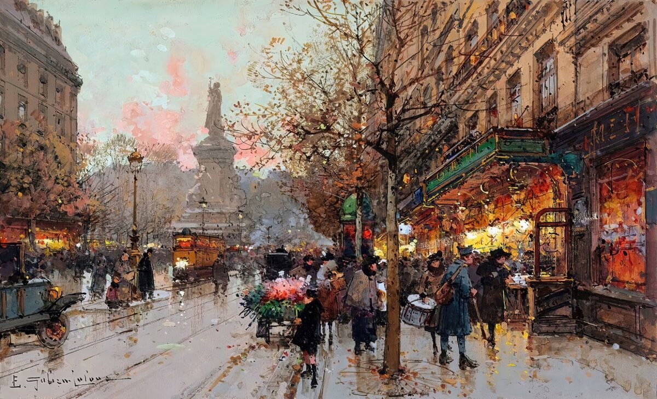


Sample Slide
Here is some sample text, in this instance the text box is much bigger than needed and goes under these images.
https://anonymous.4open.science/r/Talk-to-Your-Slides-0F4C/README.md

Slide 6
If LLM Is the Wizard, Then Code Is the Wand: A Survey on How Code Empowers Large Language Models to Serve as Intelligent Agents
AUTOPRESENT: Designing Structured Visuals from Scratch

Slide 7
Other resources
Nancy Duarte. 2008. Slide: ology: The art and science of creating great presentations, volume 1. O’Reilly Media Sebastapol.
Nancy Duarte. 2010. Resonate: Present visual stories that transform audiences. John Wiley & Sons.
Executable code actions elicit better llm agents.
Evaluating large language models for powerpoint task completion

Slide 8
https://plusai.com/use-cases/ai-for-teachers

