Slide 1
Statistical Forecasting and Analysis of Solar Radiation in Arizona
Michael Olheiser and Joseph McGuire
Winona State University

Slide 2
OUTLINE
PIC Math Course
What is AZMET?
Motivation and Background
Decadal and seasonal variability over Arizona
Exceedance Probabilities
ARIMA Forecasting
Conclusions
What we learned from PIC.

Slide 3
Background
The Arizona Meteorological Network (AZMET) has collected weather data since 1986 that is publicly available
Examples of data are evapotranspiration, solar radiation, precipitation and more.
There have been 38 stations with 27 active today.
Notes:
Transition: So where did we get motivated to work with AZMET data?

Slide 4
A problem from Industry
Preparation for Industry in mathematical sciences
Designed to introduce real world use of math and statistics in industry
Dr. Genetha Gray of Intel submitted a problem about solar radiation and risk assessment
Our job was to learn about data and methods, strategize, communicate, and deliver results in meetings and a final report to Genetha Gray

Slide 5
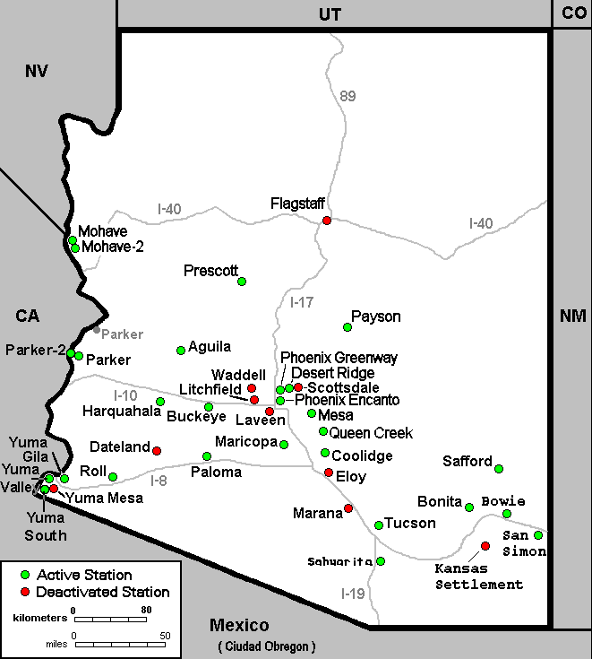

Slide 7
Moving foward
Understand variability and seasonality of solar radiation over Arizona
How does elevation or location influence this?
Look at 15 stations with 19 years of data and active
Predict and analyze solar radiation at each site

Slide 10
Exceedance Probabilities
Considering each season, we would like to know the probability of exceeding a given amount of solar radiation.
Solar radiation maximum is dependent on the seasons (precession)
Monsoon is weeks 25-37, reference of 21 MJ/m²
Winter is 38-52 and 1-8, reference of 10 MJ/m²
Warm is 9-24, reference of 19 MJ/m²

Slide 11
Exceedance Probabilities
Correlations Monsoon Warm Winter
Elevation -0.8199 -0.2550 0.0052
Monsoon EP at 21 | Warm EP at 19 | Winter EP at 10
1. Yuma Valley (94.0%) | 1. Yuma North (93.1%) | 1. Yuma Valley (94.3%)
2. Maricopa (94,.0%) | 2. Yuma Valley (92.9%) | 2. Bonita (94.2%)
3. Harquahala (94.0%) | 3. Paloma (92.6%) | 3. Harquahala (94.2%)

Slide 12
ARIMA Forecasting (p,d,q)x(P,D,Q)
52 week years -> daily readings averaged for each week
Seasonal differencing produced large negative spikes on AC plot
-> Moving Average model*
Expanding and solve to get forecasting equation
(011)(011) is commonly used, but non-seasonal differencing caused an over difference and wider confidence intervals. (assumes time-varying trend)

Slide 13
AGUILA modeled w/ (001)(011)
modeled w/ (011)(011)

Slide 14
ARIMA Comparison
Could nonseasonal autoregression fit a better model?
Nonseasonal autoregression could act as a “partial differincing” that weighst the previous weeks value.
Compare AR+SMA+MA to and SMA+MA
(101)(011) and (001)(011)

Slide 16
Comparing models
Adding non-seasonal autoregression did not significantly reduce error
In most sites, error increased when predicting back 2014
Predicting back 5 or 10 years caused the model with autoregression to not converge. (Hessian matrix is not positive definite)
Predictions of solar radiation will be based on SMA+MA w/ seasonal difference

Slide 18
Predicted Solar Radiation

Slide 19
Conclusions

Slide 20
Further Research

Slide 21
What we learned from PIC

