Slide 1



Moogle

Slide 2
First thoughts..
Cow-themed? …Seriously?
Yes. Seriously.
But this is an online store..and that’s a cow..it doesn’t make any sense
We know. But that’s okay because…

Slide 3

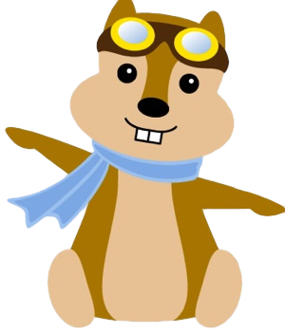

People dig mascots/themes¹
Some popular examples:
* What does a chipmunk have to do with organizing travel plans anyway?

Slide 4
Positive Association
Moogle (has mascot)
“Oh, they’re that store with cool cow. I like them.”
Amazon (does not have mascot)
“Oh, they’re that business that overworks their engineers.”
Allegedly² …

Slide 5
Motivation
Unique name
Borrowing ideas from Amazon and eBay
Can be as creative as we want

Slide 6
Requirement Analysis
Focus on our additions
Watch lists
Member of the Herd (think Prime)

Slide 7
Watch Lists
Each user can have zero or more watch lists
Every watch list that belongs to a given user has a unique name
A watch list consists of sale items
A watch list should be deleted when its owner is deleted

Slide 8
Member of the Herd
User pays an annual fee to become a herd member
As a member you get:
10% off all fixed-priced items
free shipping on all orders

Slide 9
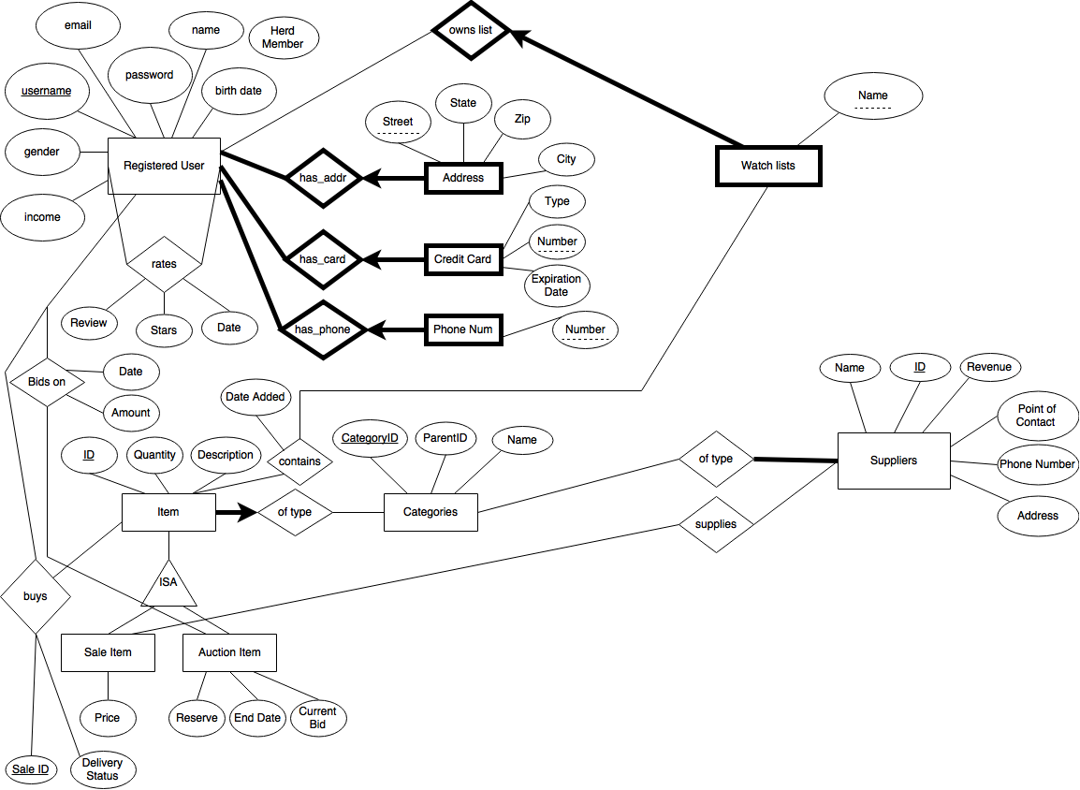
Conceptual Design

Slide 10
Action Plan
Try to have meetings twice a week in order to discuss and work on Phase 2
Translate ER Diagrams into a database
Determine how the Phase 2 workload can be divided between the members of the group
Come up with unique ideas on how to design the application

Slide 11
Sources
http://tinyurl.com/h7rtfyl
http://tinyurl.com/o9afxtq

