Slide 1
My Pagerank Implementation
Michael Ore
orem@iastate.edu

Slide 2
Three Phases
Read stdin, create all edges in memory
Create node objects and adjacency matrix
Apply algorithm until convergence

Slide 3
Read file
Edges are stored in a linked list, because the number of edges is not necessarily known.
The maximum node number is stored for the next phase.
Self-links are discarded in this phase.
Time and space are O(n), where n is the number of nodes.

Slide 4
Create Nodes and Matrix
Nodes are stored in an array.
Node objects contain the pagerank of the current and previous iterations, and the number of outgoing links.
Links are stored in adjacency matrix.
Duplicate links are discarded.
Time and space are O(n^2).

Slide 5
Apply Algorithm
Power iteration method
A node gives a portion of its pagerank to every page it links to.
I apply the formula to every node until the change in pagerank for ALL nodes is less than 1e-6 (by default).
The performance is O(in^2), where i is the number of iterations

Slide 6
Example
Input:
1 2
2 3
3 4
4 5

Slide 7
Example
Output:
1: 0.850000
2: 0.977500
3: 0.996625
4: 0.999494
5: 0.999924
iterations 5

Slide 8
Damping Factor
The damping factor determines how much the pageranks are influenced by links.
Changing the damping factor has an effect on both the final pagerank values, and on how many iterations are needed for convergence.
The previous example had a damping factor of 0.15. The next slide shows a damping factor of 0.85

Slide 9
Example 2
Output:
1: 0.150000
2: 0.277500
3: 0.385875
4: 0.477994
5: 0.556295
iterations 5

Slide 10
Overall Performance
Overall complexity is O(n^2) for space and O(in^2) for time. The number of iterations depends on the way the graph is laid out.
I performed some experiments to determine the effect of the structure of the graph, the number of nodes, and the value of the damping factor on the performance of the algorithm.

Slide 11
Test Structure
I created a conglomerate of a C program, a Perl script, and several bash scripts which generate several hundred test files of various graph structures and numbers of nodes, and then runs the program on them with different damping factors.
My pagerank implementation is modified to run phases 2 and 3 nineteen extra times for ease of measurement.

Slide 12
Three graph structures
“Chain”, in which node n points to node n+1.
“Ring”, in which node n points to node n+1 until the last node, which points to 1.
“Factors” in which node n points to the nodes which are factors of n.

Slide 13
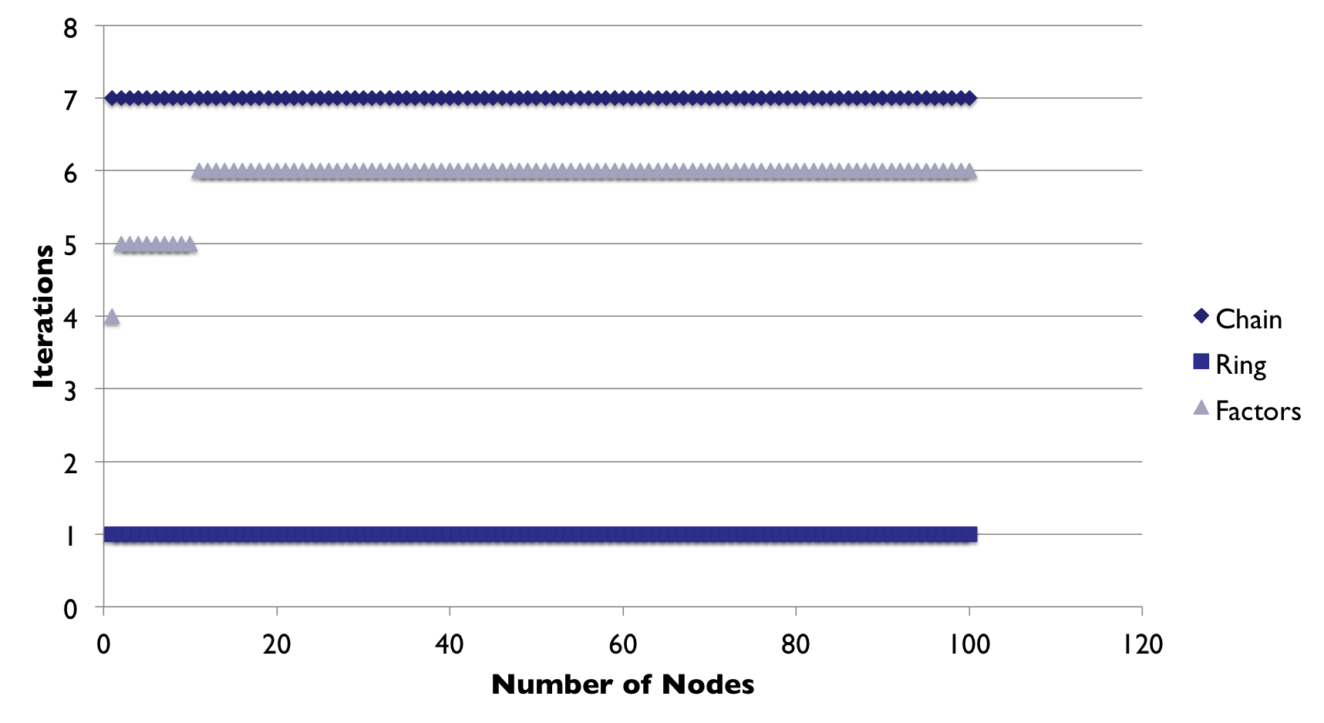
Iterations vs Nodes P=0.15

Slide 14
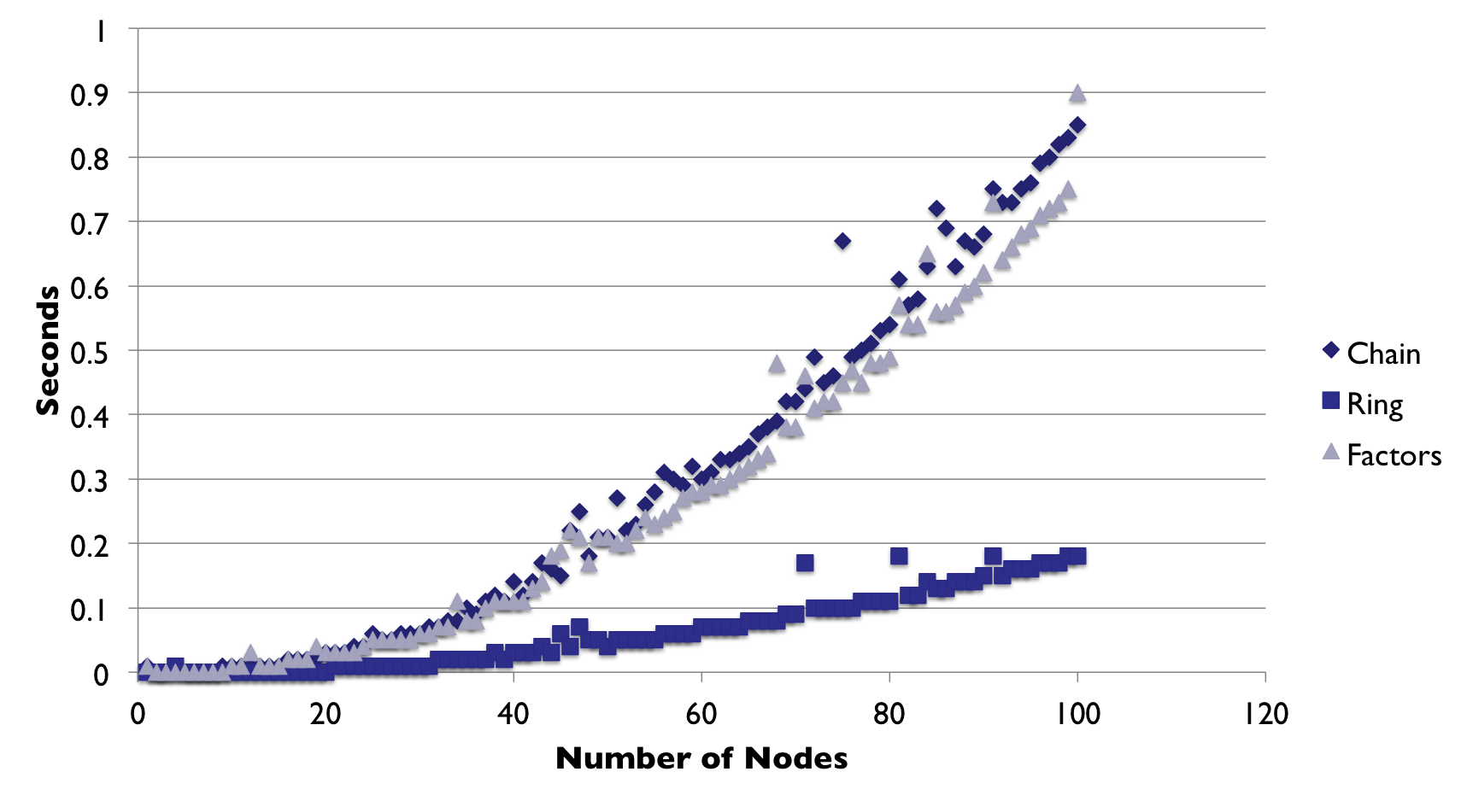
Runtime vs Nodes P=0.15

Slide 15
Results
The total number of iterations does not vary much with respect to the number of nodes.
The “ring” structure requires only one iteration regardless of the number of nodes.
The time performance appears to be O(n^2) for a constant damping factor.

Slide 16
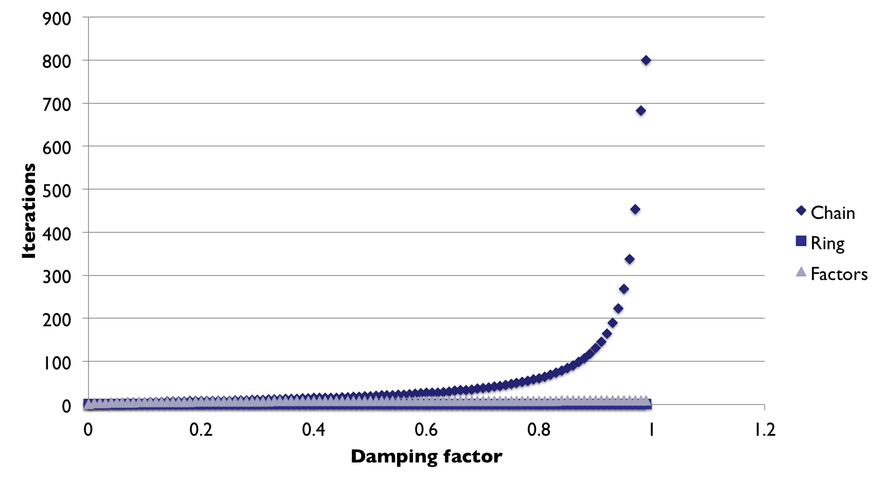
Iterations vs Damping nodes=800

Slide 17
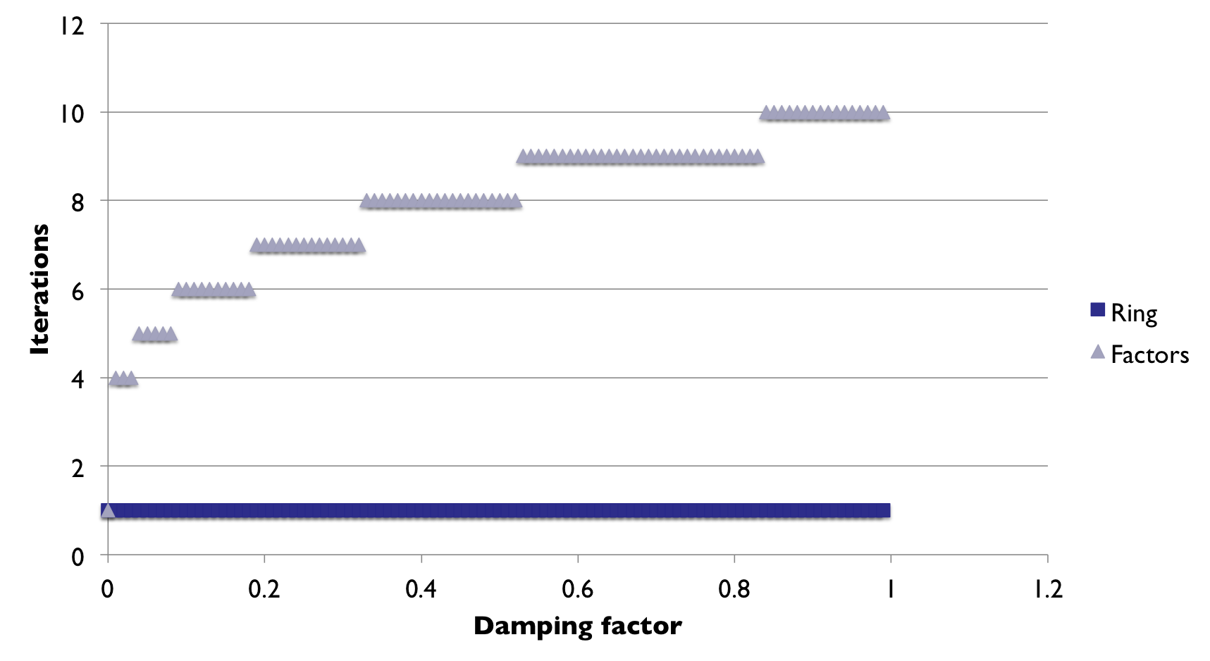
Iterations vs Damping w/o Chain

Slide 18
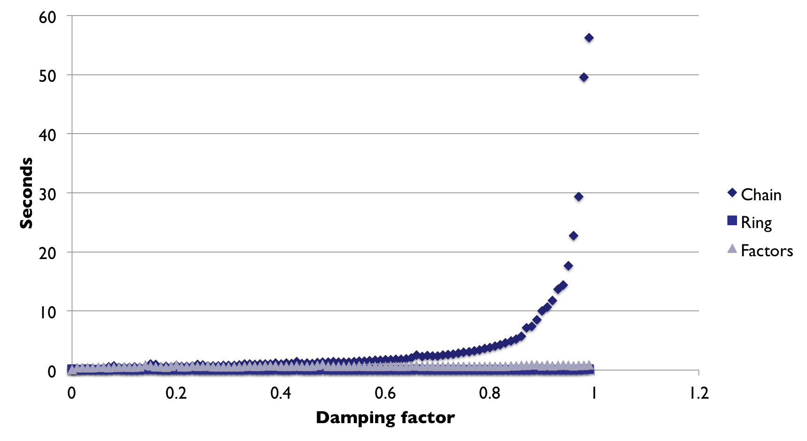
Runtime vs Damping nodes=800

Slide 19
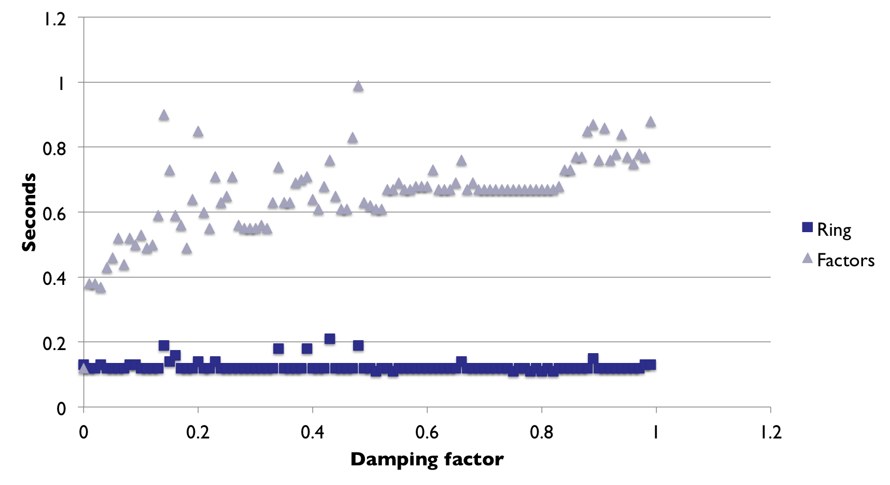
Runtime vs Damping w/o Chain

Slide 20
Results
“Chain” takes a very large number of iterations to converge for large damping factors.
“Factors” takes more iterations for larger damping factors, but it increases much more slowly.
“Ring” continues to converge in one iteration at all times.

Slide 21
Conclusions
High damping factors result in smaller pagerank values.
Performance is O(n^2)
The performance is very bad for certain graph structures and high damping values.

Slide 22
Additional Questions
If the convergence criteria depends on the damping factor, will the relationship between the damping factor and number of iterations disappear?
Is there a more disastrous worst case scenario?

