Slide 1
CAP6617 Term Project: investigation of adam
By Michael Pérez
Dr. Kejun Huang

Slide 2
Project goals
Implement adam and adamax optimization algorithms and apply them to three objective functions:
Multi-class logistic regression
Multi-layer neural network (with and without dropout)
Convolutional neural network (with and without dropout)

Slide 3
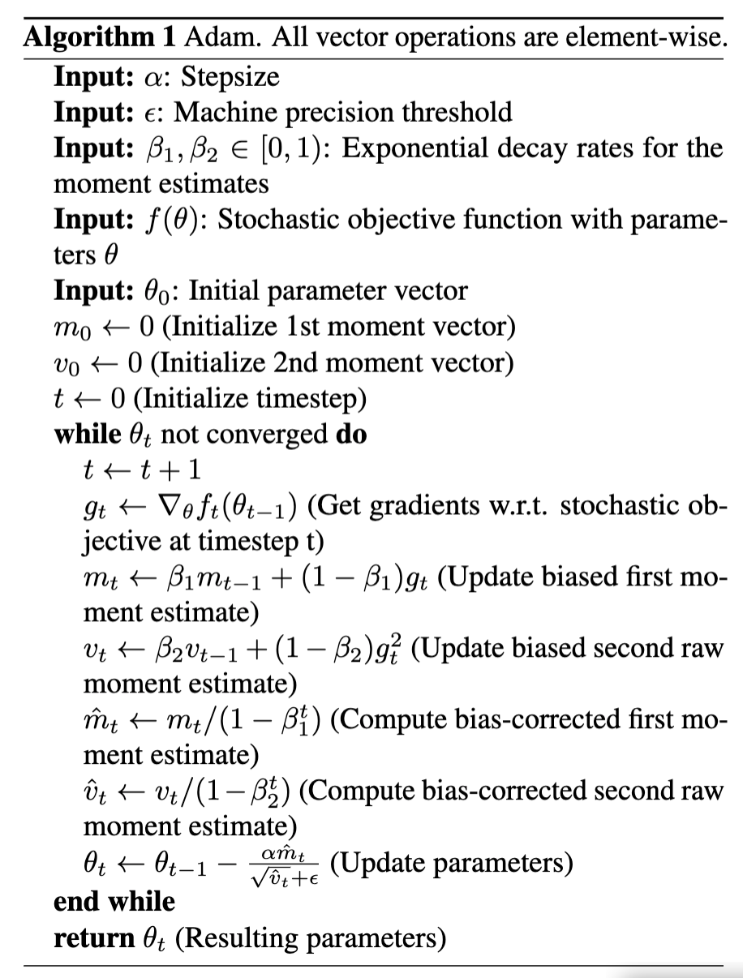
Adam Algorithm
Aims to reap the benefits of adagrad and rmsprop
Adagrad
Uses adaptive learning rate to better handle sparse gradients
Rmsprop
Uses adaptive learning rate and updates it based on estimates of the mean and variance of the gradient
adam
Exponentially decaying averages of the gradient and squared gradient are updated using the decay rates
To counteract the initialization bias, the gradient and squared gradient are bias-corrected
Parameters are updated based on the mean and variance of the gradient, using the step size and machine precision threshold

Slide 4
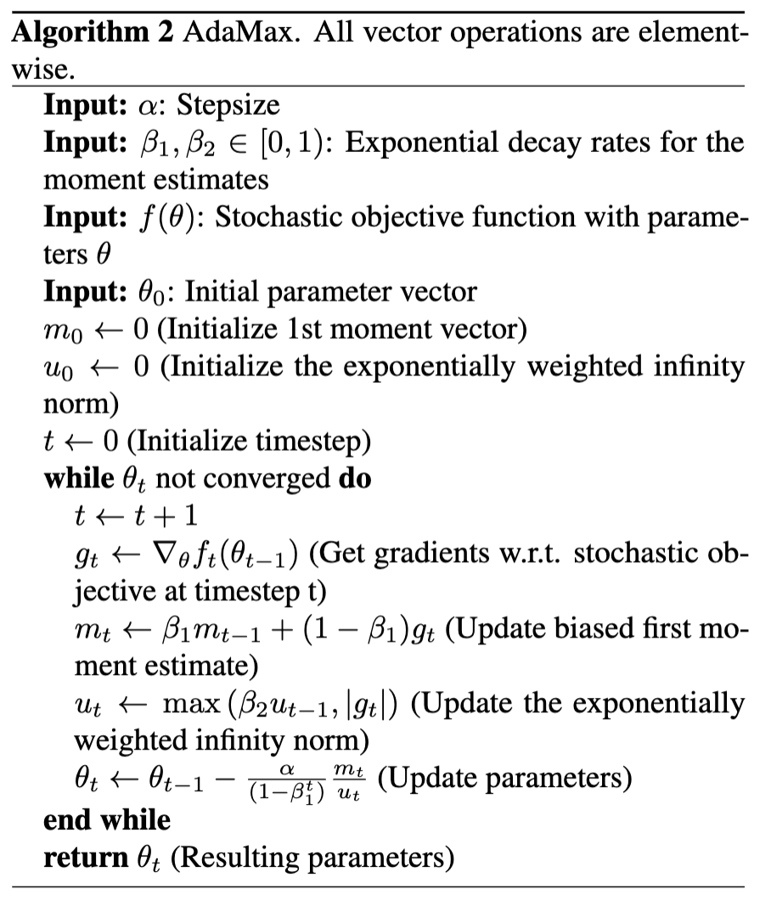
Adamax Algorithm
In Adam, weights are updated by scaling their gradients inversely proportional to a scaled L2-norm of current and past gradients
Adamax extends adam to use an update rule based on the infinity norm instead of the L2-norm
Using the infinity norm yields a simple update rule and a numerically stable algorithm
Instead of keeping track of the second moment of the gradient, the exponentially weighted infinity norm is used
No bias correction is needed

Slide 5
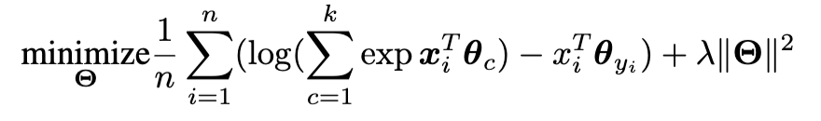
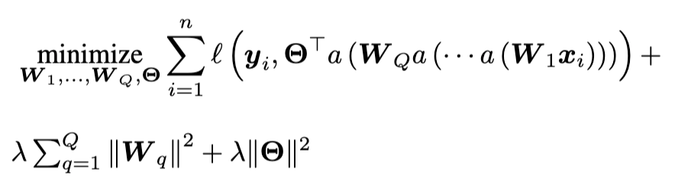
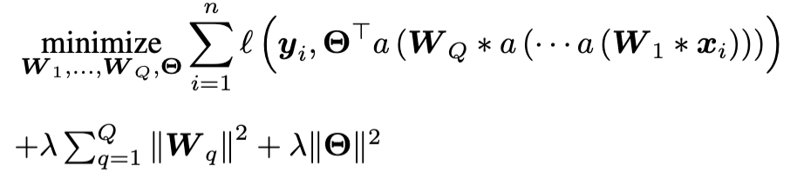
Objective functions
Multi-class logistic regression
Multi-layer neural network
Convolutional neural network

Slide 6
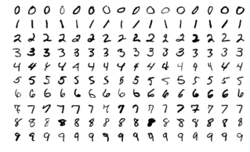
Mnist dataset
60,000 training images
10,000 test images
10 classes
28 x 28 pixels, grayscale images

Slide 7
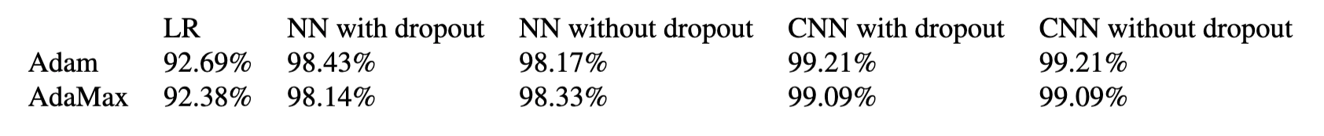
Classification Results on mnist test set

Slide 8
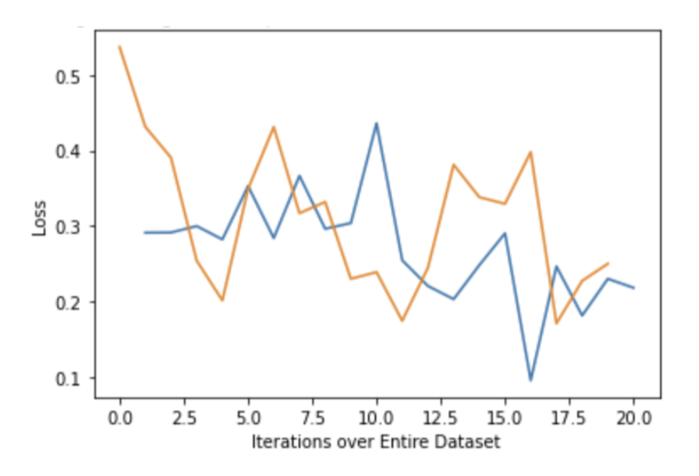
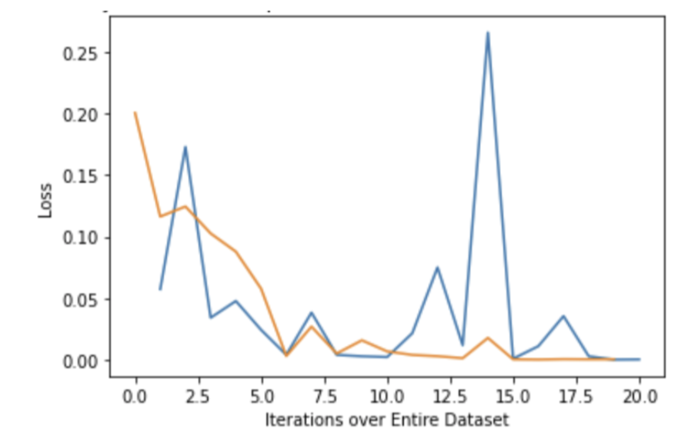
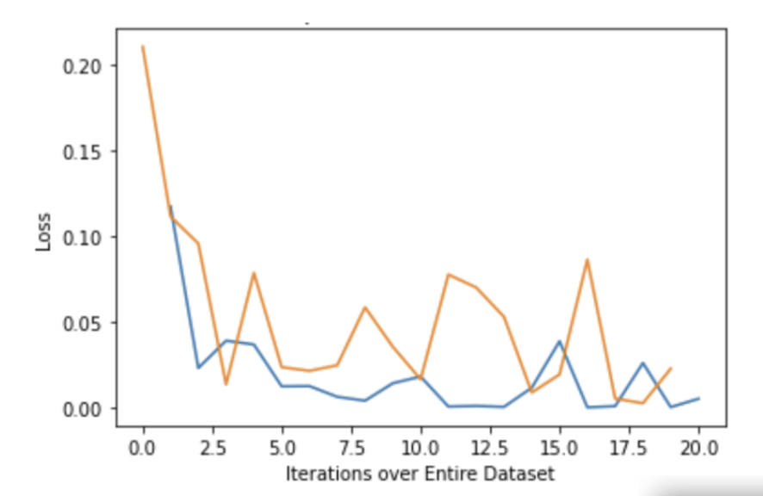
Adam (blue) vs. adamax (orange)
Logistic regression
multi-class neural network
Conv. neural network

Slide 9
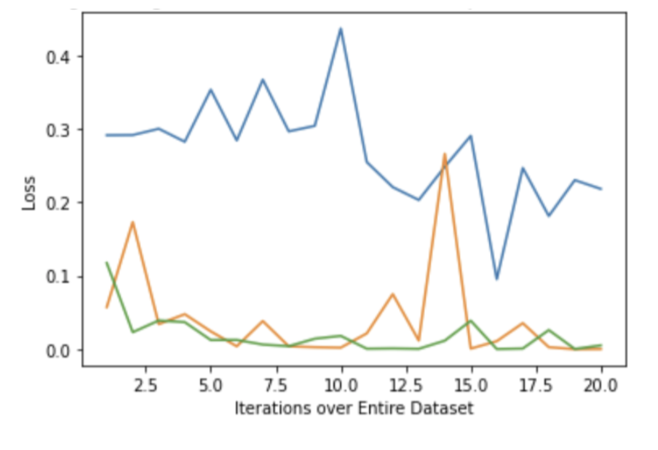
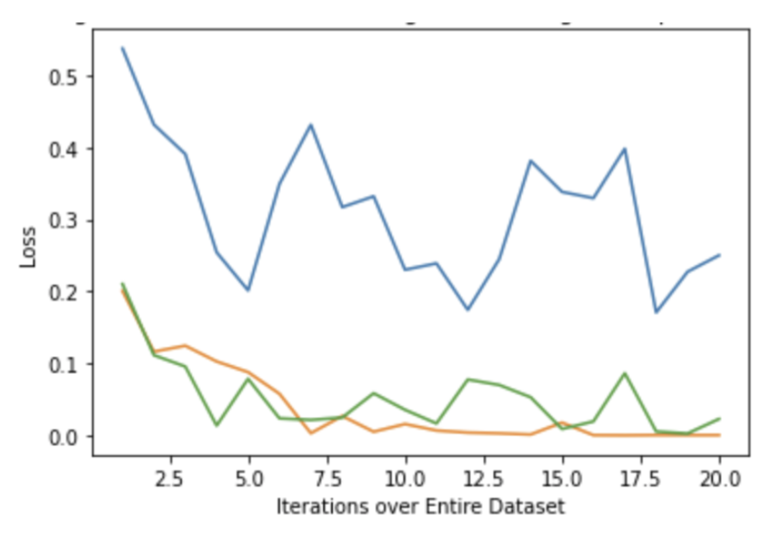
Logistic regression (blue) vs. nn (orange) vs. cnn (green)
ADAM
ADAMax

Slide 10
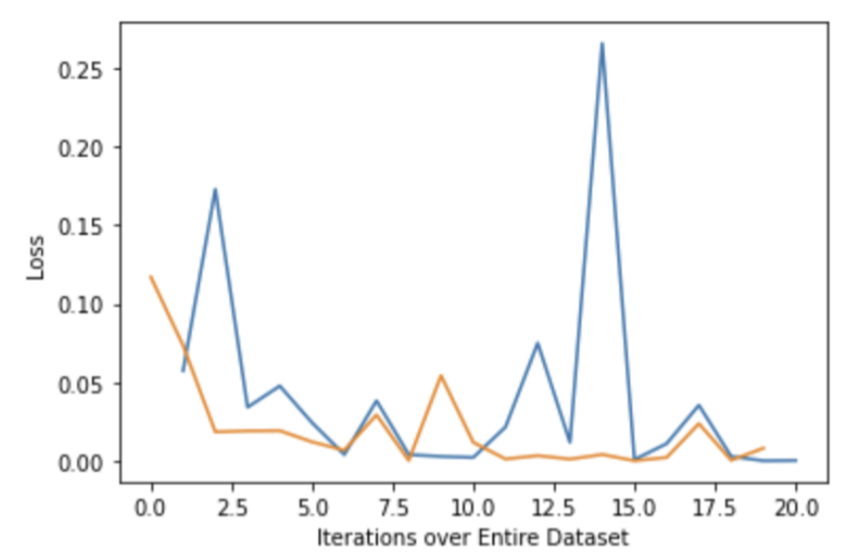
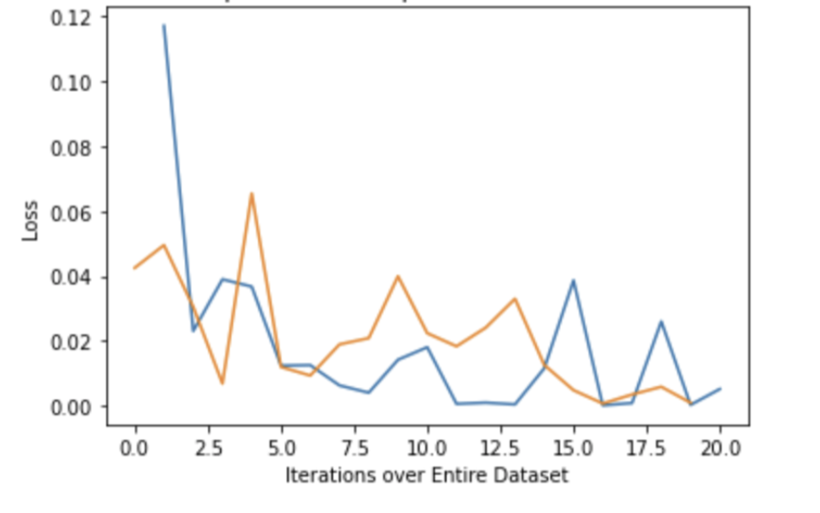
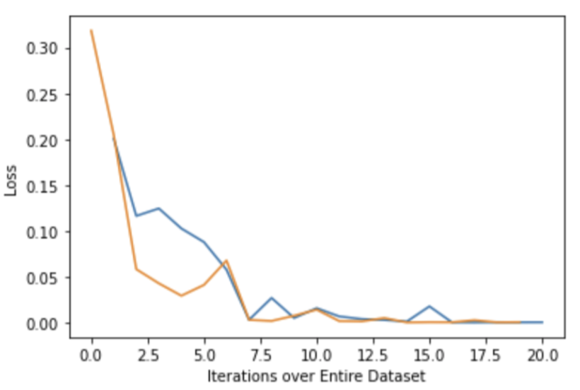
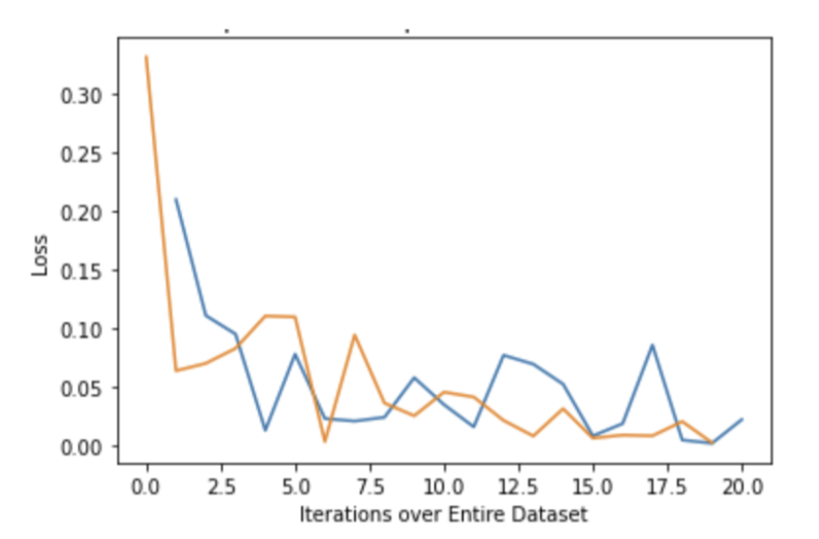
Dropout (orange) vs. no dropout (blue)
nn with ADAM
cnn with ADAM
nn with ADAMax
cnn with ADAMax

