Slide 1




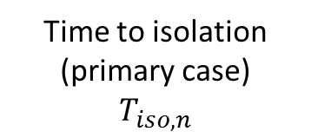
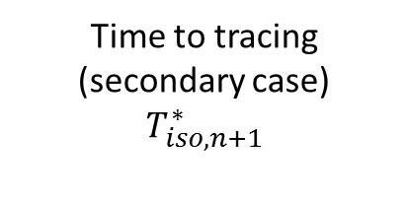

Primary case infected
Primary case symptom onset
Primary case infected
Primary case isolated
Incubation period (primary case)
Serial interval
Time to isolation (primary case)
$$T_{iso,n}$$
$$T_{trace}$$
Generation interval
Incubation period (secondary case)
Generation interval $T_{g,n}$
Time to tracing (secondary case)
$$T_{iso,n+1}^{∗}$$
Secondary case infected
Secondary case symptom onset
Secondary case infected
Secondary case traced
(a)
(b)

