Slide 1
PostgreSQL 12 and beyond
PostgreSQL Conference Japan 2019
November 15th, Tokyo
Michael Paquier

Slide 2
The man
Michael Paquier.
French, based in Tokyo.
PostgreSQL contributor since 2009
  Committer
  Hacker, Blogger
Twitter: @michaelpq
Website: https://paquier.xyz
Working at VMware: Packaging, Integration, Support.

Slide 3
Partitioning - 1
Performance improvements with many partitions
  COPY, switch to bulk-inserts
  INSERT, lock partition before insertion of single row
  SELECT, partition pruning and meta-data handling
About performance, David Rowley, 2ndQ:
https://www.2ndquadrant.com/en/blog/postgresql-12-partitioning/

Slide 4
Partitioning - 2
Tablespace inheritance.
Foreign keys to reference partitioned tables.
Expressions for partition bounds.
ATTACH PARTITION <=> Lock level lower.

Slide 5
Partitioning - 3
Partition functions
  pg_partition_root()
  pg_partition_ancestors()
  pg_partition_tree()
=# SELECT * FROM pg_partition_tree('parent_tab');
relid | parentrelid | isleaf | level
-------------+-------------+--------+-------
parent_tab | null | f | 0
child_0_10 | parent_tab | t | 1
child_10_20 | parent_tab | t | 1
child_20_30 | parent_tab | t | 1
child_30_40 | parent_tab | f | 1
child_30_35 | child_30_40 | t | 2
child_35_40 | child_30_40 | t | 2
(7 rows)

Slide 6
Partitioning - next?
Planner still slow with many partitions.
More partition-wise joins?
Logical replication and partitioned tables.
Think carefully about partitioning strategy.
  Redistribution.
  OLTP and/or analytics.

Slide 7
Btree indexes
Many duplicates
  Sort in heap-storage order
  Storage lower
  Performance with VACUUM and INSERT
Multi-column storage smaller.
Pre-11 indexes compatible after pg_upgrade but require REINDEX to get benefits.

Slide 8
REINDEX
REINDEX => access exclusive lock.
  No writes and no reads.
  Blocks production and takes time.
  Can be monitored in v12~.
CONCURRENTLY
  Allows read and writes.
  Takes longer, handles dependencies automatically.
  pg_reorg/pg_repack.

Slide 9
REINDEX - next?
Parallel job support in reindexdb --jobs (done!)
Collation version storing
Filtering of collation-sensitive indexes
glibc breaking indexes randomly with its upgrades!

Slide 10
Generated columns
Two kinds: stored and virtual.
Postgres supports only stored.
Less triggers, some restrictions on expressions.
=# CREATE TABLE person_data (
person_id int,
weight_grams numeric,
weight_kilos numeric GENERATED ALWAYS AS
(weight_grams / 1000) STORED);
CREATE TABLE
=# INSERT INTO person_data VALUES (1, 55000);
INSERT 0 1
=# SELECT * FROM person_data;
person_id | weight_grams | weight_kilos
-----------+--------------+---------------------
1 | 55000 | 55.0000000000000000
(1 row)

Slide 11
WITH and MATERIALIZE
Before 11: Always materialize (temporary copy)
  Advantage: DML + RETURNING.
  Not much: CTE with large scan.
=# EXPLAIN (COSTS OFF)
WITH large_scan AS MATERIALIZED
(SELECT * FROM very_large_tab)
SELECT * FROM large_scan WHERE id = 1;
QUERY PLAN
------------------------------------
CTE Scan on large_scan
Filter: (id = 1)
CTE large_scan
-> Seq Scan on very_large_tab
(4 rows)
=# EXPLAIN (COSTS OFF)
WITH large_scan AS NOT MATERIALIZED
(SELECT * FROM very_large_tab)
SELECT * FROM large_scan WHERE id = 1;
QUERY PLAN
-------------------------------------------
Gather
Workers Planned: 2
-> Parallel Seq Scan on very_large_tab
Filter: (id = 1)
(4 rows)

Slide 12
Table Access Methods - 1
Plugin facility to control table engine, not indexes!
API not to be considered stable, designed to evolve and break.
Heap is the default.
Zedstore (columnar), zheap (UNDO-based).
Limitation with WAL, reloptions (locks fixed in 13~).
Two categories
  Uses Postgres shared buffers, page format, storage..
  The rest, can do a lot.

Slide 13
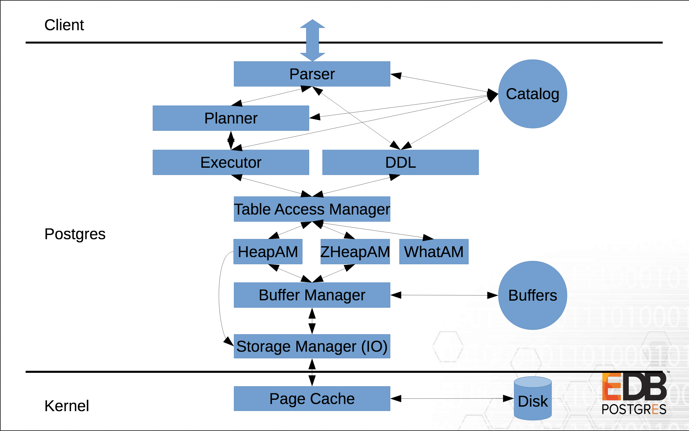
Table Access Methods - 2
Andres Freund (slide 5)
https://anarazel.de/talks/2018-10-25-pgconfeu-pluggable-storage/pluggable.pdf

Slide 14
Table Access Methods - 3
Columnar, compression storage, etc.
Example: blackhole_am
https://github.com/michaelpq/pg_plugins/tree/master/blackhole_am
=# CREATE EXTENSION blackhole_am;
CREATE EXTENSION
=# CREATE TABLE blackhole_tab (a int) USING blackhole_am;
CREATE TABLE
=# INSERT INTO blackhole_tab VALUES (1);
INSERT 0 1
=# SELECT * FROM blackhole_tab;
a
---
(0 rows)

Slide 15
Recovery
All recovery parameters become GUCs:
  SHOW and ALTER SYSTEM
  trigger_file => promote_trigger_file
  standby_mode gone
  No multiple recovery targets
  recovery_target_timeline ~> default to ‘latest’
recovery.conf gone => standby.signal & recovery.signal
pg_promote() as SQL function.

Slide 16
Data checksums
pg_checksums
  Enable and disable, no parallel support
  Progress reporting
  Only for offline cluster
  Renamed from pg_verify_checksums in 12~
Checksum failures in pg_stat_database
Next: Online mode?

Slide 17
Transaction chains
COMMIT AND CHAIN
ROLLBACK AND CHAIN
Error outside transaction block.
=# COMMIT AND CHAIN;
ERROR: 25P01: COMMIT AND CHAIN can only be used in transaction blocks
=# BEGIN;
BEGIN
=# COMMIT AND CHAIN;
COMMIT
=# BEGIN;
WARNING: 25001: there is already a transaction in progress
BEGIN
=# COMMIT;
COMMIT

Slide 18
Progress reporting
pg_stat_progress_vacuum since v9.6.
CREATE INDEX + REINDEX (+ CONCURRENTLY)
pg_stat_progress_create_index
CLUSTER and VACUUM FULL
pg_stat_progress_cluster
Progress phases can be confusing:
https://www.postgresql.org/docs/current/progress-reporting.html

Slide 19
jsonpath
Expressions => like XPath for XML.
jsonpath data type, lookup at parts of JSON tree.
Operators.
No datetime yet (committed in v13~).
Documentation:
https://www.postgresql.org/docs/devel/functions-json.html

Slide 20
Release notes: https://www.postgresql.org/docs/12/released
Thanks!
Questions?

