Slide 1
How to get a feature committed?
Michael Paquier – VMware
2019/05/31, PGCon

Slide 2
About the man
Michael Paquier.
French, based in Tokyo.
PostgreSQL contributor since 2009
  Some patches, some reviews and some bug fixes.
  Blogging.
  Committer since June 2018.
Working at VMware on PostgreSQL
  Packaging.
  Integration.
  Support.

Slide 3
Community
Core database engine
Steady, well-designed progress
World-wide investment
Code of conduct (since 2018)
https://www.postgresql.org/about/policies/coc/

Slide 4
DB engine Ranking (May 2019)
https://db-engines.com/en/ranking
# | Engine | Score | Apr 2018 | May 2017
1 | Oracle | 1285.55 | +5.61 | -4.87
2 | MySQL | 1218.96 | +3.82 | -4.38
2 | MSSQL | 1072.19 | +12.23 | -13.66
4 | Postgres | 478.89 | +0.17 | +77.99
5 | MongoDB | 408.07 | +6.10 | +65.96

Slide 5
PaaP
PostgreSQL As A Product.
(F)Orcs must die!
  If you like it, still you can fork it.
  Long-term prospect gets better by investing in the core engine.
  Some folks are still able to live with this model with customer base (EDB Postgres, Amazon, Greenplum).
Hard to contribute, initial time investment worth it long-term.
Dozens of man years into the code from core developers.

Slide 6
Database engine
ACID
Free to use – BSD like
Open engineering.
Open to new and good ideas.
Highly pluggable: data types, plugins.
High code quality.

Slide 7
Committers
World-wide, shared-something distribution
29 in total: https://wiki.postgresql.org/wiki/Committers
North America (10) - US
Europe (12) - Czech, France, Finland, Ireland, Russia, Sweden, UK
South America (1) - Chile
Asia (4) - India, Japan
Oceania (2) - NZ

Slide 8
Development cycle
Schedule decided at PGCon, developer meeting:
https://wiki.postgresql.org/wiki/PgCon_2019_Developer_Meeting
1 year, September to September, until GA
Divided into two periods
  Feature submission and new developments July~April
  Focus on stability April~September

Slide 9
Release maintenance
One branch on git per major version
  REL_11_STABLE => v11
  REL_10_STABLE => v10
  REL9_6_STABLE => v9.6
Only bug fixes, no new features
No change in system catalogs or WAL format
EOL’d after 5 years

Slide 10
Commit fests
4~5 commit fests per development cycle.
September to March.
One month of break between each.
Up to 250 patches.
https://commitfest.postgresql.org/

Slide 11
Stability period
First beta after last commit fest, in April
Stability work:
https://wiki.postgresql.org/wiki/PostgreSQL_12_Open_Items
Help in stabilizing things
  Testing, actual fixes
  Show involvement with community
  As important as writing cool features

Slide 12
Commit fest management
Up to 250 patches.
Few rejections.
A lot returned with feedback.
More patches bumped to next CF.
Authors forget!
Reviewers forget!

Slide 13
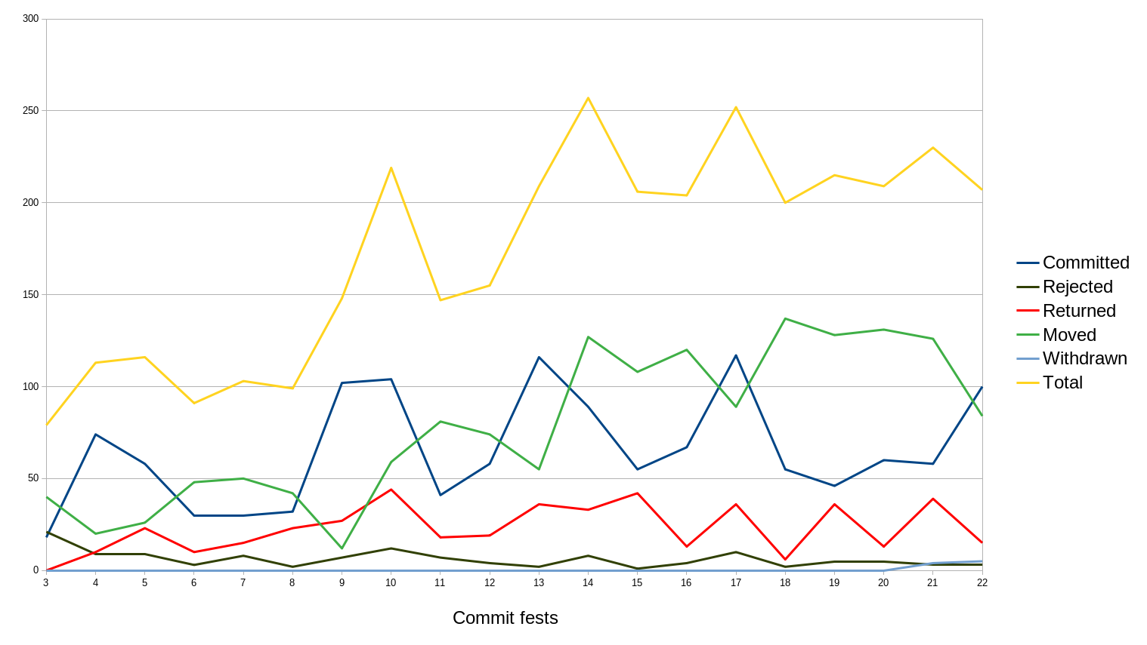
Add graph

Slide 14
Patch submission
Read guidelines
https://wiki.postgresql.org/wiki/Submitting_a_Patch
Register it in commit fest (need community account)
If WIP, begin discussion first, draft patch fine.
Email to pgsql-hackers.
Bug fixes also to pgsql-bugs.

Slide 15
Patch contents
The code itself
Comments.
Documentation!
  Explanation in email may not be enough, still helpful.
  Self-contained docs are for the user at the end.
Tests:
  isolation, regression, TAP?
  Should be designed to not be too costly, still hold value.
  Helps in reviewing feature.

Slide 16
Coding convention
Signal handling, macros, error format, etc.
Configuration in src/tools/editors/: vi, emacs.
Documentation:
https://www.postgresql.org/docs/devel/source.html

Slide 17
Regression tests
Main regression suite, src/test/regress/
Isolation test (concurrency), src/test/isolation/
Extension tests, src/test/modules/ and contrib/
https://www.postgresql.org/docs/devel/extend-pgxs.html
TAP tests
  src/test/perl/ for base modules.
  src/test/recovery/, authentication/, ssl/, etc.
PG_TEST_EXTRA='ssl ldap kerberos'

Slide 18
Patch format
Acceptable formats:
  git diff
  git format-patch
Add version in the file name
Sometimes make sense to split into multiple commits
  Refactoring first
  Actual feature
Personal viewpoint: as long as it can be applied cleanly I am fine.
  patch -p1 < your-cool-stuff-v1.patch

Slide 19
CF manager
Deputy handling patch workflow
1 or more seasoned contributors.
Actions
  Tracking
  Poking
  Mostly poking and vacuuming
Done by seasoned hackers.

Slide 20
CF bot
Automatic check of submitted patches
  Linux
  Windows
URL: http://commitfest.cputube.org/
Divided by author:
http://commitfest.cputube.org/michael-paquier.html
Credits: Thomas Munro

Slide 21
Patch review (1)
Flow
  Exchange between author(s) and reviewer(s).
  Patch marked as ready for committer.
  Committer looks at it, committing it or falling back.
1 patch written = 1 review of equivalent difficulty.
Reviews are as important as writing cool code.

Slide 22
Patch review (2)
Expect one or more rewrites of the patch.
Make sure to agree on the shape before consuming time writing it.
Consensus is key.
A complicated patch will never finish in the shape it was designed initially.

Slide 23
Conclusion
Be patient
Help others, take new challenges.
Fixing bugs and doing maintenance helps as well.
Remain polite, respect others.

Slide 24
Thanks!
Questions?

