Slide 1

Postgres-XC
Postgres Open 2011
Michael PAQUIER
2011/09/16

Slide 2
What is Postgres-XC?
Project page: http://postgres-xc.sourceforge.net
Write-scalable, multi-master clustering solution for PostgreSQL ?? @-@
Symetric cluster of PostgreSQL
  No Slave and no Master
  Transparent Transaction Management
  Every node can issue both READ/WRITE
  Shared-nothing
PostgreSQL license
Notes:
PostgreSQL based database cluster based on PostgreSQL. First developped jointly by EnterpriseDB and NTT. Then released under PostgreSQL license.
Explanation of the terms multi-master, write-scalable to do in relation of the term symetric.
- multi-master, so master/slave relationship. All the nodes are masters.
- write-scalable, table data is distributed among nodes and each node can issue read (SELECT) or write (DML/DDL) SQLs.

Slide 3
Core architecture

Slide 4

About PostgreSQL 9.1
Streaming replication and HOT-Standby
Read/Write possible
READ only
Master
Slaves
Log shipping
Asynchronous mode => timestamp view not consistent
Synchronous mode => timestamp view consistent
Notes:
In PostgreSQL, Streaming replication is:
- asynchronous since 9.0
- synchronous added for 9.1
- cascade replication planned for 9.2
Asynchronous, performance but timestamp view not consistent among nodes.
Synchronous, less performant, but timestamp view is consistent among nodes.

Slide 5
And Postgres-XC itself?
Read/Write transactions
Distributed/replicated tables
Same data consistency/transparency
Same timestamp view
Notes:
Postgres-XC is designed to allow all the nodes using READ/WRITE operations.
- avoidance of write operation bottleneck in PostgreSQL master
- data is balanced and distributed among the nodes
- timestamp view is always consistent among nodes

Slide 6

Scalability measurements
Tests done with DBT-1 (TPC-W)
Notes:
Comparison done with 1 server PostgreSQL.
And N Postgres-XC nodes.
Talk about TPS output.
Measurement results:
- PostgreSQL 8.4, 2500 TPS
With 5 servers:
- PGXC 0.9.2 => 8500 TPS
- PGXC 0.9.3 => 7500 TPS
- PGXC 0.9.5 => 4600 TPS
Since release of 0.9.3, priority done to feature development and not scalability.

Slide 7

GTM: designed for transparency
Cluster nodes are fed with a global snapshot obtained from a unique GTM node.
GTM
Cluster nodes
Snapshot
GXID
Timestamp
Sequence values
Notes:
GTM is in charge of feeding cluster with a unique GXID value, global snapshot based on the active transactions.
Timestamp is taken from the GTM clock when asking on GTM for a transaction ID.
Sequence values are cached on GTM and fed from that (currval, nextval on GTM, lastval on local node as it depends on session).

Slide 8
Node types (1)
Coordinator
  Holds table information (distribution type, key)
  Entry point for applications, remote node
  Connection pooling
Datanode
  Holds the data, backend node in cluster
  More or less like a normal Postgres server
So what?
  All nodes share the same synchronized catalogs
Notes:
Nothing much to explain here.
Graph on next slide is here to explain that.
Things are kept here SIMPLE. So should be the explanation. Only use the vocabulary on this slide and no other expressions!

Slide 9
Node types (2)
Read/Write transactions
Coordinator
Coordinator
N Coords
...
Catalog
Catalog
Pooler
Pooler
Datanode
Datanode
Catalog
data
M Dns
...
Catalog
data
Notes:
Postgres-XC architecture can be made with a customizable number of Datanodes and Coordinators.
Coordinator/Datanode numbers can be moved freely. 3 Coordinators on 1 node, and 1 Datanode only on one node is also possible.
Coordinators use Connection pooling to connect to other nodes.
Coordinator ↔ Datanode connections used for all types of queries
Coordinator ↔ Coordinator connections used for DDL queries only
Things are kept here SIMPLE. So should be the explanation. Only use the vocabulary on this slide and no other expressions!

Slide 10
Key algorithm

Slide 11
Query algorithm (1)
GTM
Receive query from application
Get snapshot, GXID and timestamp from GTM
Query
Coordinator
Catalog
Pooler
Datanode
Datanode
Datanode
Catalog
data
Notes:
Here is the key algorithm for a query:
Received query (slide 1)
Now Postgres-XC only supports read-committed isolation level.
A transaction ID and timestamps are taken each time a transaction begins.
Snapshot is taken for each query.

Slide 12
Query algorithm (2)
GTM
Incoming statements: analyzer and rewriter
Planning: analyze nodes to be involved. Build queries for local nodes (push down if necessary)
Coordinator
Catalog
Pooler
Datanode
Datanode
Datanode
Catalog
data
Notes:
Here is the key algorithm for a query:
All the nodes contain specific Postgres-XC catalog table information:
- Distribution type (replicated, distributed, rrobin)
- Distribution column (if necessary)
- Node list were data is located (necessary for node removal/addition)
Reference to this data is made at planning step.
This can also be done at rewiring step for INSERT queries with multiple values to redistribute data to correct nodes.

Slide 13
Query algorithm (3)
GTM
Run queries on remote Datanodes and send back results to Coordinator
Coordinator
Catalog
Pooler
Datanode
Datanode
Datanode
Catalog
data
Catalog
data
Catalog
data
Notes:
Datanodes also contain catalog data of tables specific to XC but they do not refer to it.
They react more or less like a PostgreSQL server.
Except that an interface for the reception of transaction ID, timestamp and snapshot has been added as this data has to be the same for Coordinator and its remote Datanodes.
This data is sent down only if necessary (this means when a new connection is opened to a Datanode).
OIDs are not consistent among nodes, relations are manipulated with there names instead of their OIDs (combined with schema names).
Coordinator pooler uses a libpq connection protocol.

Slide 14
Query algorithm (4)
GTM
Materialize results if necessary and send back to client
Results
Coordinator
Catalog
Pooler
Datanode
Datanode
Datanode
Catalog
data
Notes:
Materialization of data may be necessary to perform join operations for example (or to apply filters like limit, offset, order by etc.).
ORDER BY and GROUP BY clauses are pushed down in certain circurstances (use of aggregates for instance).
For example, a join on 2 replicated tables that are on the same nodes can be pushed down safely on a node, and save bandwidth instead of doing that on Coordinator. This works if replicated tables have at least one common node.
This is not the case for JOIN having at least 1 replicated table.

Slide 15
Demonstration
psql client 1
psql client 2
GTM
Port 6666
Coordinator 1
Port 5432
Coordinator 2
Port 5433
Datanode 1
Port 15432
Datanode 2
Port 15433
Notes:
All the nodes are located on local machine.
Program of demonstration from both clients:
1) CREATE TABLE table_dist (a int, b int) DISTRIBUTE BY HASH(a);
CREATE TEMP TABLE table_rrobin (a int, b int) DISTRIBUTE BY ROUND ROBIN;
CREATE TABLE table_rep (a int, b int) DISTRIBUTE BY REPLICATION;
2) Check creation from client 1 and 2
3) Perform some INSERT from client 2
INSERT INTO table_dist VALUES (1, 1), (2,2), (3,3);
INSERT INTO table_rrobin VALUES (1, 1), (2,2), (3,3);
INSERT INTO table_rep VALUES (1, 1), (2,2), (3,3);
4) EXECUTE DIRECT ON NODE 1 'SELECT * FROM table_dist';
EXECUTE DIRECT ON NODE 1 'SELECT * FROM table_rep';
EXECUTE DIRECT ON NODE 2 'SELECT * FROM table_rrobin';
5) EXPLAIN VERBOSE SELECT * FROM table_dist,table_rep WHERE table_dist.a = table_rep.a;
EXPLAIN VERBOSE SELECT * FROM table_dist,table_rrobin WHERE table_rrobin.a = table_dist.a;
Note: Launch a query from a Datanode to check what is happening: WARNING has no snapshots

Slide 16
About high-availability
Notes:
HA contains the following features:
BARRIER
GTM-Standby, GTM SPOF
GTM reconnection
Streaming replication, node fallback and standby nodes

Slide 17

Cluster SPOF problem
Datanode is a SPOF if it has a portion of distributed table.
GTM
Cluster nodes
GTM case
GTM
Cluster nodes
Notes:
Explain that SPOF is a single point of failure.
Cases with only one degree of failure.

Slide 18
Datanode SPOF resolution (1)
PostgreSQL 9.1 synchronous strrep
Coordinator
Cluster nodes
Catalog
Datanode
master
Catalog
data
Log shipping
Log shipping
Datanode
slave
Catalog
data
Notes:
This shows the structure of cluster before failure.
Should say that synchronous strrep is synchronous streaming replication.
Synchronous mode is necessary as all the Postgres-XC nodes have already the same timestamp view.

Slide 19
Datanode SPOF resolution (2)
Fallback slave node
Coordinator
Cluster nodes
Catalog
Datanode
master
Catalog
data
Fallback
Log shipping
Log shipping
Datanode
master
Catalog
data
Notes:
Lost a Coordinator and a Datanode.
Don't really care about losing a Coordinator: there are other entry points.
Datanode slave is fall-backedto the port and listen Ips of the previous failed node. This is OK as long as nodes are on the same segment.
Now, XC Coordinator does not use access to slave nodes for read-only transactions. This is a possible future extension for load balancing.
Fallback mechanism is not insured by XC itself. You have to use an external application on that purpose.

Slide 20
GTM SPOF resolution (1)
Use of a standby node for GTM
Cluster nodes
GTM
Status backup
GTM-Standby
Notes:
Each time a timestamp, GXID, snapshot, sequence value is taken from GTM, an immediate connection is made to GTM and its status is saved.
Performance is reduced, but synchronous backup is made. And GTM is preserved from GTM failure.

Slide 21
GTM SPOF resolution (2)
Fallback to standby and reconnect nodes
Cluster nodes
Online reconnection
GTM
Status backup
GTM-Standby
Notes:
Node reconnection can be made by signaling nodes to reconnect on new GTM Standby.
Postgres-XC core does not give functionalities to watch external processes for failures (Pacemaker?). An external process watcher has to be used.
Don't forget to say that GTM-Standby is not completely ready yet. Now it only works in the case where transactions are not running in parallel. It will not be available for next release, perhaps for end end of the year.

Slide 22
PITR – requirements (1)
PITR, Point in-time recovery
  Rollback the database to a given past state
  Need consistent points to restore to that
T
Coordinator 1
t
T
Coordinator 2
t
T
Datanode 1
t
T
Datanode 2
t
Pt 1
Pt 2
Notes:
This is a rough explanation of how should work a PITR in a cluster. If at moment a node fails, we should be able to return at the *same* state point for all the nodes in the cluster.
Each node follows a certain timeline and they cannot not break it.
This timeline could symbolize the WAL written for each server. It is unique among them.
In the case of this picture, restore back to Pt 2 is a better choice.

Slide 23
PITR – requirements (2)
Transaction status has to be consistent in the cluster
Each transaction must be either:
  Committed/Prepared/Aborted/Running on all the involved nodes
  We must avoid cases where transaction is prepared and committed partially, or prepared and rollbacked partially
Write record in WALs of all the coordinators and datanodes at a moment when all the transaction statuses are consistents.
External Application can provide such timing as with BARRIER
  CREATE BARRIER barrier_id
BARRIER:
  Waits that partially committed or aborted transactions commit (2PC)
  Block all transaction commit when running a barrier
When running PITR, specify recovery_target_barrier in recovery.conf
Notes:
This PITR has to follow some conditions in a cluster-wide environment to respect the database consistency.
BARRIER mechanism introduced since Postgres-XC 0.9.5.
It is a sufficient condition to have a consistent WAL record on all the nodes to have a recovery of Database cluster in a consistent state.

Slide 24
What now and next?

Slide 25
Current functionalities
Up to 0.9.5
  Major DDL/DML (TABLE, ROLE, VIEW...)
  PREPARE/EXECUTE (restrictions on parameters)
  Session parameters
  Support for additional distribution types
  Cursors (no backward, no CURRENT OF)
  SELECT queries: support extension
    HAVING, GROUP BY, ORDER BY, LIMIT, OFFSET...
Notes:
Distribution types include timestamps, real (even if that's a bit dangerous).
SELECT queries includes better push down GROUP BY, aggregates, ORDER BY queries.
For cursors, only support for forward cursors is done, backward cursor is not made. CURRENT OF structure is in place but not fully operational for replicated tables.

Slide 26
About release 0.9.6
Release on September 2011
Temporary objects
Merge with PostgreSQL 9.1
PREPARE/EXECUTE (all except CREATE AS)
HAVING
Aggregate generally operational
Regressions updated and maintained consistent

Slide 27
Heading to 1.0 (1)
SQL support
  Subqueries (WITH)
  Generic treatment of function SPI for data distribution (Ex: SERIAL)
  CREATE AS/SELECT INTO
  Trigger, rules
  CURRENT OF, SAVEPOINT
  TABLESPACE extension (case of multiple Datanodes on same server...)
Notes:
Release plan is April 2012.
CREATE AS/SELECT INTO being implemented.
Some study done for function value feed.
Design work done for triggers.
Not sure though if there will be time to add those functionalities by April 2012. Developers may focus only on most urgent issues.

Slide 28
Heading to 1.0 (2)
Related to tuple relocation
  Move tuples from a node to another node
    Ex: update of a distribution column
  CREATE/ALTER TABLE to choose list of nodes where a table is distributed (all nodes by default)
Connection balancing between master and slave Datanodes for read transactions.
Management of node information with SQL interface => configuration simplified

Slide 29
Challenges after 1.0?
Global constraints
  Unique/Reference integrity among partition
  Exclusion constraint among partition
Global deadlock detection (wait-for-graph mechanism)
Online server removal/addition
SQL/MED mechanisms, FDW integration
Notes:
For global wait-for-graph mechanism, now we just count on timeouts to cancel transactions waiting taking too long.

Slide 30
What can be done for PostgreSQL?
Snapshot cloning
  Several sessions holding the same snapshot
  parallel pg_dump
Parallel query execution
SQL/MED improvements
  Column projection
  Join pushdown, ORDER BY, GROUP BY, aggregates
  Foreign expression pushdown (function stable/volatile/immutable, etc.)
Materialization of external node
Cross-node join
Cross-node aggregation
Notes:
Make an explanation of what means pushdown:
- Sending to a remote node an expression directly
- This expression is calculated in a foreign node

Slide 31


Project ressources and contacts
Project home
  http://postgres-xc.sourceforge.net
Developer mailing list
  postgres-xc-developers@lists.sourceforge.net
  postgres-xc-general@lists.sourceforge.net
Contacts
  michael.paquier@gmail.com
  koichi.szk@gmail.com
Twitter: @michaelpq
Blog: http://michael.otacoo.com
Sponsored and
supported by:
Notes:
Don't forget to tell people that people can participate in development with:
- bug report
- feature development
- bug fix
- patch redaction
- remarks
- coffee for team, etc.

Slide 32
Thanks for your attention.
Questions?

Slide 33
GTM Proxy reconnection
Signal GTM Proxy and reconnect nodes
Signal
GTM
GTM-Proxy
TX info
Coordinator
Datanode
TX info
Datanode
GTM-Standby
Datanode

Slide 34
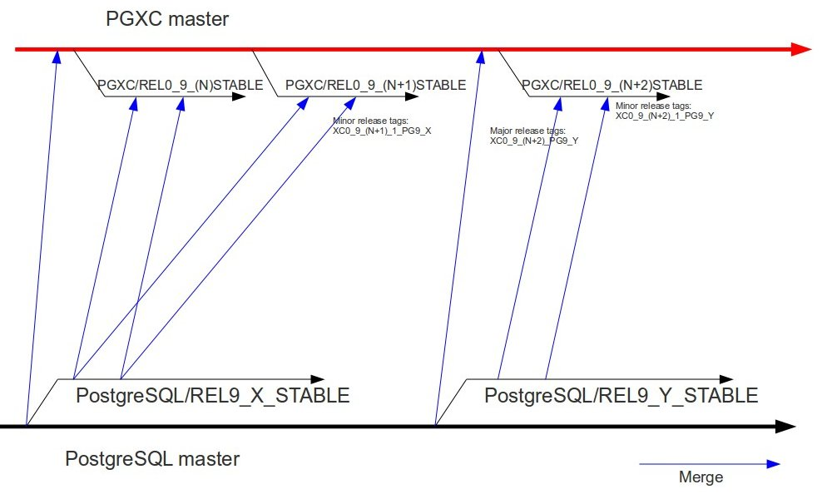
Release policy

Slide 35
License
This document is Copyright © 2011 by Michael Paquier. You may distribute it and/or modify it under the terms of the Creative Commons Attribution License (http://creativecommons.org/licenses/by-nc-sa/3.0/), version 3.0 or later.

