Slide 1

Institut für Informatik
TrendingMap
A visual tool for exploring geographic trends and data
Data Science - Hauptseminar SS 2016
Michael Prummer, Jennifer Ling, Sandra Zollner

Slide 2

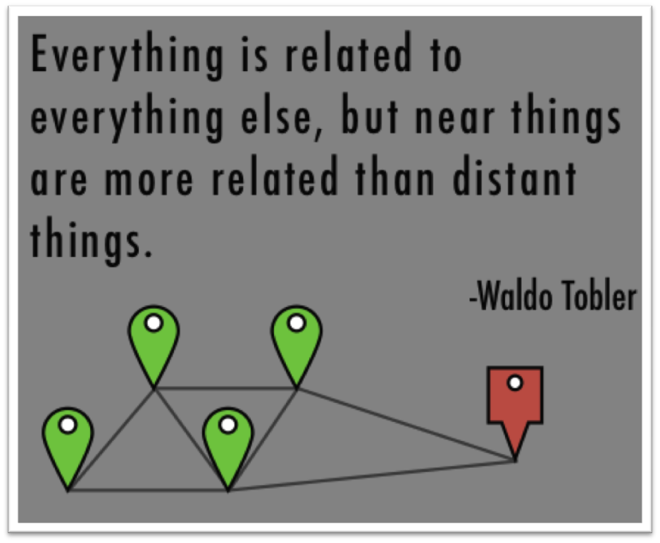
Agenda
Agenda
Idea
Corpus
Data Preprocessing
Clustering
Visualization
Demo
Future Work

Slide 3
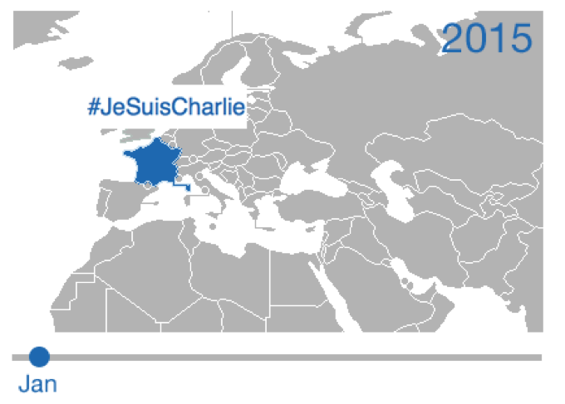
Idea
Initial idea
Interactive tool to explore trending topics on a map
GeoScope algorithm (based on topics as hashtags)
Show trends per country

Slide 4
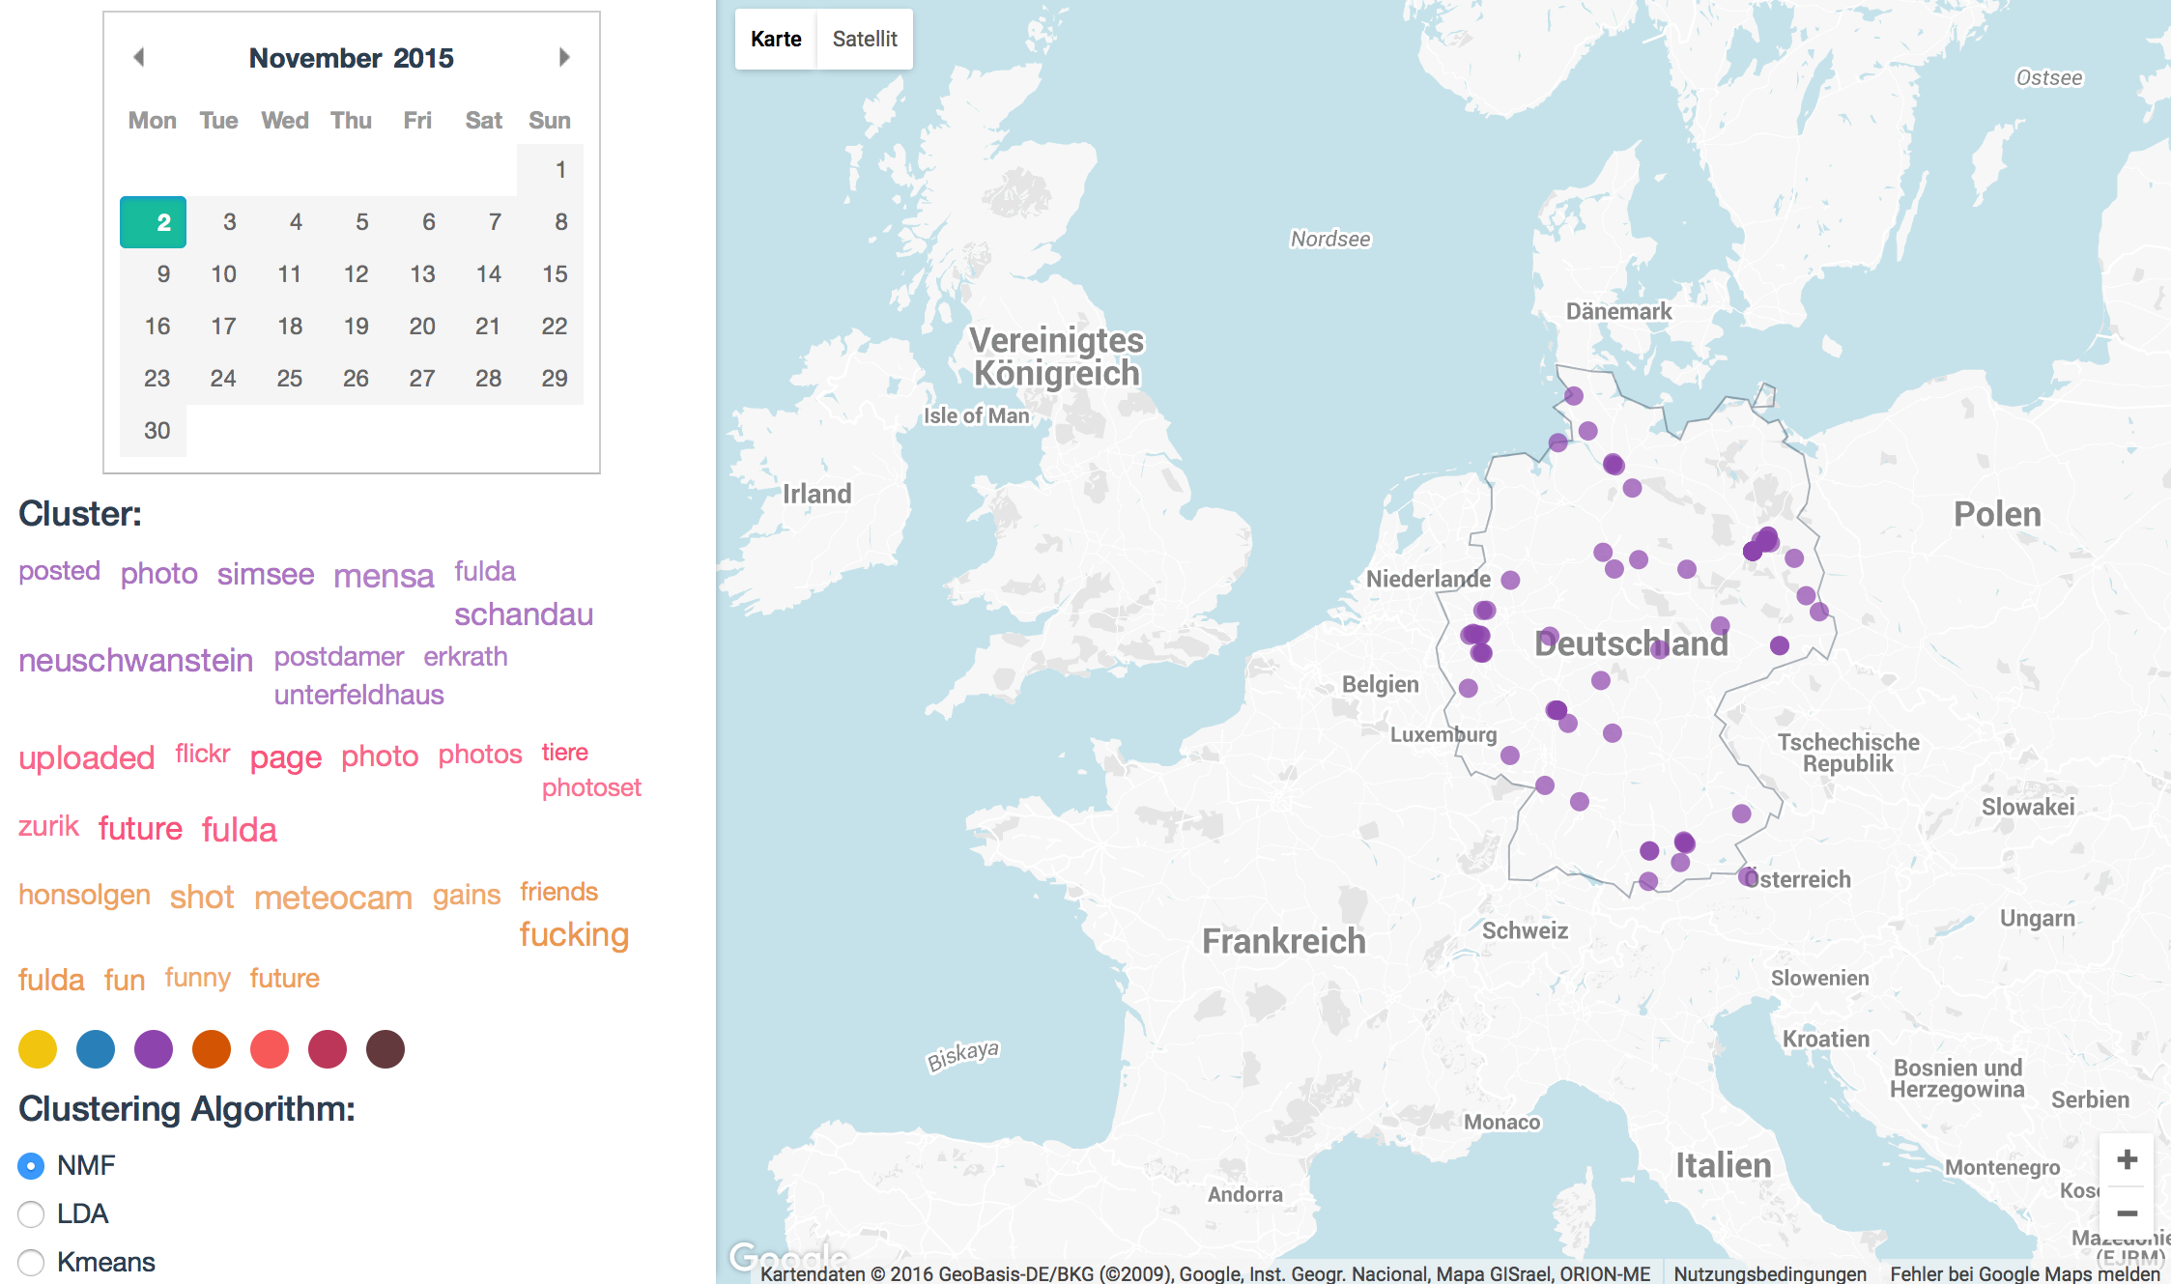
Idea
Final Idea
Cluster Tweets regarding to the information content of terms
Show distribution of Tweets belonging to one trend on the map
Time window: one day
Three clusters per day

Slide 5
Corpus
Corpus
Tweets with geographical information from a whole year
2015 (10 days missing)
Dataset provided by the "Database Systems Group" of the LMU
750GB as raw json

Slide 6
Data Preprocessing
Data Preprocessing
We kept all Tweets...
with coordinates
with more than five tokens
written in english language
Hashtags were added as tokens
City and country were calculated through reverse geocoding

Slide 7
Data Preprocessing
Data Preprocessing
We removed...
All retweets
Tweets from weather forecast bots
Duplicates (using Jaccard algorithm)
General Tweets with #jobs, #birthday
Special characters
After our preprocessing we had 179.735.774 Tweets

Slide 8
Clustering
Clustering
...

Slide 9



Visualization
Visualization
Backend
MySQL database
PHP script handles MySQL queries

Slide 10
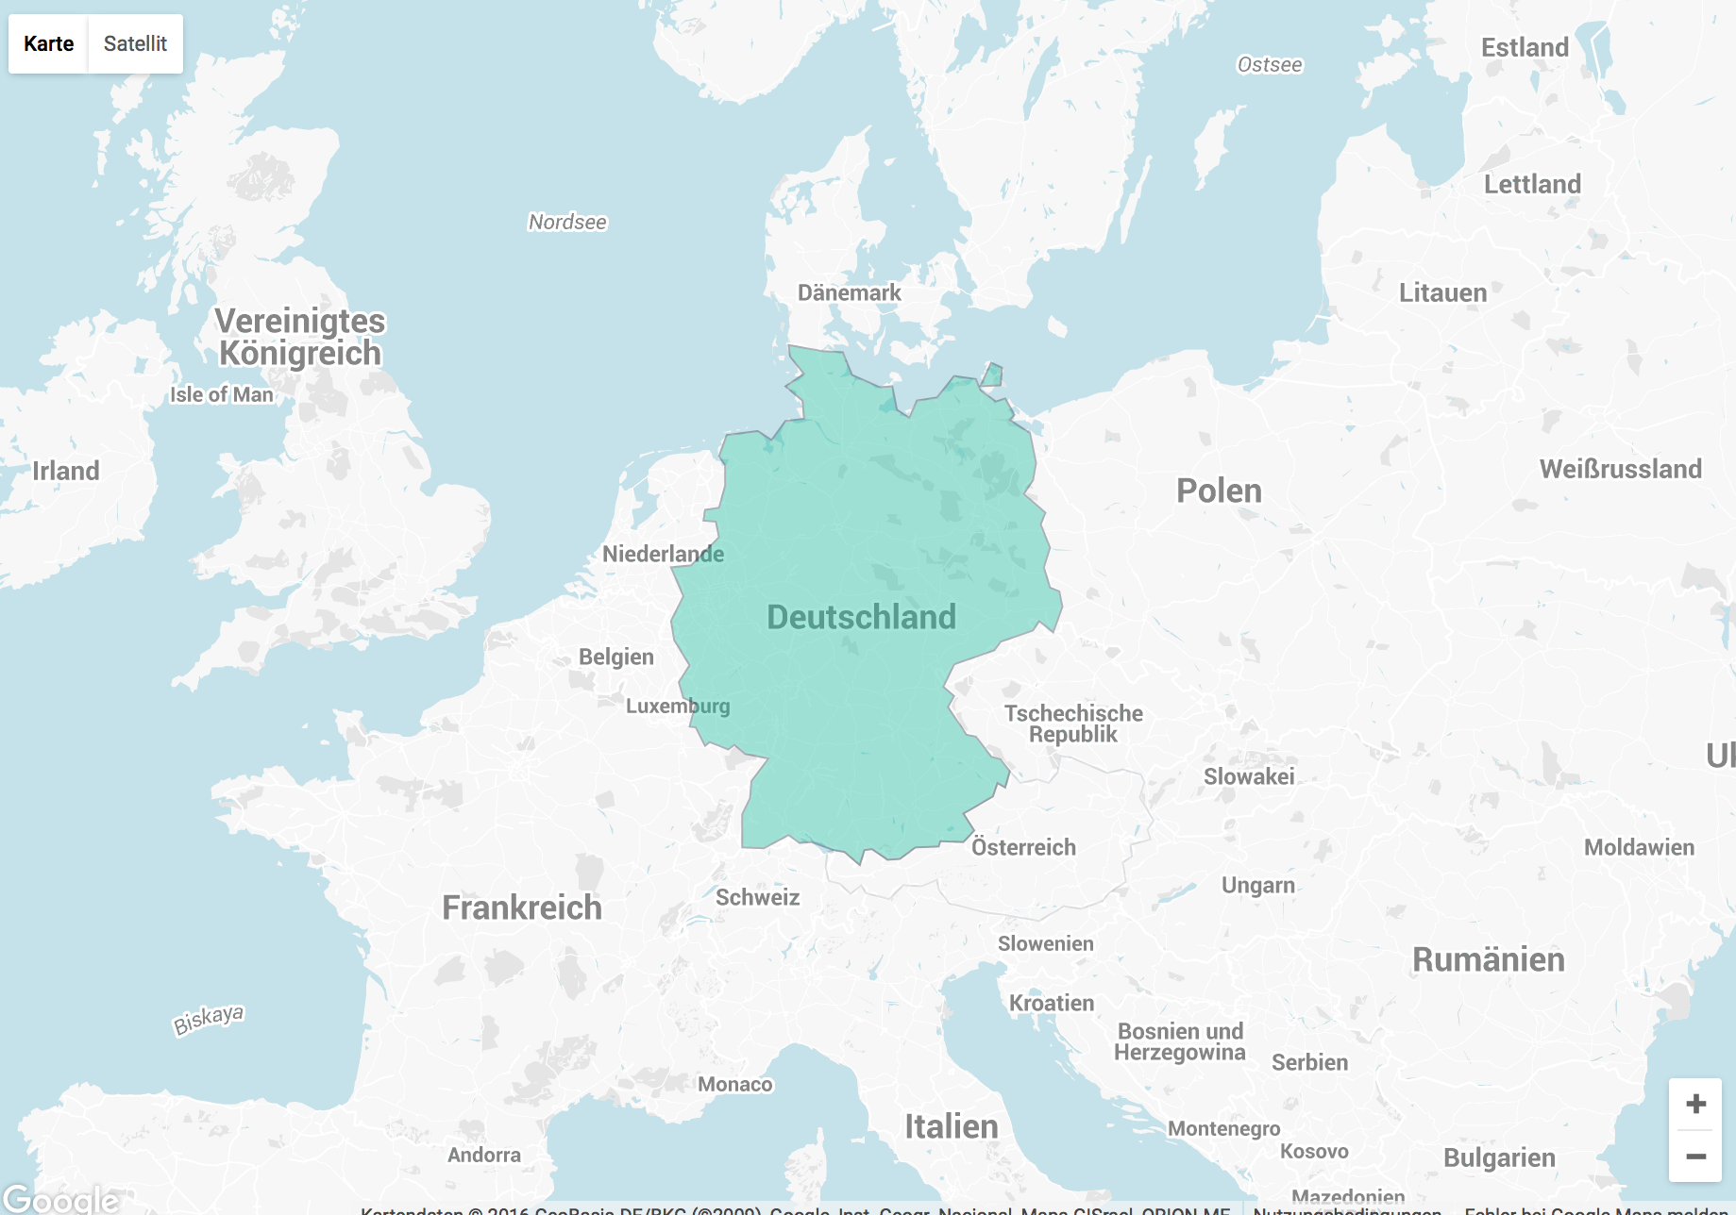
Visualization
Visualization
Frontend (jQuery, JavaScript, D3)
GoogleMap with custom OverlayView
Rendering of countries and tweets with D3
Projection of GeoJson data onto GoogleMap
Event listeners on svg elements
Ajax requests to the backend

Slide 11
Demo
Demo

Slide 12
Visualization
Future Work
Live calculation of clusters
Direct manipulation of cluster parameters
Support of different languages

