Slide 1

Institut für Informatik
GeoScope:
Online Detection of Geo-Correlated Information Trends in Social Networks
Data Science - Hauptseminar SS 2016
Michael Prummer, Jennifer Ling, Sandra Zollner

Slide 2

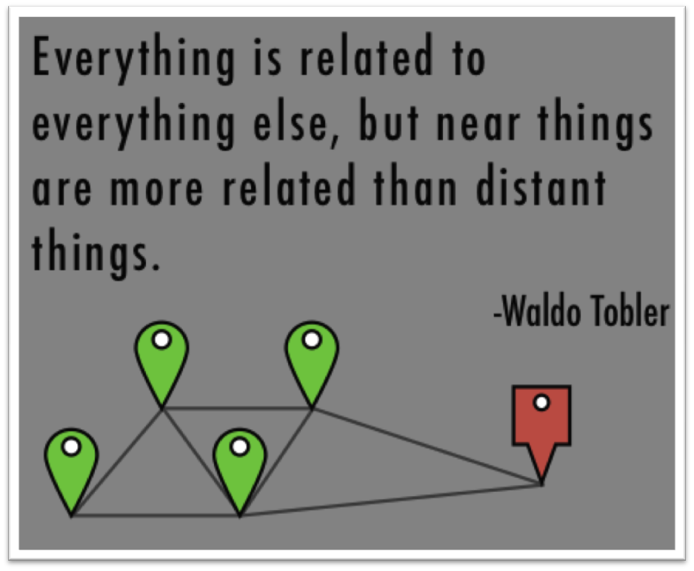
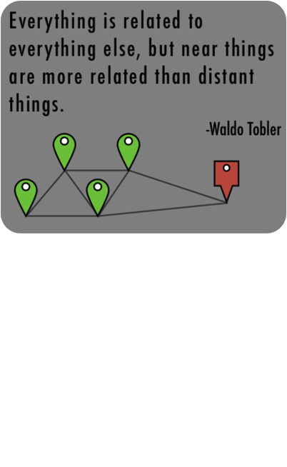
GeoScope
Geo-Trends
First Law of Geography
“Everything is related to everything else, but near things
are more related than distant things.”
Social networks:
Choice of friends
Topic interest
Tendency to talk about events that are close-by
Use of language and sentiment
Geo-trends:
→ Local emergencies, political demonstrations, cultural events, etc.

Slide 3
GeoScope
GeoScope
Algorithmic tool to detect geo-trends
Correlations between topic and location pairs in a sliding window
Sublinear space and running time
Guarantees detecting all trending correlated pairs
Problems:
Large amount of noisy data shared on social networks (500M Tweets / day)
Topic and location definition
Filter global events

Slide 4
GeoScope
Detecting Geo Trends
Premise 1: “The frequency of any topic t_{x} and any location l_{i} in the current time window should be reported in an accurate and timely fashion.”
→ Pairs must be efficiently retrievable at any particular time.
Data stream: {(l₁, t₁), (l₆, t₁), (l₂, t₁), (l₃, t₅), (l₃, t₂)}
l_{x} = Location
t_{x} = Topic

Slide 5
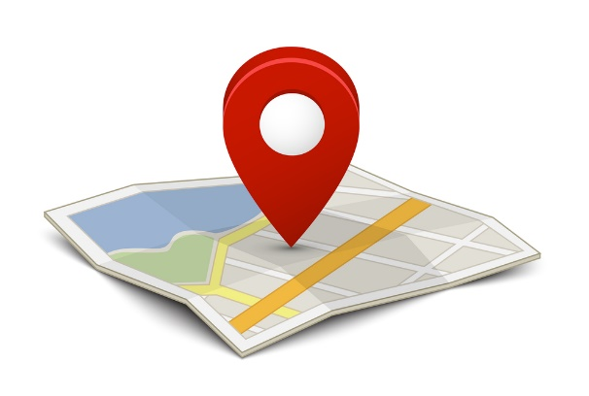
GeoScope
Detecting Geo Trends
Premise 2: “(...) A location-topic pair (l_{i}, t_{x}) is significantly correlated if at least Ф fraction of all mentions from location l_{i} are about topic t_{x} and at least ψ fraction of all mentions about topic t_{x} are from location l_{i}.”
→ Location and topic must be heavy-hitters for each other.
Ф := Dominance of topic t_{x} in location l_{i}
ψ:= Support of location l_{i} for topic t_{x}

Slide 6
GeoScope
Detecting Geo Trends
Premise 3: “Geo-trend detection should identify a list of “all” and “only” the locations that are at least Θ-frequent in the current time window and limit the reported correlations to such locations.”
→ Filter out insignificant information: F(l_{i}) > Θ*N
→ Eliminating unpopular locations
Θ:= Location-Topic significance

Slide 7
GeoScope
Example
List<location, topic> = {(l₁, t₁), (l₂, t₁), (l₃, t₁), (l₁, t₂), (l₁, t₃), (l₂, t₃), (l₂, t₃)}
User defined: Ф = ψ = 0.5 [0, 1]
(l₂, t₃): Ф = 0.67, ψ = 0.67
(l₁, t₂): Ф = 0.33, ψ = 1
Ф := Dominance of topic in location
ψ:= Support of location for topic
Θ:= Location-Topic significance

Slide 8
GeoScope
Main idea
Given: Data stream S of location-topic pairs: (l_{i}, t_{j})
User defined:
  Limitation of location frequency → ψ-frequent (support)
  Limitation of topic frequency → Ф-frequent (dominance)
  For each such topic only track Θ-frequent locations
  Sliding window (time/number limit)
  → Premises satisfied!
Goal: Detect geo-trends by keeping track of all location-topic pairs and their frequencies within the current time window.
→ Exact Solution is infeasible → approximation method

Slide 9
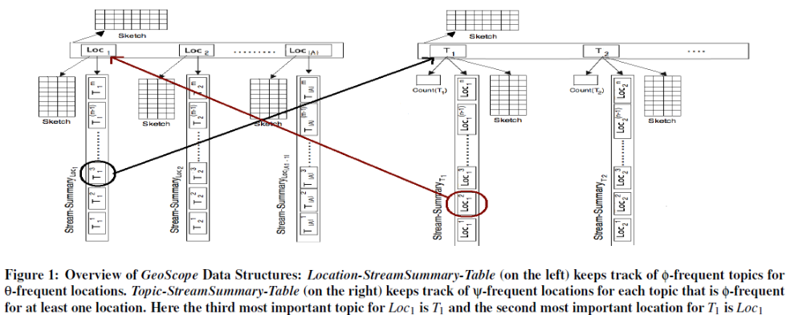
GeoScope
Data Structure

Slide 10
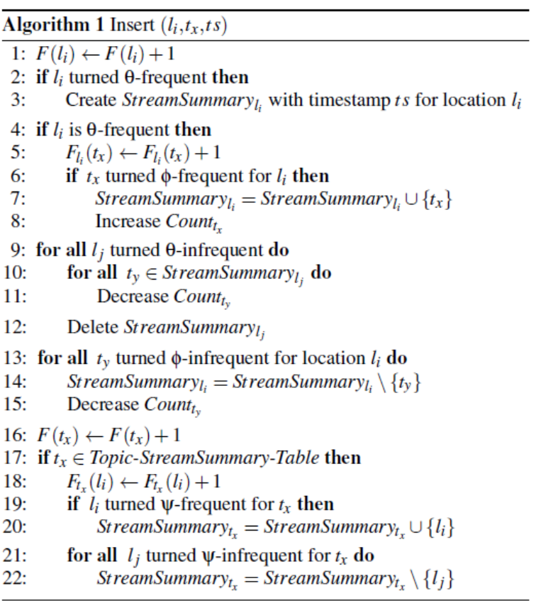
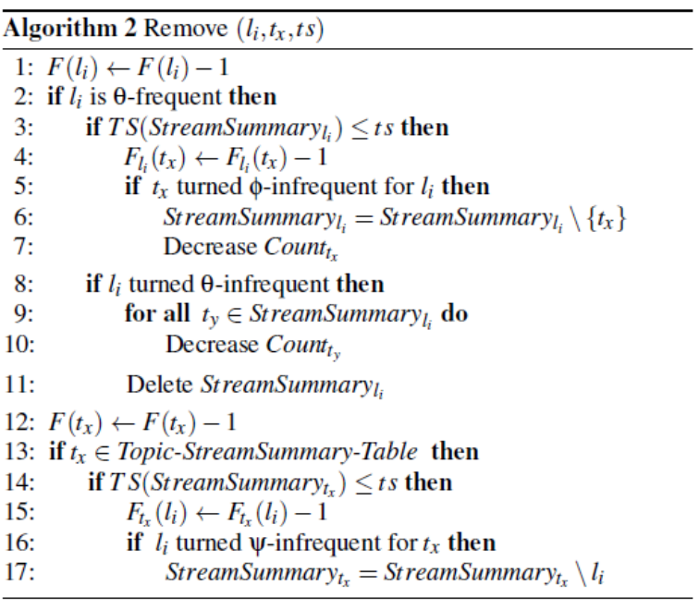
GeoScope
Operations: insert, remove, report

Slide 11
GeoScope
Running time and memory requirements
Sub-linear in its space usage
Two update operations (insert & remove): log-linear running time
Accuracy Guarantees
A location-topic pair (l_{i}; t_{x}) is a trending correlated pair if and only if t_{x} is a trending topic for l_{i} and l_{i} is a trending location for t_{x}.
trending = non-decreasing relative frequency
Perfect recall guaranteed!
I.e. At any given time t_{s}, all trending correlated pairs in the time window ending at t_{s} are reported by GeoScope

Slide 12

GeoScope
Case Study: Twitter
Data set:
hashtag → topic
city (tweet originates from) → location
February 1st to June 18th 2011
63 M Tweets
Two ways to get location:
tweet location
user location
Notes:
cities are large enough to capture local interest and not too small to result into meaningless correlations
topics and locations could be defined otherwise (n-grams, urls) (states, boxes)
two ways to get location:
tweet location: (lonigute, latitute) (1.5%)
user location: parsing information from free form text
Sliding window: almost 5 months
-> all tweets of a user tagged with this location, so 13% of the Tweets were tagged in the end
63 M Tweets (with topic and location)

Slide 13
GeoScope
Effectiveness
Comparison of the solution to three baselines:
Traditional Heavy-Hitters Approach (THHA)
Geographical Heavy-Hitters Approach (GHHA)
Statistically Significant Topic-Location Detection (SSTLD)
Information overload
Method | GeoScope | GHHA | SSTLD
Number of pairs | 17 | 23 | 150 000
Notes:
THHA: Detects the most popular topics in the entire stream
GHHA: Simply reports the φ-frequent topics for all θ-frequent locations. Unlike GeoScope, GHHA does not filter pairs where the location is not significant for the topic (no ψ psi (support) parameter).
SSTLD: Defines the association strength between a location and a topic by comparing their expected and observed frequencies. For this purpose, we compute the χ2 statistic for each topic-location pair

Slide 14
GeoScope
Effectiveness
Human validation
Online questionnaire
Human judge has to choose hashtag with most geographical significance out of two distinct hashtags h1 and h2
 | THHA vs. GeoScope | GHHA vs. GeoScope | SSTLD vs. GeoScope
Fraction of GeoScope hashtags | 0.94 | 0.74 | 0.89
Notes:
top 100 topics from GeoScope and each baseline
randomized order of hashtags
3 questionnaires GeoScope vs. THHA,...
fraction: percentage of hashtags for which the majority chose the same hashtag as GeoScope would report
GHHA topics with no geo-intend are reported

Slide 15
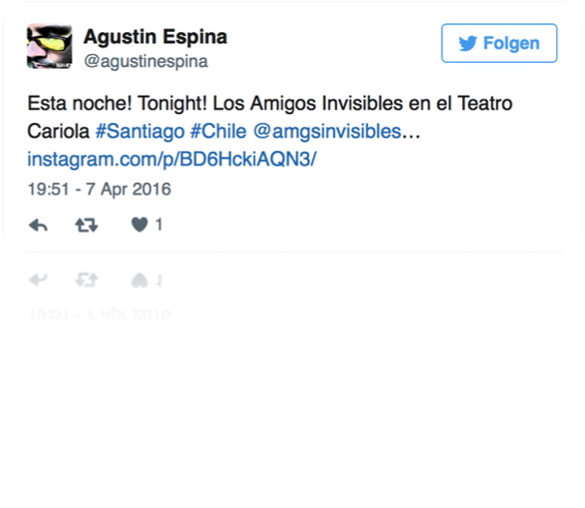
GeoScope
Topics and locations
Topics with high geo-significance
many hashtags with global significance (e.g. #ff, #jobs)
only a small amount of topics is signficant as geographical trend (e.g. #egypt)
Cities with high geo-significance
cities which appear in a large number of
correlations (e.g. Santiago)
Notes:
Santiago: users from this area are interested in local topics / events

Slide 16
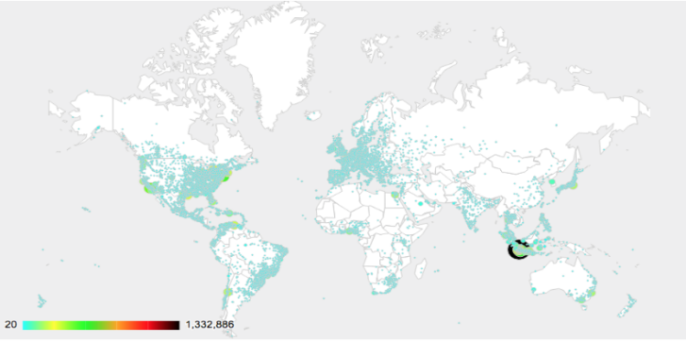
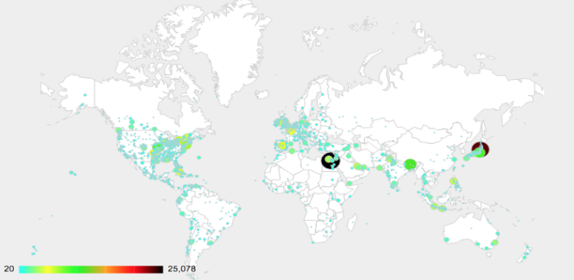
GeoScope
Topics and locations
Geo-Origin vs. Geo-Focus
geo-origin: where social content is created
geo-focus: what location content is about
→ GeoScope is geo-focus based
Tweets in cities [1]
Tweets about cities [1]
Notes:
cities such as Jakarta that commonly talk about local topics (high geo-origin significance)
have low geo-focus values indicating low international recognition
We see a boost in significance for cities such as Tokyo which can be attributed to the international interest in the Japan earthquake.

Slide 17
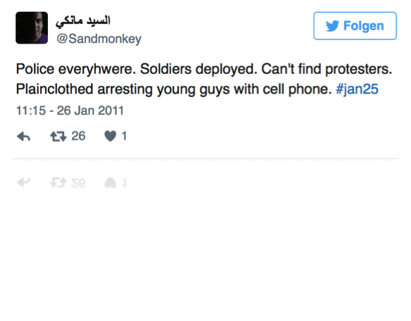
GeoScope
Topics and locations
Sliding window
interesting topics detected at particular points in time
Examples:
#earthquake correlated to Tokio
#Jan25, Cairo
#NewCastle, Nottingham
→ crisis management, political interests, general interests
Notes:
GeoScope can be used in crisis management as it detects emergency events in a fast and automated manner

Slide 18
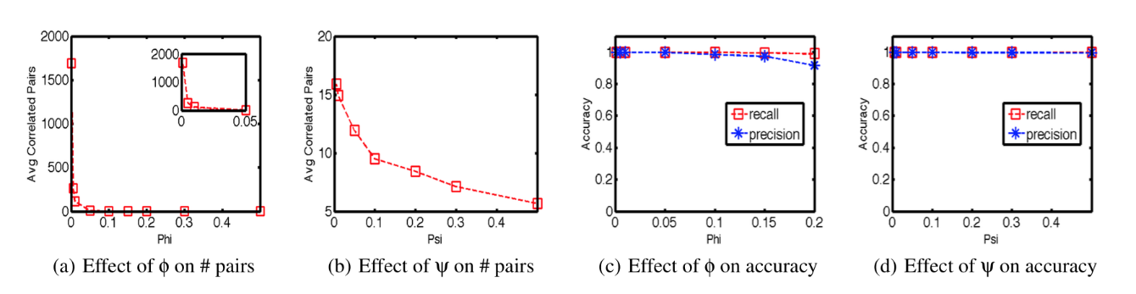
GeoScope
Accuracy
Increasing Ф and ψ drastically decreases the number of correlated pairs
proper settings are dependent on the specific application
perfect recall rate for various settings
increasing ψ slightly affects precision rate
Effect of Ф and ψ on accuracy [1]
Notes:
accuracy = Treffergenauigkeit
recall = Trefferquote
precision = Genauigkeit
The difference is more significant for small φ values, which indicates that it is less likely for the entire population to be interested in only one topic, while it is far more likely that there is only one (or few) location(s) that is interested in a given topic.

Slide 19
GeoScope
Space and Time Efficiency
comparison between GeoScope and exact method
Increasing window size:
memory requirement remains constant (GeoScope)
time required to report correlated pairs remains constant

Slide 20
GeoScope
Conclusion
Online detection of geo-correlated information trends
GeoScope identifies correlated location-topic pairs along a sliding window in a social data stream
Approximate solution (with sub-linear memory and running time) and guarantee to capture all trending correlations
Tool is generic (not only Twitter analysis)
Redefine topics (here: hashtag based) and locations (here: cities)
Future work: compact way for hierarchical geo-trend detection

Slide 21
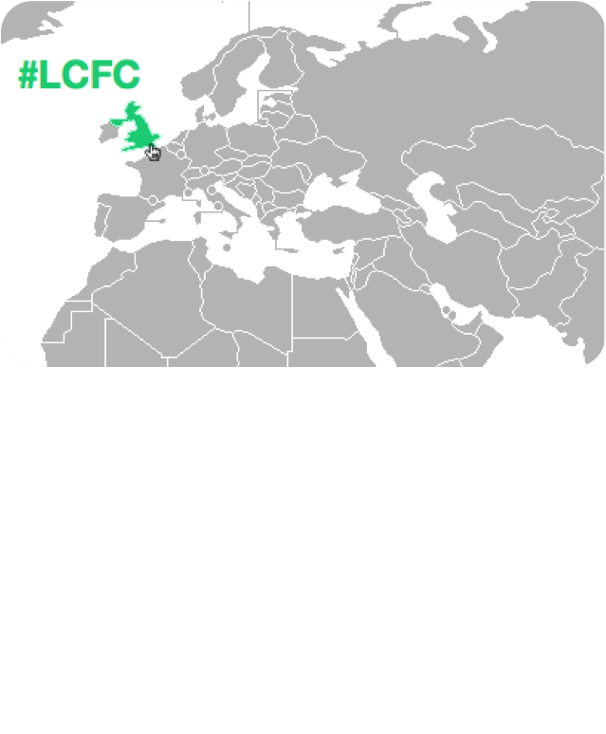
Project Ideas
Project Ideas
I. Map of trending topics

Slide 22
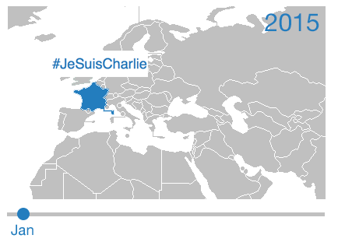
Project Ideas
Project Ideas
II. Map of trending topics (or specific products) over time period

Slide 23
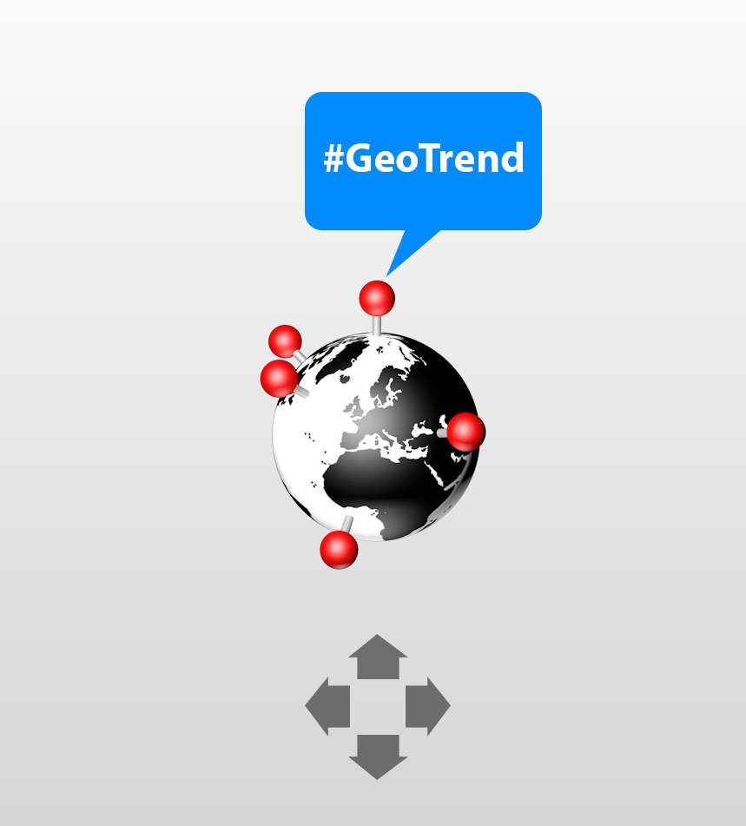
Project Ideas
Project Ideas
III. 3D Version

Slide 24
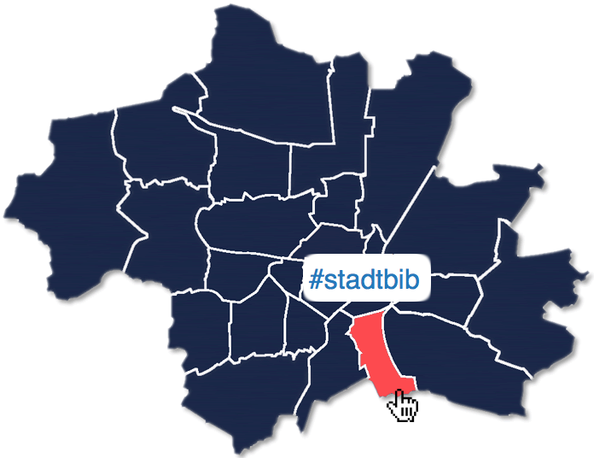
Project Ideas
Project Ideas
IV. Map of trending topics for districts of a city

Slide 25

Project Ideas
Project Ideas
V. Personal recommendations (depending on location)

Slide 26

Project Ideas
Project Ideas
VI. Sarcasm in tweets (depending on location)

Slide 27
Sources
Sources
[1] Budak, Ceren, et al. "Geoscope: Online detection of geo-correlated information trends in social networks." Proceedings of the VLDB Endowment 7.4 (2013): 229-240.
[2] https://twitter.com/agustinespina/status/718134116755988480
[3] https://twitter.com/Sandmonkey/status/30207160700899329

