Slide 1

Battery Failure
Boundaries
A Comparative EDA of Li-ion NMC, LFP, and Solid-State Cell Chemistries
Team Members: Jarrett, Aaron | Le, Michael | Medina, Phillip | Zaidi, Hussain | UC Berkeley MIDS
Dataset: battery_failure_surfaces.csv | 60,600 observations × 9 variables
Li-ion NMC
LFP
Solid-State
Notes:
Good Afternoon,
Our Project is Titled: Battery Failure Boundaries
A Comparative Exploratory Data Analysis of Li-ion NMC, LFP and Solid-State Cell Chemistries
Our Team members are: Aaron Jarrett, Michael Le, Hussain Zaidi and myself Phillip Medina
Instead of average performance, we focus on the conditions that define battery failure.

Slide 2
Research Questions
Q1
Capacity Degradation
Q2
Resistance Growth
Which cell chemistry experiences the lowest capacity fade rate cycle-over-cycle, and when does each chemistry cross the 80% End-of-Life (EOL) threshold?
Which chemistry shows the most favorable (slowest) internal resistance growth over its operational lifespan?
Q3
Safety & Reliability
Q4
Thermal Stress Sensitivity
How do the three chemistries compare across thermal runaway risk, irreversible damage index, and B10 fleet reliability milestones?
Does operational temperature stress (Cool / Optimal / Warm / Hot zones) differentially degrade retention across chemistries?
Notes:
To understand battery failure boundaries, we break the problem into four key questions, each capturing a different dimension of failure:
Q1: Capacity Degradation
We look at how quickly each battery loses capacity over time. This helps us identify which chemistry lasts longer and when it reaches end-of-life, typically around 80% capacity.
Q2: Resistance Growth
We analyze internal resistance growth. As resistance increases, efficiency drops and heat generation rises,
making this a key indicator of aging and performance decline.
Q3: Safety & Reliability
We focus on safety and reliability. This includes thermal runaway risk, irreversible damage, and B10 life,
which tells us when 10% of batteries are expected to fail in real-world conditions.
Q4: Thermal Stress Sensitivity
Finally, we examine how temperature impacts performance.
Batteries behave very differently under cool, optimal, and high-temperature conditions, which directly affects degradation and failure risk.
Summary:
Together, these four questions help us map where each battery chemistry operates safely, and where it begins to fail.
.

Slide 3
Data Pipeline
battery_failure_surfaces.csv
60,600 × 9
pd.read_csv()
Data Cleanup
Immutable raw copy
Validate + standardize
Sort + deduplicate
df_raw.copy() preserved
Domain bounds, dtype downcast
By chemistry → cycle order
Cleaned DataFrame
Calculate Research Variables
capacity_fade_rate
resistance_growth_rate
temp_volatility
pct_change() per group
diff() per group
rolling std (window=5)
stress_index
risk_category
est_cycles_to_80%
min-max normalized composite
pd.cut() → Low…Critical
linear extrapolation to EOL
Enriched DataFrame
Exploratory Analysis (Answer Research Questions)
Q1: Capacity
Q2: Resistance
Q3: Thermal
Q4: Safety
groupby + rank
aggregate stats
Performance scorecard
ranks
D3.js interactive scorecard
6 metrics × 3 chemistries ranked
SVG data-join · tabs

Slide 4
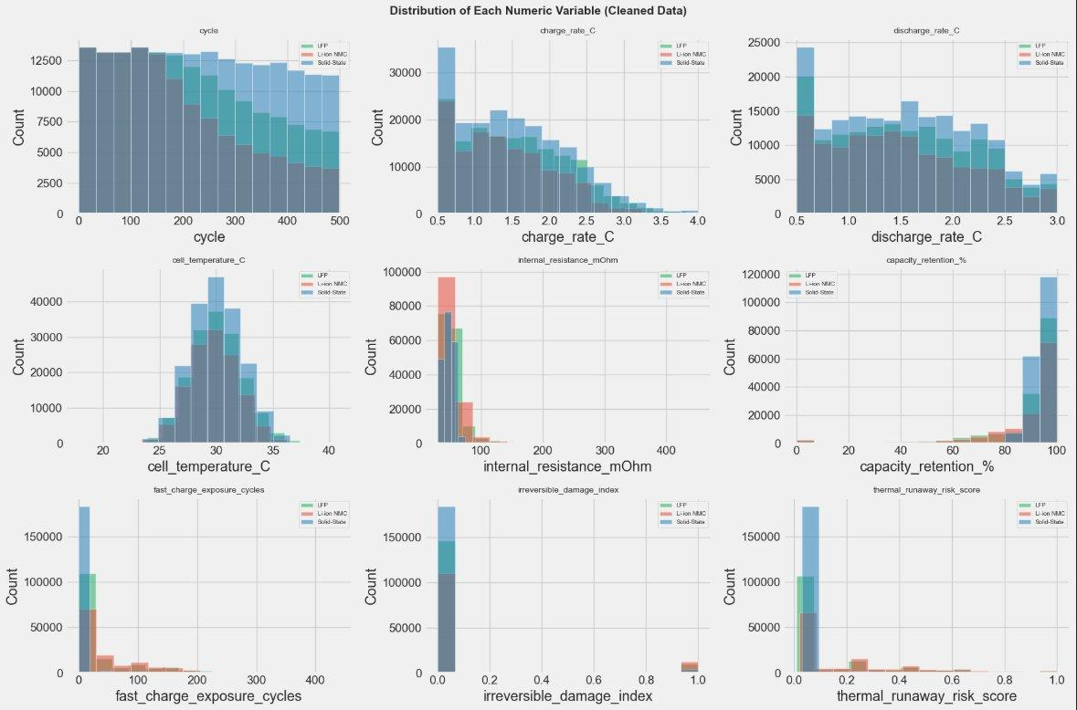
Dataset & Cleaning Overview
60,600
Total Observations
9
Variables
3
Cell Chemistries
0
Missing Values

Slide 5
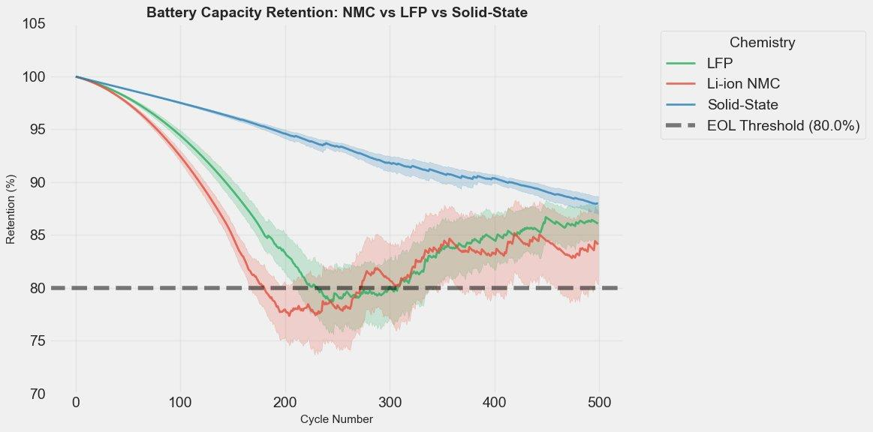
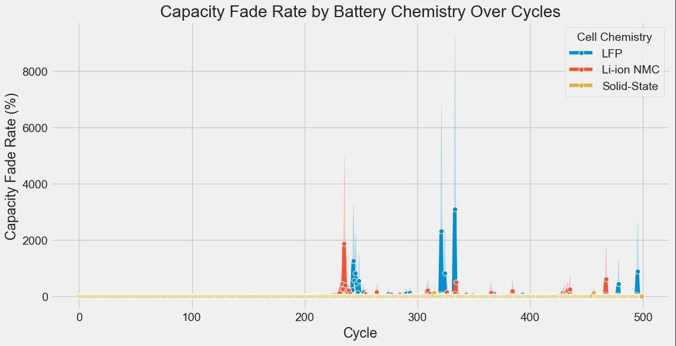
Q1: Capacity Degradation Over Cycles
Key Findings
Solid-State
Never crosses the 80% EOL threshold across the full 500-cycle window. Retains ~88% at cycle 500.
LFP
Dips below 80% EOL around cycles 200-300 before recovering. Volatile mid-cycle behavior.
Li-ion NMC
Also dips below 80% EOL in the mid-cycle range. Highest fade rate spikes visible in cycles 200-350.
Solid-State is the only chemistry that never crossed the EOL threshold across the full test window.

Slide 6
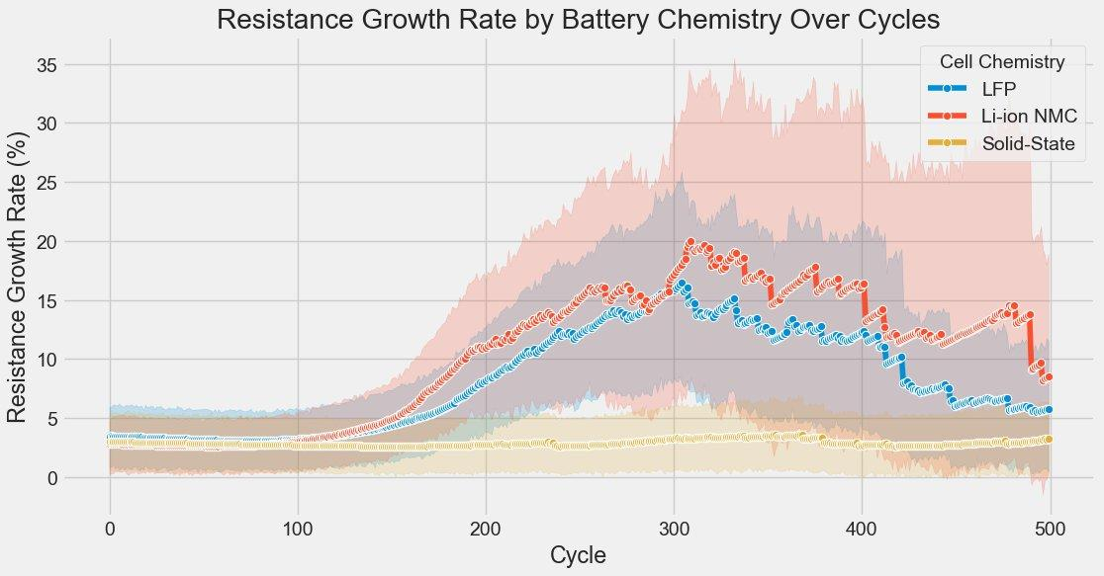
Q2: Internal Resistance Growth Over Cycles
Why It Matters
Rising internal resistance means more heat generated per cycle, accelerating degradation and reducing usable power output.
Solid-State
Nearly flat across all 500 cycles. Resistance growth rate stays below 5% throughout.
LFP
Moderate growth, rising sharply around cycle 200-300 before declining back.
Li-ion NMC
Largest growth — peaks near 20% around cycle 300 with wide variance. Highest thermal stress risk.

Slide 7
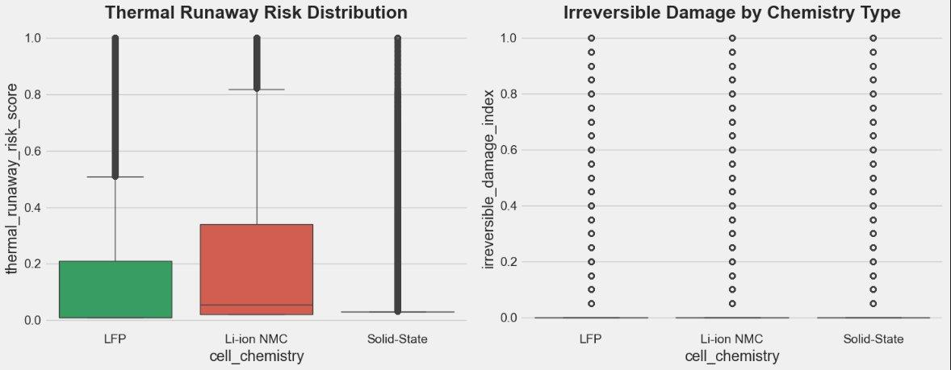
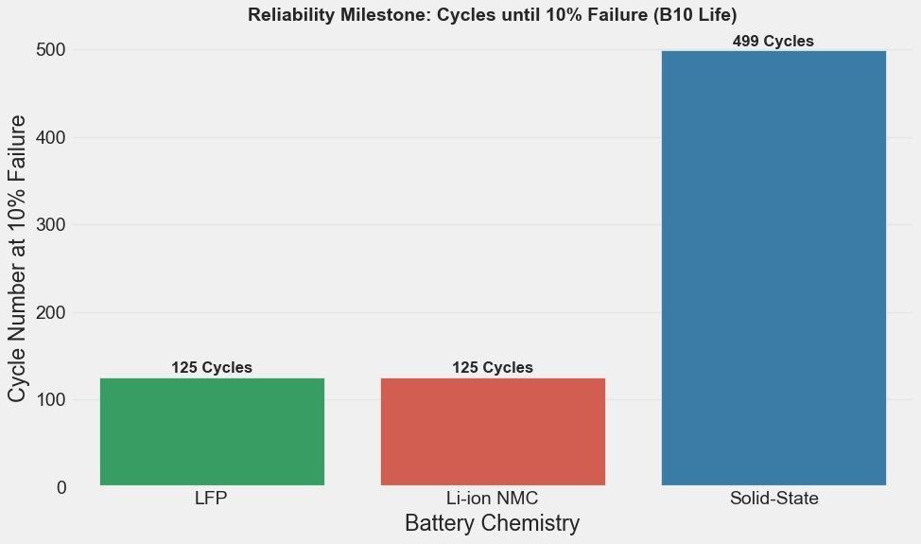
Q3: Safety Profile & Fleet Reliability (B10 Life)
Safety & Reliability
B10 Life
Solid-State:
499 cycles
LFP:
125 cycles
Li-ion NMC:
125 cycles
Thermal Risk Profile
Solid-State
Nearly zero thermal runaway risk across all cycles
LFP
Concentrated IQR at low risk; some extreme outliers
Li-ion NMC
Widest IQR; highest median risk of the three chemistries

Slide 8
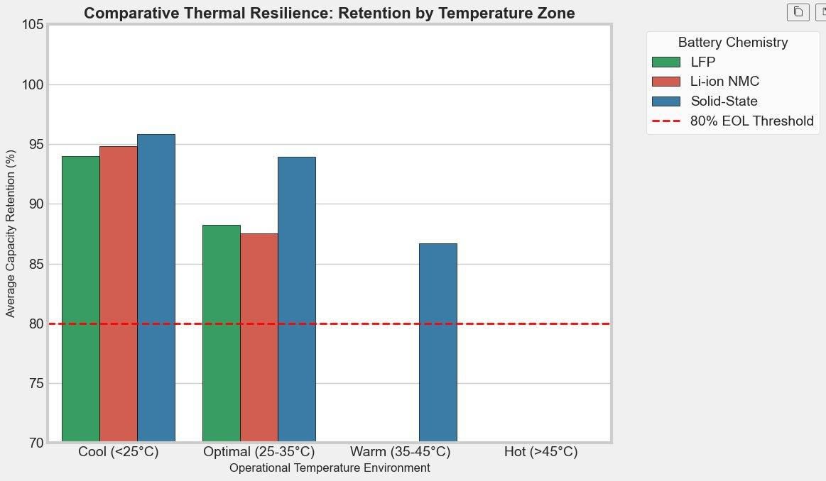
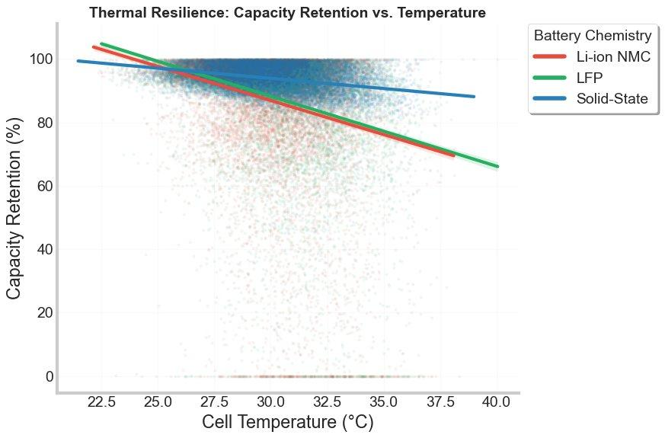
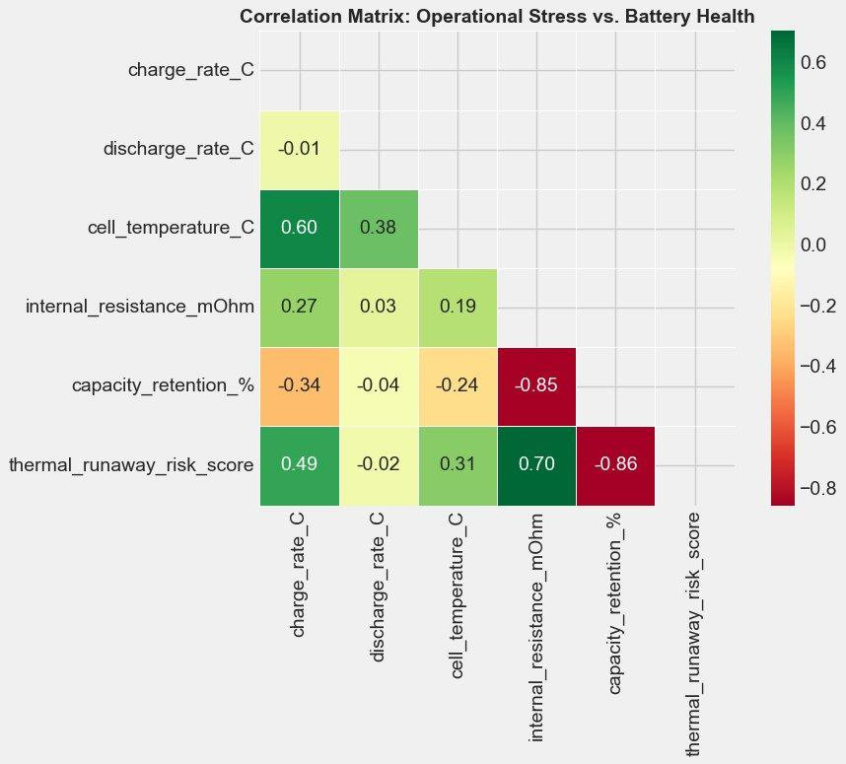
Q4: Thermal Stress Sensitivity & Electrochemical Drivers
Thermal Findings
LFP and NMC have no data in the Warm (35-45°C) or Hot (>45°C) zones, only Solid-State operates at those temperatures in this dataset
Solid-State retention declines progressively across temperature zones: ~96% cool, ~94% optimal, ~87% warm, still above EOL throughout
Correlation matrix: internal resistance is the strongest negative driver of capacity retention (r = -0.85). Temperature has a moderate negative effect (r = -0.24)
Scatter plot confirms Solid-State holds the shallowest slope across temperature, while NMC and LFP decline more steeply

Slide 9
Assumptions & Limitations
Assumption 1
Limitation 1
Data treated as representative of laboratory cycling conditions. Real-world duty cycles include variable charge/discharge patterns not captured here.
LFP and NMC have no observations above 35°C in the dataset. Thermal zone comparisons for those chemistries are incomplete.
Assumption 2
Limitation 2
pct_change() for fade and resistance rates assumes uniform cycle spacing. Non-uniform intervals would require interpolation prior to rate calculation.
B10 analysis shows LFP and NMC reach 10% fleet failure by cycle 125, well within the test window. Longer observation past 500 cycles would clarify long-run Solid-State behavior.
Assumption 3
Limitation 3
The dataset is representative of the theoretical performance of each battery chemistry under comparable operating conditions, including cycle life, temperature range, and charge/discharge rates.
This is descriptive EDA only. No statistical testing was applied. Observed differences between chemistries should not be interpreted as statistically significant.

Slide 10
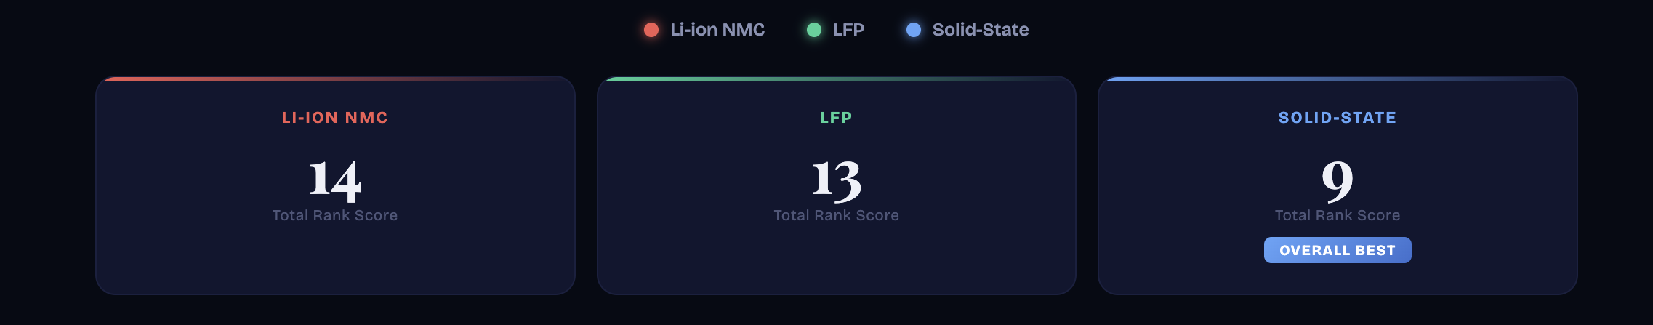
D3 Visualization
Chemistry Performance Scorecard

Slide 11
Conclusions
Across all four research questions, a consistent hierarchy emerged:
Solid-State
Best performer on every metric: never crosses EOL threshold, near-flat resistance growth, lowest thermal risk (near zero), and B10 life of 499 cycles vs. 125 for both competitors.
LFP
Middle performer: dips below EOL in mid-cycles before recovering, moderate resistance growth, and B10 failure at cycle 125. No data above 35°C limits thermal zone conclusions.
Li-ion NMC
Comparable to LFP on most metrics but with higher resistance growth variance and higher thermal runaway risk. B10 failure also at cycle 125. Most volatile fade rate behavior.
This EDA describes patterns observed in the dataset. Results inform chemistry selection decisions, not population-level claims.
Notes:
Across all four research questions, we see a consistent pattern.
Solid-state clearly outperforms the other chemistries in regards to safety, degradation, and reliability.
LFP shows moderate, more stable performance,
while NMC exhibits greater variability and higher risk, particularly under thermal stress.
It’s important to note that this is an exploratory analysis, so these results highlight relative differences based on this dataset, and not real-world cases.
Thank you!

