Slide 1
Categorical Data Analysis
From: GradQuant
Host: Michael Remington (He/Him)

Slide 2
Table of Contents
Definitions and Background
Grouping, Pivoting, and Manipulating Categorical Data
Introductory Visualizations
Contingency Tables and Bayesian Statistics
Logistic Regression

Slide 3
Table of Contents
Definitions and Background
Grouping, Pivoting, and Manipulating Categorical Data
Introductory Visualizations
Contingency Tables and Bayesian Statistics
Logistic Regression

Slide 4
What is Categorical Data?
Usually discrete
Quantitative or qualitative
Can be a rank, a descriptive bucket, or a binary
We use categorical variables to describe or label phenomena
Categories are useful as either explanatory (independent) variables or as response (Dependent) variables

Slide 5
Examples
Qualitative
Quantitative
Binary/Boolean
Yes/No
Groups
Red, Yellow, Blue
Good, Average, Bad
West, East, North, South
Binary/Boolean
0/1
Rank
1st, 2nd,3rd ….
Tiers
1, 2, 3, …

Slide 6
Type of Categories
Nominal: 2 or more categories that do not have an intrinsic way of ordering them.
Example: yes/no, states/countries, names
Ordinal: 2 or more categories that do not have clear ability to be ordered.
Example: rank, low/medium/high, tiers
Source: https://stats.oarc.ucla.edu/other/mult-pkg/whatstat/what-is-the-difference-between-categorical-ordinal-and-interval-variables/

Slide 7
Table of Contents
Definitions and Background
Pivoting, and Manipulating Categorical Data
Introductory Visualizations
Contingency Tables and Bayesian Statistics
Logistic Regression

Slide 8
See (R Script)

Slide 9
Table of Contents
Definitions and Background
Grouping, Pivoting, and Manipulating Categorical Data
Introductory Visualizations
Contingency Tables and Bayesian Statistics
Logistic Regression

Slide 10
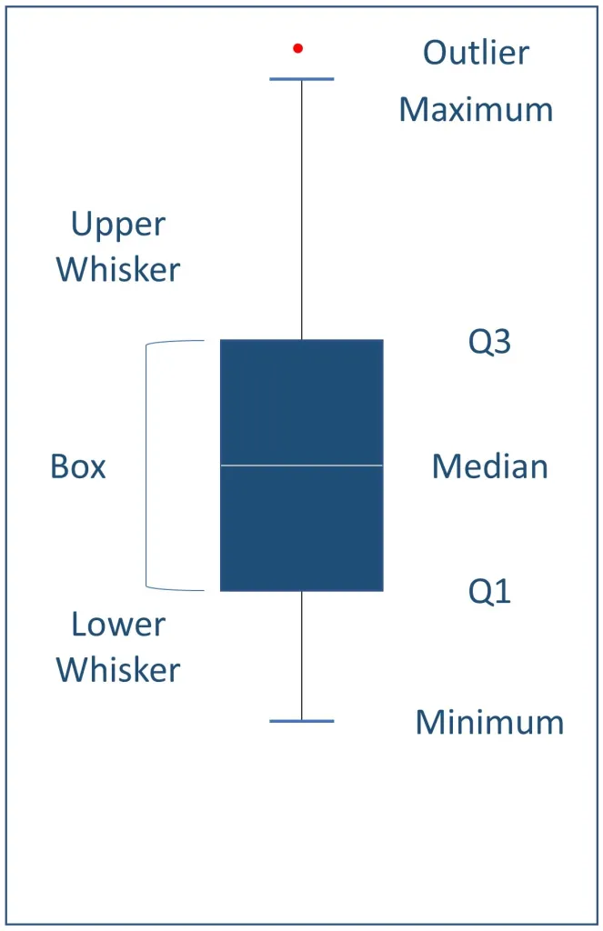
Box Plot
Image from: https://insightoriel.com/what-is-boxplot-box-and-whisker-plot/

Slide 11
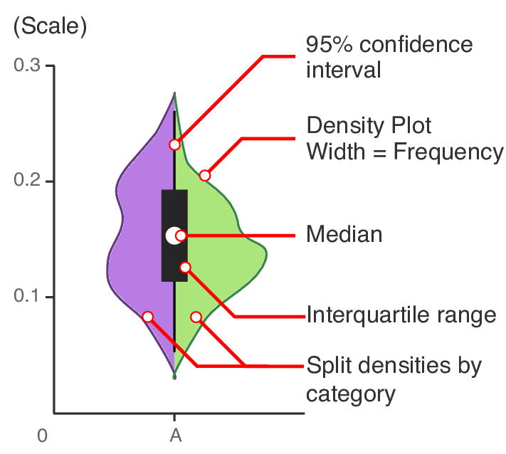
Violin Plot
Image from: https://www.researchgate.net/figure/Explanation-of-Violin-plot-Densities-are-estimated-using-a-Gaussian-kernel-density_fig15_329035470

Slide 12
Table of Contents
Definitions and Background
Grouping, Pivoting, and Manipulating Categorical Data
Introductory Visualizations
Contingency Tables and Bayesian Statistics
Logistic Regression

Slide 13
Contingency Tables
 | No | Yes
Child | 52 | 57
Adult | 1438 | 654

Slide 14
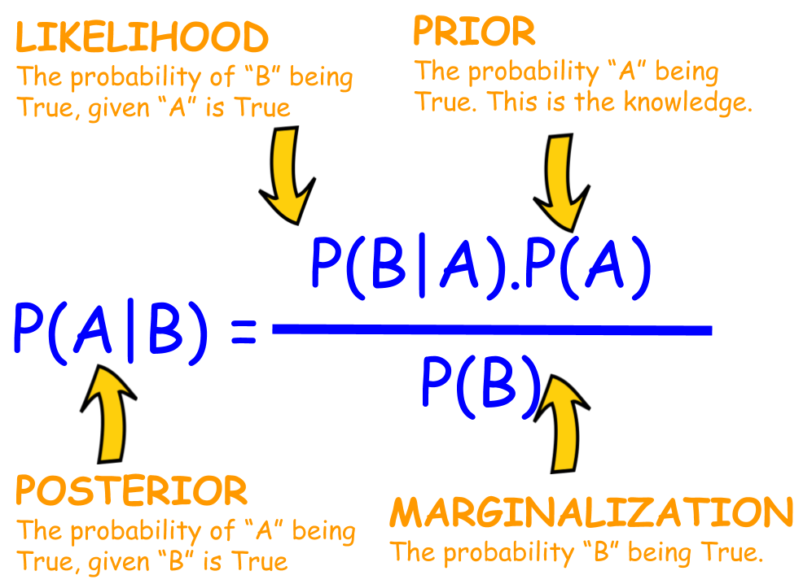
Bayes Theorum

Slide 15
Our Example
p(child|survived) = p(survived|child)*p(child)
p(survived)

Slide 16
p(child)
Child | 52+57=109
Adult | 1438+654=2092
p(child) | 109/(109+2092)=0.0495
 | No | Yes
Child | 52 | 57
Adult | 1438 | 654
Marginalize

Slide 17
p(survive)
 | No | Yes
Child | 52 | 57
Adult | 1438 | 654
No | Yes | p(survive)
52+1438 = 1490 | 57+654 = 711 | 711 1490+711 = 0.323
Marginalize

Slide 18
p(survive|child)
 | No | Yes
Child | 52 | 57
Adult | 1438 | 654
57
= 0.523
(57+52+1438+654)

Slide 19
Table of Contents
Definitions and Background
Grouping, Pivoting, and Manipulating Categorical Data
Introductory Visualizations
Contingency Tables and Bayesian Statistics
Logistic Regression

Slide 20
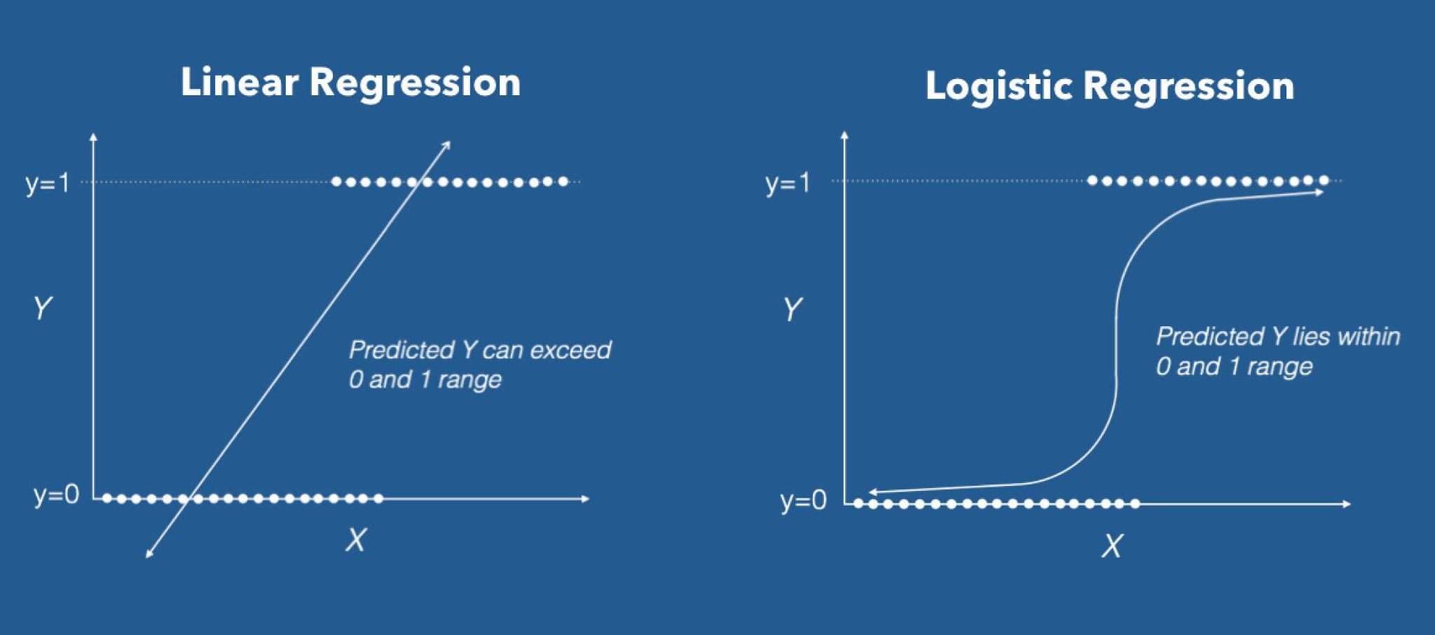
Linear vs Logistic Regression
Image from: https://www.machinelearningplus.com/machine-learning/logistic-regression-tutorial-examples-r/

