Slide 1
Intro To Matlab
Presented By: Michael Remington

Slide 2

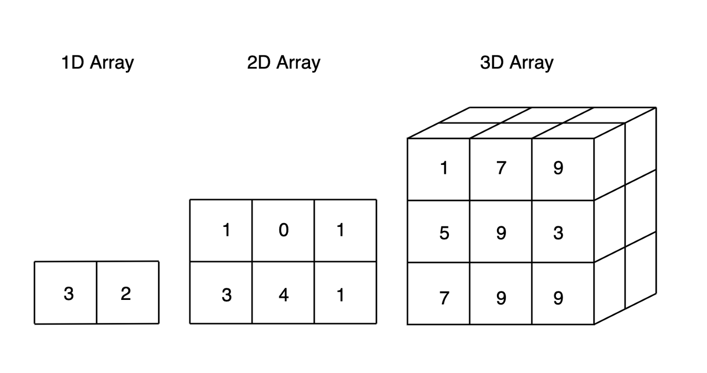
What is MATLAB?
Matlab is a programming and numeric computing platform used by millions of engineers and scientists to analyze data, develop algorithms, and create models.
Includes many optional toolboxes including: Simulink, signal processing, line fitting, SimBiology, Econometrics, and many more!
Integrates well with python, C++, Latex
Fundamentally, an environment for numerical array computations

Slide 3
Working with Matlab
Some Notes of writing Matlab Code
No need to define variable types
All variables are handled by value (and not by reference)
Variable names must begin with a letter
Case sensitive
Avoid names that correspond to functions
(Open File)

