Slide 1
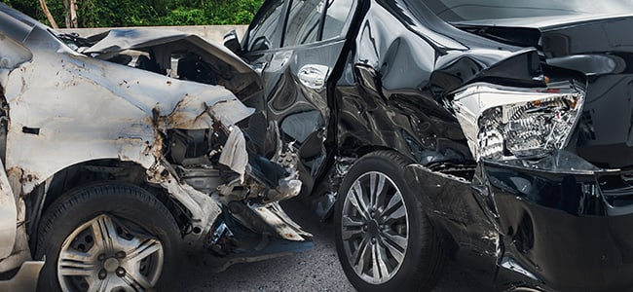
Car Accidents Severity
Predictive model.
Michael Rodriguez Gamboa.
September, 2020.

Slide 2
Introduction
Can we predict the outcome of a transit accident before it happen?
How severe would be?
It's a job for a prophet?

Slide 3
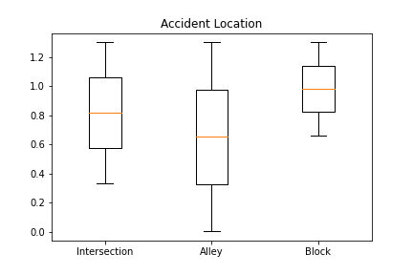
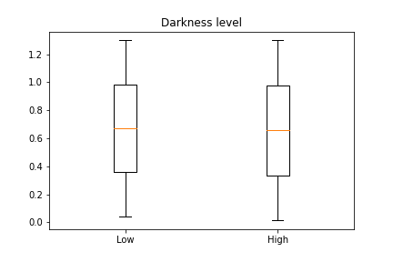
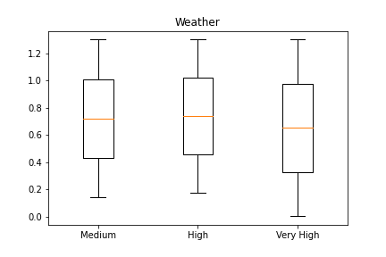
Data
Categorical variables:

Slide 4
Methodology
K-Nearest Neighbors algorithm with a "k= 4“.
Decision Tree algorithm with an "8 depth" level

Slide 5
Results
Algorithm | Accuracy | F1-score | Jaccard
KNN | 0.7440349300115577 | 0.7440349300115578 | 0.7440349300115577
D-Tree | 0.7532554257095159 | 0.7532554257095159 | 0.7532554257095159

Slide 6
Conclusion & Discussion
The intersections are the most dangerous.
The Decision Tree has 75% prediction accuracy.
Help to the transit police.
Guide to future researches.

