Slide 1
UGly Sum

Slide 2
We hypothesized that
In the implicit condition, learning would occur faster in the nonsocial than the social condition
In the explicit condition, learning would not differ between the social and the nonsocial
Learning would not differ between the implicit nonsocial and explicit social
To test these hypotheses, we first ran “model-free” analyses
Specifically, we used multilevel regressions.

Slide 3
Regression 1: model
lmer(offer ~ ( social * opponent * opp_trial * explicit) + (1 | sub_name), data=UG)
Translation: the dependent variable is the offer (between 0 and 20), and the independent variables are social (binary factor), opponent (3 level factor), opp_trial (the opponent specific trial, i.e. the number of times that an opponent appears to a subject, continuous variable between 25 and 50*), and explicit (binary factor), as well as all the interactions between all of these, and subject as a random factor (intercept allowed to vary randomly across subjects)
Analysis of Deviance Table (Type III Wald chisquare tests)
*This range was due to a bug in a stimulus code which will be fixed in the next iteration of the study, should have been fixed as 40 trials per opponent

Slide 4
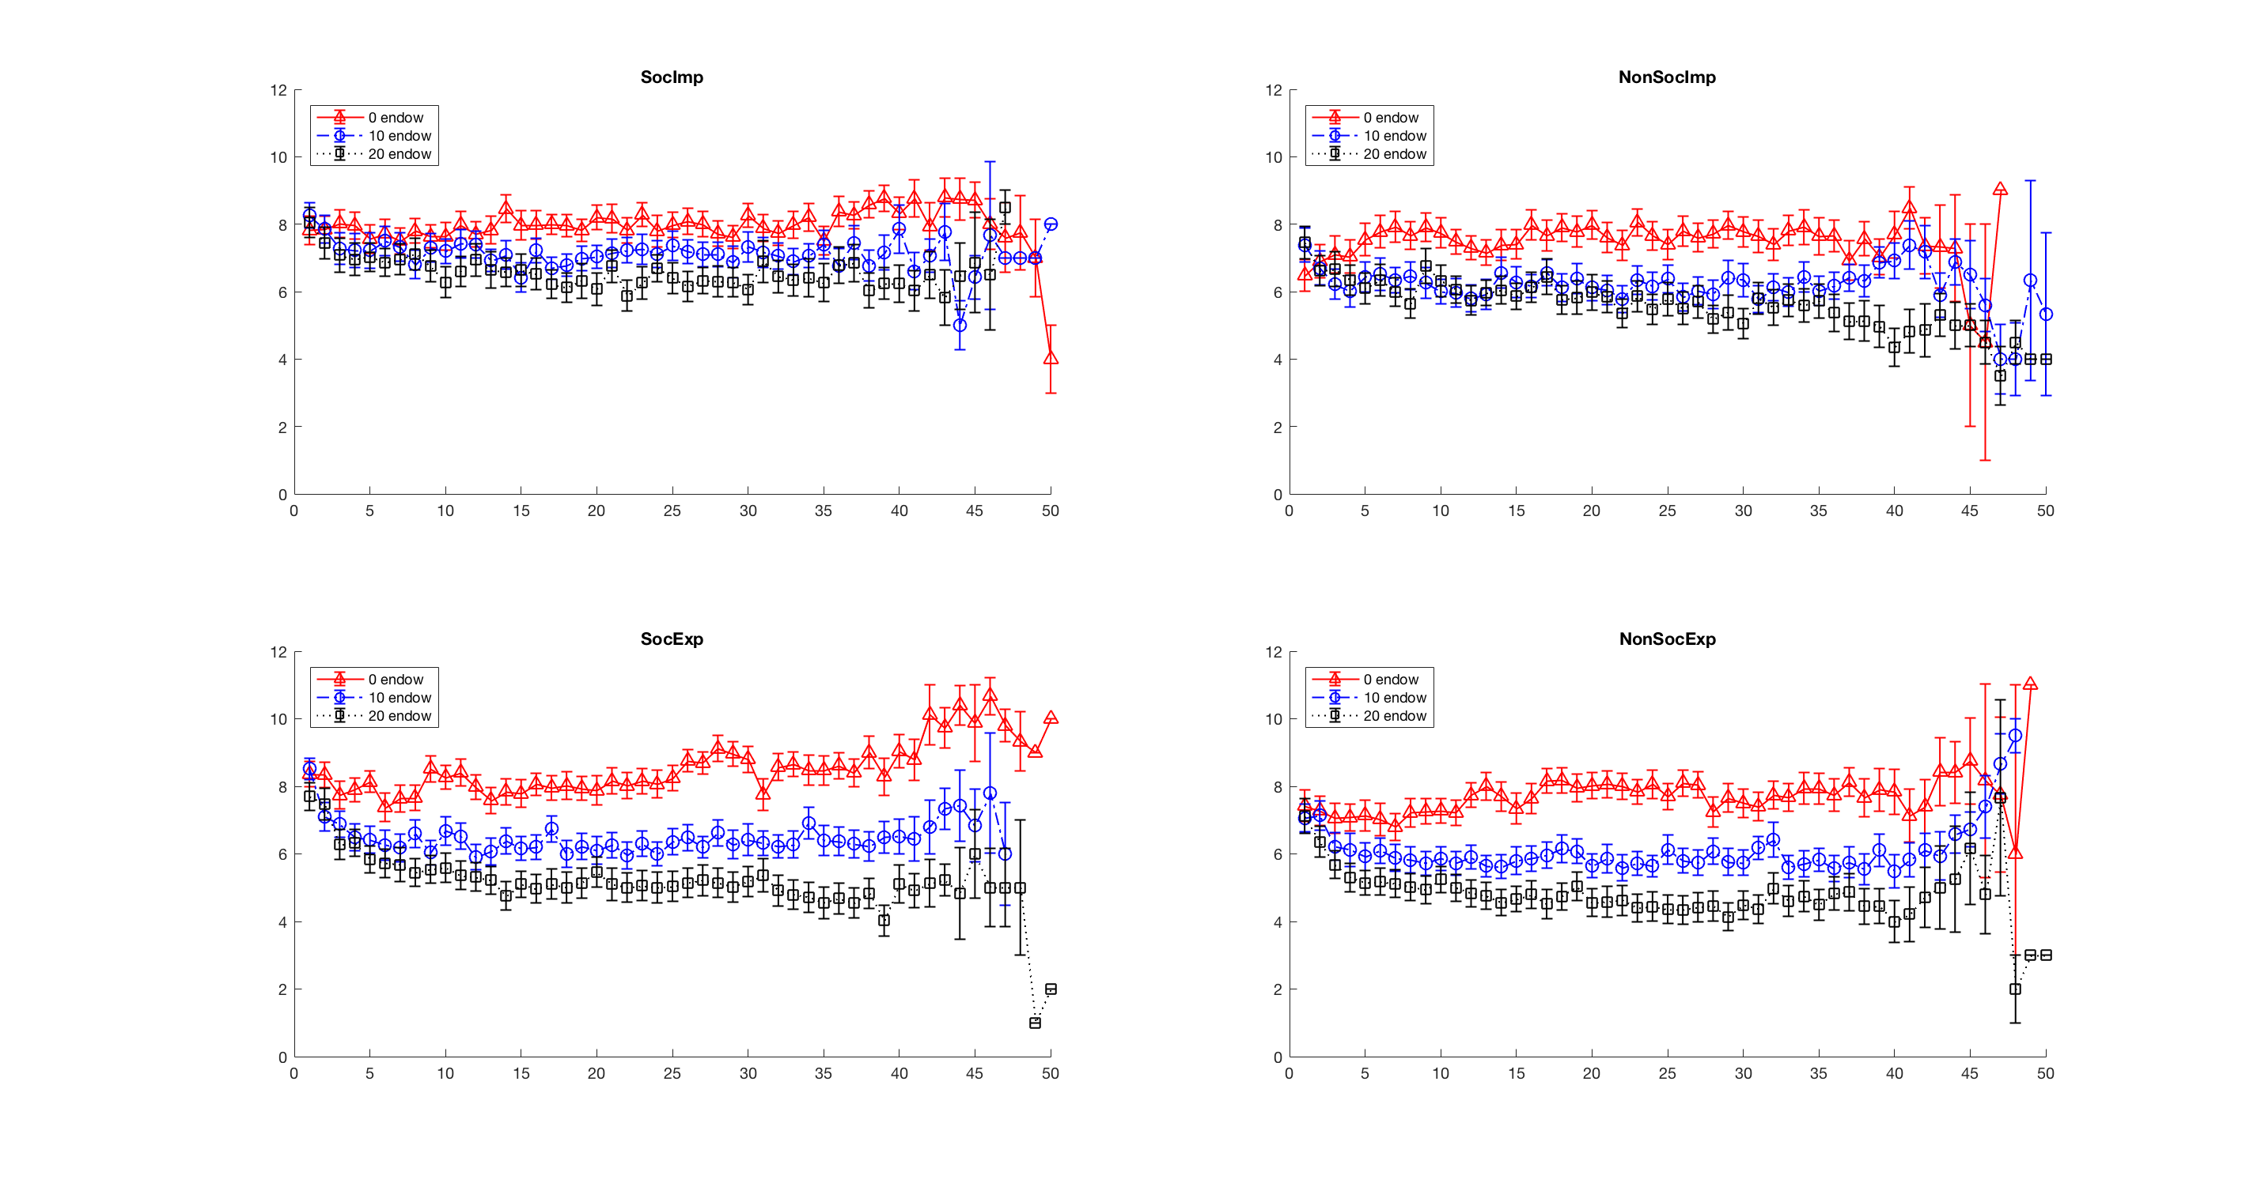
Regression 1: results
Social X explicit X opponent X opp_trial
(with Anova function on lme4 model)
p = 0.034
This indicates that the extent to which offers differ to opponents as a function of exposure to those opponents differs according to explicit and implicit, social and non-social.
Based on these plots, it appears that learning is taking place in explicit to a much higher degree than implicit. For this reason, we examined these effects in the explicit condition

Slide 5
Regression 2: model
uglm = lmer(offer ~ ( social * opponent * opp_trial) + (1 | sub_name), data=UG[which (UG$explicit == 1),])
Translation: within the explicit condition, the dependent variable is the offer (between 0 and 20), and the independent variables are social (binary factor), opponent (3 level factor), and opp_trial (the opponent specific trial, i.e. the number of times that an opponent appears to a subject, continuous variable between 25 and 50*), and subject as a random factor (intercept allowed to vary randomly across subjects)
Linear mixed model fit by REML t-tests use Satterthwaite approximations to degrees of freedom
Number of obs: 12000, groups: sub_name, 50
*This range was due to a bug in a stimulus code which will be fixed in the next iteration of the study, should have been fixed as 40 trials per opponent

Slide 6
Regression 2: results
 | Estimate | Std..Error | df | t.value | P-value
(Intercept) | 7.236493462 | 0.260577011 | 68.64018442 | 27.77103564 | 0
social1 | 0.436627607 | 0.148051737 | 11939.28013 | 2.949155576 | 0.003192613
opponent2 | -1.115736267 | 0.148183318 | 11939.45567 | -7.52943233 | 5.46E-14
opponent3 | -1.773412154 | 0.148804996 | 11939.48698 | -11.91769231 | 0
opp_trial | 0.020422001 | 0.004381052 | 11939.98054 | 4.661437491 | 3.17E-06
social1:opponent2 | 0.027981791 | 0.209904913 | 11939.43466 | 0.133306987 | 0.893952849
social1:opponent3 | 0.270837437 | 0.2101475 | 11939.43148 | 1.288796852 | 0.197493692
social1:opp_trial | 0.009541524 | 0.006170702 | 11939.82824 | 1.546262297 | 0.122067737
opponent2:opp_trial | -0.029867118 | 0.006184426 | 11940.39451 | -4.829408235 | 1.39E-06
opponent3:opp_trial | -0.051373966 | 0.0062648 | 11940.47473 | -8.200415562 | 2.22E-16
social1:opponent2:opp_trial | -0.00817223 | 0.008784846 | 11940.31942 | -0.930264444 | 0.352252989
social1:opponent3:opp_trial | -0.021051811 | 0.0088194 | 11940.30338 | -2.386988942 | 0.017002471

Slide 7
Regression 2: results
Summary:
All trials:
Social1 X opponent3 X opponent_trail: 𝛽 = -.021, t = -2.39, p = 0.017
Trials < 45
Social1 X opponent3 X opponent_trail: 𝛽 = -.019, t = -2.09, p = 0.036
Trials < 40
Social1 X opponent3 X opponent_trail: 𝛽 = -.014, t = -1.47, p = 0.14

Slide 8
Regression 2: results
Summary:
All trials:
Social1 X opponent3 X opponent_trail: 𝛽 = -.021, t = -2.39, p = 0.017
Means that subjects in the social condition (social = 1) playing against opponent 3 (black squares, €20 starting endowment) offer significantly less over opponent-specific trials than they offer opponent 1 (red triangles, €0 starting endowment) with respect to the non-social condition. In other words, the difference between offers to opponents 1 and 3 over time is bigger in the social than in the non-social condition, within the explicit condition. However, this seems to be driven at least in part by noisy data at the end of the game.

Slide 9
Regression 2: results
Summary:
Notably, subjects start with a higher investment in the social than in the non-social condition, which could be attributing to the effect that we see.
Outstanding questions:
Are subjects homing in more accurately on the optimal acceptance function of the opponent in the social condition?
Is the fairness norm facilitating learning, instead of impeding it, as we first thought?
To test this, we can simply compare how close our subjects have gotten to the true acceptance functions of their opponents in either condition.

Slide 10
We hypothesized that
In the implicit condition, learning would occur faster in the nonsocial than the social condition
In the explicit condition, learning would not differ between the social and the nonsocial
Learning would not differ between the implicit nonsocial and explicit social
For model-based analyses, for what could be any number of reasons, the priors predicted from the no-feedback task did not match with the first offers made during the task. Therefore we added prior estimates as additional free-parameters in the model estimated from the ultimatum game itself.

