Slide 1
Prey learns from predator

Slide 2
Case 2: P updates his/her 𝛃_{R0} at time t using the choice prediction error δ_{Ct} and two learning rates: α⁺ for positive prediction errors, and α⁻ for a negative prediction errors:
𝛽_{R0,t+1}=𝛽_{R0,t}+α⁺× δ_{Ct} if δ_{Ct} > 0 (6)
𝛽_{R0,t+1}=𝛽_{R0,t}+α⁻× δ_{Ct} if δ_{Ct} < 0
Case 3: P updates his/her 𝛃_{R0} at time t using the reward prediction error δ_{R} and a single learning rate α. The calculation of δ_{R} is accomplished by subtracting the actual reward from the expected reward and is equivalent to the following expressions (see supplementary slides for full derivations of these equations):
δ_{Rt} = δ_{Ct} × (𝑬_{𝒕}−𝑨_{𝒕}) if subject is prey (7)
δ_{Rt} = δ_{Ct} × (I_{t} −𝑨_{𝒕}) if subject is predator (8)

Slide 3
δ_{Rt} is then used by P to update ϑ in the same way δ_{Ct} was used in cases 1 and 2:
𝛃_{R0,t+1}=𝛃_{R0,t}+α× δ_{Rt} (9)
Case 4: P updates his/her 𝛃_{R0} at time t using the reward prediction error δ_{Rt} and two learning rates: α⁺ for positive prediction errors, and α⁻ for a negative prediction errors:
𝛽_{R0,t+1}=𝛽_{R0,t}+α⁺× δ_{Rt} if δ_{Ct} > 0 (10)
𝛽_{R0,t+1}=𝛽_{R0,t}+α⁻× δ_{Rt} if δ_{Ct} < 0

Slide 4
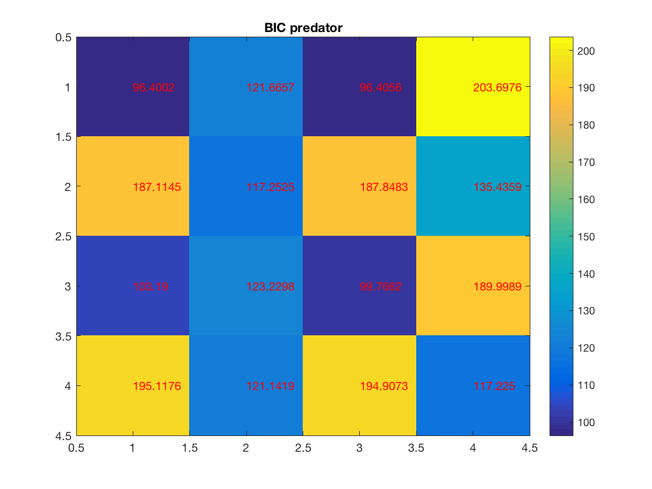
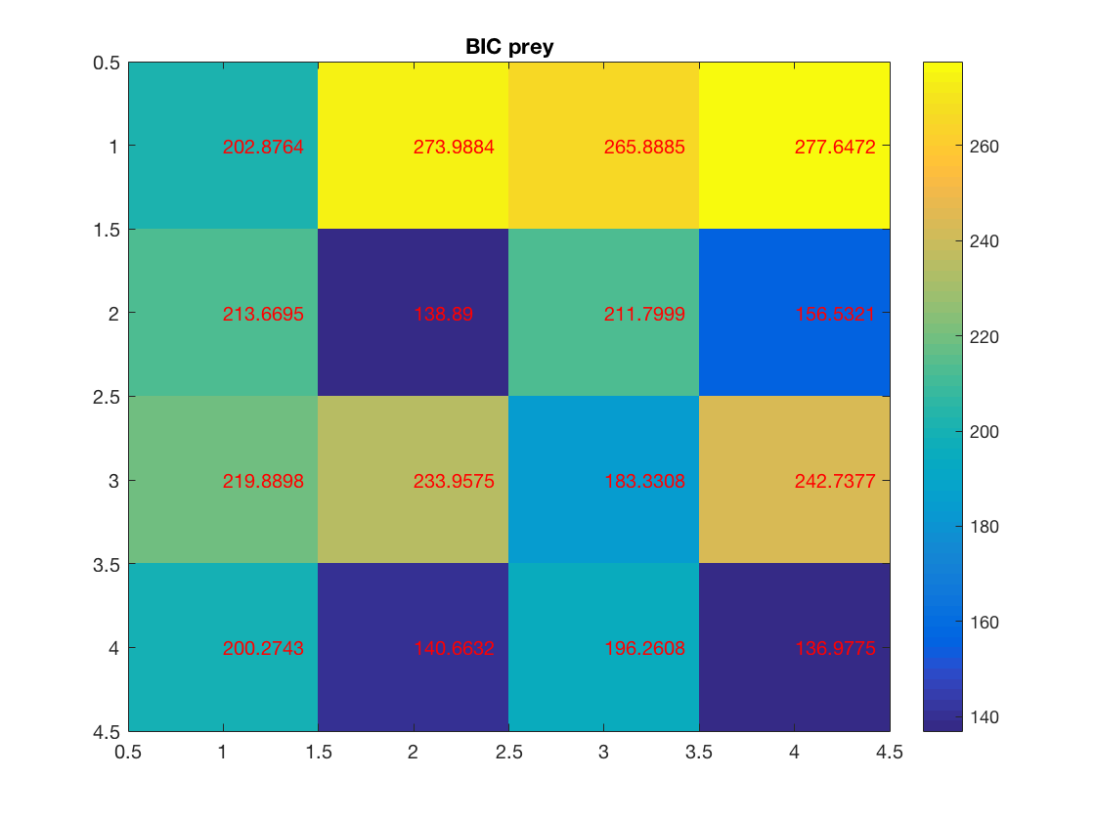
Simulations: Experiment 4 Model Identifiability: Confusion Matrices
Confusion matrices. Each row represents the model that was used to simulate the data (cases 1-4), and each column represents the model that was used to fit the data. Lower Bayesian information criterion (BIC) indicates a better fit of the model to the data. Therefore, for optimal model identifiability, we would hope for a dark diagonal, and white everywhere else. While this is not the case with these models, in almost every case, the model used the generate the data does yield the lowest BIC when used to fit the data. In other words, while the models do appear to be identifiable, we should interpret BIC’s near one another with caution.
\
What this suggests to me is that there’s hardly any difference between choice prediction error and reward prediction error, which would mean the models are pretty much the same. Look into that.

Slide 5
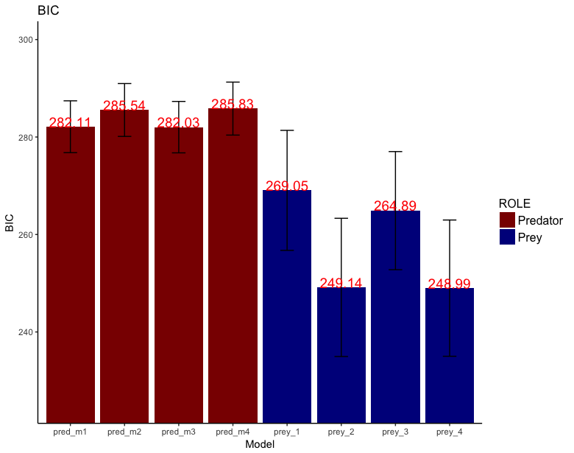
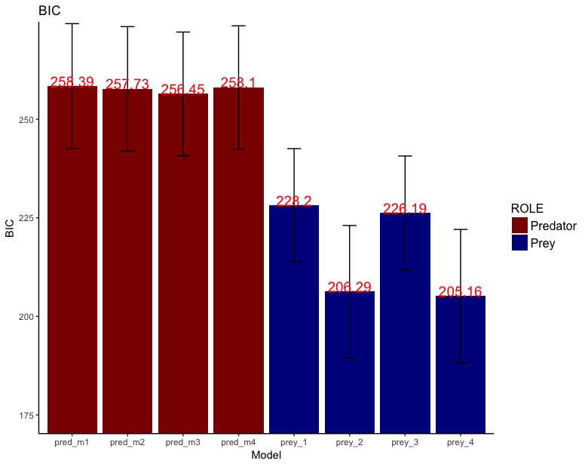
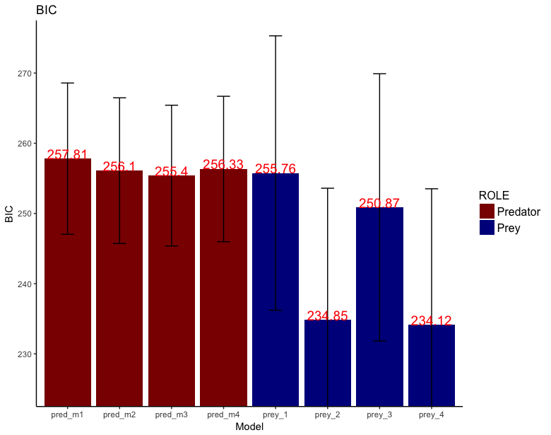
Model fits to real data
I fit each model to the behavioral data of three different datasets and assessed the goodness of fit by comparing the BIC of each model, across subjects, separately for predator and for prey. As can be seen from figures #, in each dataset model 3 yields the lowest BIC for predators (red bars), indicating a better fit to the data, while model 4 yields the lowest BIC for prey (blue bars). This means that predator behavior is better explained by a learning model with 1 learning rate, and prey behavior is better explained by a learning model with 2 learning rates. Furthermore, while there is no significant difference between models 1 and 3 for predators nor models 2 and 4 for prey, based on the simulated model identifiability test visualized in the confusion matrices in figure #, in which these models are likewise similar in terms of BIC, we should not expect a significant difference between these models even if subjects were using them perfectly to generate their behavior.
Exp. 4
Exp. 3
Exp. 2
***
***
***
*
***
N = 166, b/w sub design
N = 50, b/w sub design
N = 24, w/in sub design
Asterisks represent significant results of paired t-tests, ”*” represents p<0.05, “**” represents p<0.01, and “***” represents p<0.0001

Slide 6
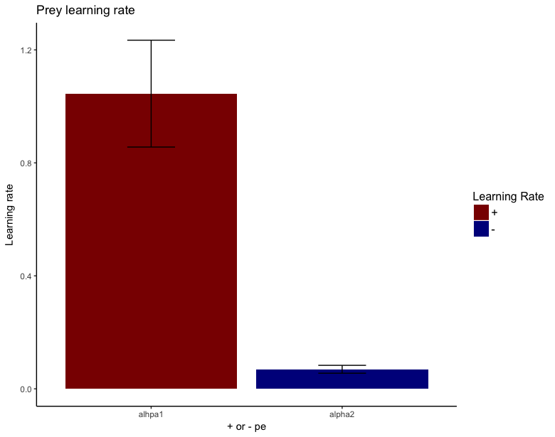
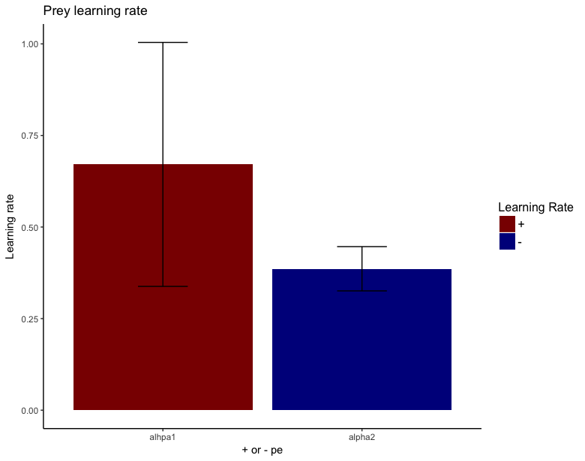
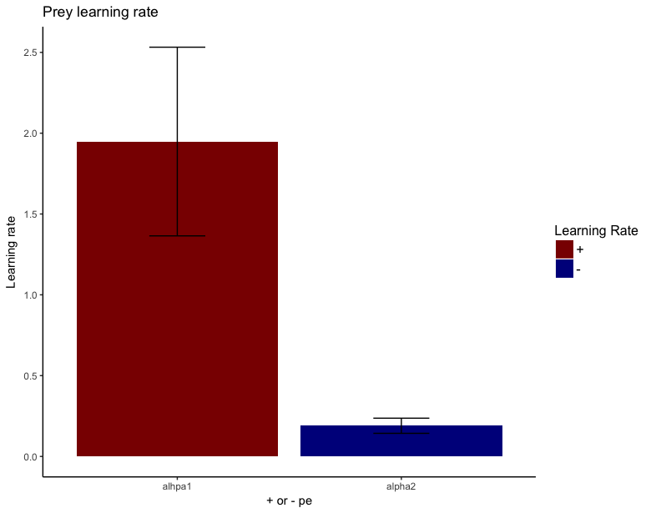
Model fits to real data
When examining the model parameters of the most parsimonious models, we see that prey in fact exhibit a large difference in terms of learning rate, but only for two out of the three datasets (results of paired t-tests). This means that prey their behavior much stronger to a positive prediction error than to a negative prediction error, and in effect indicates that they behave in risk-seeking rather than risk-avoiding manner.
Exp. 4
Exp. 3
Exp. 2
t(1, 80)=5.26, p<0.0001
t(1, 24)=0.81, p=0.43
t(1, 23)=3.22, p=0.0038

Slide 7
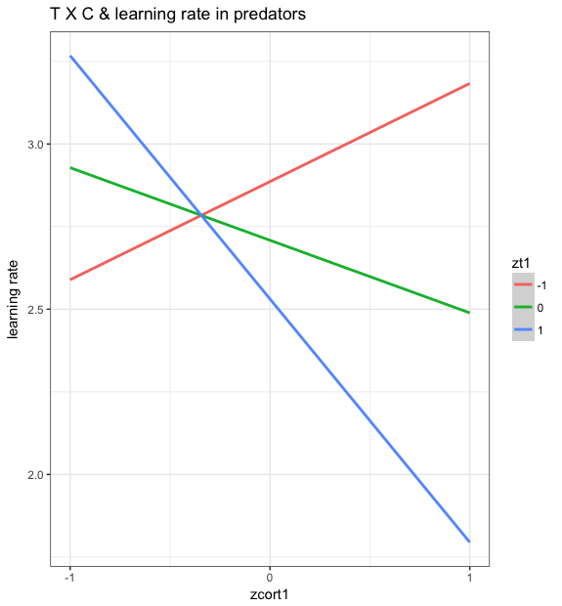
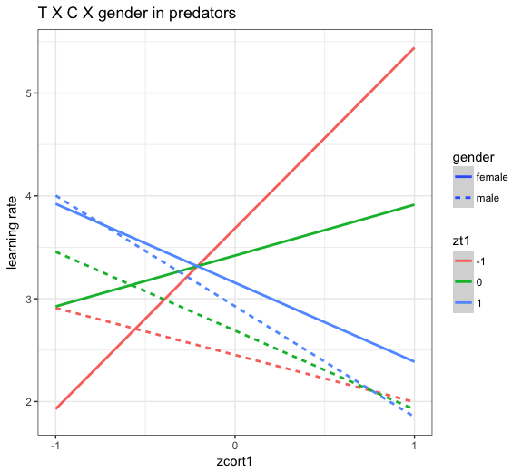
Model fits to real data experiment 4
When examining the parameters of the most parsimonious model in predators (model 3, reward learning with a single learning rate), we used multiple linear regression with cortisol, testosterone, gender, and the interactions between all three as independent variables, and learning rate as the dependent variable, with BMI included as a covariate (largest VIF = 5.22). We have a significant interaction between testosterone and cortisol, and a marginally significant 3-way interaction between testosterone, cortisol, and gender.
Learning rate as DV and T, C, TXC, and BMI as IV’s
TXC interaction: t=-2.46 p=0.016
TXCXgender interaction: t=1.87, p=0.066
Cxgender interaction: t=-2.192, p=0.031
TXC interaction: t=-2.80, p=0.0065
Whole model: F(8, 76)=2.28, p=0.031

Slide 8
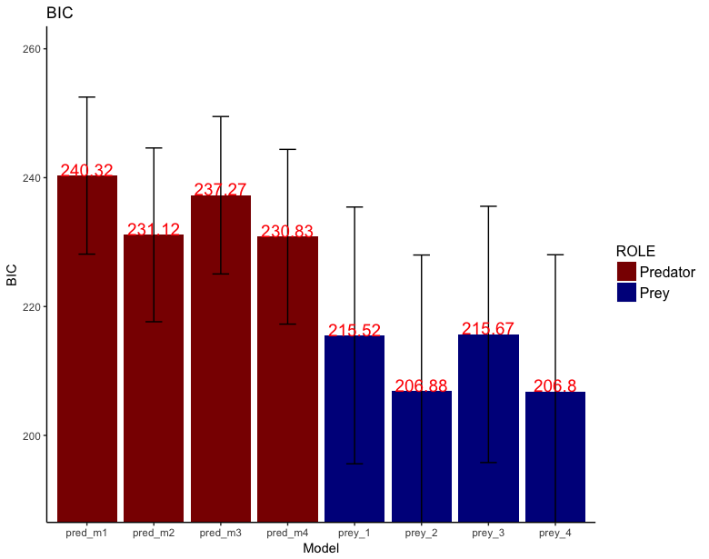
Model fits to real data
Similar to the previous studies, model 4 fit prey behavior best. However, in contrast to the previous studies, model 4 also fit predator behavior. This suggests that when subjects alternate between roles in close succession, their learning mechanisms appear to shift from predatory to prey-like. ANOVA’s on the BIC’s were not significant, prey p=0.11, predator p=0.064. Likewise, t-tests were all not significant

Slide 9
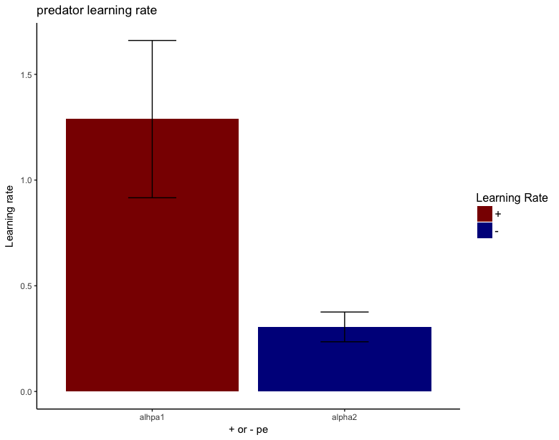
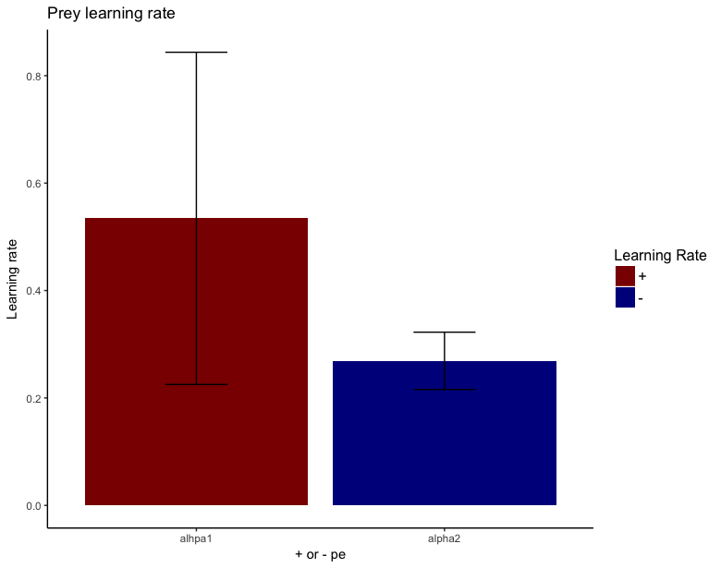
Model fits to real data
Interestingly, while the difference in learning rates for prey is in the same direction as the previous experiments, it does not reach significance for prey, t(26)=0.92, p=0.37, but does for predators, t(26)=2.74, p=0.011.
t(26)=2.74, p=0.011
t(26)=0.92, p=0.37

Slide 10
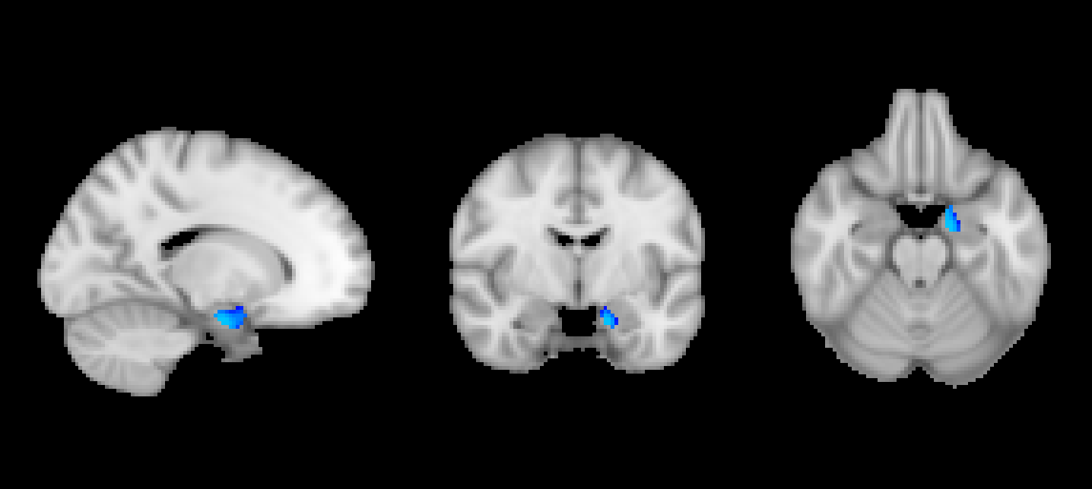
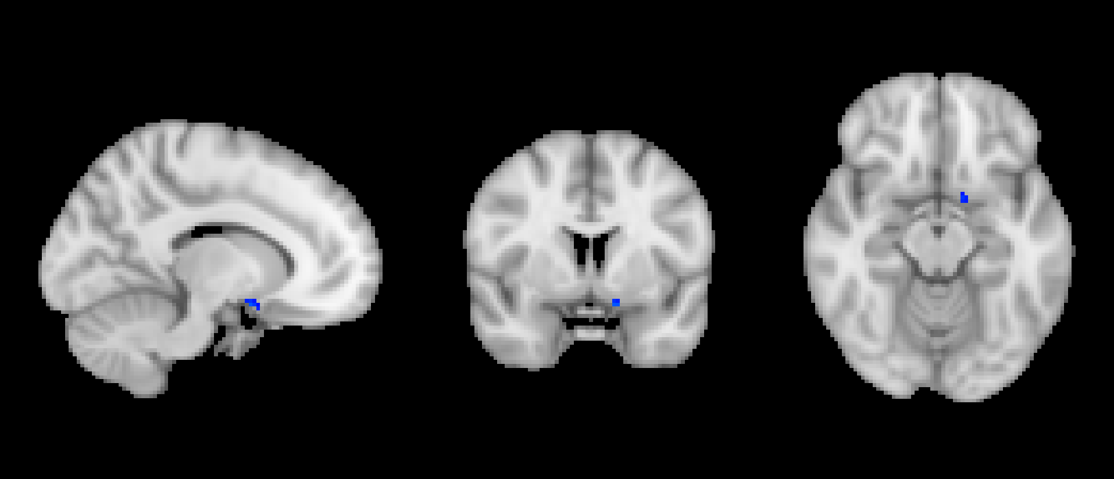
Model 3 prey feedback
Negative amygdala, negative VS

Slide 11
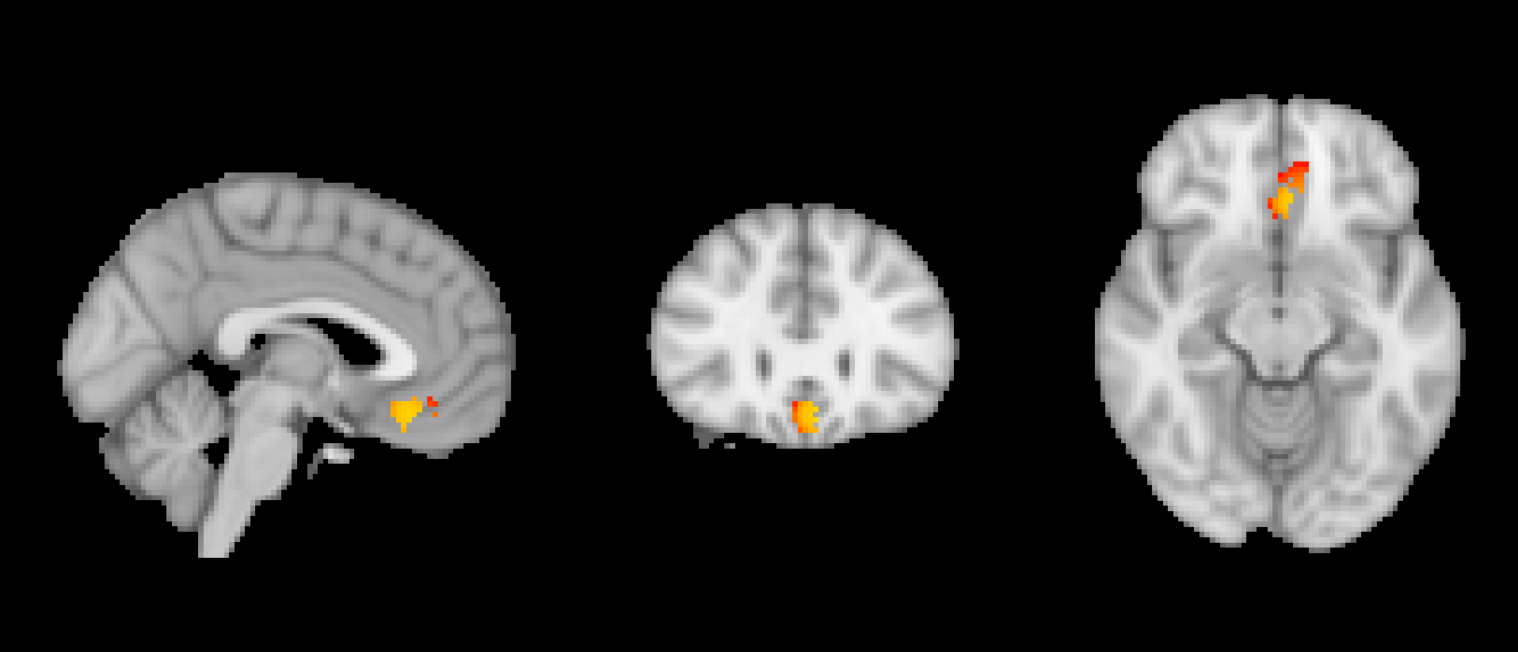
Model 3 prey select
Positive VMPFC

Slide 12
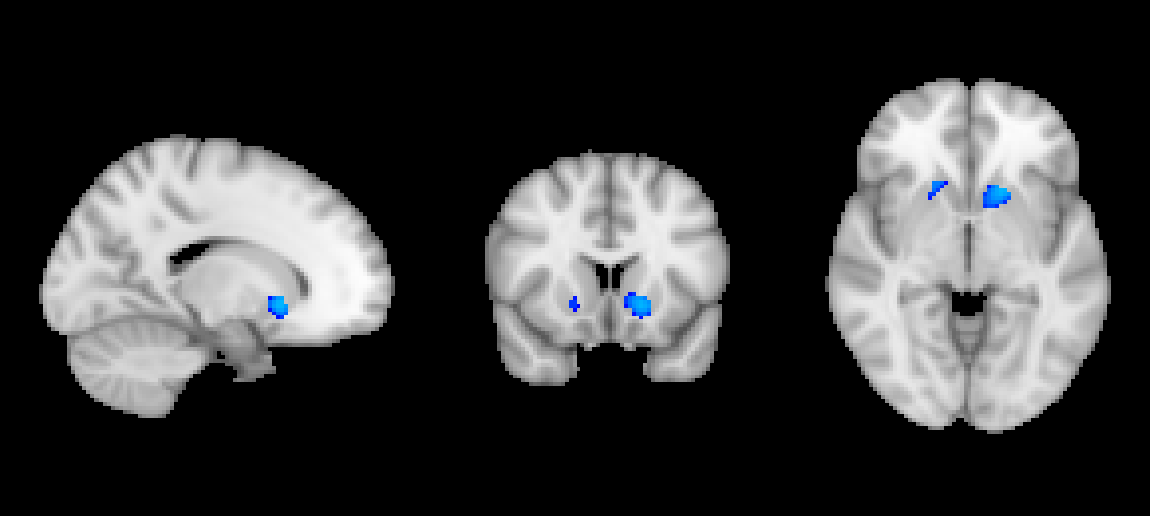
Model 3 Predator select
Negative VS activation

