Slide 1
UG

Slide 2
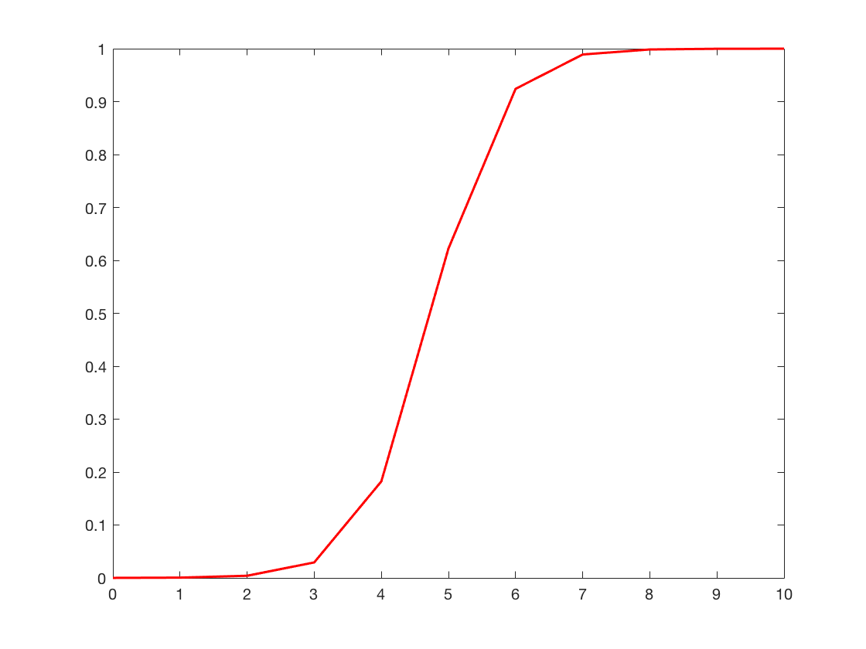
What could subjects be doing?
We submit that subjects are attempting to learn an optimal behavior from a noisy environment!
And how could they be doing this?
Not through simple Q-learning, that is too cumbersome and we believe psychologically unlikely
Specifically, we assume that a participant (P) learns a rival’s (R) acceptance logistic function 𝝋, which maps the investment amount into a victory or a defeat. This function is governed by two parameters, an intercept 𝝋_{R0} and a slope 𝝋_{R1}.
𝝋_{𝜷R1}
Probability of success
𝝋_{𝜷R0}
Investment

Slide 3
At each trial 𝒕, from his/her endowment 𝑬_{𝒕}, 𝑷 has to consider each possible offer 𝑨_{𝒕} and compute the expected payoff 𝑽_{𝒕}. This expected payoff depends on his/her estimate of how likely it is that 𝑨_{𝒕} will result in a victory: 𝑷_{𝑹,𝒕} (𝑫_{𝒕} = 𝟏|𝑨_{𝒕}), where 𝑫_{𝒕} represents whether A_{t} results in a victory (𝑫_{𝒕} = 𝟏) or a feat (𝑫_{𝒕} = 0). This will occur if R accepts 𝑨_{𝒕.} For simplicity, this will be referred to as 𝑷_{𝑹,𝒕}(𝑨_{𝒕}). 𝑷’s expected payoff 𝑽_{𝒕} for the offer 𝑨_{𝒕} is:
𝑽_{𝒕}=[P_{𝑹,𝒕}(𝑨_{𝒕})×(𝑬_{𝒕}−𝑨_{𝒕})]+[(𝟏–𝑷_{𝑹,𝒕}(𝑨_{𝒕}))×𝟎] (1)
With the two square brackets representing cases where 𝑨_{𝒕} is accepted or rejecte3d, respectively.
Critically, 𝑷 estimates 𝑷_{𝑹,𝒕}(𝑨_{𝒕}) by estimating 𝑹’s acceptance logistic function 𝝋. Specifically, P forms a representation ϑ of R’s acceptance function 𝝋 by forming estimates 𝜷_{𝑹𝟎} and 𝜷_{𝑹1} of 𝝋‘s intercept and slope, respectively.
𝑷_{𝑹,𝒕}(𝑨_{𝒕})=𝟏/(𝟏+𝒆𝒙𝒑(−(𝜷_{𝑹𝟎,𝒕}+𝜷_{𝑹𝟏,𝒕}×𝑨_{𝒕}))) (2)

Slide 4

𝑷 can choose 𝑨_{𝒕} according to a softmax function (multinomial), with a temperature parameter 𝜷
P(A_{t} = i) = $\frac{eβ×V_{i}}{\sum_{j=1}^{n}{β×V_{i}}}$ (3)
Learning can be done using a simple delta rule on ϑ’s two parameters 𝜷_{𝑹𝟎,𝒕} and 𝜷_{𝑹𝟏,𝒕}. This means that P first computes a choice prediction error 𝜹_{C𝒕}
𝜹_{C𝒕} = 𝑫_{𝒕}−𝑷_{𝑹,𝒕}(𝑨_{𝒕}) (4)

Slide 5
This choice prediction error can then be used to update the parameters for the next trial using a Rescorla-Wagner update function . For simplicity, we assume that 𝜷_{𝑹𝟏} will remain constant, while 𝜷_{𝑹𝟎} will be updated on each trial. We propose four different iterations of an update procedure that P can conceivably utilize in order to learn 𝝋.
Case 1: P updates his/her 𝛃_{R0} at time t using the choice prediction error δ_{Ct} and a single learning rate α. Specifically, if δ_{Ct} is positive, P increases 𝛃_{R0} (meaning P lowers the investment value necessary for victory), and if δ_{Ct} is negative P decreases 𝛃_{R0} (meaning P raises the investment value necessary for victory – recall that increasing the intercept shifts the entire logit function to the right and hence lowers the expected probability of success for each investment):
𝛃_{R0,t+1}=𝛃_{R0,t}+α× δ_{Ct} (5)

Slide 6
Case 2: P updates his/her 𝛃_{R0} at time t using the choice prediction error δ_{Ct} and two learning rates: α⁺ for positive prediction errors, and α⁻ for a negative prediction errors:
𝛽_{R0,t+1}=𝛽_{R0,t}+α⁺× δ_{Ct} if δ_{Ct} > 0 (6)
𝛽_{R0,t+1}=𝛽_{R0,t}+α⁻× δ_{Ct} if δ_{Ct} < 0
Case 3: P updates his/her 𝛃_{R0} at time t using the reward prediction error δ_{R} and a single learning rate α. The calculation of δ_{R} is accomplished by subtracting the actual reward from the expected reward and is equivalent to the following expressions (see supplementary slides for full derivations of these equations):
δ_{Rt} = δ_{Ct} × (𝑬_{𝒕}−𝑨_{𝒕}) (7)

Slide 7
δ_{Rt} is then used by P to update ϑ in the same way δ_{Ct} was used in cases 1 and 2:
𝛃_{R0,t+1}=𝛃_{R0,t}+α× δ_{Rt} (9)
Case 4: P updates his/her 𝛃_{R0} at time t using the reward prediction error δ_{Rt} and two learning rates: α⁺ for positive prediction errors, and α⁻ for a negative prediction errors:
𝛽_{R0,t+1}=𝛽_{R0,t}+α⁺× δ_{Rt} if δ_{Ct} > 0 (10)
𝛽_{R0,t+1}=𝛽_{R0,t}+α⁻× δ_{Rt} if δ_{Ct} < 0

Slide 8
Case 2: P updates his/her 𝛃_{R0} at time t using the choice prediction error δ_{Ct} and two learning rates: α⁺ for positive prediction errors, and α⁻ for a negative prediction errors:
𝛽_{R0,t+1}=𝛽_{R0,t}+α⁺× δ_{Ct} if δ_{Ct} > 0 (6)
𝛽_{R0,t+1}=𝛽_{R0,t}+α⁻× δ_{Ct} if δ_{Ct} < 0
Case 3: P updates his/her 𝛃_{R0} at time t using the reward prediction error δ_{R} and a single learning rate α. The calculation of δ_{R} is accomplished by subtracting the actual reward from the expected reward and is equivalent to the following expressions (see supplementary slides for full derivations of these equations):
δ_{Rt} = δ_{Ct} × (𝑬_{𝒕}−𝑨_{𝒕}) (7)

Slide 9
δ_{Rt} is then used by P to update ϑ in the same way δ_{Ct} was used in cases 1 and 2:
𝛃_{R0,t+1}=𝛃_{R0,t}+α× δ_{Rt} (8)
Case 4: P updates his/her 𝛃_{R0} at time t using the reward prediction error δ_{Rt} and two learning rates: α⁺ for positive prediction errors, and α⁻ for a negative prediction errors:
𝛽_{R0,t+1}=𝛽_{R0,t}+α⁺× δ_{Rt} if δ_{Ct} > 0 (9)
𝛽_{R0,t+1}=𝛽_{R0,t}+α⁻× δ_{Rt} if δ_{Ct} < 0

Slide 10
Simulations for number of trials, all with 5 conditions and 2 sessions. So trials are trials per condition

Slide 11
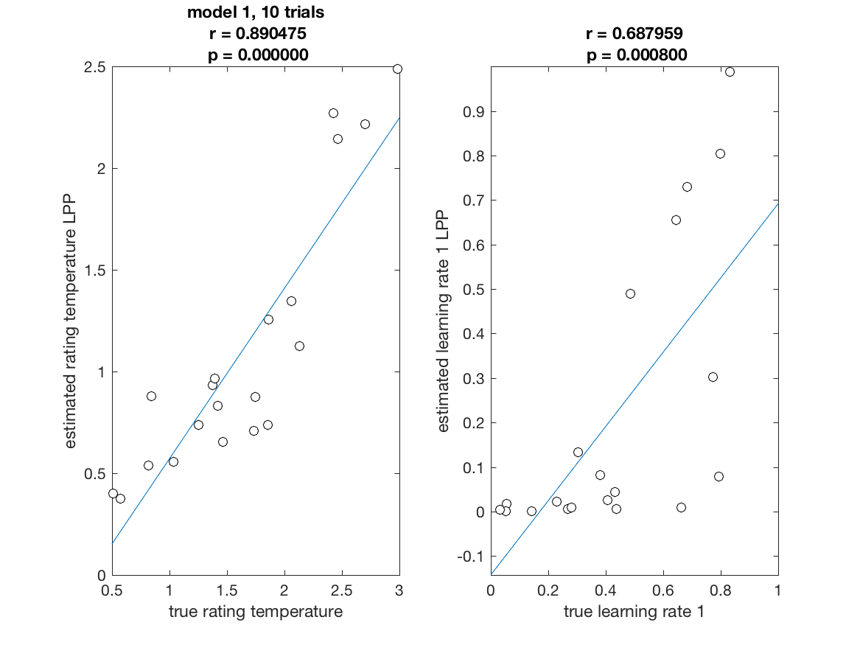
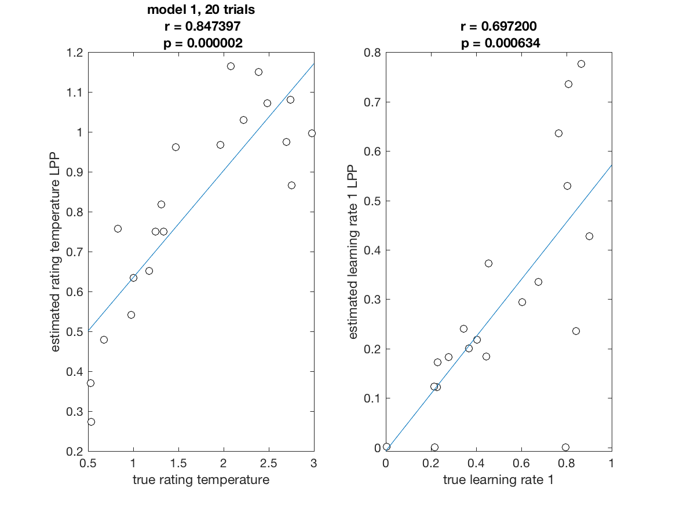
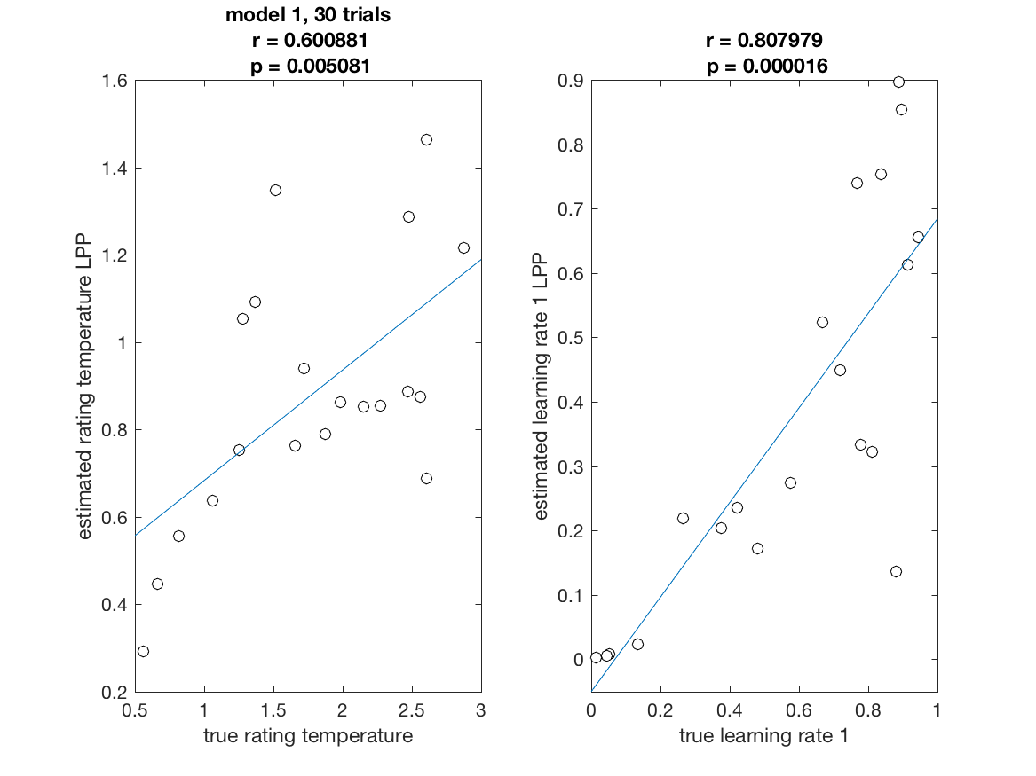
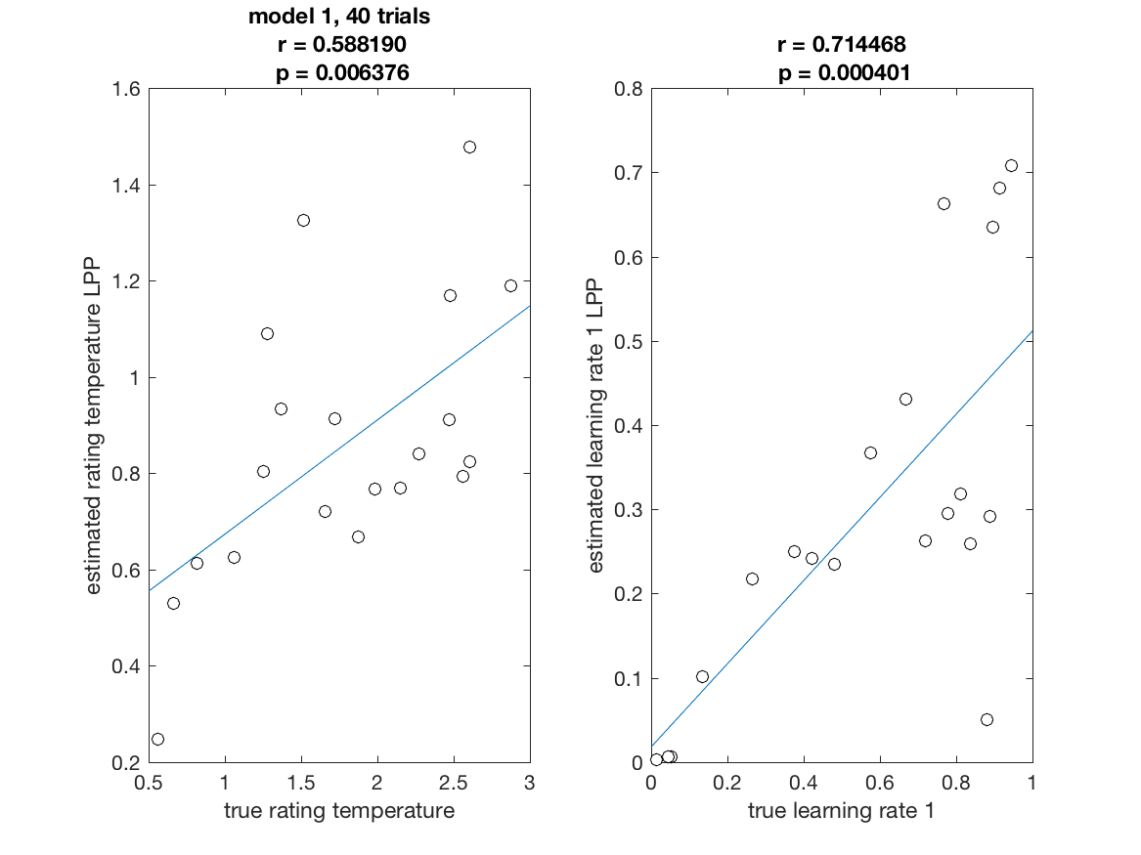
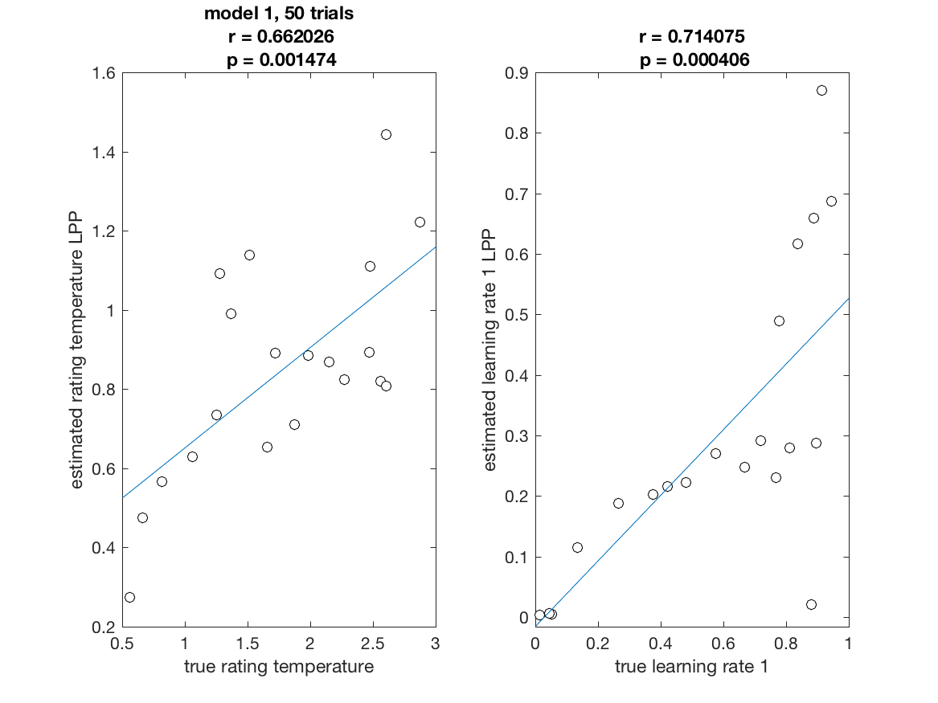
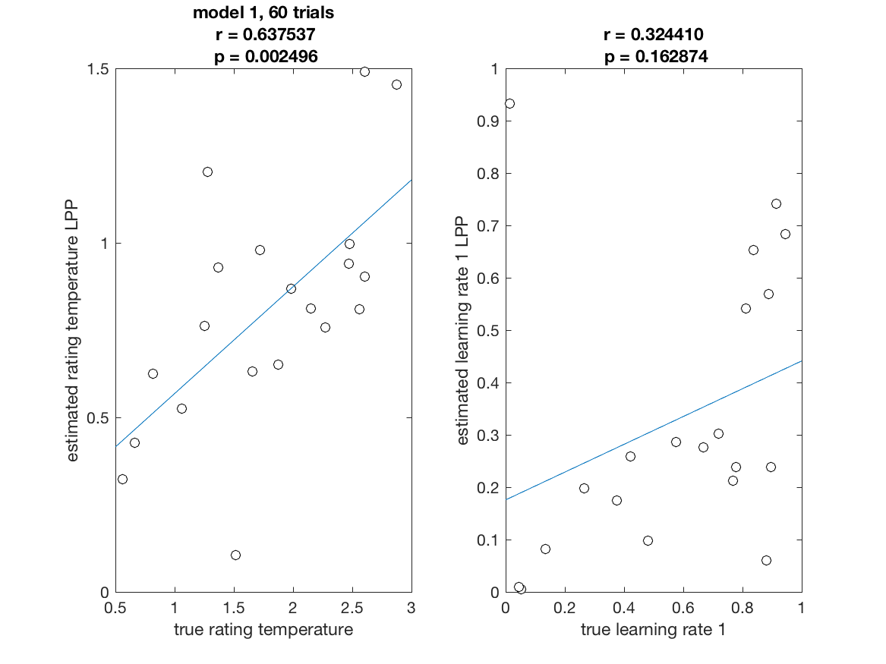
Recoverability Model 1

Slide 12
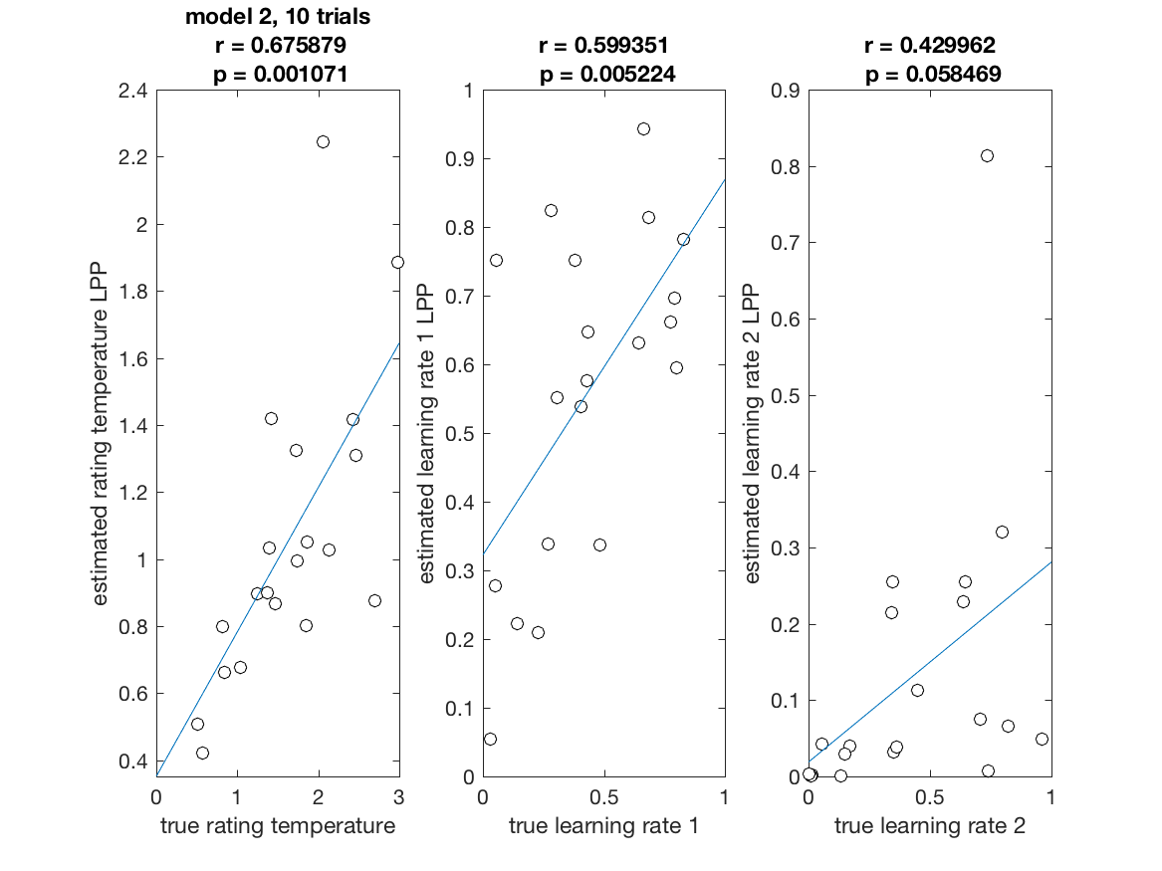
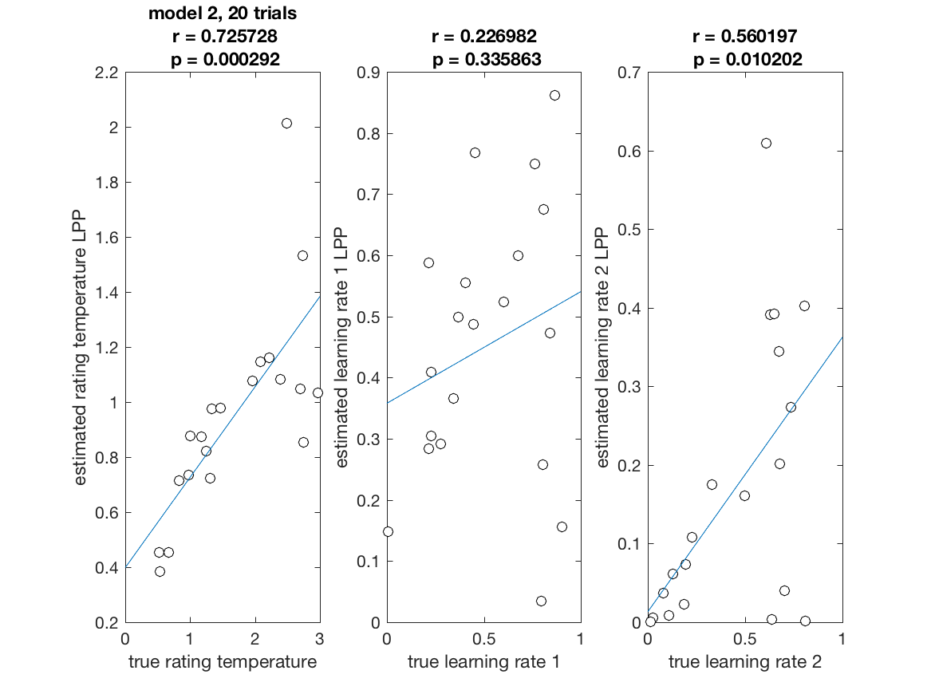
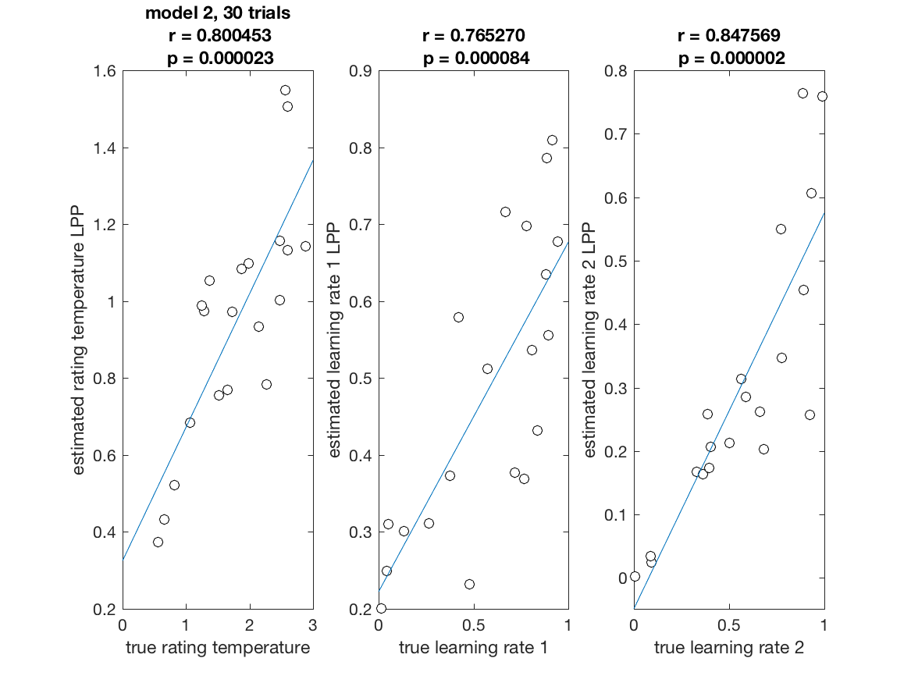
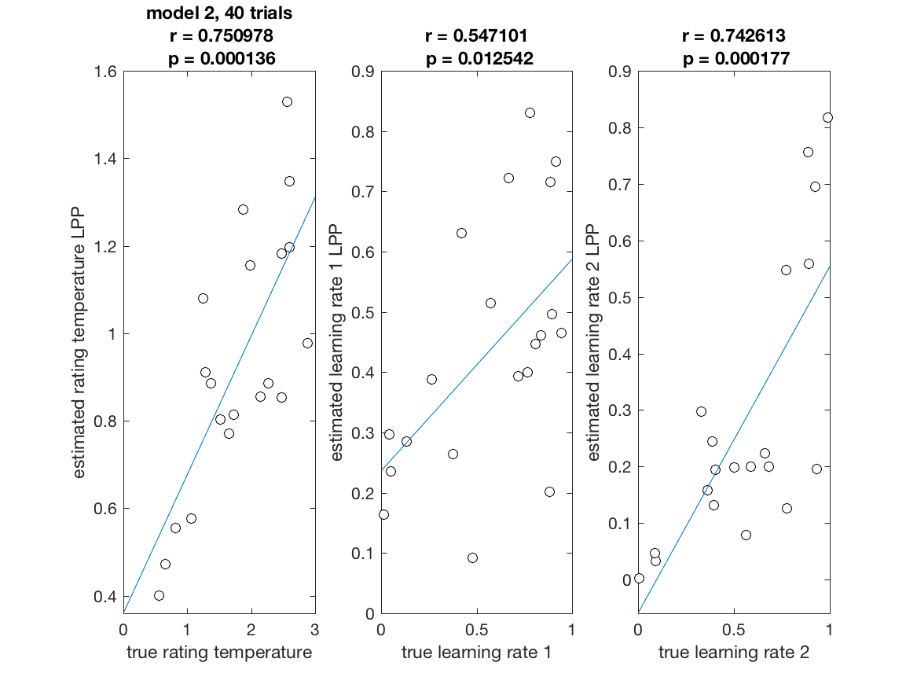
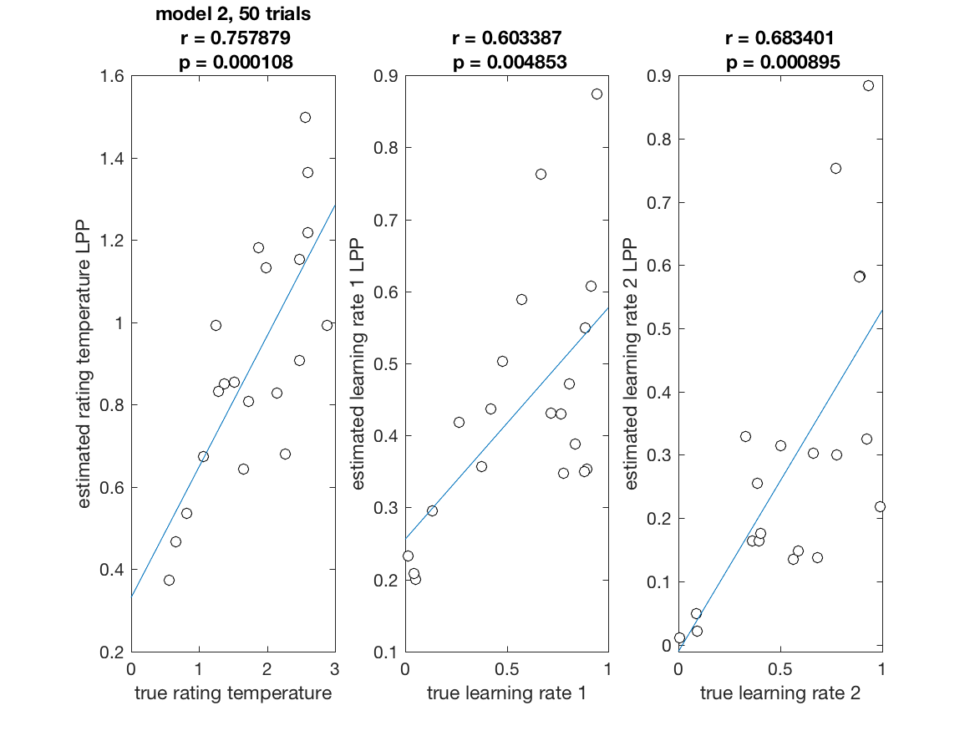
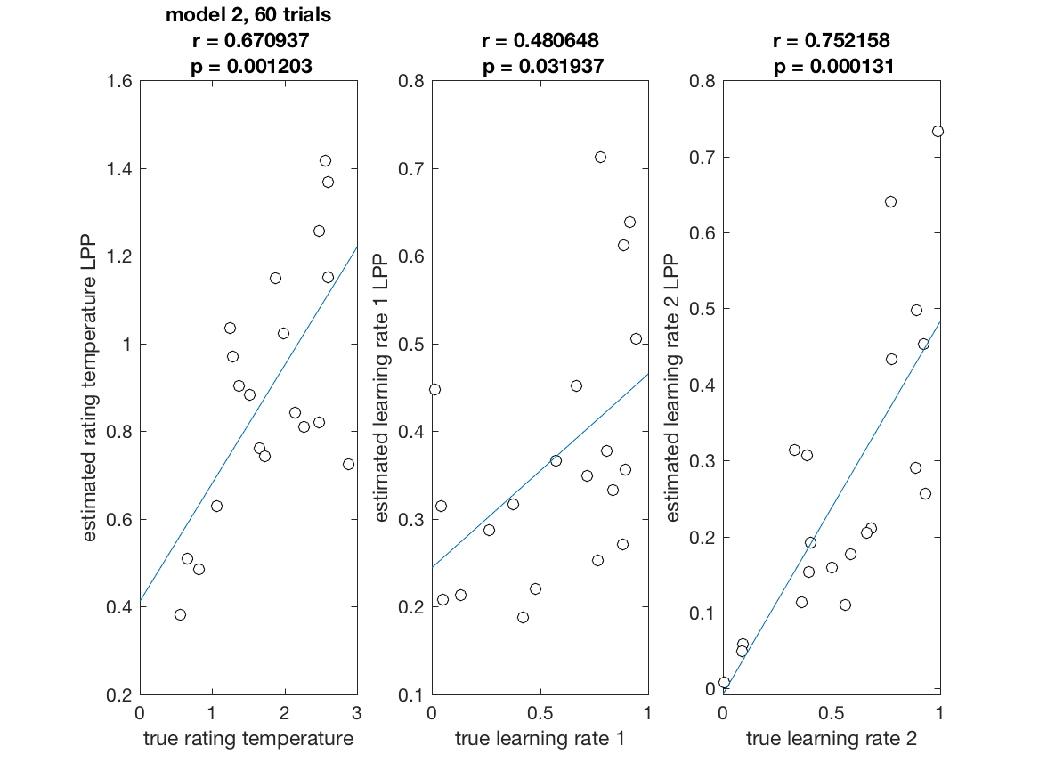
Recoverability Model 2

Slide 13
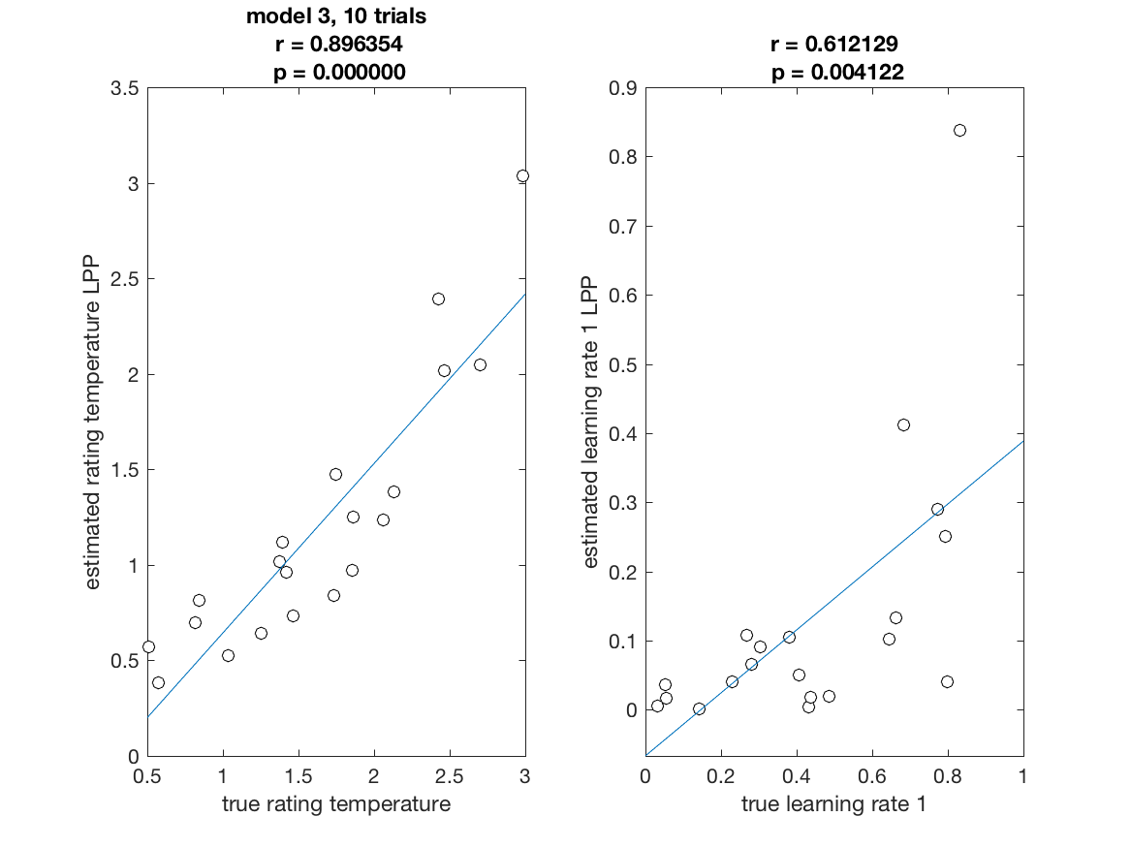
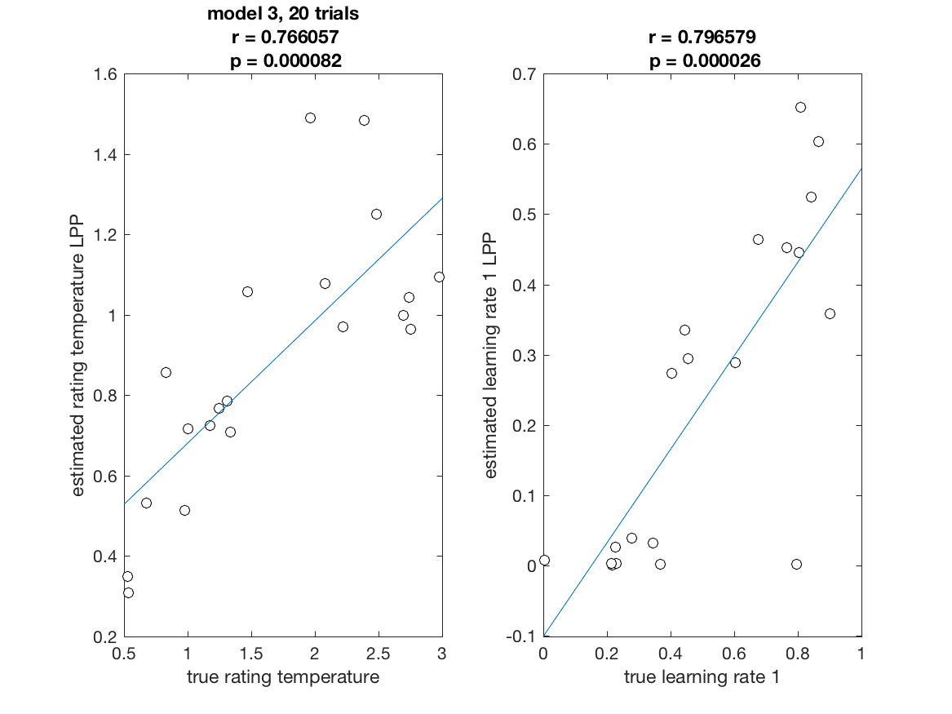
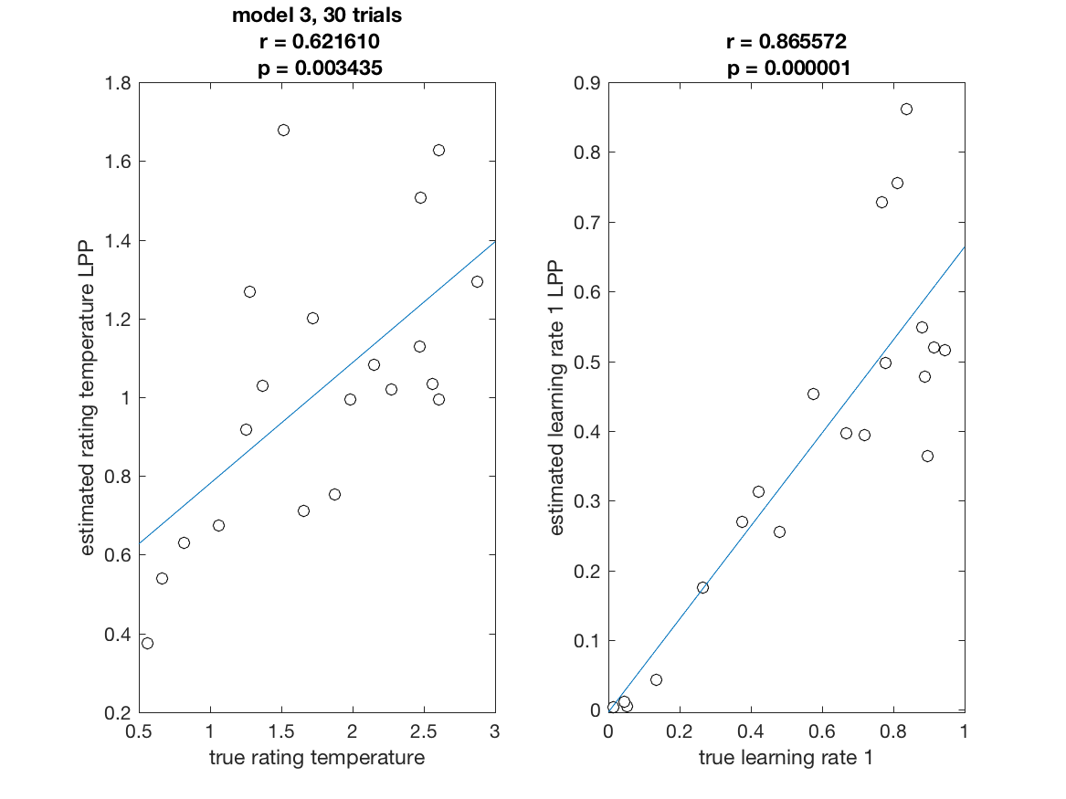
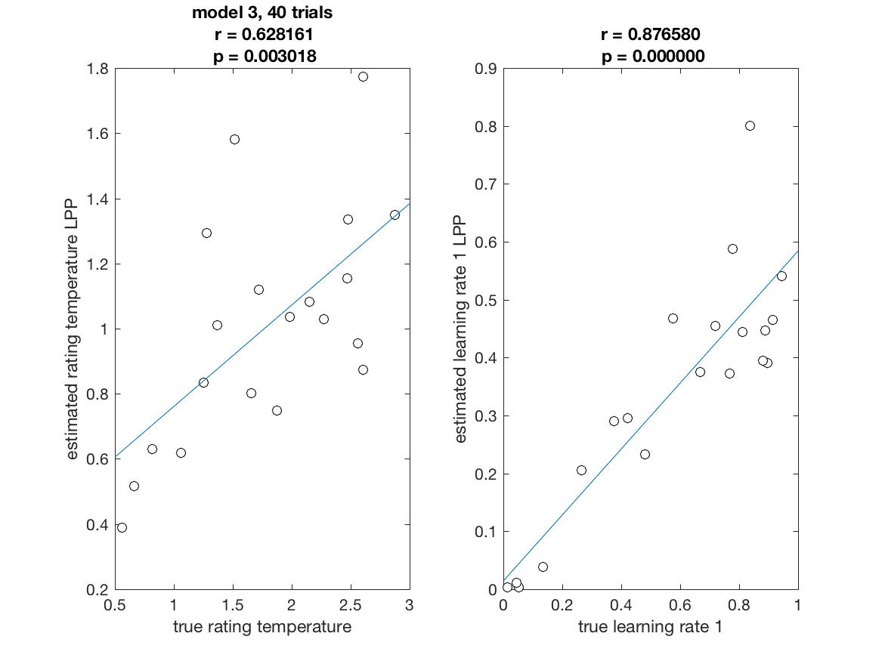
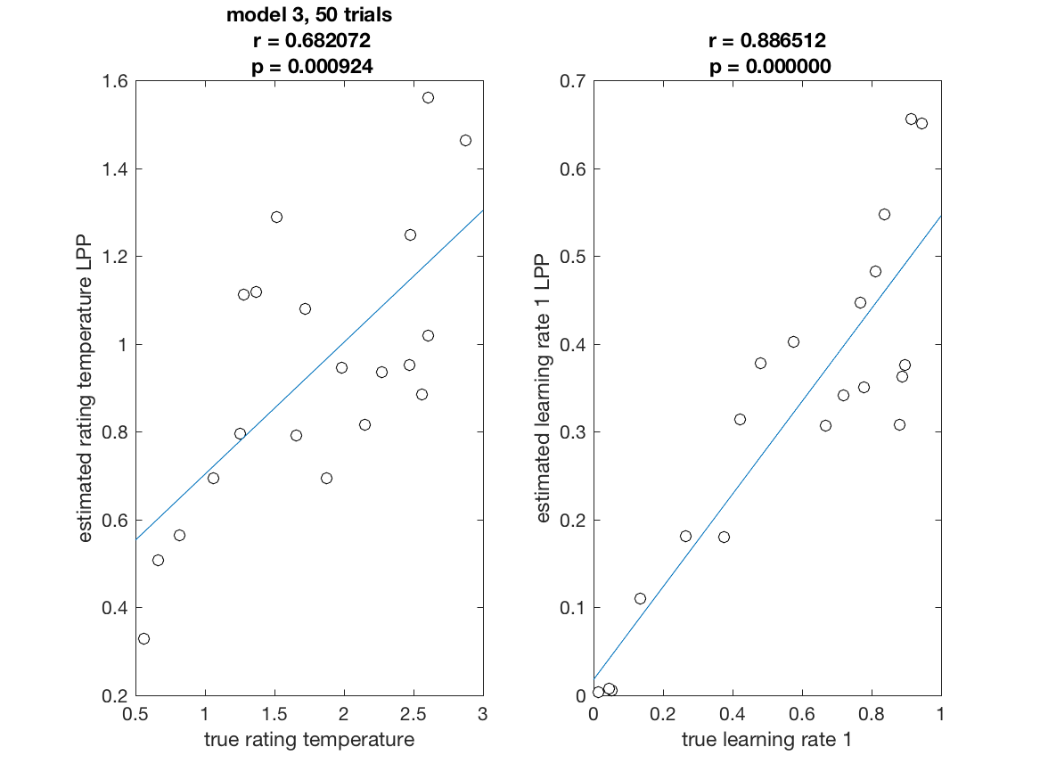
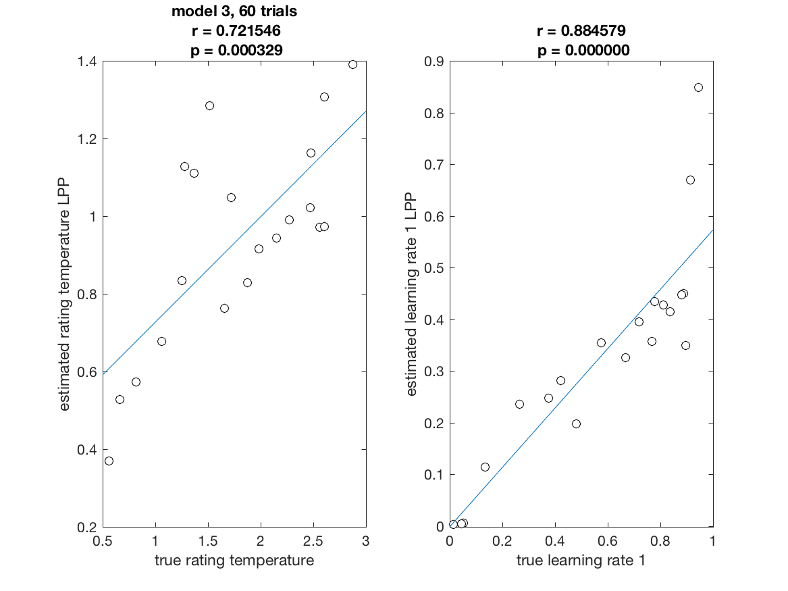
Recoverability Model 3

Slide 14
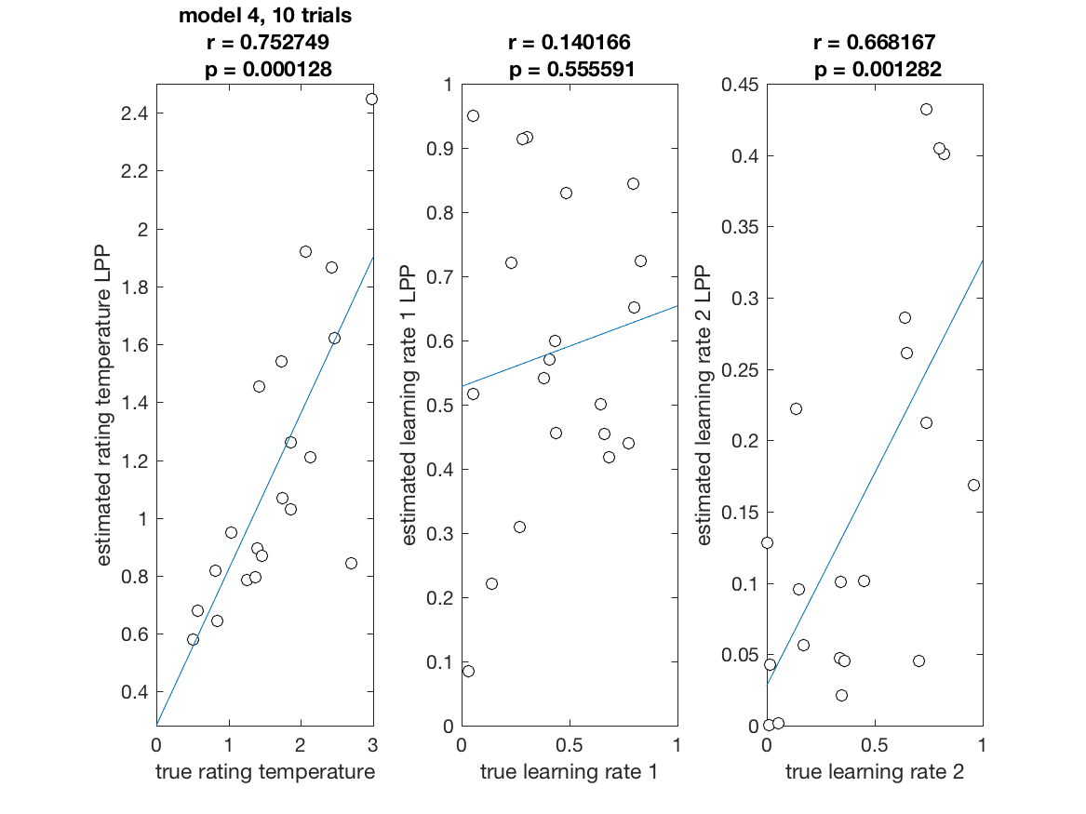
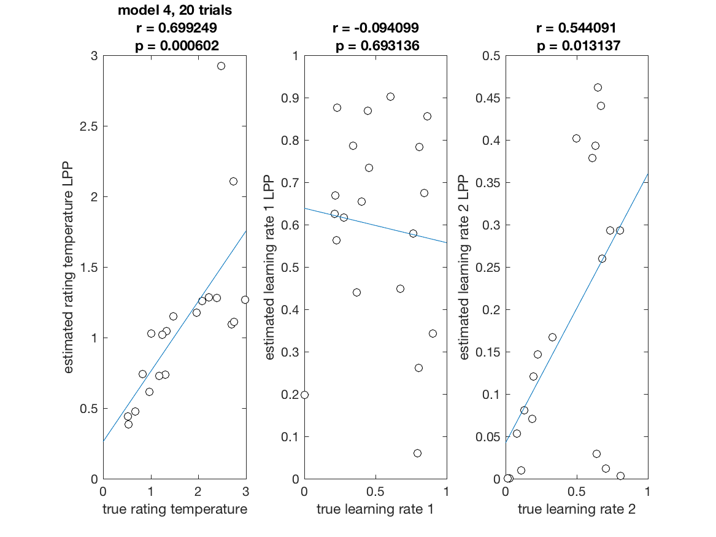
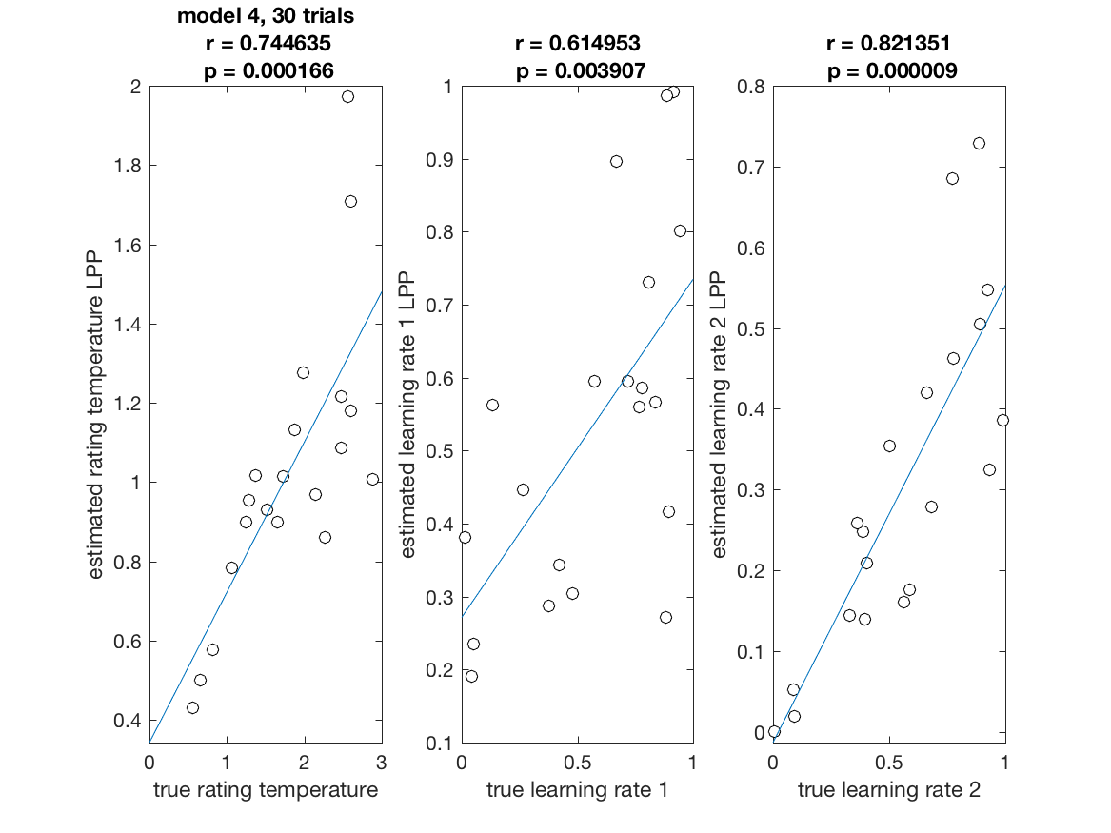
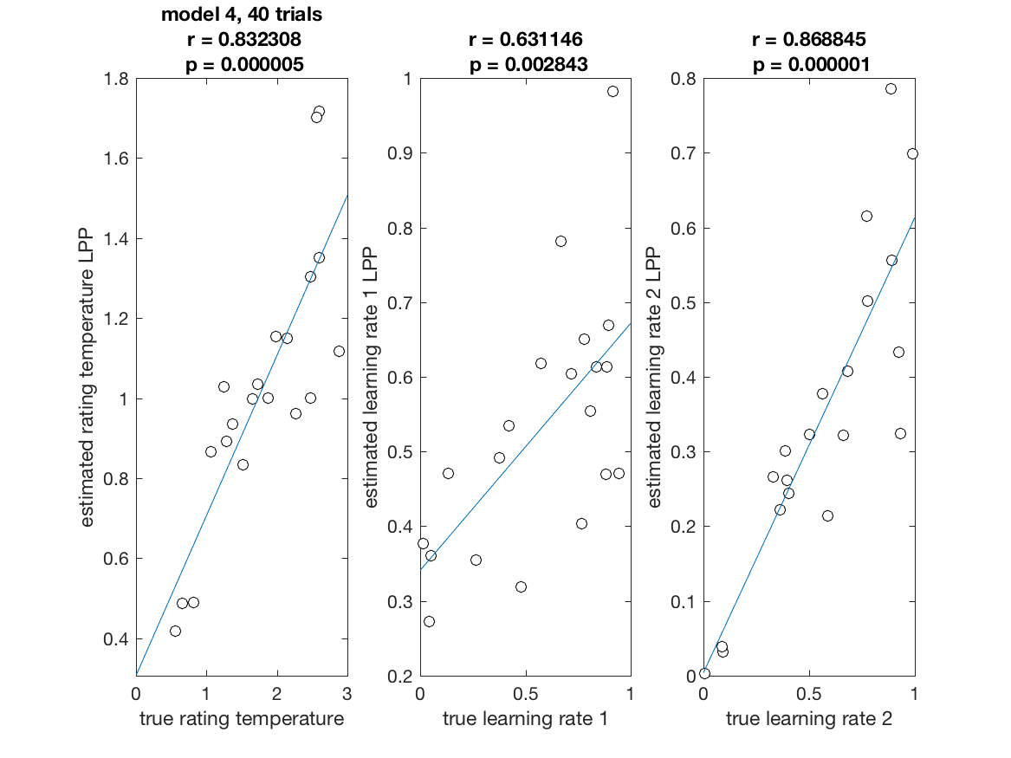
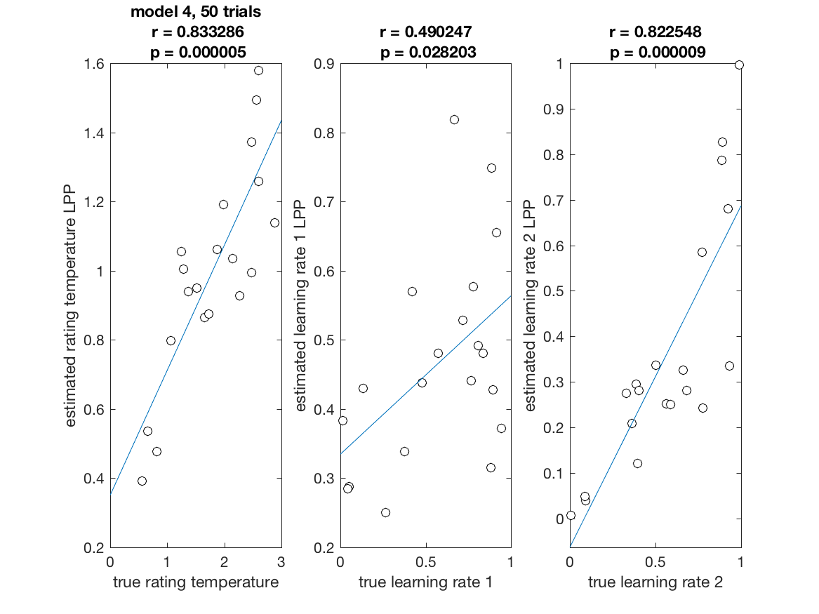
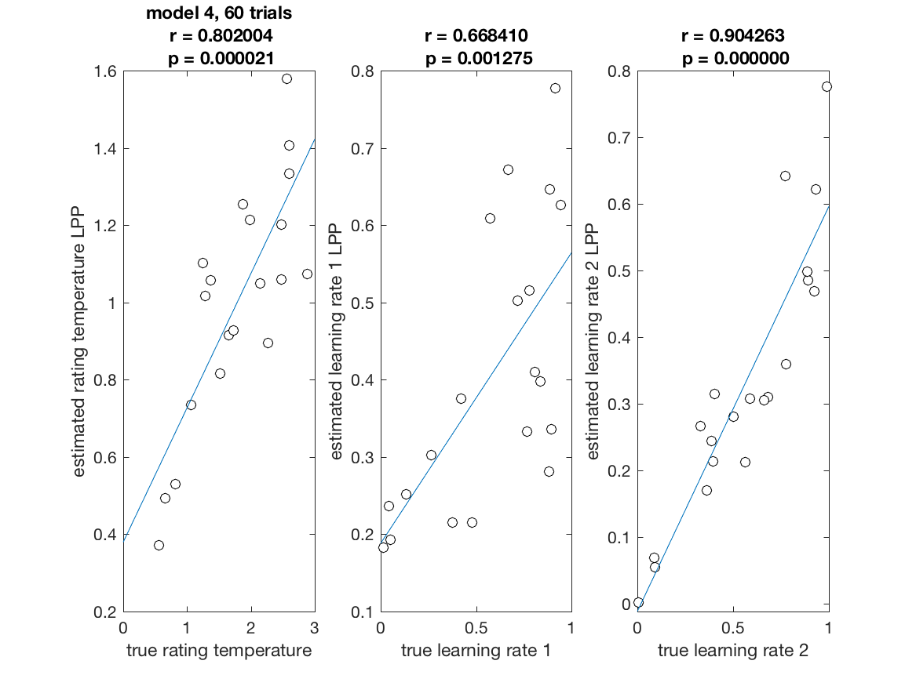
Recoverability Model 4

Slide 15
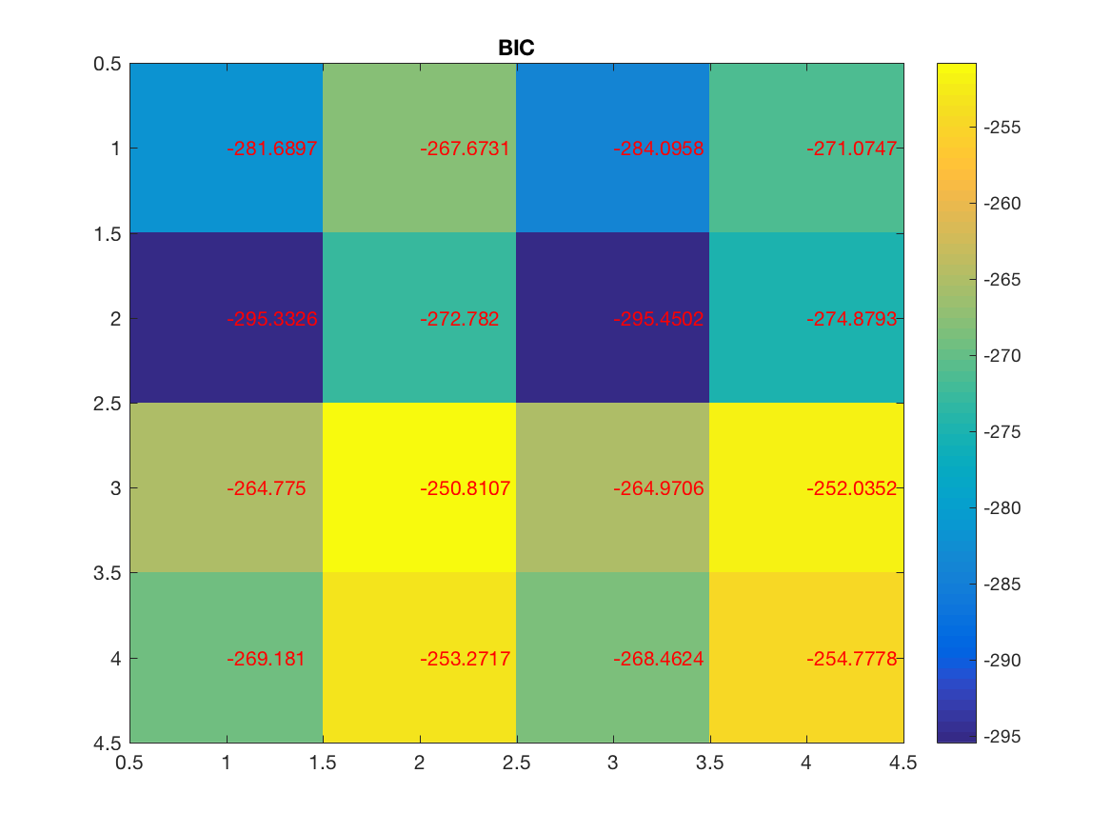
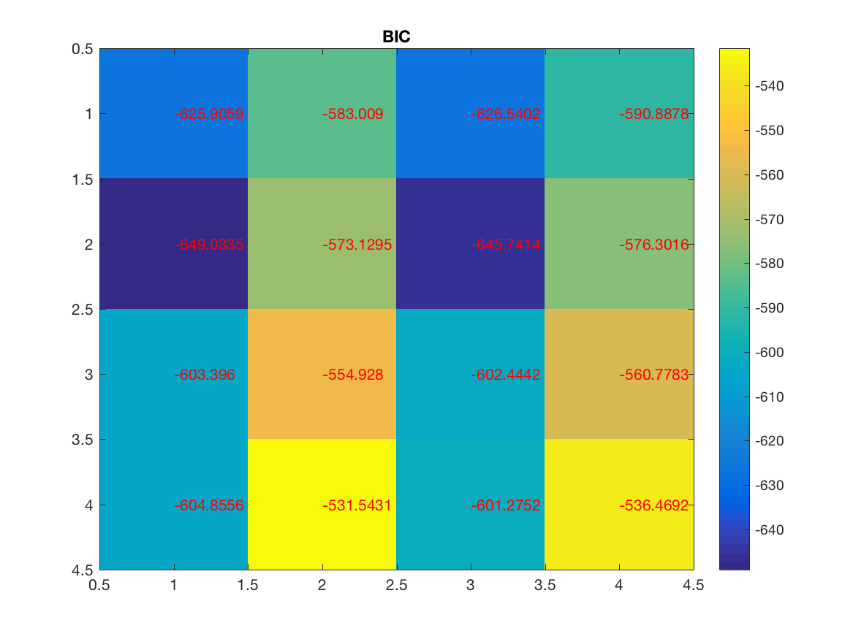
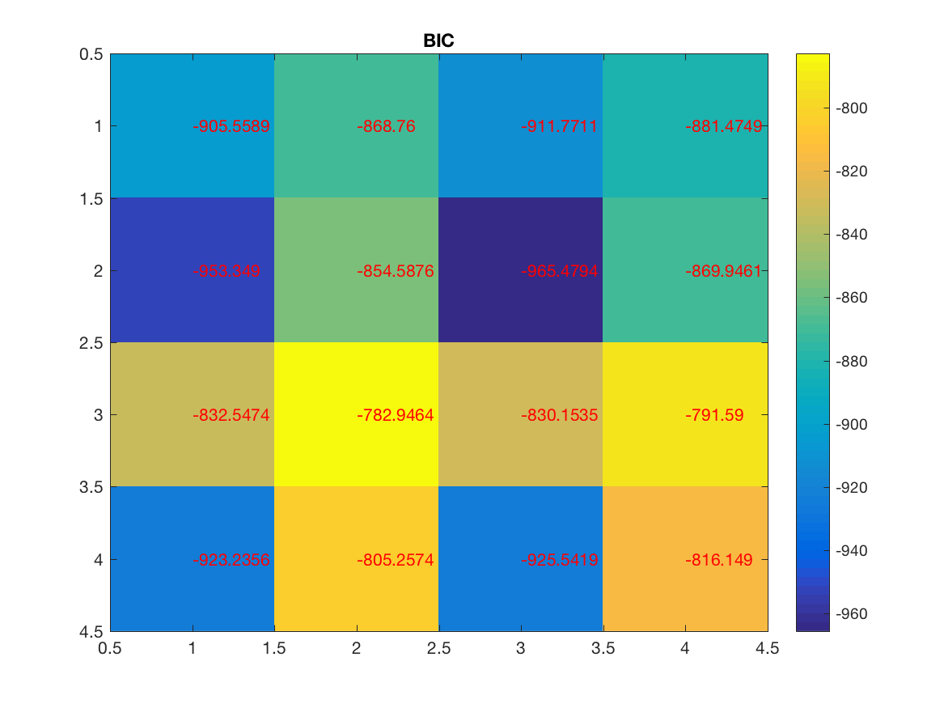
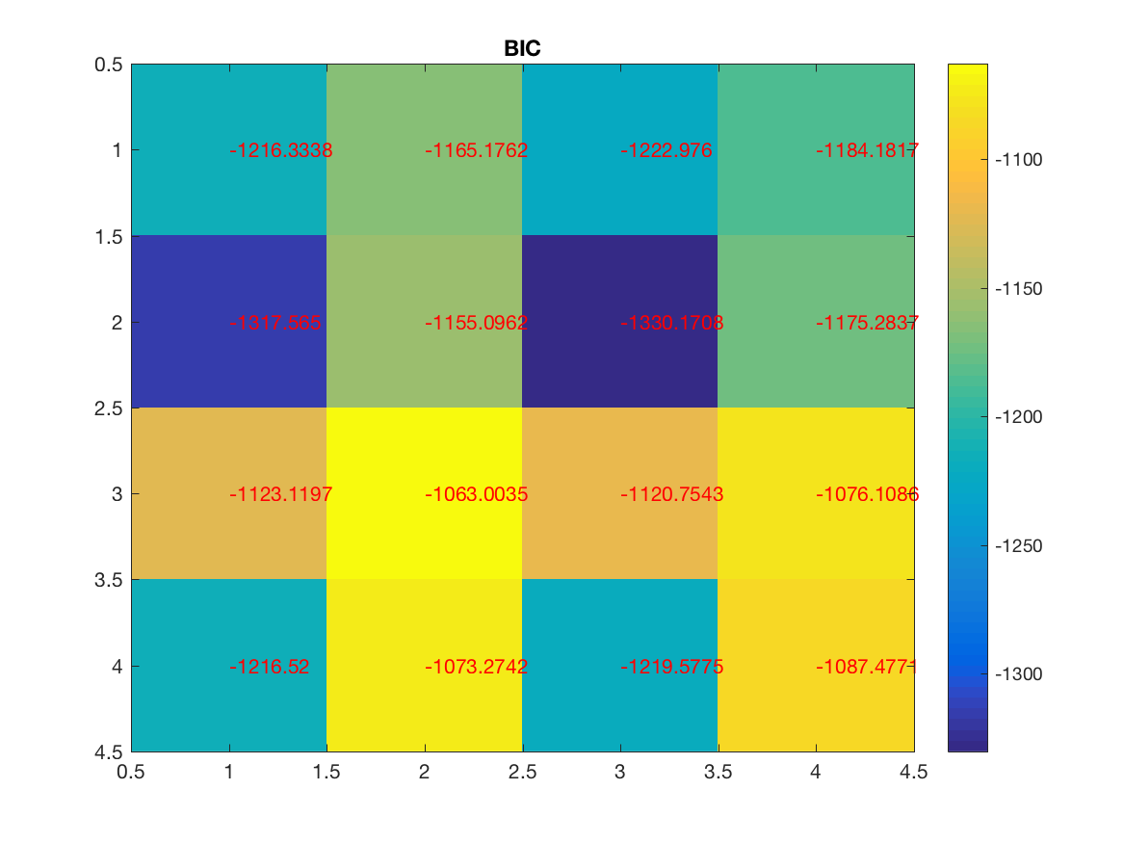
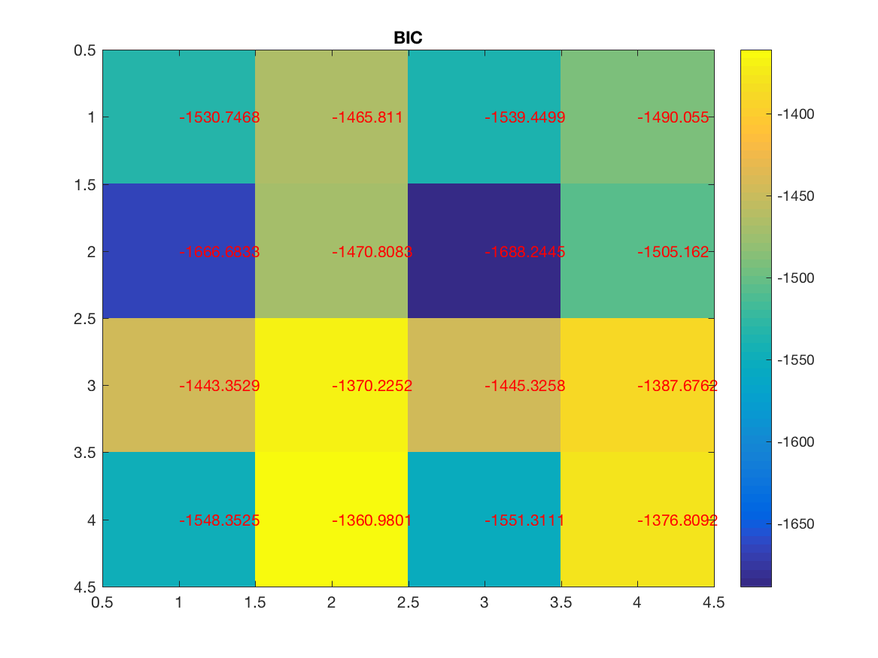
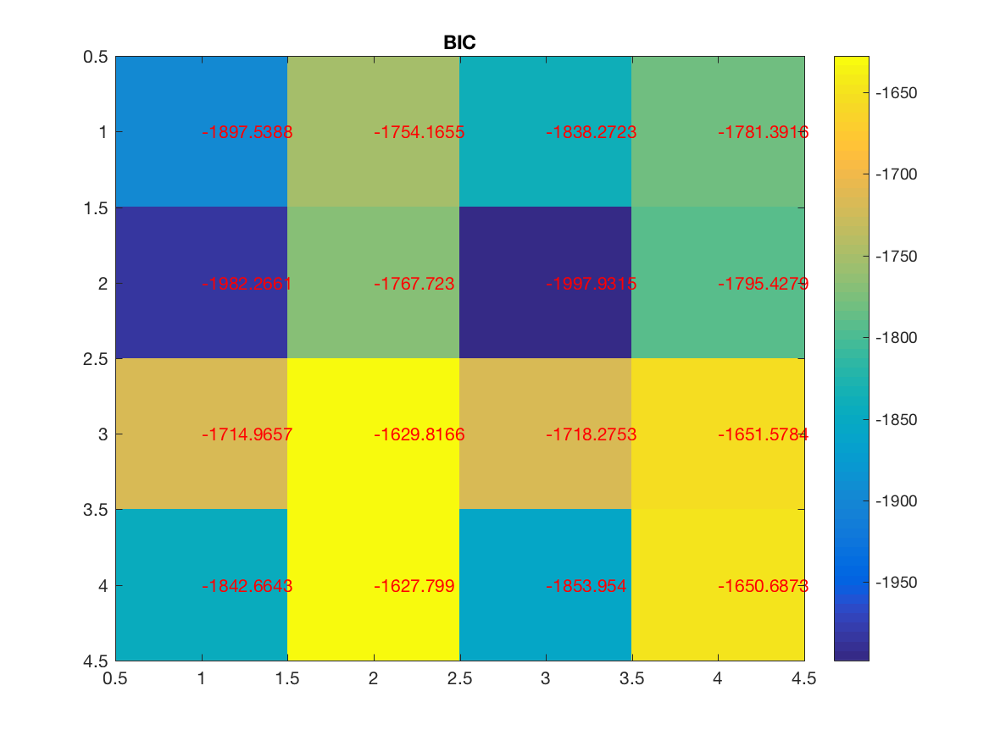
Identifiability
10 trials
20 trials
30 trials
40 trials
50 trials
60 trials

