Slide 1
UG

Slide 2
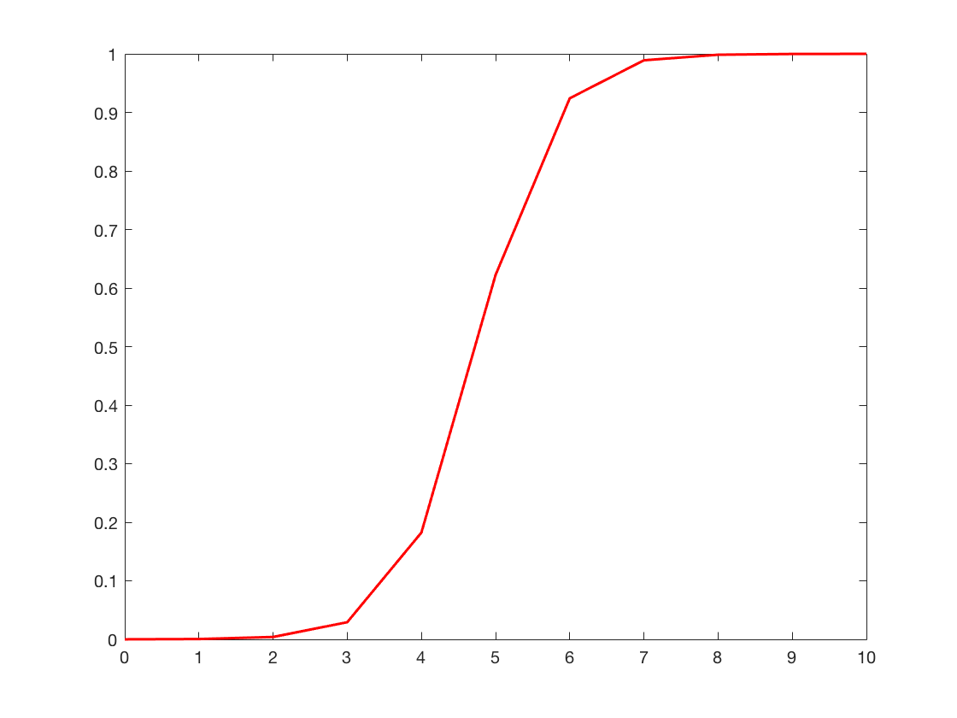
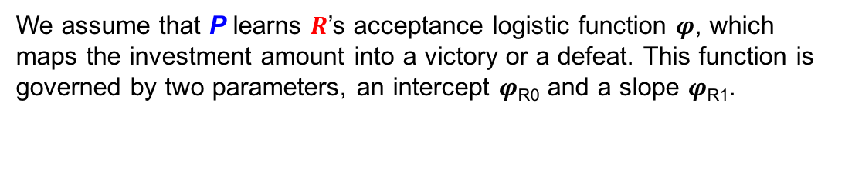
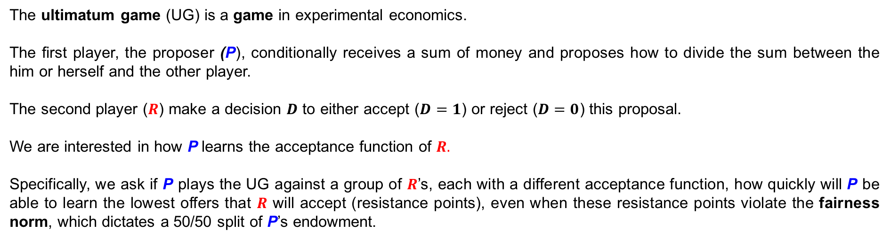
The ultimatum game (UG) is a game in experimental economics.
The first player, the proposer (P), conditionally receives a sum of money and proposes how to divide the sum between the him or herself and the other player.
The second player ($R$) make a decision $D$ to either accept ($D=1$) or reject ($D=0$) this proposal.
We are interested in how P learns the acceptance function of $R.$
Specifically, we ask if P plays the UG against a group of $R$’s, each with a different acceptance function, how quickly will P be able to learn the lowest offers that $R$ will accept (resistance points), even when these resistance points violate the fairness norm, which dictates a 50/50 split of P’s endowment.
We assume that P learns $R$’s acceptance logistic function 𝝋, which maps the investment amount into a victory or a defeat. This function is governed by two parameters, an intercept 𝝋_{R0} and a slope 𝝋_{R1}.
𝝋_{𝜷R1}
Probability of success
𝝋_{𝜷R0}
Investment

Slide 3
Reinforcement Learning Framework
At each trial 𝒕, from his/her endowment 𝑬_{𝒕}, 𝑷 has to consider each possible offer 𝑨_{𝒕} and compute the expected payoff 𝑽_{𝒕}. This expected payoff depends on his/her estimate of how likely it is that 𝑨_{𝒕} will result in a victory: 𝑷_{𝑹,𝒕} (𝑫_{𝒕} = 𝟏|𝑨_{𝒕}), where 𝑫_{𝒕} represents whether A_{t} results in a victory (𝑫_{𝒕} = 𝟏) or a defeat (𝑫_{𝒕} = 0). This will occur if R accepts 𝑨_{𝒕.} For simplicity, this will be referred to as 𝑷_{𝑹,𝒕}(𝑨_{𝒕}). 𝑷’s expected payoff 𝑽_{𝒕} for the offer 𝑨_{𝒕} is:
𝑽_{𝒕}=[P_{𝑹,𝒕}(𝑨_{𝒕})×(𝑬_{𝒕}−𝑨_{𝒕})]+[(𝟏–𝑷_{𝑹,𝒕}(𝑨_{𝒕}))×𝟎] (1)
With the two square brackets representing cases where 𝑨_{𝒕} is accepted or rejected, respectively.
Critically, 𝑷 estimates 𝑷_{𝑹,𝒕}(𝑨_{𝒕}) by estimating 𝑹’s acceptance logistic function 𝝋. Specifically, P forms a representation ϑ of R’s acceptance function 𝝋 by forming estimates 𝜷_{𝑹𝟎} and 𝜷_{𝑹1} of 𝝋‘s intercept and slope, respectively.
𝑷_{𝑹,𝒕}(𝑨_{𝒕})=𝟏/(𝟏+𝒆𝒙𝒑(−(𝜷_{𝑹𝟎,𝒕}+𝜷_{𝑹𝟏,𝒕}×𝑨_{𝒕}))) (2)

Slide 4

Reinforcement Learning Framework
𝑷 can choose 𝑨_{𝒕} according to a softmax function (multinomial), with a temperature parameter 𝜷
P(A_{t} = i) = $\frac{e^{β×V_{i}}}{\sum_{j=1}^{n}{β×V_{i}}}$ (3)
Learning can be done using a simple delta rule on ϑ’s two parameters 𝜷_{𝑹𝟎,𝒕} and 𝜷_{𝑹𝟏,𝒕}. This means that P first computes a choice prediction error 𝜹_{C𝒕}
𝜹_{C𝒕} = 𝑫_{𝒕}−𝑷_{𝑹,𝒕}(𝑨_{𝒕}) (4)

Slide 5
Reinforcement Learning Framework
This choice prediction error can then be used to update the parameters for the next trial using a Rescorla-Wagner update function . For simplicity, we assume that 𝜷_{𝑹𝟏} will remain constant, while 𝜷_{𝑹𝟎} will be updated on each trial. We propose four different iterations of an update procedure that P can conceivably utilize in order to learn 𝝋.
Case 1: P updates his/her 𝛃_{R0} at time t using the choice prediction error δ_{Ct} and a single learning rate α. Specifically, if δ_{Ct} is positive, P increases 𝛃_{R0} (meaning P lowers the investment value necessary for victory), and if δ_{Ct} is negative P decreases 𝛃_{R0} (meaning P raises the investment value necessary for victory – recall that increasing the intercept shifts the entire logit function to the right and hence lowers the expected probability of success for each investment):
𝛃_{R0,t+1}=𝛃_{R0,t}+α× δ_{Ct} (5)

Slide 6
Reinforcement Learning Framework
Case 2: P updates his/her 𝛃_{R0} at time t using the choice prediction error δ_{Ct} and two learning rates: α⁺ for positive prediction errors, and α⁻ for a negative prediction errors:
𝛽_{R0,t+1}=𝛽_{R0,t}+α⁺× δ_{Ct} if δ_{Ct} > 0 (6)
𝛽_{R0,t+1}=𝛽_{R0,t}+α⁻× δ_{Ct} if δ_{Ct} < 0
Case 3: P updates his/her 𝛃_{R0} at time t using the reward prediction error δ_{R} and a single learning rate α. The calculation of δ_{R} is accomplished by subtracting the actual reward from the expected reward and is equivalent to the following expressions (see supplementary slides for full derivations of these equations):
δ_{Rt} = δ_{Ct} × (𝑬_{𝒕}−𝑨_{𝒕}) (7)

Slide 7
Reinforcement Learning Framework
δ_{Rt} is then used by P to update ϑ in the same way δ_{Ct} was used in cases 1 and 2:
𝛃_{R0,t+1}=𝛃_{R0,t}+α× δ_{Rt} (9)
Case 4: P updates his/her 𝛃_{R0} at time t using the reward prediction error δ_{Rt} and two learning rates: α⁺ for positive prediction errors, and α⁻ for a negative prediction errors:
𝛽_{R0,t+1}=𝛽_{R0,t}+α⁺× δ_{Rt} if δ_{Ct} > 0 (10)
𝛽_{R0,t+1}=𝛽_{R0,t}+α⁻× δ_{Rt} if δ_{Ct} < 0

Slide 8
Reinforcement Learning Framework
Case 2: P updates his/her 𝛃_{R0} at time t using the choice prediction error δ_{Ct} and two learning rates: α⁺ for positive prediction errors, and α⁻ for a negative prediction errors:
𝛽_{R0,t+1}=𝛽_{R0,t}+α⁺× δ_{Ct} if δ_{Ct} > 0 (6)
𝛽_{R0,t+1}=𝛽_{R0,t}+α⁻× δ_{Ct} if δ_{Ct} < 0
Case 3: P updates his/her 𝛃_{R0} at time t using the reward prediction error δ_{R} and a single learning rate α. The calculation of δ_{R} is accomplished by subtracting the actual reward from the expected reward and is equivalent to the following expressions (see supplementary slides for full derivations of these equations):
δ_{Rt} = δ_{Ct} × (𝑬_{𝒕}−𝑨_{𝒕}) (7)

Slide 9
Reinforcement Learning Framework
δ_{Rt} is then used by P to update ϑ in the same way δ_{Ct} was used in cases 1 and 2:
𝛃_{R0,t+1}=𝛃_{R0,t}+α× δ_{Rt} (8)
Case 4: P updates his/her 𝛃_{R0} at time t using the reward prediction error δ_{Rt} and two learning rates: α⁺ for positive prediction errors, and α⁻ for a negative prediction errors:
𝛽_{R0,t+1}=𝛽_{R0,t}+α⁺× δ_{Rt} if δ_{Ct} > 0 (9)
𝛽_{R0,t+1}=𝛽_{R0,t}+α⁻× δ_{Rt} if δ_{Ct} < 0

Slide 10
Experimental design
Our design will consist of both a within (social vs. nonsocial) and a between (known vs. unknown) manipulation. Each subject will play both against real opponents as well as computer generated lotteries. However, within the social condition, half of our subjects will be informed that they are playing against responders who have received different starting endowments (known), while half of our subjects will be informed that they are playing against responders who, for no given reason, have different acceptance thresholds (unknown). In each of these conditions, the resistance points of R will be identical, and must be learned by P through trial and error. However, in the known condition (where subjects know the reason for the different thresholds), subjects will be aware that the fairness norm is not violated by low offers, while in the unknown condition this fact is never made explicit. Therefore, in the known condition, subjects could explore the full acceptance range in an attempt either to learn what behavior is fair or to maximize profit.

Slide 11
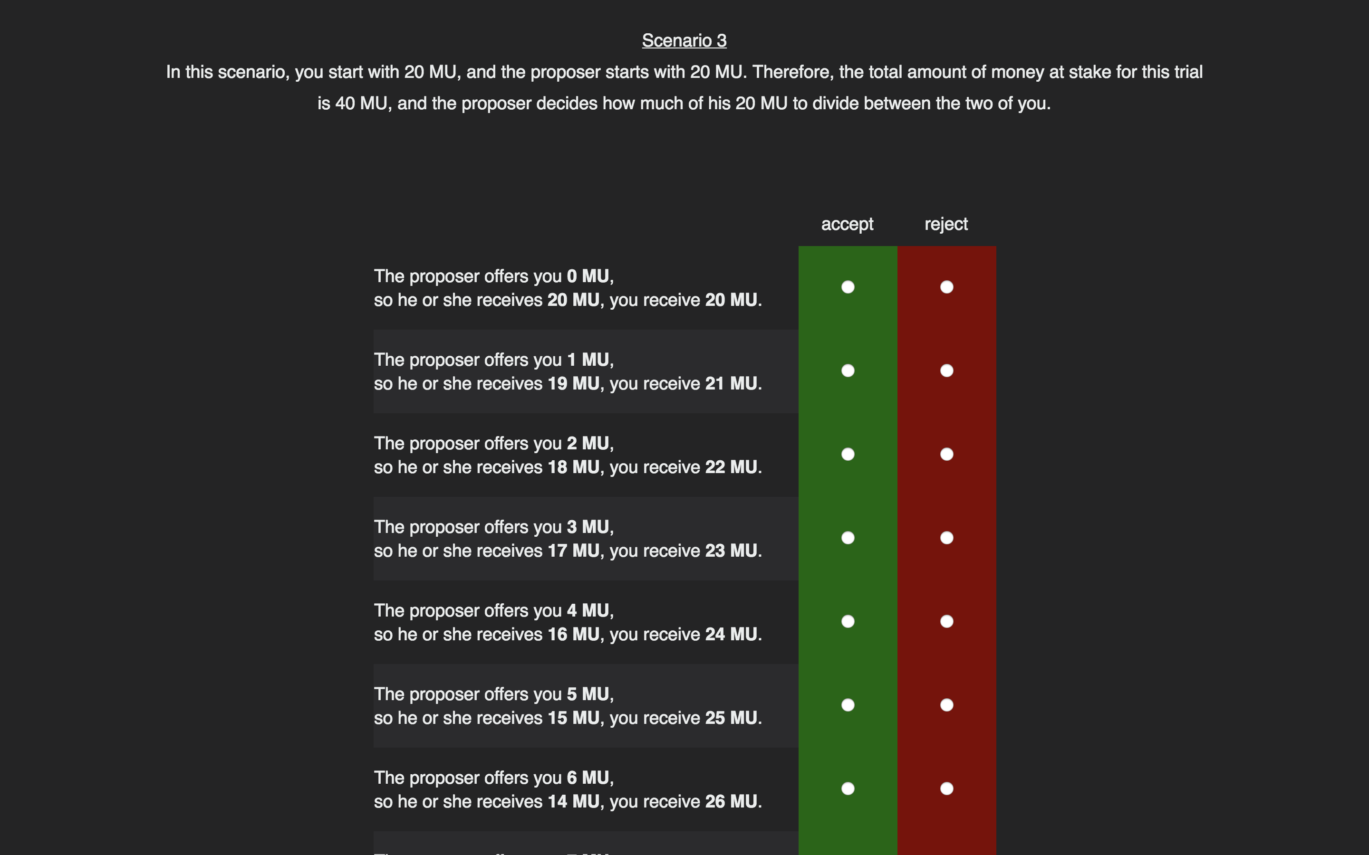
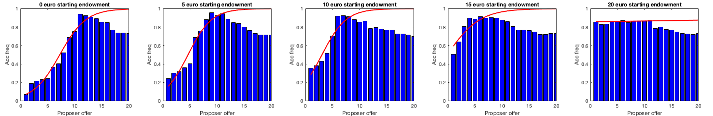
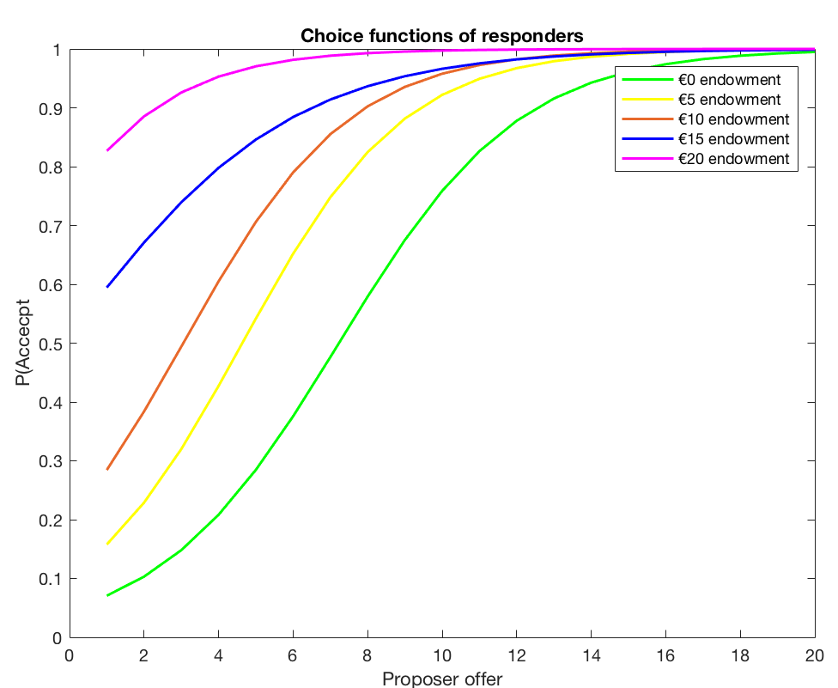
Experiment phase 1: generate different environments, where fairness norm differs.
Strategy method, without feedback. Interested in the Responder’s behavior
P received an endowment of 20€
You received an endowment of X€
What participants saw
5 Scenarios/Environments:
1: X = 0€ ~ fair 50/50 is 10€
2: X = 5€ ~ fair 50/50 is 7.5€
3: X = 10€ ~ fair 50/50 is 5€
4: X = 15€ ~ fair 50/50 is 2.5€
5: X = 20€ ~ fair 50/50 is 0€
Responder’s behavior
Logit fit
N = 210
This generated different acceptance functions of the responders, with higher starting endowments creating lower resistance points.
We fit logit functions to the behavioral data of the responders and simulated proposer behavior on those response functions in order to determine how many trials would be required for optimal model recovery/identifiability

Slide 12
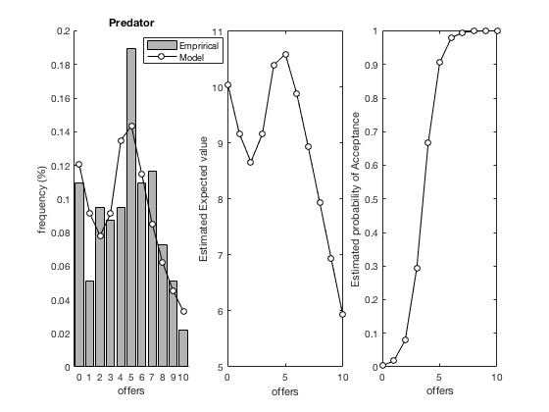
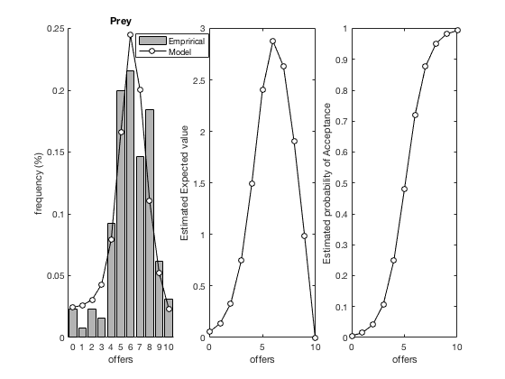
Empirical Priors
Importantly, to avoid fitting additional free parameters, the model requires initial estimates of 𝜷_{𝑹𝟎} and 𝜷_{𝑹𝟏}.
We estimated these as fixed effects from the first investments made by subjects playing the game for the first time. We used data from several datasets, amounting to a total of 267 subjects, 130 player as prey and 137 playing as predator*. Importantly, we constrained the parameters using a Laplace procedure, allowing us to stay away from the bounds of the parameter space.
* Prey: 12 (old_hor) + 81 (hor) + 25 (ital) + 12 (OT)
Predator: 12 (old_hor) + 85 (hor) + 25 (ital) + 15 (OT) the parameters and accompanying plots were produced by PPG/empirical_priors_mg_predprey_2017_10_03.m

Slide 13
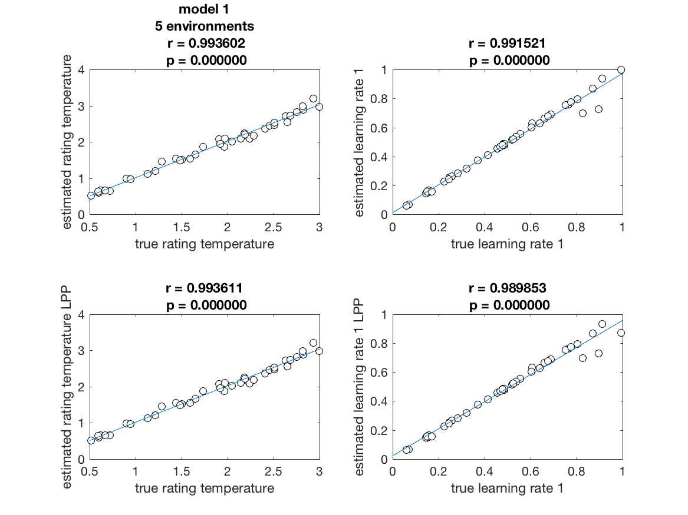
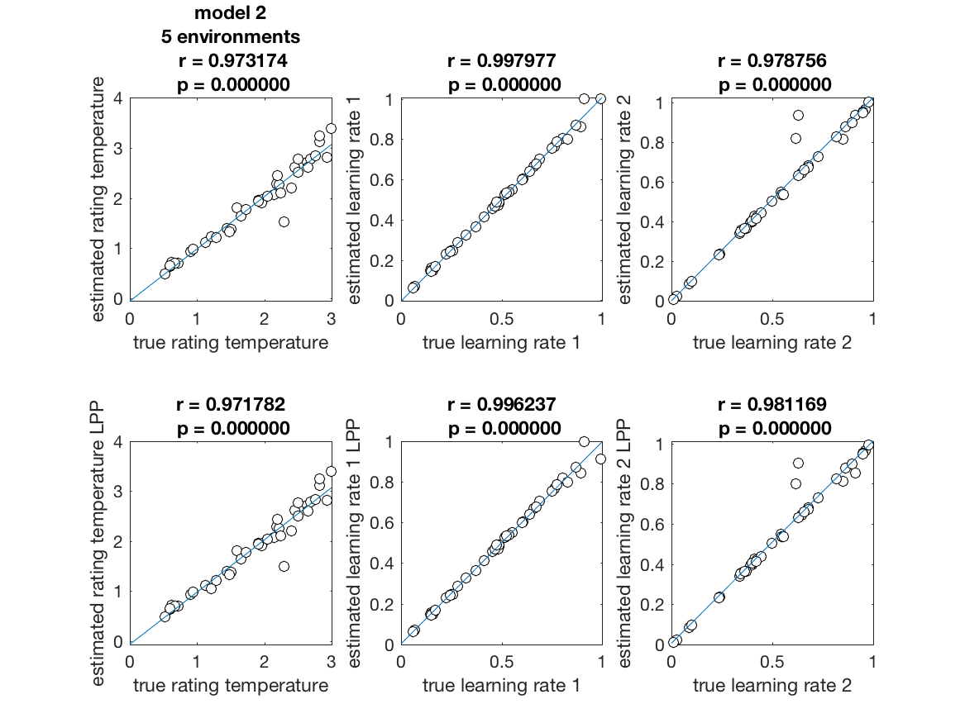
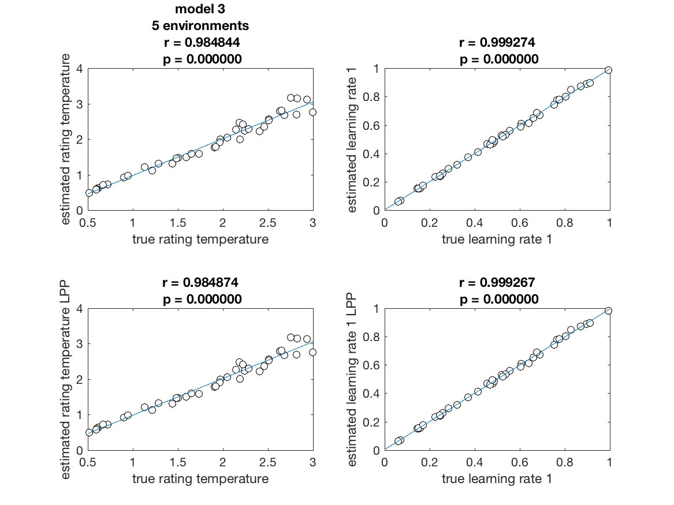
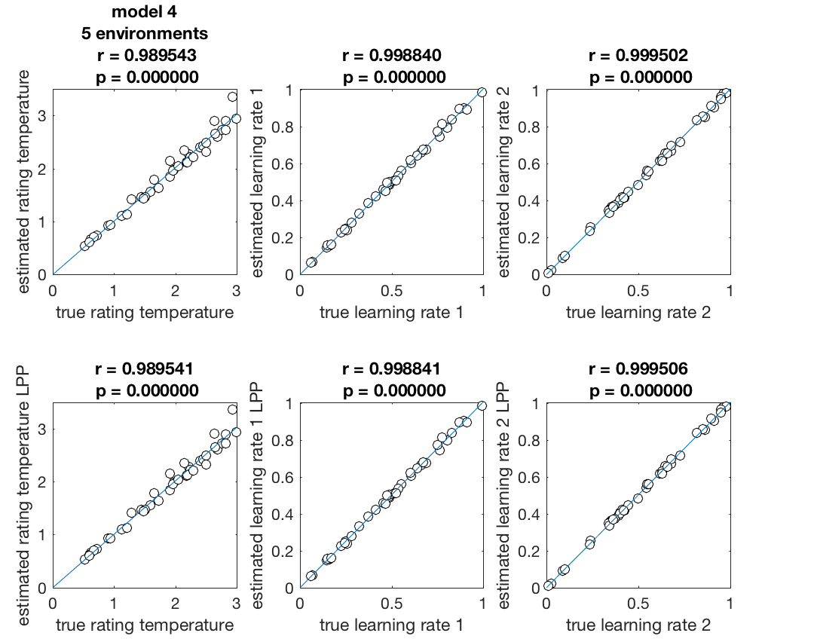
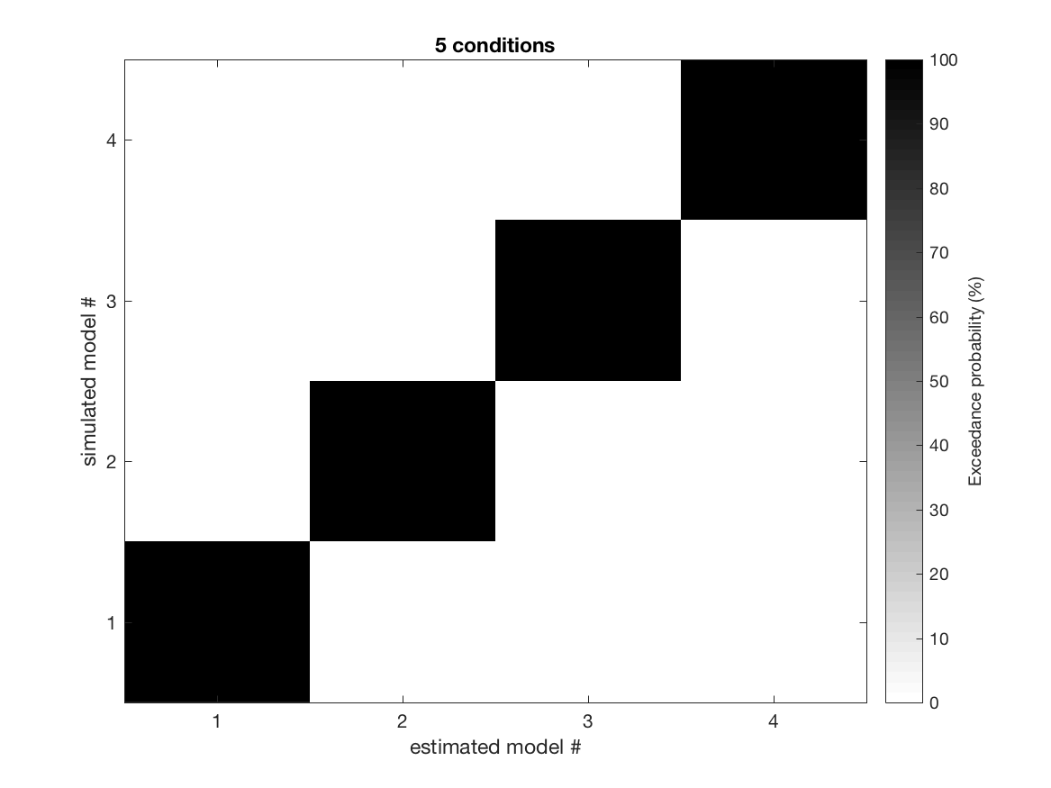
A
B
Simulations
40 simulations with 120 trials over 5 environments, 24 trials per environment. A, B, D, and E depict parameter recovery, with the top row of each using uniform parameter bounds and the bottom rows using Laplace approximation. In all cases Laplace approximation results in better recovery. C is a confusion matrix indicating how well each model is identified relative to the other models.
C
D
E

Slide 14
Experiment phase 2: Investigating norm learning
These tasks involve feedback. We focus on Proposer behavior
Phase 2a/b: social norms VS maximizing reward.
You received an endowment of 20€.
Phase 2a (Known):
R will be repeatedly sampled from one of 5 experiments which received a fixed (but unknown to you) endowment of [0-20€].
Phase 2b (Unknown):
R will be repeatedly sampled from one of 5 experiments in which responders differed in the offers they deemed acceptable.
Each experiment will be indicated by an abstract symbol (■, ●, ♦, , )
We pair the conditions/environments with the abstract symbols, e.g. 1: ■ / 2: ● / 3: ♦ / 4: / 5:
you play with a participant from
Select your offer
18
20
your offered
13€
10
19
11
12
13
14
15
16
0
1
2
3
4
5
6
7
8
9
17
offers (€)
participant from
your final payoff
is
20 – 13 = 7€
accepted !
As feedback, we use the behavior from step 1

Slide 15
Experiment phase 2: Investigating norm learning
These tasks involve feedback. We focus on Proposer behavior
Phase 2c: social norms VS maximizing reward.
You received an endowment of 20€.
R You will play against five machines which have specific (but different, and imprecise) threshold of acceptance.
Each machine will be indicated by an abstract symbol (□, ○, ◊, , )
We pair the conditions/environments with the abstract symbols, e.g. 1: □ / 2: ○ / 3: ◊/ 4: / 5:
you play with a participant from
Select your offer
18
20
your offered
13€
10
19
11
12
13
14
15
16
0
1
2
3
4
5
6
7
8
9
17
offers (€)
participant from
your final payoff
is
20 – 13 = 7€
accepted !
As feedback, we use the behavior from step 1

Slide 16
Hypotheses
1: Learning occurs:
In all conditions, proposer start with a (distributional) prior about the norm, but gradually integrate feedback to update the norm and improve payoff.
2: Learning can be captured in an RL framework, by assuming that proposer learns the intercept of the acceptance function by trial-and-error
3: Learning differs between social and non-social conditions:
Faster and more asymmetric learning in social (learn more from rejection than acceptance, because of social “acceptability”) than in non-social, leading to sub-optimal behavior
4: Learning differs between social-known and social-unknown conditions:
Faster learning in social-known than in social-unknown due to subjects (i) using the opacity of what constitutes fair as an excuse to eschew fairness and maximize profit, or (ii) exploring the acceptance space in order to learn what constitutes fair.
5: Learning does not differ between social-known and non-social conditions:
Subjects explore the acceptance range of responders in both conditions
6: Priors differ between social and non-social
Uniform in the non-social condition, while driven by a norm expectation (50/50) in the social condition.
7: Decision functions differ between social and non-social
More maximizer in non-social, and more exploratory (i.e. “soft”) in social.

Slide 17
Experimental procedure
The entire experiment will take roughly 1 hour.
Prior estimation: ~7 minutes
Dictator game: ~7 minutes
Risk task: ~3 minutes
UG social: ~20 minutes
UG non-social: ~20 minutes
Total: ~57 minutes
If we estimate that each trial in the UG will take ~6 seconds, with a 4 second inter-stimulus interval, then we have 120 trials for the UG.
In order to help decide how many scenarios/environment to include, we simulated 40 subjects playing 120 trials of the UG with 3 (40 trials per environment), 4 (30 trials per environment), and 5 (24 trials per environment) in order to test for differences in parameter recovery and model identifiability.
In every case, parameter recovery was highly significant, however 5 environments slightly outperformed simulations with 3 and 4 conditions.
There was no difference in model identifiability.

Slide 18
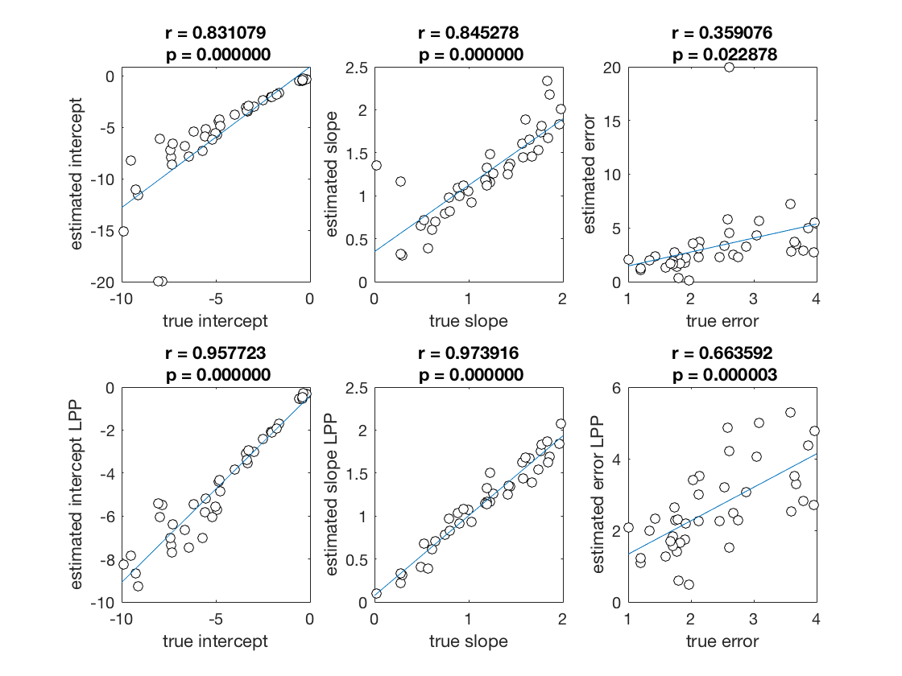
Simulations
We also know that we within ~210 trials we can estimate our subjects priors with a very high degree of accuracy.
Here are 40 simulations of 210 trials, representing a choice that each subject has to make regarding whether they think the responder will accept a given division of the endowment, with every possible combination represented once.

Slide 19
Task Characteristics
Step1:
XX offerers; XX responders; XXX trials
Step 2:
Start with section without feedback to estimate priors (XX trials to be determined /w model prior sims recovery)
XX sessions of XX conditions and XX trials per condition (to be determined /w model sims recovery)
×2 for social and non-social framing
Ideas
Integrate RT

Slide 20
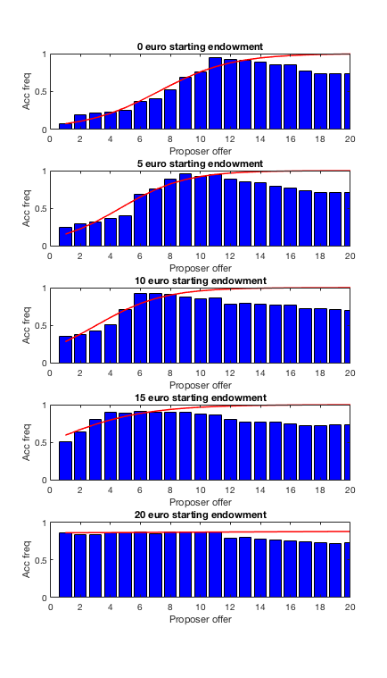
Experiment phase 1: generate different environments, where fairness norm differs.
Strategy method, without feedback. Interested in the Responder’s behavior
Responder’s behavior
P received an endowment of 20€
You received an endowment of X€
Logit fit
This generated different functions p(accept) = f(o)
3 Scenarios/Environments:
1: X = 0€ ~ fair 50/50 is 10€
2: X = 5€ ~ fair 50/50 is 7.5€
3: X = 10€ ~ fair 50/50 is 5€
4: X = 15€ ~ fair 50/50 is 2.5€
5: X = 20€ ~ fair 50/50 is 0€
N = 210

