Slide 1

Model Driven Software Design in Cyber Physical Systems
using Graphical Workflow-Models
Michael Roth

Slide 2









Vertical Integration
VI Framework
Enterprise Manangement
Plant Management
Plant Control
Field
1

Slide 3
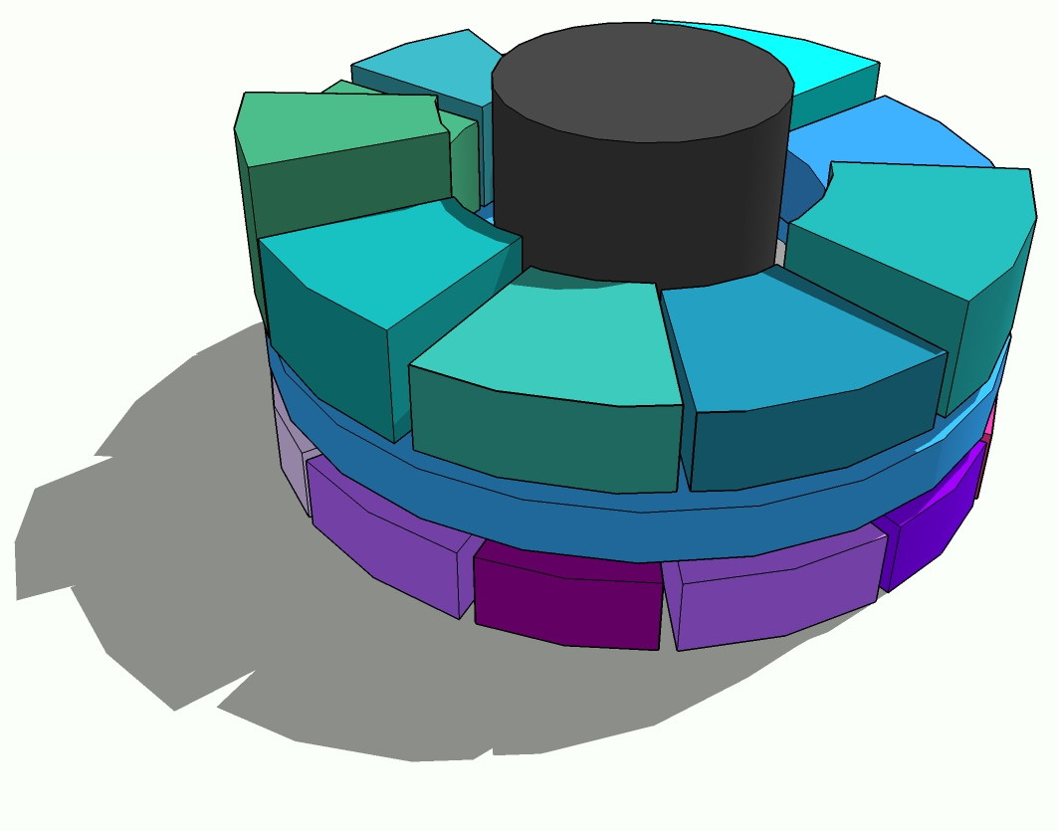
VI Framework
.Net (C#, WPF,…)
Efficient solution design
High quality software
Decrease time to market
Timezone handling
UnitOfMeasurement
handling
Frontend Controls
Workflow
Engine
DB
SDKs
OPC
SAP
2

Slide 4
Workflow handling
Corrections
Requirements& Modelling
Cross-Domain models
Easy Code generation
Verification / Validation
Workflow file
Verification
Transformation
C#
Simulation
(Validation)
Run in Production
3
* [2] Model based system engineering for embedded systems

Slide 5
Modelling
Simple State Chart model
Graphical design
Patterns
4
* [7] Sicherheitsgerichtete Echtzeitsysteme – Einfachheit als Entwurfsprinzip

Slide 6
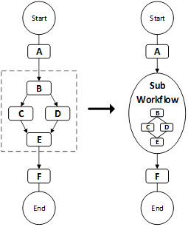
Modelling
Simple State Chart model
Graphical design
Patterns
Simplification
Parallelism
Joins/Splits
4
* [6] workflow patterns

Slide 7
Code Generation
5
* [4] Workflow-Management in produktionsnahen Softwaresystemen

Slide 8
Validation
Deadlock analysis
Decompiler
Simulator
OR-SPLIT
6
* [3] Einsatz von Echtzeitstrategien in der MES Automatisierung

Slide 9
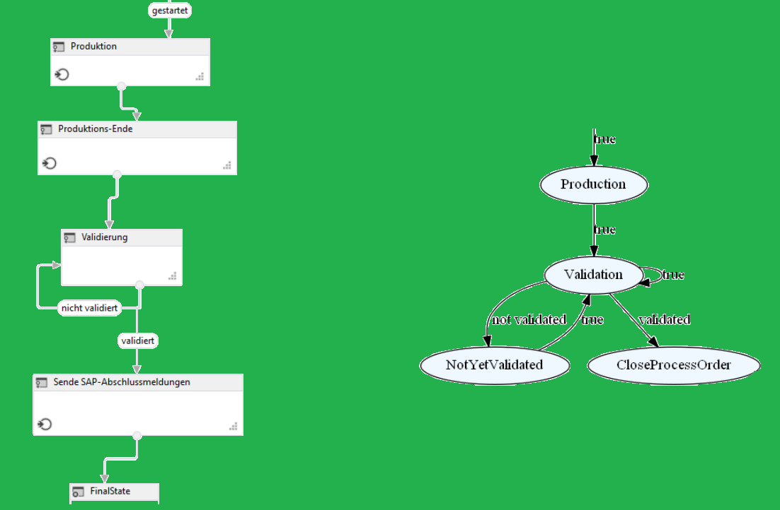
Validation
Deadlock analysis
Decompiler
Simulator
* [3] Einsatz von Echtzeitstrategien in der MES Automatisierung
[7] Sicherheitsgerichtete Echtzeitsysteme – Diversitäre Rückübersetzung
6

Slide 10
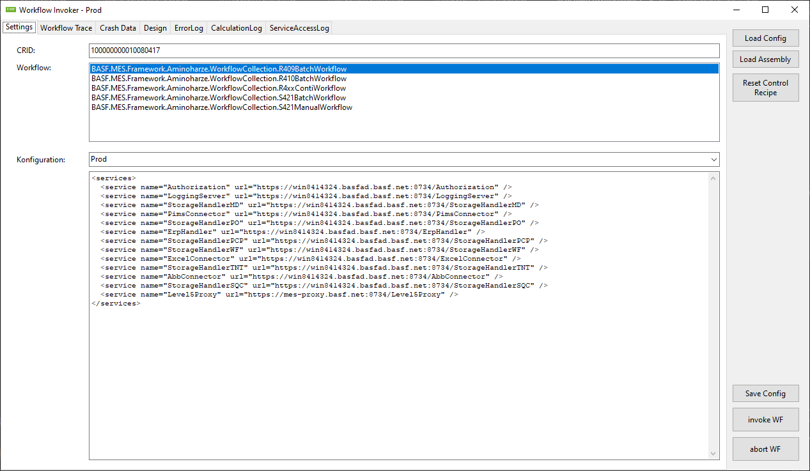
Validation
Deadlock analysis
Decompiler
Simulator
6

Slide 11


Results
120
7

Slide 12
Thank you
[1] Paulo Eduardo Papotti, Antonio F. do Prado, Wanderley L. de Souza; Reducing time and effort in legacy systems reengineering to MDD using metaprogramming; published in RACS '12: Proceedings of the 2012 ACM Research in Applied Computation Symposium, 2012, Pages 348–355
[2] Muhammad Rashid, Muhammad Waseem Anwar, Aamir M. Khan: Toward the tools selection in model based system engineering for embedded systems -A systematic literature review in Journal of Systems and Software. Vol. 29, 2015
[3] M. Roth: Einsatz von Echtzeitstrategien in der MESAutomatisierung, In: Informatik aktuell – Herausforderungen durch Echtzeitbetrieb, Ed. W. A. Halang – Springer Berlin Heidelberg, Boppard, Germany, pp. 91-100, 2012..
[4] Silvan Castor; Workflow-Management in produktionsnahen Softwaresystemen; Master Thesis; HS Mannheim; Fakultät Informationstechnik; 2023
[5] Workflow Engine Software Tool; https://github.com/michaelroth1/mitoSoft.Workflows
Michael Roth
[6] Workflow design patterns; Eindhoven University of Technology; http://www.workflowpatterns.com/patterns/control/;
[7] Wolfgang A. Halang, Rudolf M. Konakovsky; Sicherheitsgerichtete Echtzeitsysteme; Springer Verlag; 2. Auflage; ISBN 978-3-642-37297-1

