Slide 1


Analysis of the Used Car Market in Egypt
Factors Influencing Prices and Market Trends
Team Members: Michael Samuel, Toka Ghonim, Abd Elrahman Khaled, Fahim Aziz
Supervisor: Eng. Sherihan Ali
Date: 31 October 2025
1

Slide 2
Project Idea: Problem, Solution, Value
Problem Statement
The Egyptian used car market faces challenges related to a lack of transparency and difficulty in determining fair prices, affecting buyer and seller confidence.
Proposed Solution & Value Proposition
Solution: Analyze used car market data to understand key factors influencing prices.
Value: Provide clear, data-driven insights and recommendations to support decision-making for market participants.
Key Findings (Executive Summary)
Economic Segment Dominance:
Over 87% of sales are concentrated in "Cheap" and "Affordable" categories.
Persistent Price Increase:
The market has seen a sharp and sustained price increase since 2016 due to economic inflation.
Preference for Reliability:
Demand is focused on reliable, affordable models (e.g., Lanos, Verna) with a near-equal split between manual and automatic transmission.
2

Slide 3

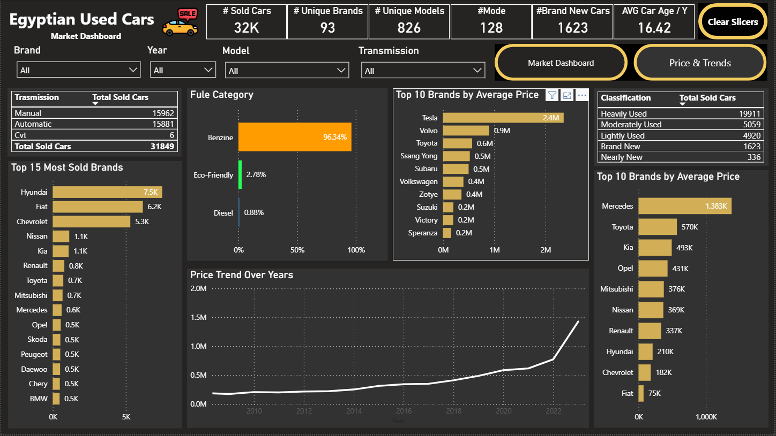
Key Data Visualizations: Market Overview
32,000
Total Used Vehicles Sold
Price Segment
Units Sold
Share %
Cheap
21,000
65.6%
Affordable
6,912
21.6%
Mid-range
3,244
10.1%
Expensive
988
3.1%
Extreme
116
0.4%
Analysis: Over 87% of sales are concentrated in the "Cheap" and "Affordable" categories, confirming that Value for Money is the primary market driver.
3

Slide 4
Market Segmentation & Key Findings
Top 5 Brands by Volume
Consumer Preferences
Brand
Units Sold
Transmission Type
Hyundai
6,500
Manual: 15,962 units (50.1%)
Fiat
6,200
Automatic: 15,881 units (49.9%)
Chevrolet
5,300
The near-perfect balance indicates a diverse buyer base with no strong preference for one type over the other.
Nissan
1,100
Kia
1,100
Fuel Category
Top 3 Models by Sales
Benzine: 96.34%
Diesel: 0.88%
Model
Units Sold
Eco-Friendly: 2.78%
Verna
2,177
Lanos
Benzine's overwhelming dominance reflects limited adoption of alternative fuels in the used car market.
1700
Optra
1,675
4

Slide 5
Data Source & Methodology
Data Source
CSV file containing
32,000 records
of used car transactions in Egypt
Data collected from market transactions spanning multiple years (2010-2022)
Key Data Fields
Brand, Model, Year, Final Price, Transmission Type, Fuel Category, Classification, Color, Governorate, Engine Size
Balanced dataset with no single brand dominating the data collection process
Data Cleaning & Preparation
Handling missing values and standardizing data formats (e.g., price normalization to EGP)
Categorizing vehicles into price segments: Cheap, Affordable, Mid-range, Expensive, Extreme
Classification of vehicle condition: Heavily Used, Moderately Used, Lightly Used, Nearly New
Key Metrics (KPIs)
Total Sales Volume:
32,000 units
Average Car Age:
16.42 years
Market Share by Segment:
Cheap (65.6%), Affordable (21.6%), Mid-range (10.1%), Expensive (3.1%), Extreme (0.4%)
Price Trends:
Sharp and sustained price increase from 2016 to 2022
5

Slide 6
Tools & Techniques
Programming Languages & Tools Used
All project steps were completed entirely within Power BI, from importing and cleaning the data to transforming it for analysis.
The tool was used to explore the dataset, generate key insights, and create clear analytical visuals.
Interactive dashboards were developed to present the findings in an intuitive and dynamic way.
Overall, the full workflow—preparation, analysis, and reporting—was executed smoothly using Power BI.
Microsoft Power BI:
Analytical Techniques Applied
Descriptive Statistics:
Calculated mean, median, and standard deviation for price analysis.
Data Aggregation:
Grouped data by brand, model, price segment, and governorate to identify market patterns.
Segmentation Analysis:
Classified vehicles into price categories (Cheap, Affordable, Mid-range, Expensive, Extreme) and condition categories (Heavily Used, Moderately Used, Lightly Used, Nearly New).
Price Trend Analysis:
Analyzed historical price trends from 2016 to 2022 to identify inflationary patterns and market dynamics.
6

Slide 7
Vehicle Condition & Best Deals
Vehicle Condition Classification
Best Deal Opportunities
Classification
Units Sold
Share %
Model
Price (EGP)
Deal Score
Heavily Used
19,911
62.2%
Alsvin
125,000
0.99
Moderately Used
5,059
15.8%
Arrizo 3
445,000
0.98
Lightly Used
4,920
15.4%
Alsvin
250,000
0.98
Nearly New
336
1.0%
S Presso
255,000
0.98
Alsvin
260,000
0.98
The dominance of "Heavily Used" vehicles (62.2%) reflects buyer prioritization of the lowest possible price point. However, the 10K+ units in "Moderately Used" and "Lightly Used" categories represent a significant opportunity for buyers seeking better quality and value.
Models with high "Deal Scores" (0.98-0.99) offer excellent value propositions. These vehicles represent the best opportunities for buyers seeking reliable, affordable options with strong market appeal.
7

Slide 8
Geographical & Color Preferences
Top 3 Governorates (by Sales Volume)
Top 3 Selling Colors
Governorate
Sales Count
Color
Sales (K)
Greater Cairo (Tagamo3)
893
Silver
5.0K
Suez
510
White
5.0K
Tanta
265
Black
3.4K
Sales activity is concentrated in key urban centers, requiring precise geographical marketing strategies to maximize reach and effectiveness. The dominance of Greater Cairo reflects the high population density and purchasing power in the capital region.
Classic colors are the most demanded, minimizing resale risk and should be prioritized in inventory management and procurement strategies. The preference for neutral colors reflects buyer confidence in long-term resale value.
8

Slide 9
Project Team + Roles
Core Team Members
Team Member
Role & Responsibilities
Michael Samoel Dawod
Data Analysis & Statistical Insights & Visualization & Dashboard Design & Market Research & Insights Documentation & Presentation. (Team Leader).
Toka Ghonim
Data Visualization & Dashboard Design
Abd Elrahman Khaled
Market Research & Insights Documentation
Fahim Aziz
Project Coordination & Presentation
Project Supervisor
Eng. Sherihan Ali
9

Slide 10
Contact information:
1
2
Michael Samoel Dawod Fanos
Fahim Aziz Ebrahim Isaac
Mail : Michael.samoel31@Gmail.com
Mobile: +201202884784
Mail : Fahimazizguide@gmail.com
Mobile: +201278095038
3
4
Toka Elsayed Aly Ghonim
Abdelrahman Khalid Abdo Amir
Mail : taka.ghonam123@gmail.com
Mobile: +201016041453
Mail : Abdelrhman_Khalid1994@outlook.com
Mobile: +201004481386
Thank You
For questions or feedback, please contact the project team. We welcome your insights.
10

